Slide 1
Wireless and Mobile Communication
(UEC 804)
Reference Text book
“Wireless communication_ principles and practices” (Second Edition )
Author: Theodore s Rapport
Publisher: Prentice Hall (2002)

Slide 2
MODULE -IV

Slide 3
Topics covered till now in this module
Propagation Basics
Antenna Basics
Reflection
Two Ray Model
Diffraction
Topics to be covered in this video
Scattering

Slide 4
Scattering
Scattering occurs when the medium through which the wave travels consists of objects with dimensions that are small compared to the wavelength, and where the number of obstacles per unit volume is large.
Scattered waves are produced by
rough surfaces,
small objects,
or by other irregularities in the channel.
Scattering is caused by trees, lamp posts, towers, etc.

Slide 5
Scattering
Received signal strength is often stronger than that predicted by reflection/diffraction models alone
The EM wave incident upon a rough or complex surface is scattered in many directions and provides more energy at a receiver
  Energy that would have been absorbed is instead reflected to the Rx.
flat surface → EM reflection (one direction)
Rough surface → EM scattering (many directions)

Slide 6
Scattering
Rayleigh criterion: used for testing surface roughness. A surface is considered smooth if its min to max protuberance (bumps) h is less than critical height h_{c}
where h_{c} = λ/8 sinθ_{i}
Scattering path loss factor ρs is given by
ρ_{s} =exp[-8[(π*σ_{h} *sin θ_{i} )/ λ] 2 ]
Where h is surface height and σ_{h} is standard deviation of surface height about mean surface height.
For rough surface, the flat surface reflection coefficient is multiplied by scattering loss factor ρs to account for diminished electric field
Reflected E-fields for h> hc for rough surface can be calculated as Г_{rough}= ρ_{s}Г

Slide 7
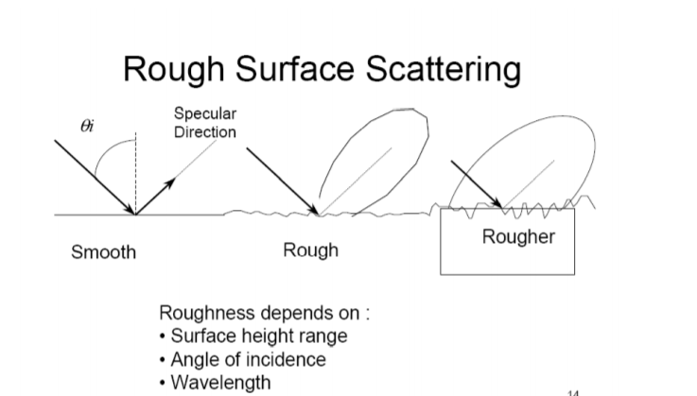
Scattering

Slide 8


