Slide 1
Wireless and Mobile Communication
(UEC 804)
Reference Text book
“Wireless communication_ principles and practices” (Second Edition )
Author: Theodore s Rapport
Publisher: Prentice Hall (2002)

Slide 2
MODULE -IV

Slide 3
Topics covered till now in this module
Propagation Basics
Antenna Basics
Reflection
Two Ray Model
Diffraction
Scattering
Outdoor propagation model
Topics to be covered in this video
Okumura and Hata model

Slide 4
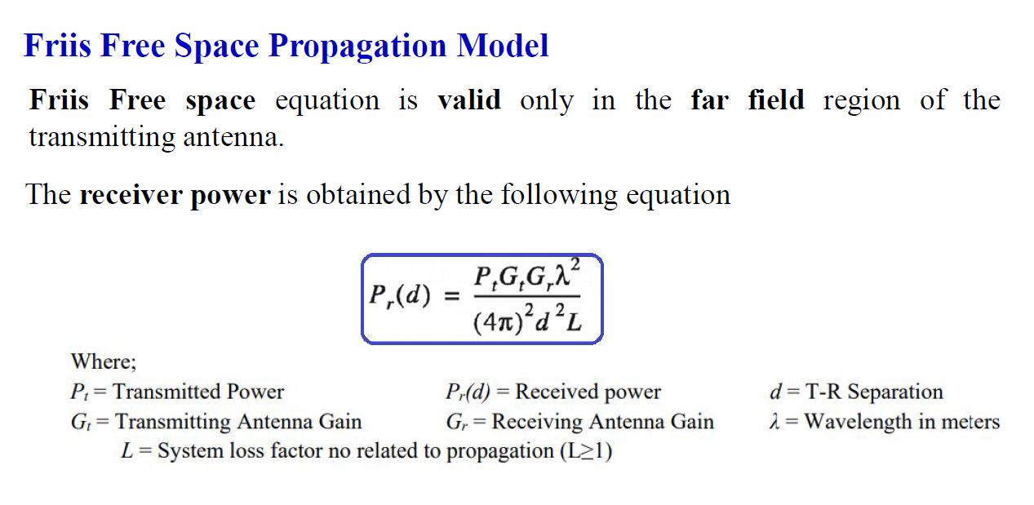

Slide 5
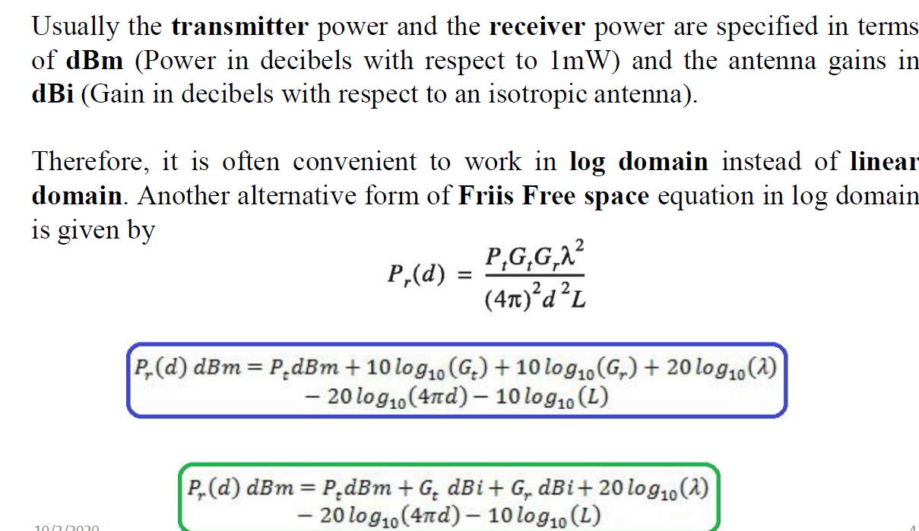

Slide 6
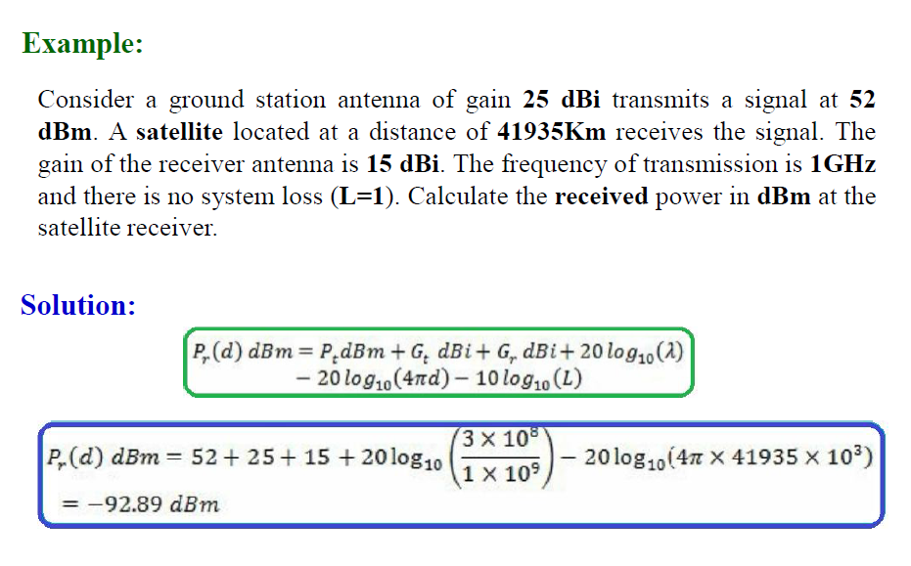

Slide 7
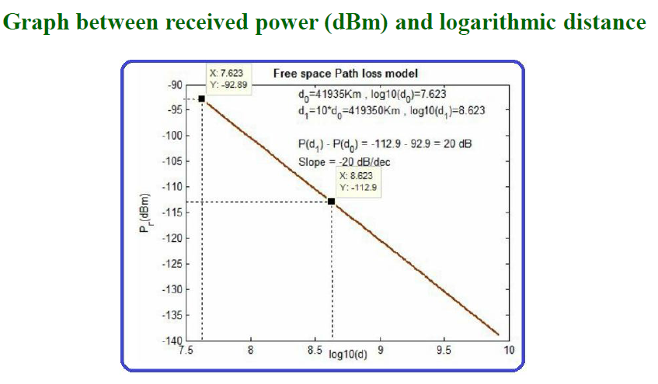

Slide 8
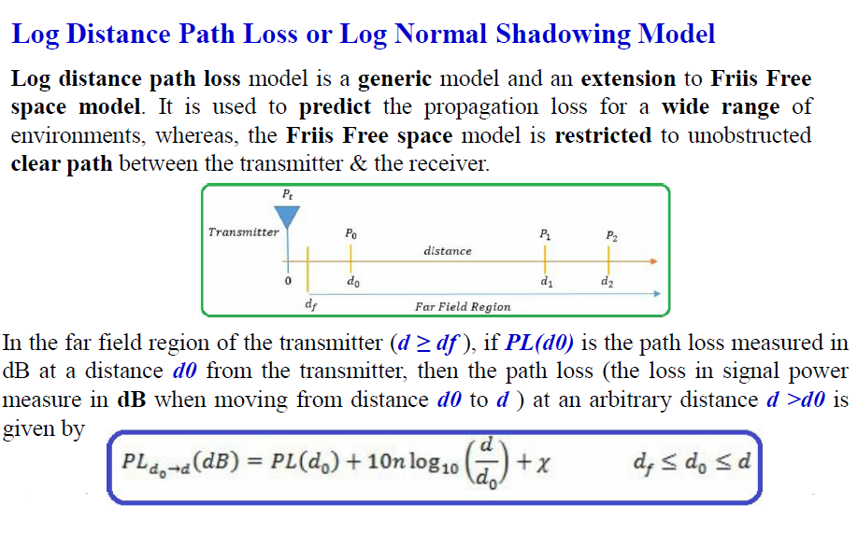

Slide 9
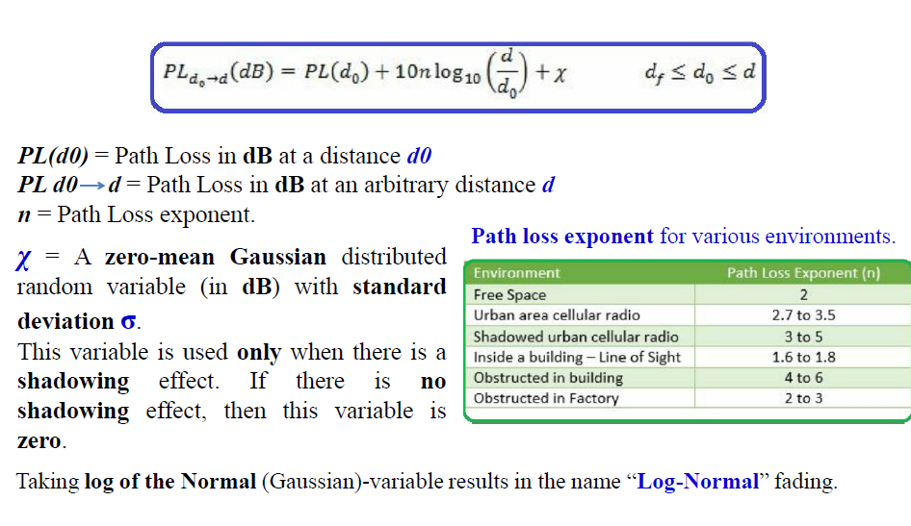

Slide 10
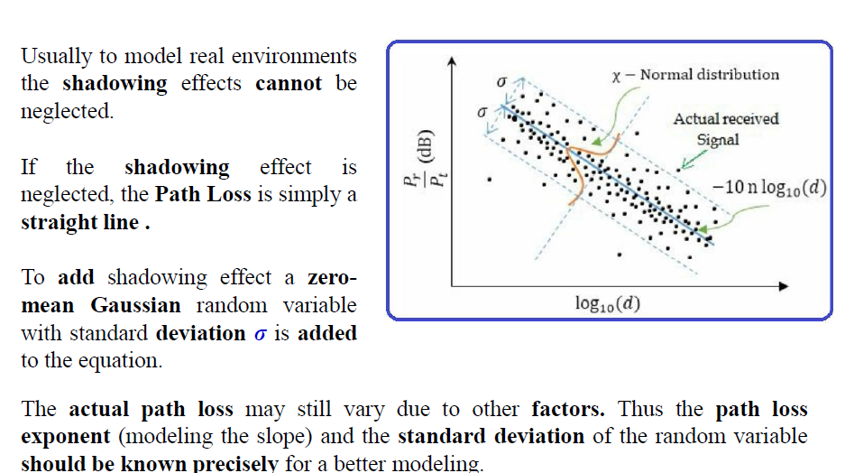

Slide 11
Okumura Model
In 1968 Okumura did a lot of measurements and produce a new model.
The new model was used for signal prediction in Urban areas.
Okumura introduced a graphical method to predict the median attenuation relative to free-space for a quasi-smooth terrain
The model consists of a set of curves developed from measurements and is valid for a particular set of system parameters in terms of carrier frequency, antenna height, etc

Slide 12

Okumura Model
First of all the model determined the free space path loss of link.
After the free-space path loss has been computed, the median attenuation, as given by Okumura’s curves has to be taken to account
The model was designed for use in the frequency range 150 MHz to 1920 MHz and mostly in an urban propagation environment.
Okumura’s model assumes that the path loss between the TX and RX in the terrestrial propagation environment can be expressed as:

Slide 13
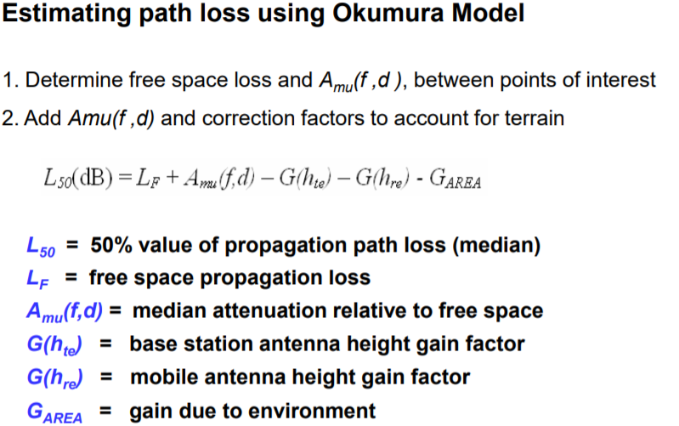
Okumura Model

Slide 14
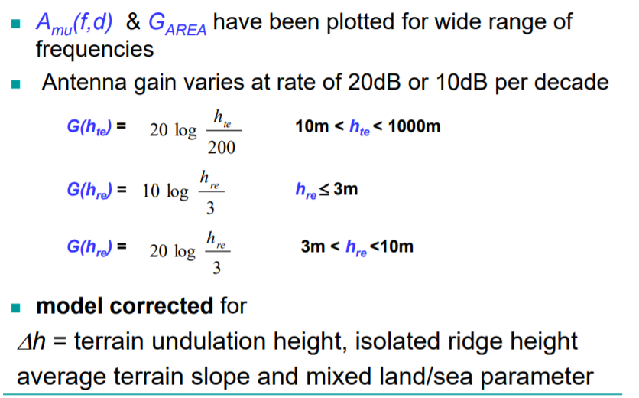
Okumura Model

Slide 15
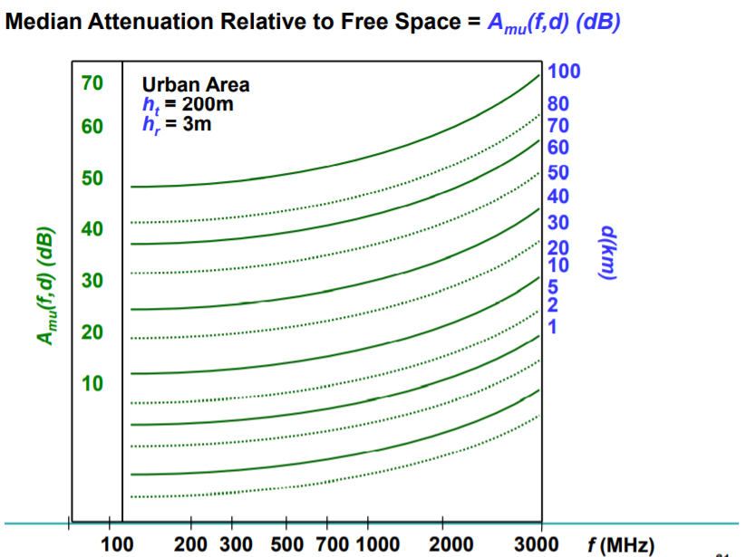
Okumura Model

Slide 16
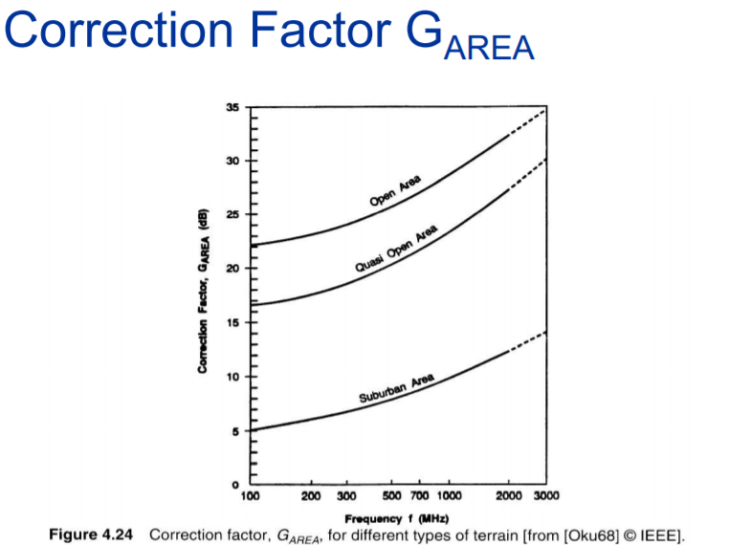
Okumura Model

Slide 17
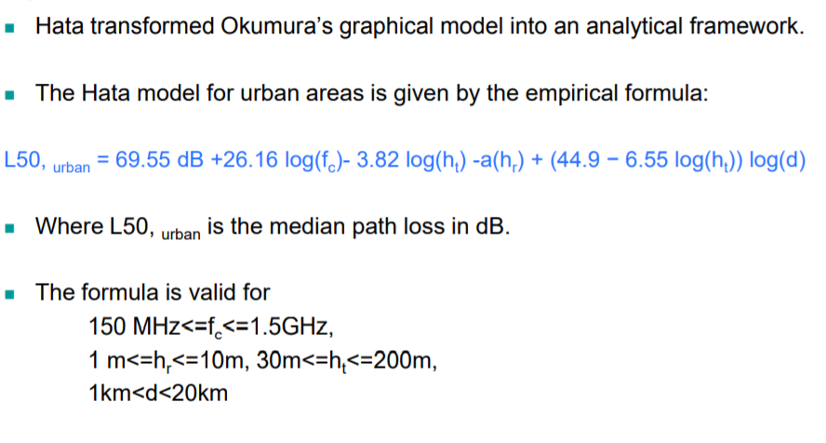
HATA Model

Slide 18
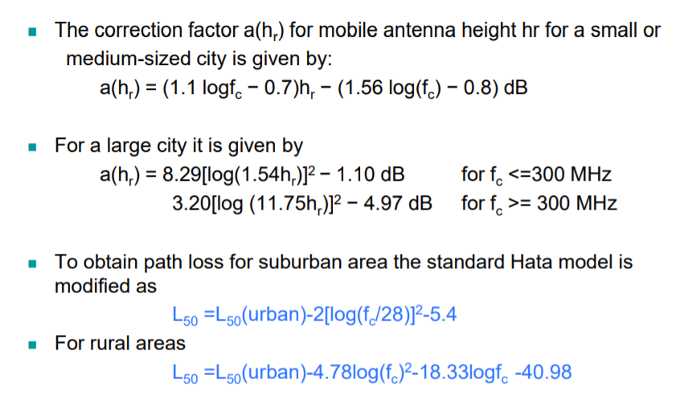
HATA Model

Slide 19


