Slide 1
Wireless and Mobile Communication
(UEC 804)
Reference Text book
“Wireless communication_ principles and practices” (Second Edition )
Author: Theodore s Rapport
Publisher: Prentice Hall (2002)

Slide 2
MODULE -V
Mobile Radio Propagation: Small-Scale Fading and Multipath

Slide 3
Topics to be covered in this video
Introduction to fading

Slide 4
Fading
Fading: rapid fluctuations of received signal strength over short time intervals and/or travel distances
Caused by interference from multiple copies of Tx signal arriving @ Rx at slightly different times
Three most important effects:
  Rapid changes in signal strengths over small travel distances or short time periods.
  Changes in the frequency of signals.
  Multiple signals arriving a different times. When added together at the antenna, signals are spread out in time. This can cause a smearing of the signal and interference between bits that are received

Slide 5
Fading
Fading signals occur due to reflections from ground & surrounding buildings (clutter) as well as scattered signals from trees, people, towers, etc.
  often an LOS path is not available so the first multipath signal arrival is probably the desired signal (the one which traveled the shortest distance)
  allows service even when Rx is severely obstructed by surrounding clutter
  Even stationary Tx/Rx wireless links can experience fading due to the motion of objects (cars, people, trees, etc.) in surrounding environment off of which come the reflections

Slide 6
Fading
Multipath signals have randomly distributed amplitudes, phases, & direction of arrival
  vector summation of (A ∠θ) @ Rx of multipath leads to Constructive/destructive interference as mobile Rx moves in space with respect to time

Slide 7
Fading
Received signal strength can vary by Small-scale fading over distances of a few meter (about 7 cm at 1 GHz)!
  This is a variation between, say, 1 mW and 10⁻⁶ mW.
  If a user stops at a deeply faded point, the signal quality can be quite bad.
  However, even if a user stops, others around may still be moving and can change the fading characteristics.
  And if we have another antenna, say only 7 to 10 cm separated from the other antenna, that signal could be good.
    This is called making use of diversity

Slide 8
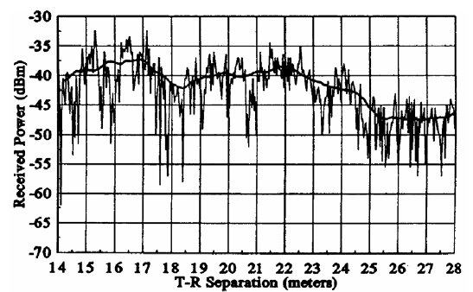
Fading
fading occurs around received signal strength predicted from large-scale path loss models

Slide 9


