Slide 1
Wireless and Mobile Communication
(UEC 804)
Reference Text book
“Wireless communication_ principles and practices” (Second Edition )
Author: Theodore s Rapport
Publisher: Prentice Hall (2002)

Slide 2
MODULE -V
Mobile Radio Propagation: Small-Scale Fading and Multipath

Slide 3
Topics covered till now in this module
Introduction to fading
Topic to be covered in this video
Factors influencing the fading

Slide 4
Physical Factors Influencing Fading in Mobile Radio Channel (MRC)
Multipath Propagation
  Strength of multipath signals
  Time delay of signal arrival
    large path length differences → large differences in delay between signals
    Urban area - many buildings distributed over large spatial scale
      large interference of strong multipath signals with only a few having a large time delay
    Suburban with nearby office park or shopping mall
      moderate interference of strong multipath signals with small to moderate delay times
    Rural area -few multipath signals (LOS + ground reflection)

Slide 5
Fading
Speed of Mobile
  relative motion between base station & mobile causes random frequency modulation due to Doppler shift (f_{d})
  Different multipath components may have different frequency shifts.
Speed of Surrounding Objects
  also influence Doppler shifts on multipath signals
  dominates small-scale fading if speed of objects > mobile speed

Slide 6
Fading
Tx signal bandwidth (B_{s})
  The mobile radio channel (MRC) is modeled as filter with specific bandwidth (BW). The relationship between the signal BW & the MRC BW will affect fading rates and distortion, and so will determine:
    a) if small-scale fading is significant
    b) if time distortion of signal leads to inter-symbol interference (ISI)
  An MRC can cause distortion/ISI or small-scale fading, or both.But typically one or the other.

Slide 7
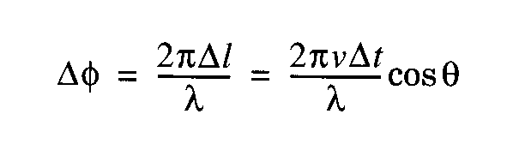
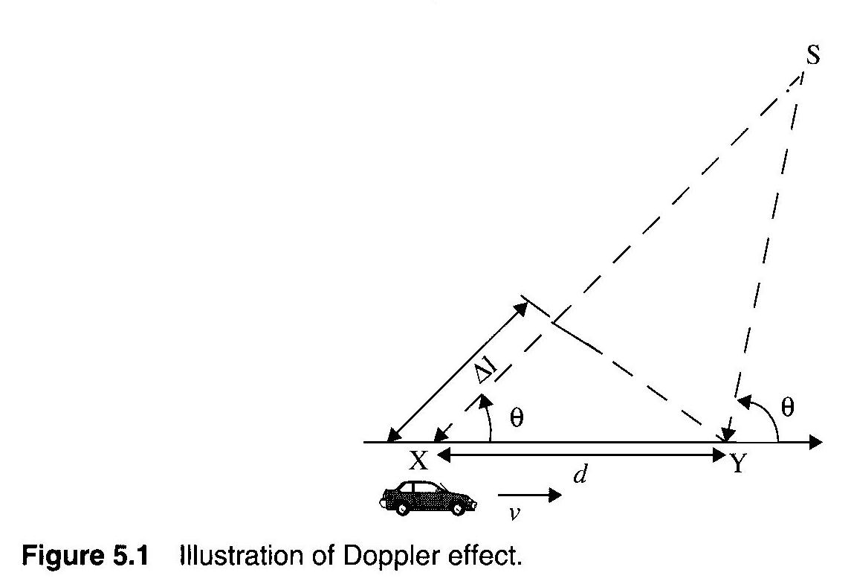
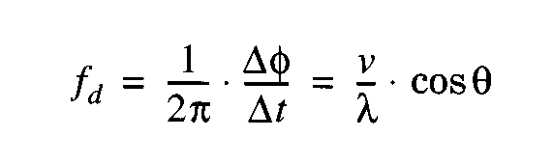
Motion causes frequency modulation due to Doppler shift (f_{d})
v : velocity (m/s)
λ : wavelength (m)
θ : angle between
mobile direction
and arrival direction of RF energy
        + shift → mobile moving toward S
        − shift → mobile moving away from S

Slide 8
Fading
Two Doppler shifts to consider above
  The Doppler shift of the signal when it is received at the car.
  The Doppler shift of the signal when it bounces off the car and is received somewhere else.
Multipath signals will have different f_{d}’s for constant v because of random arrival directions!!

Slide 9
Fading
Example
  Carrier frequency = 1850 MHz
  Vehicle moving 60 mph
  Compute frequency deviation in the following situations.
    Moving directly toward the transmitter
    Moving away from the transmitter
    Moving perpendicular to the transmitter

Slide 10
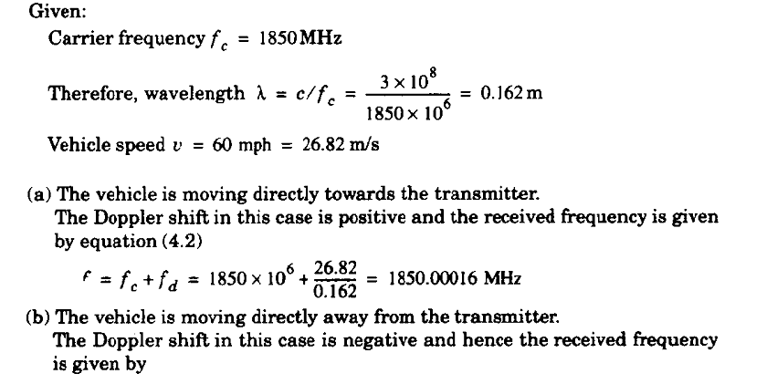
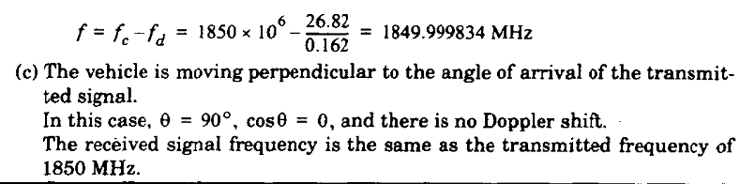
Fading

Slide 11
Fading
Note: What matters with Doppler shift is not the absolute frequency, but the shift in frequency relative to the bandwidth of a channel.
  For example: A shift of 166 Hz may be significant for a channel with a 1 kHz bandwidth.
  In general, low bit rate (low bandwidth) channels are affected by Doppler shift.

Slide 12


