Slide 1
Wireless and Mobile Communication
(UEC 804)
Reference Text book
“Wireless communication_ principles and practices” (Second Edition )
Author: Theodore s Rapport
Publisher: Prentice Hall (2002)

Slide 2
MODULE -V
Mobile Radio Propagation: Small-Scale Fading and Multipath

Slide 3
Topics to be covered in this video
Introduction to fading

Slide 4
MRC Impulse Response Model
Mobile radio channel (MRC) may be modelled as a linear filter with a time varying impulse response
Vector summation of random amplitudes & phases of multipath signals results in a "filter"
  That is to say, the MRC takes an original signal and in the process of sending the signal produces a modified signal at the receiver.

Slide 5
MRC Impulse Response Model
Time variation due to mobile motion → time delay of multipath signals varies with location of Rx
    Can be thought as a "location varying" filter.
    As mobile moves with time, the location changes with time; hence, time-varying characteristics.
The MRC has a fundamental bandwidth
limitation → model as a band pass filter

Slide 6
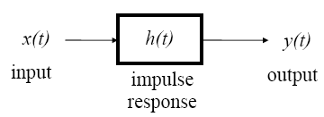
MRC Impulse Response Model
Linear filter theory y(t) = x(t) ⊗ h(t) or
Y ( f ) = X( f ) ⋅H ( f )
How is an unknown h(t) determined?
    let x(t) = δ(t) → use a delta or impulse input
    y(t) = h(t) → impulse response function
    Impulse response for standard filter theory is the same regardless of when it is measured → time invariant!

Slide 7
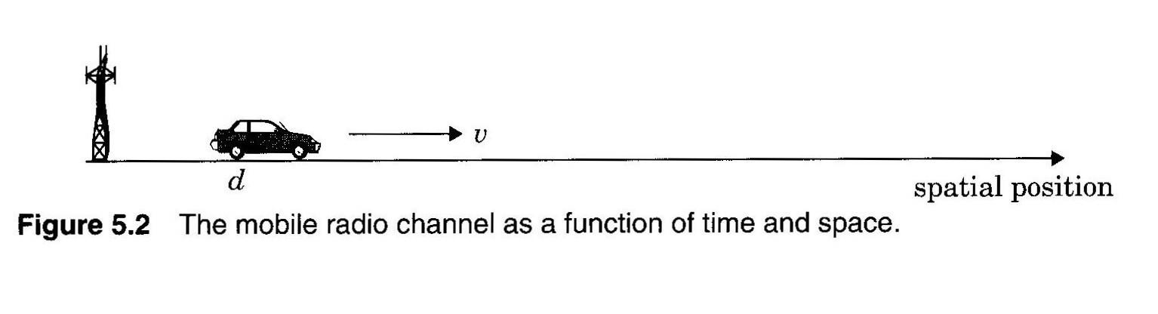
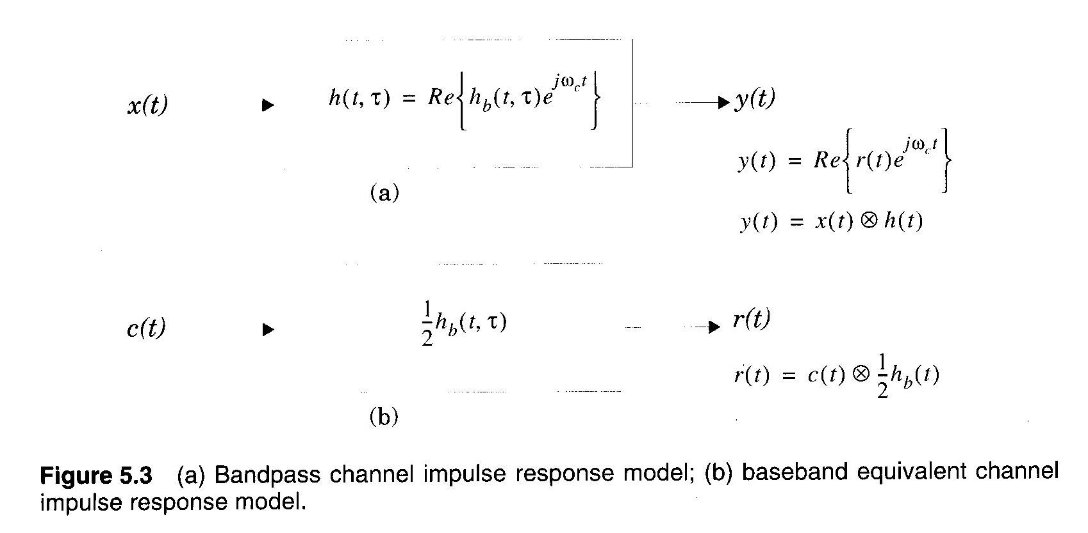
MRC Impulse Response Model

Slide 8
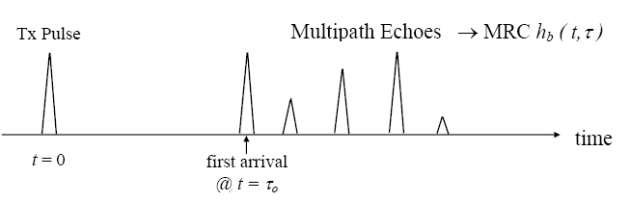
MRC Impulse Response Model
How is the impulse response of an MRC determined?
  “channel sounding” → like radar
  transmit short time duration pulse (not exactly an impulse, but with wide BW) and record multipath echoes @ Rx

Slide 9
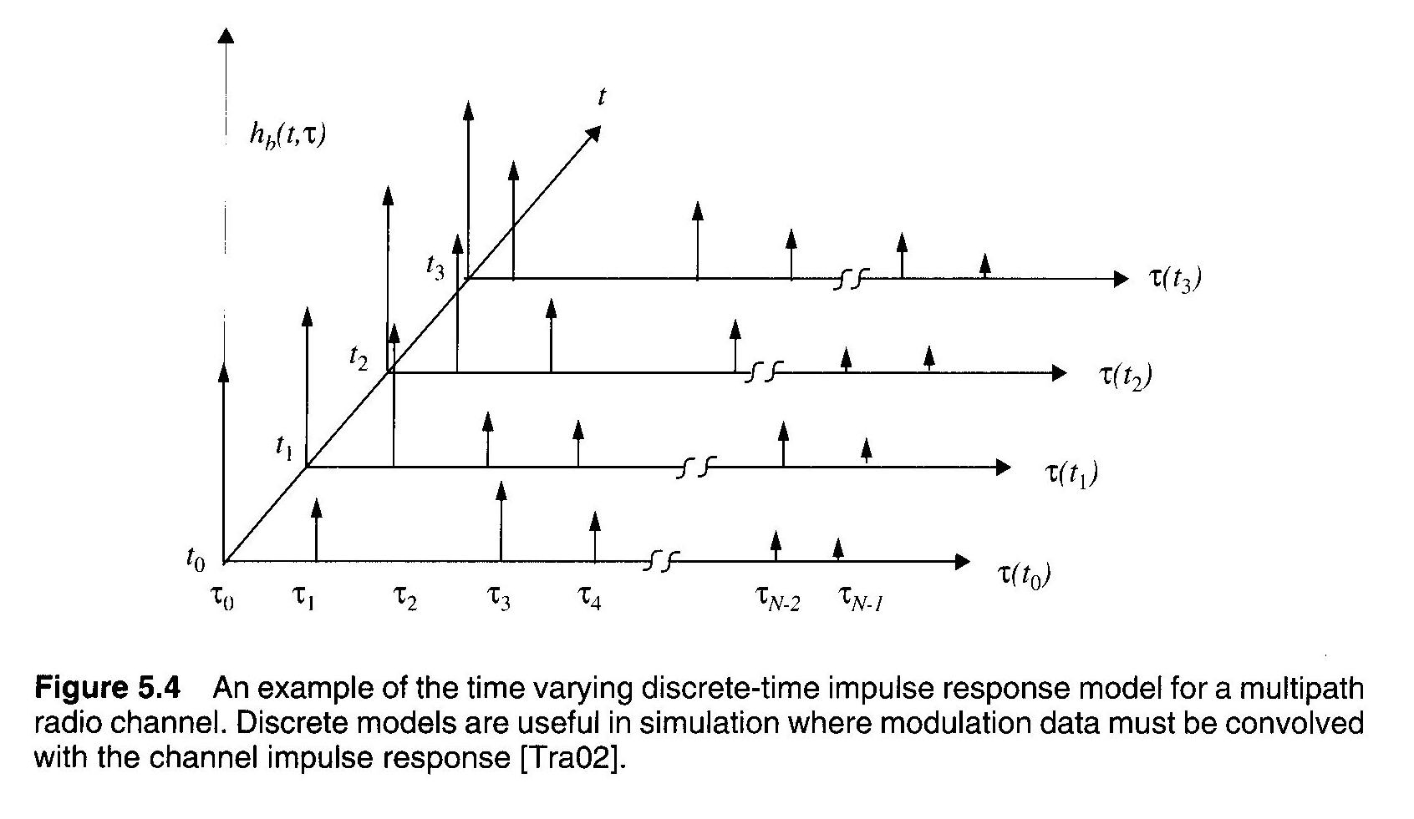
MRC Impulse Response Model
short duration Tx pulse ≈ unit impulse
define excess delay bin as
amplitude and delay time of multipath returns change as mobile moves
Fig. 5.4, pg. 184 → MRC is time variant

Slide 10

MRC Impulse Response Model
model multipath returns as a sum of unit impulses
  a_{i} ∠ θ _{i} = amplitude & phase of each multipath signal
  N = # of multipath components
  a_{i} is relatively constant over an local area
    But θ _{i} will change significantly because of different path lengths (direct distance plus reflected distance) at different locations.

Slide 11
MRC Impulse Response Model
The useful frequency span of the model :
The received power delay profile in a local area:
    Assume the channel impulse response is time invariant, or WSS

Slide 12


