Slide 1
Wireless and Mobile Communication
(UEC 804)
Reference Text book
“Wireless communication_ principles and practices” (Second Edition )
Author: Theodore s Rapport
Publisher: Prentice Hall (2002)

Slide 2
MODULE -V
Mobile Radio Propagation: Small-Scale Fading and Multipath

Slide 3
Topics covered till now in this module
Introduction to fading
Topic to be covered in this video
Factors influencing the fading

Slide 4
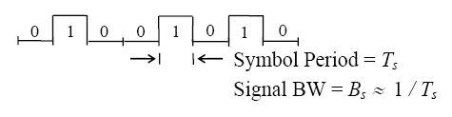
Types of Small-Scale Fading
Fading can be caused by two independent MRC propagation mechanisms:
  1) time dispersion → multipath delay (B_{c} , Ts )
  2) frequency dispersion → Doppler spread (B_{D} , T_{c})
    Important digital Tx signal parameters → symbol period & signal BW

Slide 5
Fading
A pulse can be more than two levels, however, so each period would be called a "symbol period".
  We send 0 (say +1 Volt) or 1 (say -1 Volt) → one bit per “symbol”
  Or we could send 10 (+3 Volts) or 00 (+1 Volt) or 01 (-1 Volt) or 11 (-3 Volts) → two bits per “symbol”

Slide 6
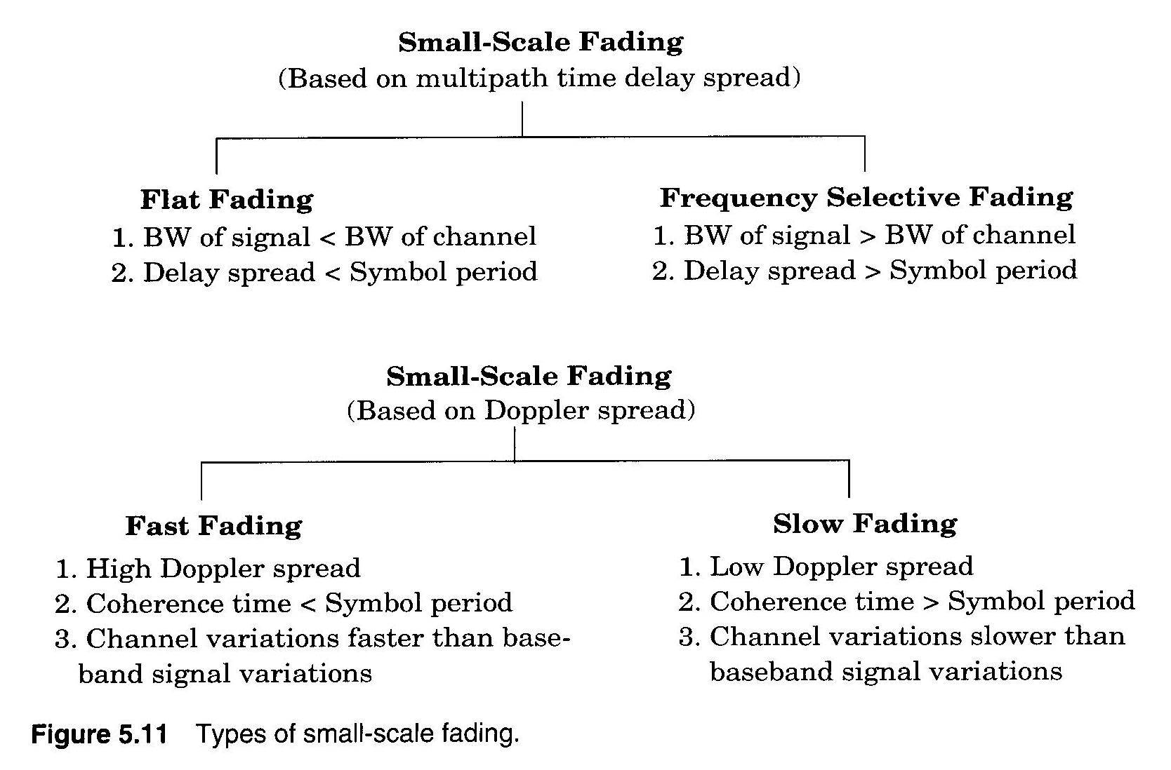
illustrates types of small-scale fading

Slide 7
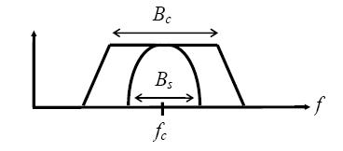
Fading due to Multipath Delay(Flat fading)
  A）Flat Fading → B_{s} << B_{c} or T_{s} >>
    signal fits easily within the bandwidth of the channel
    channel BW >> signal BW
    most commonly occurring type of fading

Slide 8
Flat fading
spectral properties of Tx signal are preserved
  signal is called a narrowband channel, since the bandwidth of the signal is narrow with respect to the channel bandwidth
  signal is not distorted
What does T_{s} >> mean??
  all multipath signals arrive at mobile Rx during 1 symbol period
  Little intersymbol interference occurs (no multipath components arrive late to interfere with the next symbol)

Slide 9
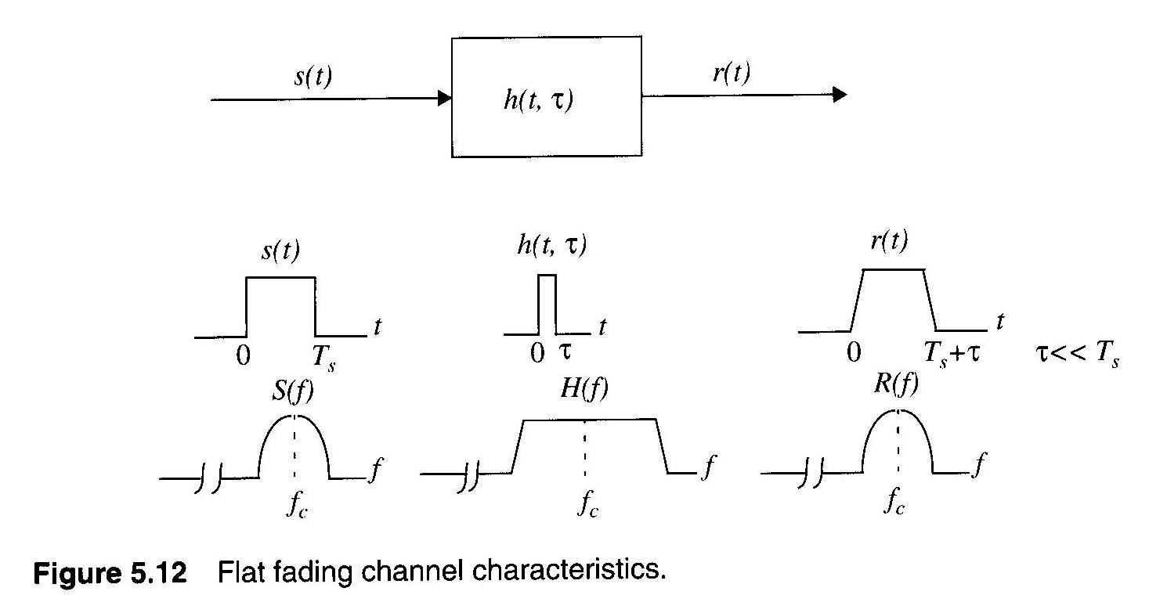
Fading due to Multipath Delay

Slide 10
Fading due to Multipath Delay
flat fading is generally considered desirable
  Even though fading in amplitude occurs, the signal is not distorted
  Forward link → can increase mobile Rx gain (automatic gain control)
  Reverse link → can increase mobile Tx power (power control)
  Can use diversity techniques (described in a later lecture)

Slide 11
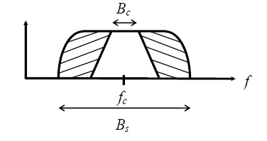
Frequency Selective Fading
B) Frequency Selective Fading → B_{s} > B_{c} or T_{s} <
  B_{s} > B_{c} → certain frequency components of the signal are attenuated much more than others

Slide 12
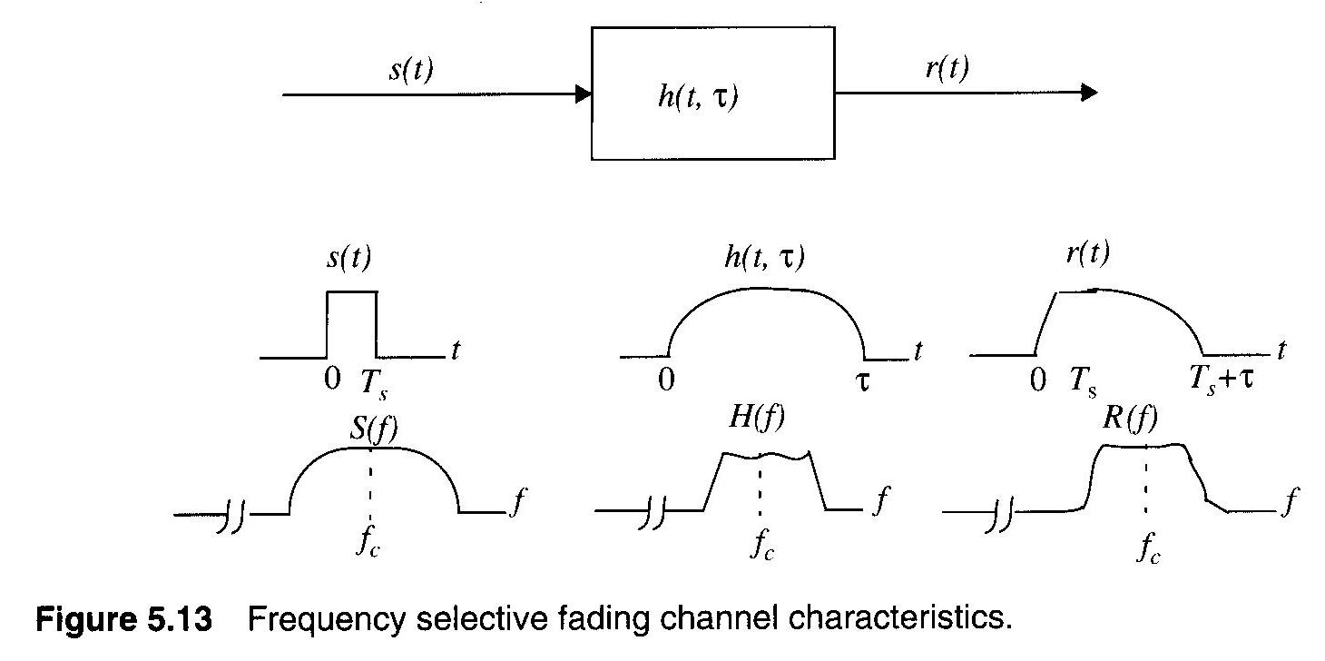
Frequency Selective Fading

Slide 13
Frequency Selective Fading
Ts < σ_{τ} → delayed versions of Tx signal arrive during different symbol periods
    e.g. receiving an LOS → “1” & multipath “0” (from prior symbol!)
    This results in intersymbol interference (ISI)
    Undesirable
it is very difficult to predict mobile Rx performance with frequency selective channels

Slide 14
Frequency Selective Fading
But for high bandwidth applications, channels with likely be frequency selective
    a new modulation approach has been developed to combat this called OFDM
One aspect of OFDM is that it separates a wideband signal into many smaller narrowband signals
    Then adaptively adjusts the power of each narrowband signal to fit the characteristics of the channel at that frequency.
    Results in much improvement over other wideband transmission approaches (like CDMA).

Slide 15
Frequency Selective Fading
  OFDM is used in the new 802.11g 54 Mbps standard for WLAN’s in the 2.4 GHz band.
  Previously it was thought 54 Mbps could only be obtained at 5.8 GHz using CDMA, but 5.8 GHz signals attenuate much more quickly.
  Signals are split using signal → FFT, break into pieces in the frequency domain, use inverse FFT to create individual signals from each piece, then transmit.

Slide 16
Fading due to Doppler Spread(Fast Fading)
  Caused by motion of Tx and Rx and reflection sources.
  A) Fast Fading → B_{s} < B_{D} or T_{s} > T_{c}
    B_{s} < B_{D}
      Doppler shifts significantly alter spectral BW of TX signal
    signal “spreading” Ts > Tc
      MRC changes within 1 symbol period
      rapid amplitude fluctuations
    uncommon in most digital communication systems

Slide 17
Slow fading
Slow Fading → T_{s} << T_{c} or B_{s} >> B_{D}
  MRC constant over many symbol periods
  slow amplitude fluctuations
  for v = 60 mph @ f_{c} = 2 GHz → B_{D} = 178 Hz
  ∴ B_{s} ≈ 2 kHz >> B_{D and} B_{s} almost always >> B_{D} for most applications
** NOTE: Typically use a factor of 10 to designate “>>” **

Slide 18
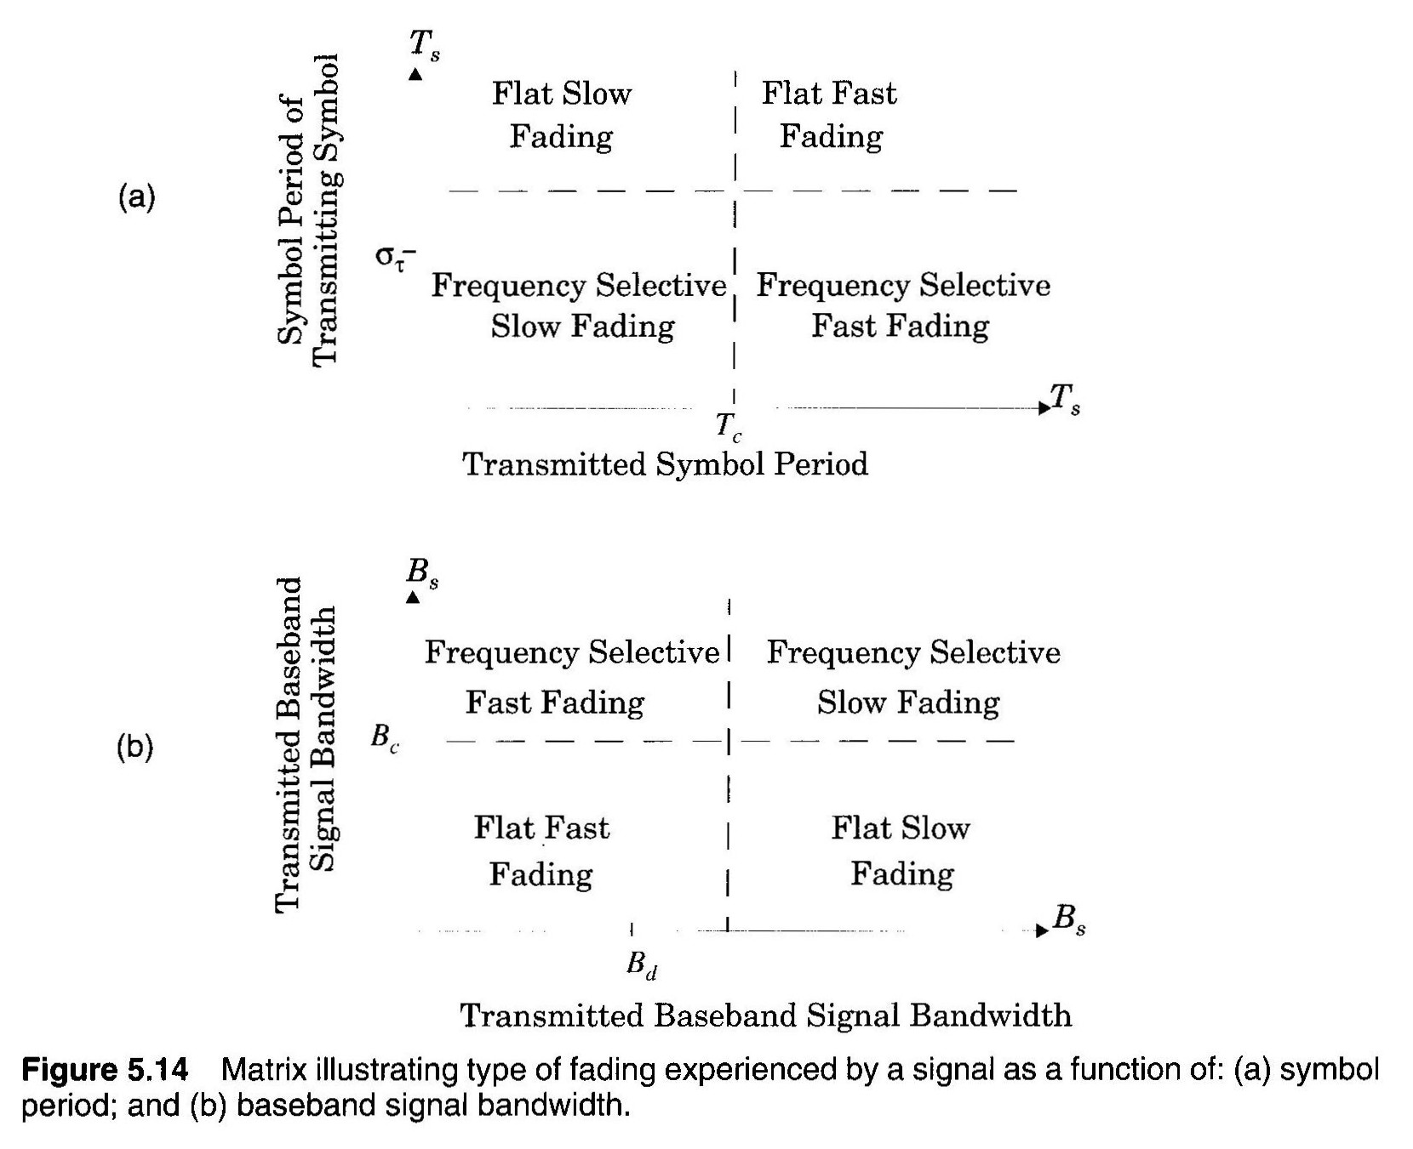
Fading due to Doppler Spread

Slide 19

Fading Signal Distributions
Rayleigh probability distribution function →
  Used for flat fading signals.
  Formed from the sum of two Gaussian noise signals.
  σ : RMS value of Rx signal before detection (demodulation)
  common model for Rx signal variation
    urban areas → heavy clutter → no LOS path
  probability that signal does not exceeds predefined threshold level R

Slide 20
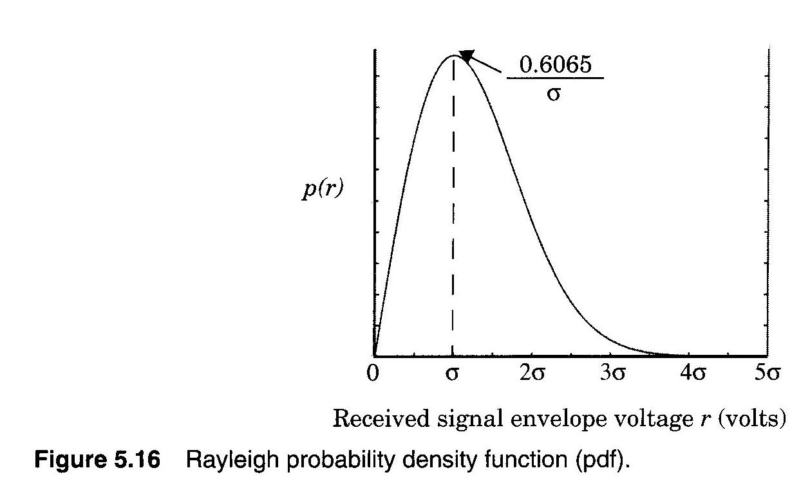
Rayleigh PDF

Slide 21
Rayleigh distribution
  r_{mean} : The mean value of Rayleigh distribution
  σ_{r}² : The variance of Rayleigh distribution; ac power of signal envelope
    σ : RMS value of Rx signal before detection (demodulation)

Slide 22
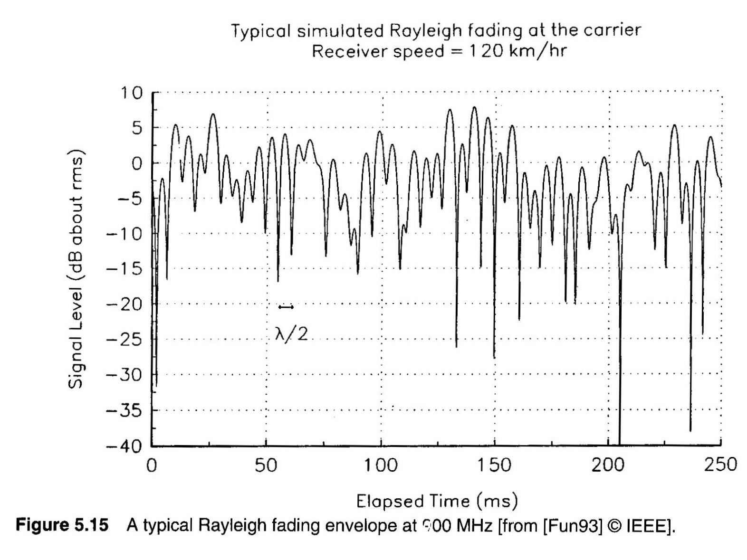
Rayleigh distribution

Slide 23

Ricean distribution
  one dominant signal component along with weaker multipath signals
  dominant signal → LOS path
    suburban or rural areas with light clutter
  becomes a Rayleigh distribution as the dominant component weakens

Slide 24
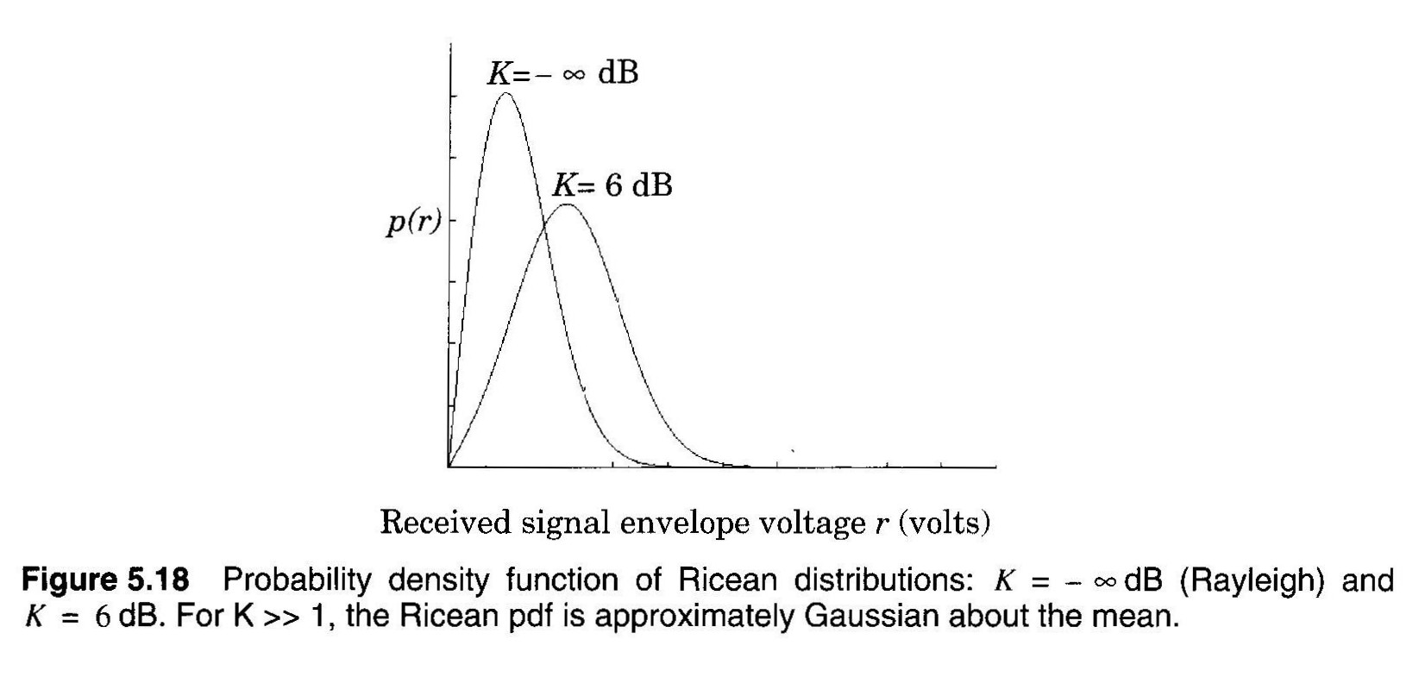
Ricean distribution

Slide 25


