Slide 1
5G WIRELESS COMMUNICATION
(UEC 719)
Course Instructor
Dr. Hem Dutt Joshi
Dr. Surbhi Sharma
Associate Professor,
TIET, Patiala

Slide 2
Lecture
5G Core Network Architecture
Reference Point

Slide 3


Slide 4
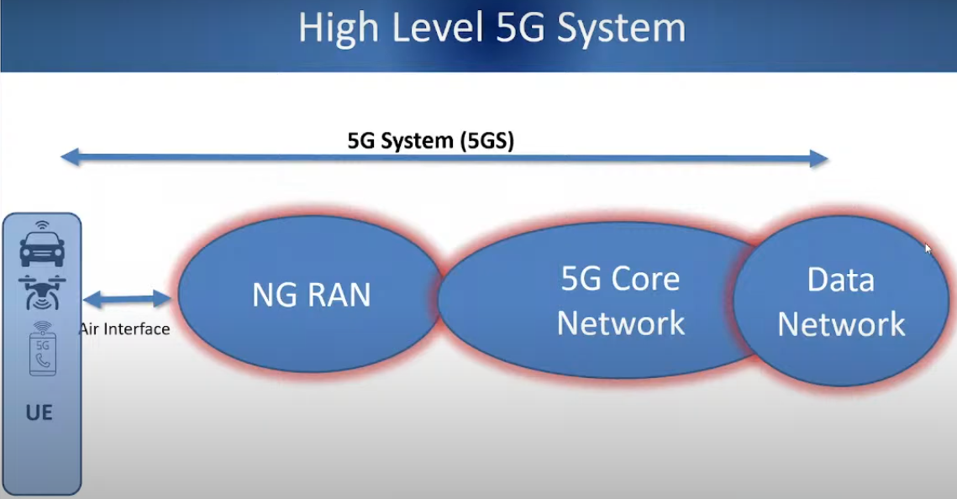
Next Generation
Radio Access Network

Slide 5
5G CORE ATTRIBUTES
The 5G core network is aimed to be:
Flexible: 5G Core should be able to flexibly add new services and configure the network on a shared infrastructure.
Agile: The 5G Core should shorten the service implementation time from hours to minutes and delivers faster time-to-market (TTM) for new services from months to days.
Scalable: 5G Core should be scalable rapidly and highly with telco-grade reliability.
Tunable: 5G Core should be able to quickly adapt and optimise the network according to operating conditions. It should also support cost-efficient migration from 4G to 5G based on access agnostic common core.
To achieve these aims, the key 5GC design principles are:
Network slicing: This feature enables independent scalability and decoupled technical evolution and flexible deployments & configuration of the network as per the needs of the different services.
Modular function design: This is a form of functional disaggregation such that a function composed of multiple modules can be created according to the use case's requirements.

Slide 6
Unified authentication framework : This is useful in multi-access core, for efficiency and to enable operators to offer "follow-the-user" services, independently of access method.
“Stateless" network functions: With this feature, the "compute" resource is decoupled from the "storage" resource. This concept is derived from cloud applications. It enables much more efficient creation and consumption of network resources.
Support for cloud native applications: This is further step from NFV (Network Function Virtualisation) and improves the scalability and efficient creation and consumption of network resources.
Network capability exposure: Exposing information about the network's capabilities to internal and external applications is very important where operators want to integrate 5G with vertical industry processes. Standardizing this interface makes integration easier for vertical customers, especially those with international operations and multi-operator relationships.
Support for mobile edge computing: This is to support access to low- latency services hosted in local data centres. Typically, user-plane functions might be deployed remotely i.e. near to the user, while the control plane is centralized. In very low-latency, mission- critical applications, the control plane may also be distributed.

Slide 7
5G CORE NETWORK ARCHITECTURE
The 5G core network architecture standardised by 3GPP,
The new 5G core, as defined by 3GPP, utilizes cloud-aligned, service-based architecture (SBA) that spans across all 5G functions and interactions including authentication, security, session management and aggregation of traffic from end devices.
The 5G core further emphasizes NFV as an integral design concept with virtualized software functions capable of being deployed in the network

Slide 8
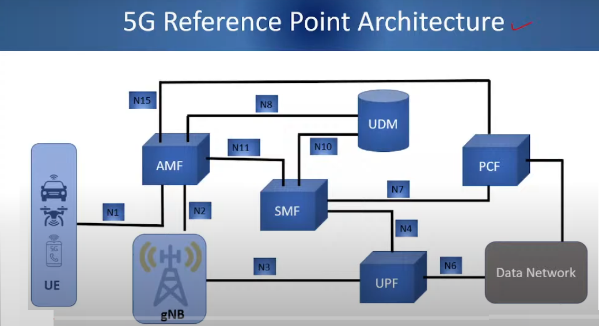

Slide 9
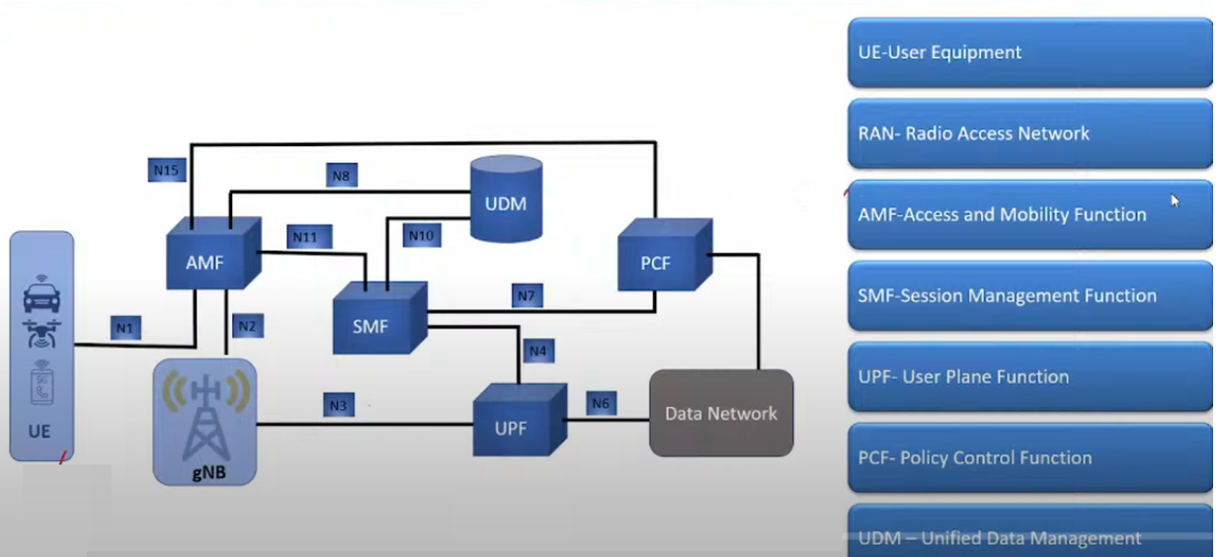

Slide 11
5G CORE NETWORK ARCHITECTURE
The primary Network Functions (NFs) and their capabilities:
Authentication Server Function (AUSF): This acts as an authentication server. It contains mainly the EAP authentication server functionality and acts as storage for keys and provides keying material to the requester NF.
Access and Mobility Management Function (AMF): It carries out termination of NAS signaling, NAS ciphering & integrity protection, registration management, connection management, mobility management, access authentication and authorization, security context management. The AMF also includes the Network Slice Selection Function (NSSF) and acts as the termination point for RAN CP interfaces (N2).
Session Management Function (SMF): It carries out session management (session establishment, modification and release), UE IP address allocation & management, DHCP functions, termination of NAS signalling related to session management, DL data notification and traffic steering configuration for UPF for proper traffic routing.

Slide 12
5G CORE NETWORK ARCHITECTURE
The primary Network Functions (NFs) and their capabilities:
User Plane Function (UPF):
  It carries out packet routing & forwarding, packet inspection, QoS handling, acts as external PDU session point of interconnect to Data Network (DN), and is an anchor point for intra- & inter-RAT mobility.
Network Exposure Function (NEF):
  It supports exposure of capabilities and events, secure provision of information from external application to 3GPP network and translation of internal/external information.
  It acts as an API gateway that allows external users, such as enterprises or partner operators, the ability to monitor, provision and enforce application policy, for users inside the operator network. Thus, it
  Provides security when services or Application Functions (AF) access 5G Core nodes
  Acts as a proxy, or API aggregation point, or translator into the Core Network

Slide 13
5G CORE NETWORK ARCHITECTURE
The primary Network Functions (NFs) and their capabilities:
NF Repository Function (NRF)
  The network repository function (NRF) discovers network function instances. When it receives an NF discovery request from a NF instance, it provides the discovered NF instances. It is not present in 4G. It maintains/supports
    Profiles of Network Function (NF) instances and their supported services within the network
    Service-Based Interfaces, Management & Maintenance
  In the SBA, the NF Repository Function (NRF) provides service discovery between individual network functions. It maintains profiles of network function instances and their supported services (for example, function ID, function type, network slice identifiers, capacity information, supported services, and endpoint information such as IP addresses). In this sense, it is an important "pivot" in the SBA.

Slide 14
5G CORE NETWORK ARCHITECTURE
NF Repository Function (NRF)
  The NRF plays an important role in the establishment of a new session. Here, the SMF discovery and selection request is initiated by the AMF when a request to establish a data session is received from the UE.
  The NRF is used to assist the discovery and selection of the correct SMF. In a network slice context, the same process occurs: the AMF queries the NRF to select an SMF that is part of a Network Slice instance based on S-NSSAI, UE subscription profile and operator policy, when the UE requests a session to be set up.
  Control-plane functions communicate with one another, via the NRF, over service-based interfaces (using HTTP 2.0 transport). These are self-contained software modules that are reusable independently of each other and can be thought of as micro services.
  The network function is either a producer or consumer of services with two modes of interaction: either a consumer NF can request a response from a producer NF – for example, to request subscriber policy information; or it can subscribe to a producer and be notified if needed – for example, if a subscriber's state changes to inactive mode.

Slide 15
Policy Control Function (PCF)
  It carries out unified policy framework, providing policy rules to CP functions, access subscription information for policy decisions in UDR. This provides a policy framework incorporating network slicing, roaming and mobility management. It has similarities with the existing Policy and Charging Rules Function - PCRF of 4G.
Unified Data Management (UDM)
  It stores subscriber data and profiles and carries out generation of Authentication and Key Agreement (AKA) credentials, user identification handling, access authorization, subscription management.
Application Functions (AF)
  The application function (AF) resembles an application server that can interact with the other control-plane NFs. AFs can exist for different application services, and can be owned by the network operator or by trusted third parties. For instance, the AF of an over-the-top application provider can influence routing, steering its traffic towards its external edge servers. For services considered to be trusted by the operator, the AF can access Network Functions directly whereas untrusted or third-party AFs would access the Network Functions through the NEF

Slide 16
Data Network (DN)
  This refers to the external data network through which operator services, 3rd party services etc. can be accessed.
  This new representation of the 5G Core Architecture in terms of network functions (for example, Access Management Function (AMF)) within the control plane enables other authorized network functions to access their services. Communications with these nodes leverage HTTP based APIs, replacing protocols like Diameter.
  This represents a major shift in the telecom world with the adoption of stateless functions, interfaces based on APIs and signals a move towards the software world. The overall design and their potential benefits include:
    Flexible and extensible architecture
    Easier integration with third party software using Application Programming Interfaces (APIs)
    Multi-slice User Equipment (UE), single UE simultaneously connecting to multiple services over multiple slices with optimized access and mobility signalling.
    Improved QoS

