Slide 1
The Non-3GPP Interworking Function (N3IWF)

Slide 2
N3IWF (Non-3GPP Interworking Function) is an integral component of the 5G network architecture that enables seamless interworking between 3GPP (Third Generation Partnership Project) and non-3GPP networks.
It plays a crucial role in ensuring interoperability and connectivity between 5G networks and various non-3GPP access technologies, such as Wi-Fi and Ethernet.
N3IWF acts as a bridge, allowing the integration and interconnection of these heterogeneous networks, thereby expanding the coverage and service capabilities of the 5G ecosystem.
Functionalities of N3IWF:
Access Translation: N3IWF translates the protocols and signaling messages between 3GPP and non-3GPP networks. It converts the 5G protocols into the appropriate format compatible with the non-3GPP technology, ensuring smooth communication and handover procedures.

Slide 3
2. Authentication and Authorization: N3IWF handles the authentication and authorization processes for non-3GPP users. It verifies the identity and credentials of the users before granting access to the 5G network.
3.Session Management: N3IWF manages the establishment, modification, and termination of user sessions. It tracks the user's connection and ensures continuous connectivity during handover between different access networks.
4. Mobility Management: N3IWF facilitates mobility management for non-3GPP users. It handles procedures such as tracking area update, handover, and location management, allowing users to move across different networks while maintaining active sessions.
5. Policy and Charging Control: N3IWF enforces policy and charging rules for non-3GPP users. It ensures that users comply with the predefined policies and regulations, providing fair usage and QoS (Quality of Service) enforcement.

Slide 4
N3IWF Interfaces
The N3IWF has several interfaces that enable communication between the different components of the network. These interfaces include:
N3 interface: This interface is used to connect the standalone N3IWF to the 5G Core network. It is responsible for communication between the N3IWF and the AMF.
Non-3GPP access network interface: This interface is used to connect the N3IWF to the non-3GPP access network. It is responsible for signaling and user data transmission between the two networks.
N4 interface: This interface is used to connect the integrated N3IWF to the 5G Core network. It is responsible for communication between the N3IWF and the UPF.

Slide 5
5G Network slicing

Slide 6
Network slicing is the technology that will enable the division of a physical network into multiple virtual ones, specially tailored to each particular requirement, application, or service. All of these segments will be working as if they were different and separate networks with their own characteristics in terms of bandwidth, delay, security, or mobility.
The Step-by-Step Process
Slicing Creation: The network operator defines the parameters for each slice, including bandwidth, latency, and security requirements.
Resource Allocation: Dedicated resources are allocated to each slice, ensuring it has the necessary capacity for its intended use.
Isolation and Management: Each slice is isolated from the others, providing independent network functions, management, and control.

Slide 7
Real-World Applications
Smart Cities: Network slicing ensures smart cities run efficiently, supporting applications like traffic management and energy optimization.
Autonomous Vehicles: Self-driving cars rely on dedicated resources for uninterrupted communication, made possible by network slicing.
IoT and Industry 4.0: Network slicing enables seamless data exchange for IoT and Industry 4.0, essential for efficient industrial processes and IoT device connectivity.

Slide 8
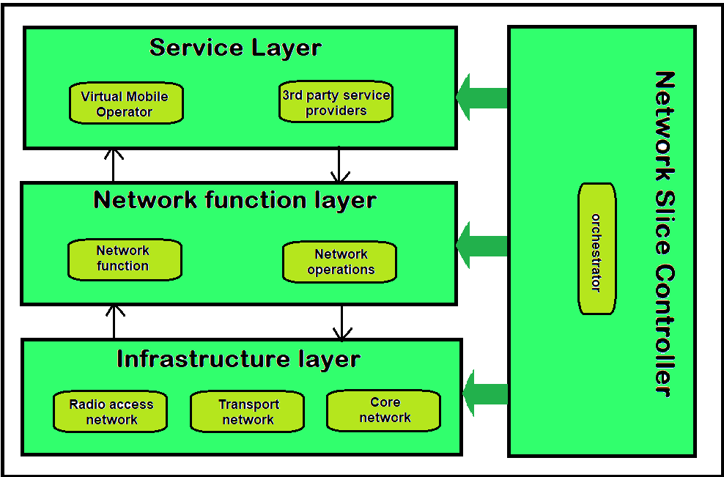
Architecture OF SLICING

Slide 9
service layer
The service interface directly connects with network businesses like MVNOs and third-party providers, which share the physical network. It offers a clear view of what services are needed. Each service is represented as a service instance, which includes all the network details in the form of SLA requirements that must be met by a suitable slice creation.
Network function layer
This layer is responsible for the development of every network segment based on requests for services from the higher layer. It consists of a collection of network functions, each with clearly defined actions and ways of interacting. These functions are arranged over the virtual network infrastructure and linked together to form a complete network segment that matches the desired network features of the service.
Infrastructure layer
The infrastructure layer is the physical network's structure, including the radio access, transport, and core networks. It supports the different network functions within each slice by providing necessary resources.
Network slice controller
The network slice controller acts as a Orchestrator within the network, interacting with the functions of each layer to manage each slice's requests in a unified manner. Its advantage lies in the ability to create slices that are both efficient and adaptable, allowing for changes throughout their lifespan. Within the operation of the network slice controller, it is responsible for various activities that improve coordination among the layers mentioned earlier:

