Slide 1
5G WIRELESS COMMUNICATION
(UEC 719)
Course Instructor
Dr. Hem Dutt Joshi
Dr. Surbhi Sharma
Associate Professor,
TIET, Patiala

Slide 2
Lecture
5G Core Network Architecture
SERVICE BASED ARCITECTURE

Slide 3
5G CORE NETWORK ARCHITECTURE (Service Based)
Service-Based Architecture” (SBA) is a modular architecture which is centered on services that can register themselves to provide certain services and also can subscribe to other services and using these as the building blocks, more complex services can be provided.
3GPP has adopted a service-based architecture of the 5G core system.
This is significantly different from 4G, where such modularity in the network elements that constitute the core network was not included.
SBA helps in the adoption of virtualization, provides increased flexibility and adaptability to the core network.
To make the applications more flexible, scalable and dynamic, the applications have been deconstructed into smaller and smaller components which can be reused for other applications and can also developed, tested and deployed independently.
These units are called micro services. Micro services are an architectural design pattern where the system is composed of small granularity, highly cohesive and loosely-coupled services. Each of these services fulfils a specific functionality and is self-contained. Interactions between services implement standard light-weight interfaces (e.g. Restful principles etc.).

Slide 4
5G CORE NETWORK ARCHITECTURE (Service Based)

Slide 5
5G CORE NETWORK ARCHITECTURE (Service Based)
This concept from the software world has been adopted into the telecom domain where each network element, which carries out certain functions has been broken down into the constituent parts and each network function can register, discover and use the services offered by other functions.
The network functions and the Interfaces are designed to have minimum impact on others so that introduction of new network functions, upgradation of existing network functions etc. does not impact the whole network. This makes possible continuous updation, upgradation, and introduction of new services. This is the Service Based Architecture approach.

Slide 6
The Service-based architecture brings following benefits to 5G:
Easy update of Network:
  Finer granularity allows individual services to be upgraded with minimal impact to other services.
  Facilitated continuous integration reduces the time-to-market for installing bug fixes and rolling out new network features and operator applications.
Extensibility:
  Light-weighted service-based interfaces are needed to communicate across services.
Modularity & Reusability:
  The network is composed of modularized services reflecting the network capabilities and provides support to key 5G features such as network slicing.
  A service can be easily invoked by other services (with appropriate authorization), enabling each service to be reused as much as possible.
Openness
Together with some management and control functions (i.e. authentication, authorization, accounting), the information about a 5G network can be easily exposed to external users such as 3rd parties through a specific service without complicated protocol conversion

Slide 7
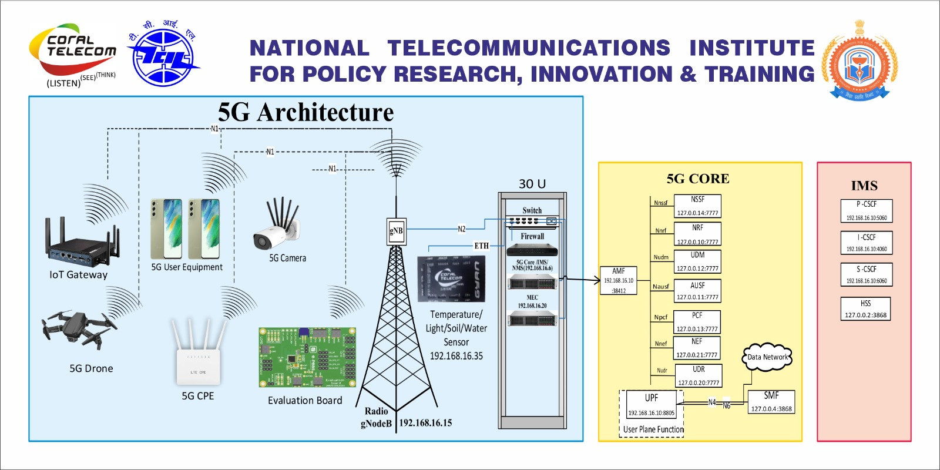
5G Core Network Architecture
Installed in 5G Use Case Lab

