Slide 1
5G WIRELESS COMMUNICATION
(UEC 719)
Course Instructor
Dr. Hem Dutt Joshi
Dr. Surbhi Sharma
Associate Professor,
TIET, Patiala

Slide 2
Lecture: 16
5G NR
Frame Structure

Slide 3
Contents
Frame Structure in Time Domain

Slide 4

Frame Structure in Time domain
Frame
Sub Frame
Slot
Symbols

Slide 5

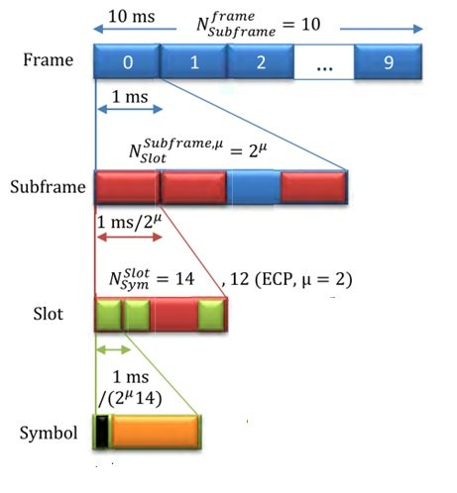

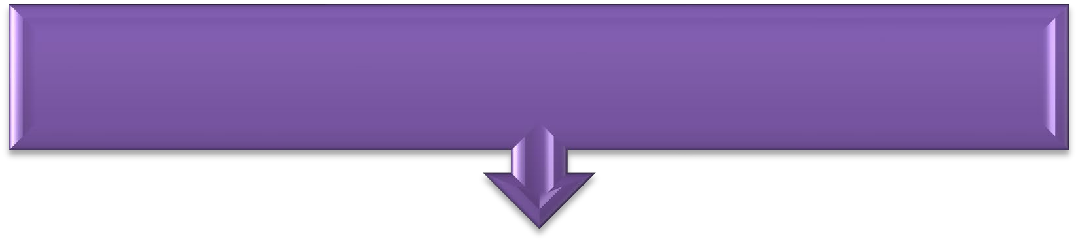


Radio Frame
Frame duration = 10msec
Subframe duration = 1msec
Slot Duration : Varies according to
sub carrier spacing used.
OFDM Symbols per slot = 14
Symbol duration : Varies according to sub
carrier spacing used.

Slide 6

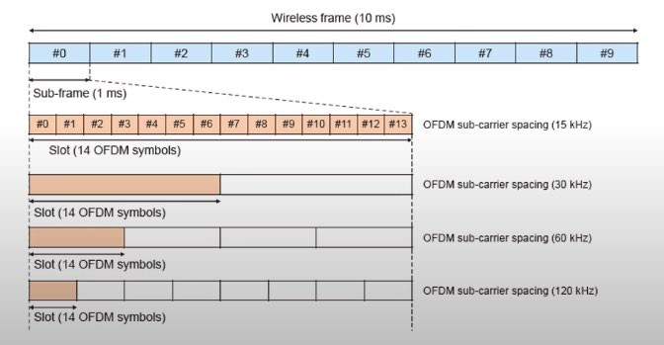
Slot Length

Slide 7
No. of Slots in frame/Sub Frame
SCS
Slot per Sub Frame (1ms)
Symbols per Sub Frame (1ms)
Slot per Frame (10ms)
Symbol per Frame(10ms)
15KHz
30KHz
60KHz
120KHz
240KHz

Slide 8
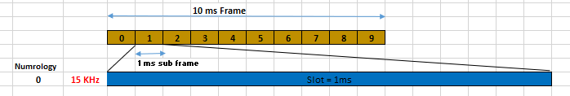
15 KHz sub carrier
Frame duration = 10 mSec
Sub frame duration = 1 msec
Slots per sub frame = 1 slot
Slot duration = 1msec
Symbols per slot = 14 symbols
Symbols per SF = 14
Symbol per F = 140

Slide 9
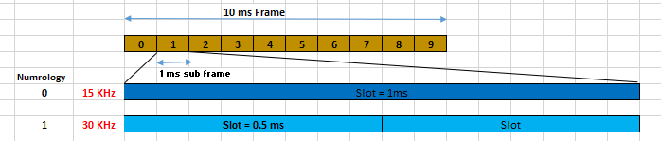
30 KHz sub carrier
Frame duration = 10 mSec
Sub frame duration = 1 msec
Slots/ subframe = 2 slot
Slot duration = 0.5 msec
Symbols/ slot = 14 symbols
Symbols per SF = 28
Symbols per F = 280

Slide 10
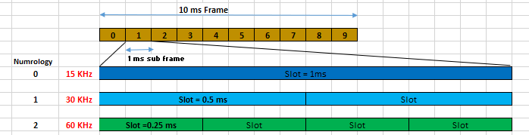
60 KHz sub carrier
Frame duration = 10 mSec
Sub frame duration = 1 msec
Slots / SF = 4 slot
Slot duration = 0.25 msec
Symbols/ slot = 12/14 symbols
Symbols per SF = 56
Symbol per F = 560

Slide 11
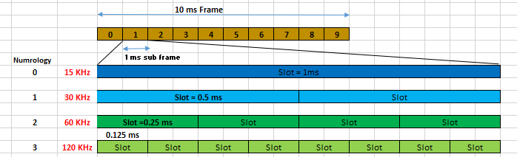
120 KHz sub carrier
Slots/SF = 8 slot
Slot duration = 0.125 msec
Symbols /slot = 14 symbols
Symbols per SF =112
Symbol per F =1120

Slide 12
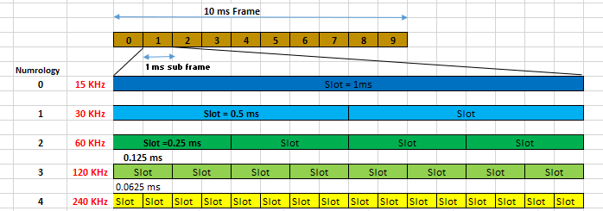
240 KHz sub carrier
Slots / subframe = 16 slot
Slot duration = 0.0625 msec
Symbols / slot = 14 symbols
Symbols per SF = 288
Symbol per F =2880

Slide 13

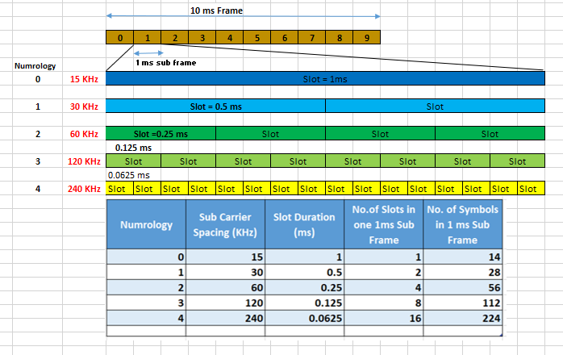
Frame Structure

Slide 14
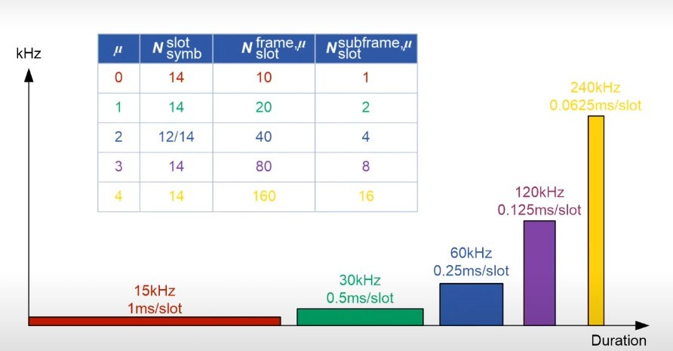
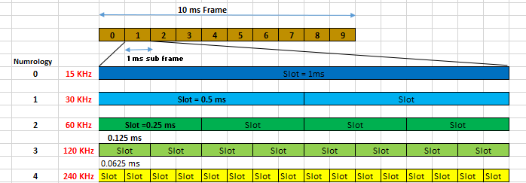
Sub carrier spacing and slot duration

Slide 15
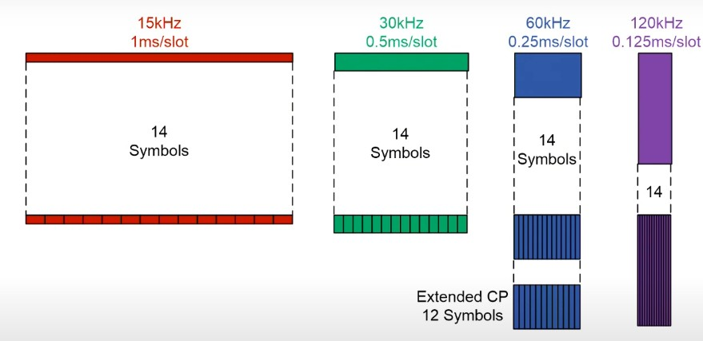
Symbol in a slot

