Slide 1
5G WIRELESS COMMUNICATION
(UEC 719)
Course Instructor
Dr. Hem Dutt Joshi
Dr. Surbhi Sharma
Associate Professor,
TIET, Patiala

Slide 2
Lecture:
Capacity Limits of MIMO Systems

Slide 3
Capacity Limit
Shannon capacity limits of single-and multi-user MIMO systems limits dictate the maximum data rates that can be transmitted over the MIMO channel to one or more users (not in outage) with asymptotically small error probability, assuming no constraints on the delay or the complexity of the encoder and decoder.
MIMO Shannon capacity for both single- and multi-user systems with and without fading under different assumptions about what is known at the transmitter(s) and receiver(s).

Slide 4
Mutual information and Shannon Capacity
Channel capacity was pioneered by Claude E Shannon in the late 1940s.
The capacity of a channel, denoted by C, is the maximum rate at which reliable communication can be performed, without any constraints on transmitter and receiver complexity.
In MIMO, capacity gain depends on
The available channel information at either the receiver or the transmitter.
The channel signal-to-noise ratio (SNR).
The correlation between the channel gains on each antenna element.

Slide 5
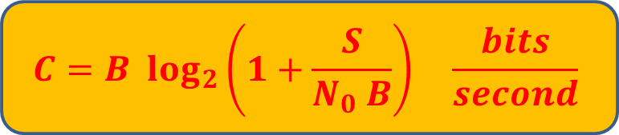
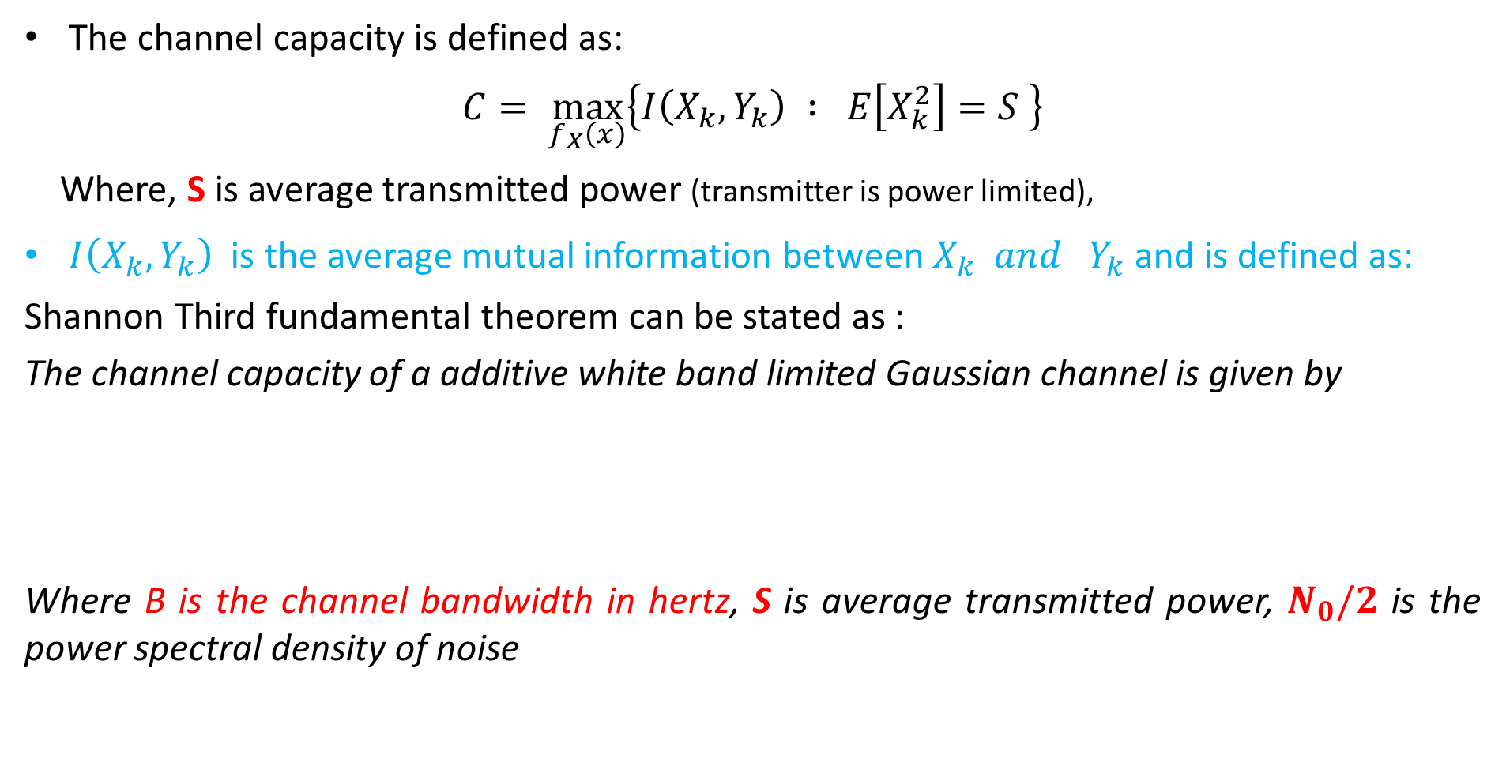
Channel Capacity Theorem (Shannon-Hartley Theorem)
The channel capacity is defined as:
$$C= \max_{f_{X}\left(x\right)}\left\{I\left(X_{k},Y_{k}\right) : E\left[X_{k}^{2}\right]=S \right\}$$
Where, S is average transmitted power (transmitter is power limited),
$I\left(X_{k},Y_{k}\right)$ is the average mutual information between $X_{k} and Y_{k}$ and is defined as:
Shannon Third fundamental theorem can be stated as :
The channel capacity of a additive white band limited Gaussian channel is given by
Where B is the channel bandwidth in hertz, S is average transmitted power, $N_{0}/2$ is the power spectral density of noise
$$C=B \log_{2}\left(1+\frac{S}{N_{0} B}\right) \frac{bits}{second}$$

Slide 6
Capacity of MIMO system
Over
fading Channels

Slide 7
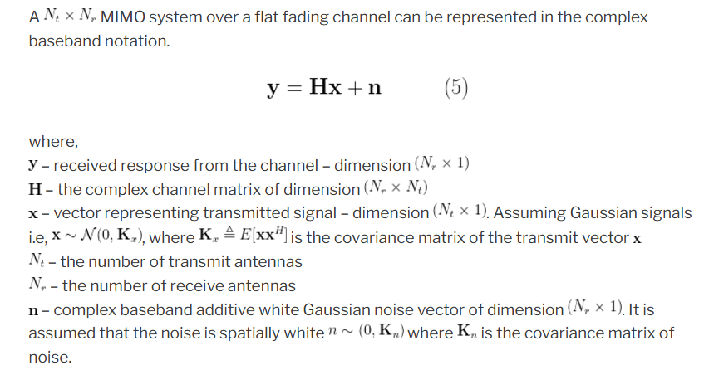
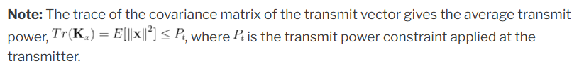
MIMO flat fading Channel model

Slide 8
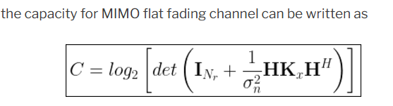
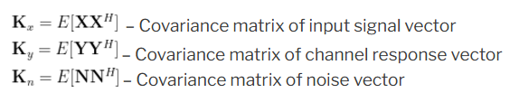

Slide 9
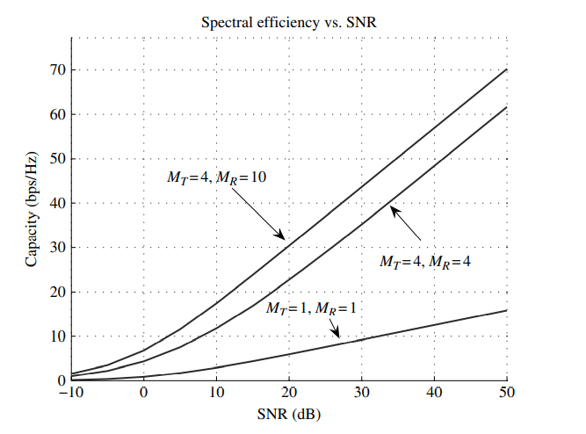

Slide 10
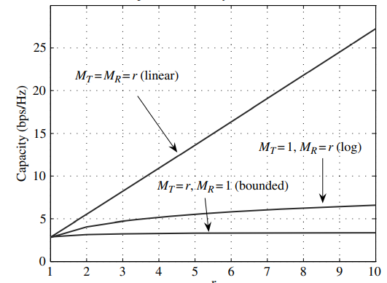

Slide 11
Capacity Gain
If the number of receiving antennas (M_{R}) is taken to infinity while keeping (M_{T}) fixed, the capacity does indeed go to infinity approximately as log(M_{R}).
The key difference is that adding receive antennas increases the amount of received power, while adding transmit antennas does not do so because the power is split between all transmit antennas.
If MT and MR are simultaneously taken to infinity, the capacity is seen to grow linearly with min (M_{T} M_{R}) i.e. C ≈ min (M_{T} M_{R}) · K, where K is a constant depending on the ratio of MT and MR, and on the SNR.

Slide 12
Capacity Gain
In summary, increasing the number of receive antennas leads to a logarithmic growth in capacity,
while simultaneously increasing the number of receive and transmit antennas leads to linear growth.
Increasing the number of transmit antennas, on the other hand, provides only a bounded increase in capacity.
One crucial point to take away from this section is that the capacity of an M × M MIMO system supports approximately M times the capacity of a SISO system at any SNR

