Slide 1

Antenna Arrays
Presented by:
Dr. Amanpreet Kaur(Sr.)
Assistant Professor
Department of Electronics and Communication Engineering,
Thapar Institute of Engineering and Technology, Patiala

Slide 2
Antenna arrays
In many applications -> design antennas with very directive characteristics (very high gains) to meet the demands of long distance communication.
The radiation pattern of a single element is usually wide, and each element provides low values of directivity (gain).
This can only be accomplished by increasing the electrical size of the antenna.

Slide 3
Physically not realizable
Form an assembly of radiating elements in an electrical and geometrical configuration. referred to as an array
For convenience- elements can be same or they may be of any form (wires, apertures, etc.).
The total field of the array is determined by the vector addition of the fields radiated by the individual elements.

Slide 4
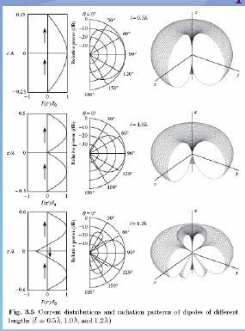
Assuming the current fed to all the elements is same and there is no mutual coupling.

Slide 5
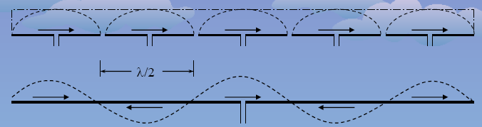
Long wire antenna with a single feed point produces low gain pattern with several large side lobes.
Array antenna of the same length with multiple feed points produces a large gain narrow beam pattern with low side lobes.
The individual feed currents can be adjusted to produce a very low side lobe pattern.

Slide 6
In an array of identical elements, the five controls that shape the overall pattern of array are:
1. The Geometrical Configuration of the Overall Array (Linear, Circular, Rectangular.)
2. The Relative Displacement Between the Elements
3. The Excitation Amplitude of the Individual Elements
4. The Excitation Phase of the Individual Elements.
5. The Relative Pattern of the Individual Elements.

Slide 7
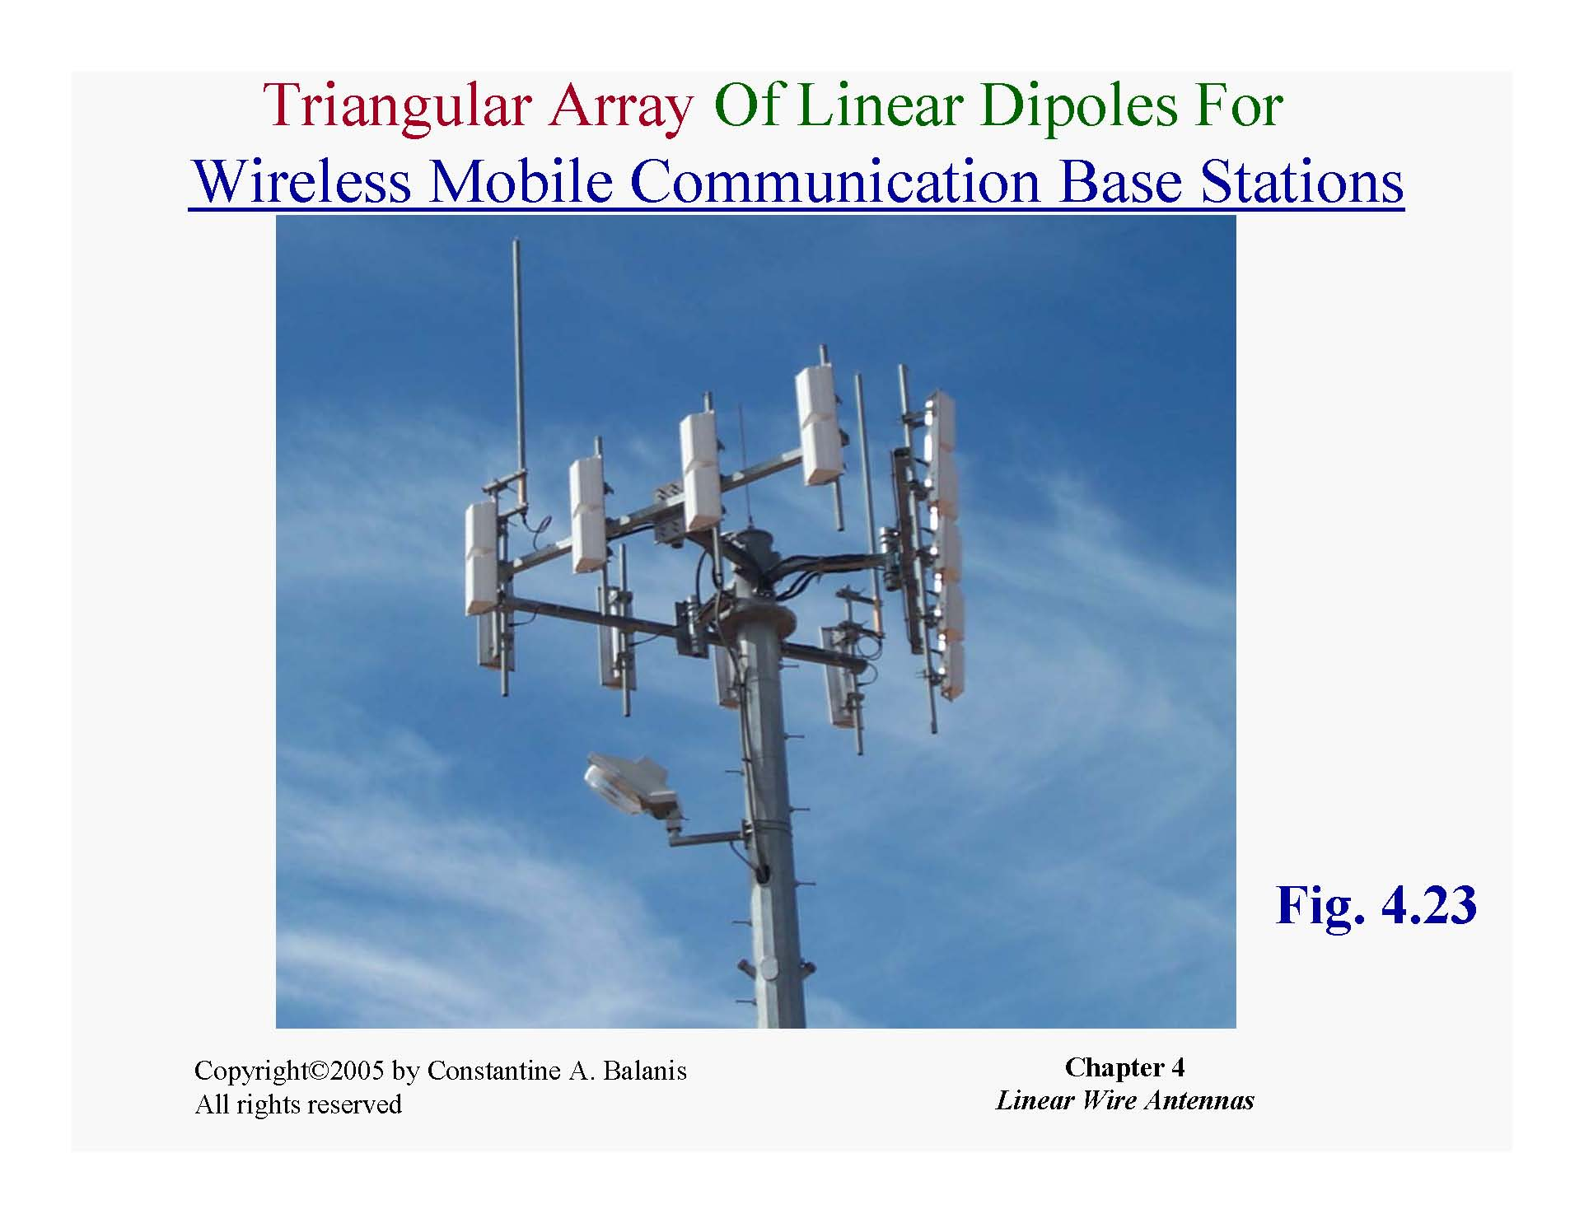

Slide 8
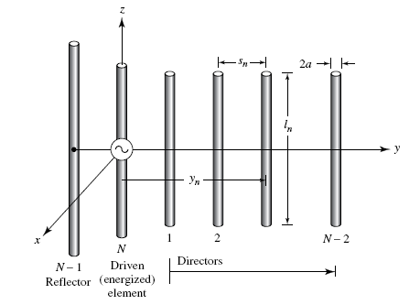
Yagi uda antenna: array of dipoles

Slide 9
Types of arrays
Broadside: Elements are perpendicular to the array axis; max is at 90 degrees to array axis.
End fire: Currents 180 degrees phase shifted with respect to each other; max along array axis
Collinear: Coaxially arranged; max is at 90 degrees to array axis, but circular symmetry .
Parasitic :Elements are electromagnetically coupled
Binomial: Currents fed to elements are proportional to binomial coefficients
Tchebyscheff: Currents fed to elements are proportional to tchebyscheff coefficients.

Slide 10
References :
[1]. Constantine A Balanis , “Antenna theory , Analysis and Design , 2nd Edition” Jhon Wiley and Sons 2007.

