Slide 1

Analysis of a two Element Antenna Array
Presented by:
Dr. Amanpreet Kaur(Sr.)
Assistant Professor
Department of Electronics and Communication Engineering,
Thapar Institute of Engineering and Technology, Patiala

Slide 2
Mathematical Analysis
To Analyze the output fields radiated by an array .
Let us consider a simplest case of an array formed by placing the antenna elements along a line.
To give a better physical interpretation of the array techniques, a two-element array will first be considered.
The analysis of an N-element array will then follow.

Slide 3
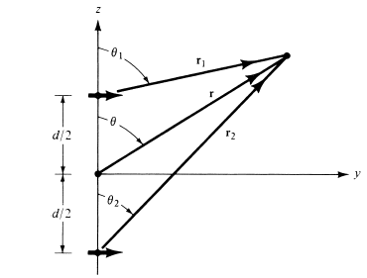
Assumption:
Antenna under investigation is an array of two infinitesimal horizontal dipoles positioned horizontally along the z-axis.
No coupling between the elements of the Array,

Slide 4

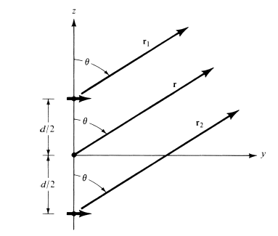
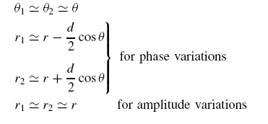
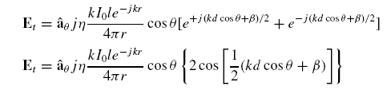
where β is the difference in phase excitation between the elements. The magnitude
excitation of the radiators is identical. Assuming far-field observations and referring to figure:
The total field of the array is equal to the field of a single element positioned at the origin multiplied by a factor which is widely referred to as the array factor

Slide 5


Thus for the two-element array of constant amplitude with a linear geometry , the array factor is given by :
The array factor is a function of the geometry of the array and the excitation phase. By varying the separation d and/or the phase β between the elements, the characteristics of the array factor and of the total field of the array can be controlled.
We have seen that the far-zone field of a uniform two-element array of identical elements is equal to the product of the field of a single element, at a selected reference point (usually the origin), and the array factor of that array.

Slide 6
Principle of Pattern Multiplication
For an array of identical radiating elements , the total filed output is given as the product of a output of a single element and an array factor.
This Array factor is computed by replacing the actual sources with point sources fed with current of same magnitude and phase as the original array .

Slide 7
References:
[1]. Constantine A Balanis , “Antenna theory , Analysis and Design , 2nd Edition” Jhon Wiley and Sons 2007.

