Slide 1

Uniform Linear Antenna Arrays
Presented by:
Dr. Amanpreet Kaur(Sr.)
Assistant Professor
Department of Electronics and Communication Engineering,
Thapar Institute of Engineering and Technology, Patiala

Slide 2
N-ELEMENT LINEAR ARRAY: UNIFORM AMPLITUDE AND SPACING
To find the Array Factor of N Infinitesimally small dipoles placed in a linear geometry.
For this , let us generalize the method to include N elements
let us assume that all the elements have identical current amplitudes
But each succeeding element has a β progressive phase lead current excitation relative to the preceding one.
The array factor can be obtained by considering the elements to be point sources.
If the actual elements are not isotropic sources, the total field can be formed by multiplying the array factor of the isotropic sources by the field of a single element.
This is the pattern multiplication rule and it applies only for arrays of identical elements.

Slide 3
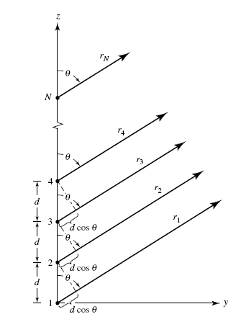
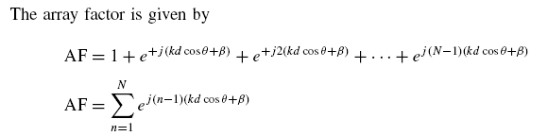
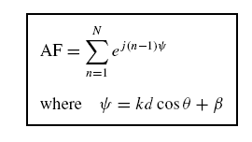

………………….(i)
To be expressed in an alternate, compact and closed form whose functions and the distributions are more recognizable. we have
………………….(ii)

Slide 4

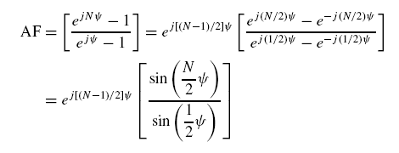
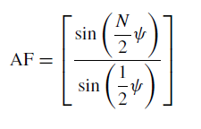
Subtracting (i) from (ii)
If the reference point is the physical center of the array, the array factor becomes :
For small values of ψ, the above expression can be approximated by :
…………………………………………………(iii)

Slide 5
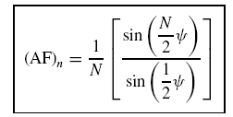



Since the maximum value of above equation is equal to N.
To normalize the array factors so that the maximum value of each is equal to unity, the eqn. (iii) in normalized form as:
……………………………………………(iv)
To find the nulls of the array, (iv) is set equal to zero. That is,
The values of n determine the order of the nulls (first, second, etc.).
Thus the number of nulls that can exist will be a function of the element separation d and the phase Excitation difference β.

Slide 6
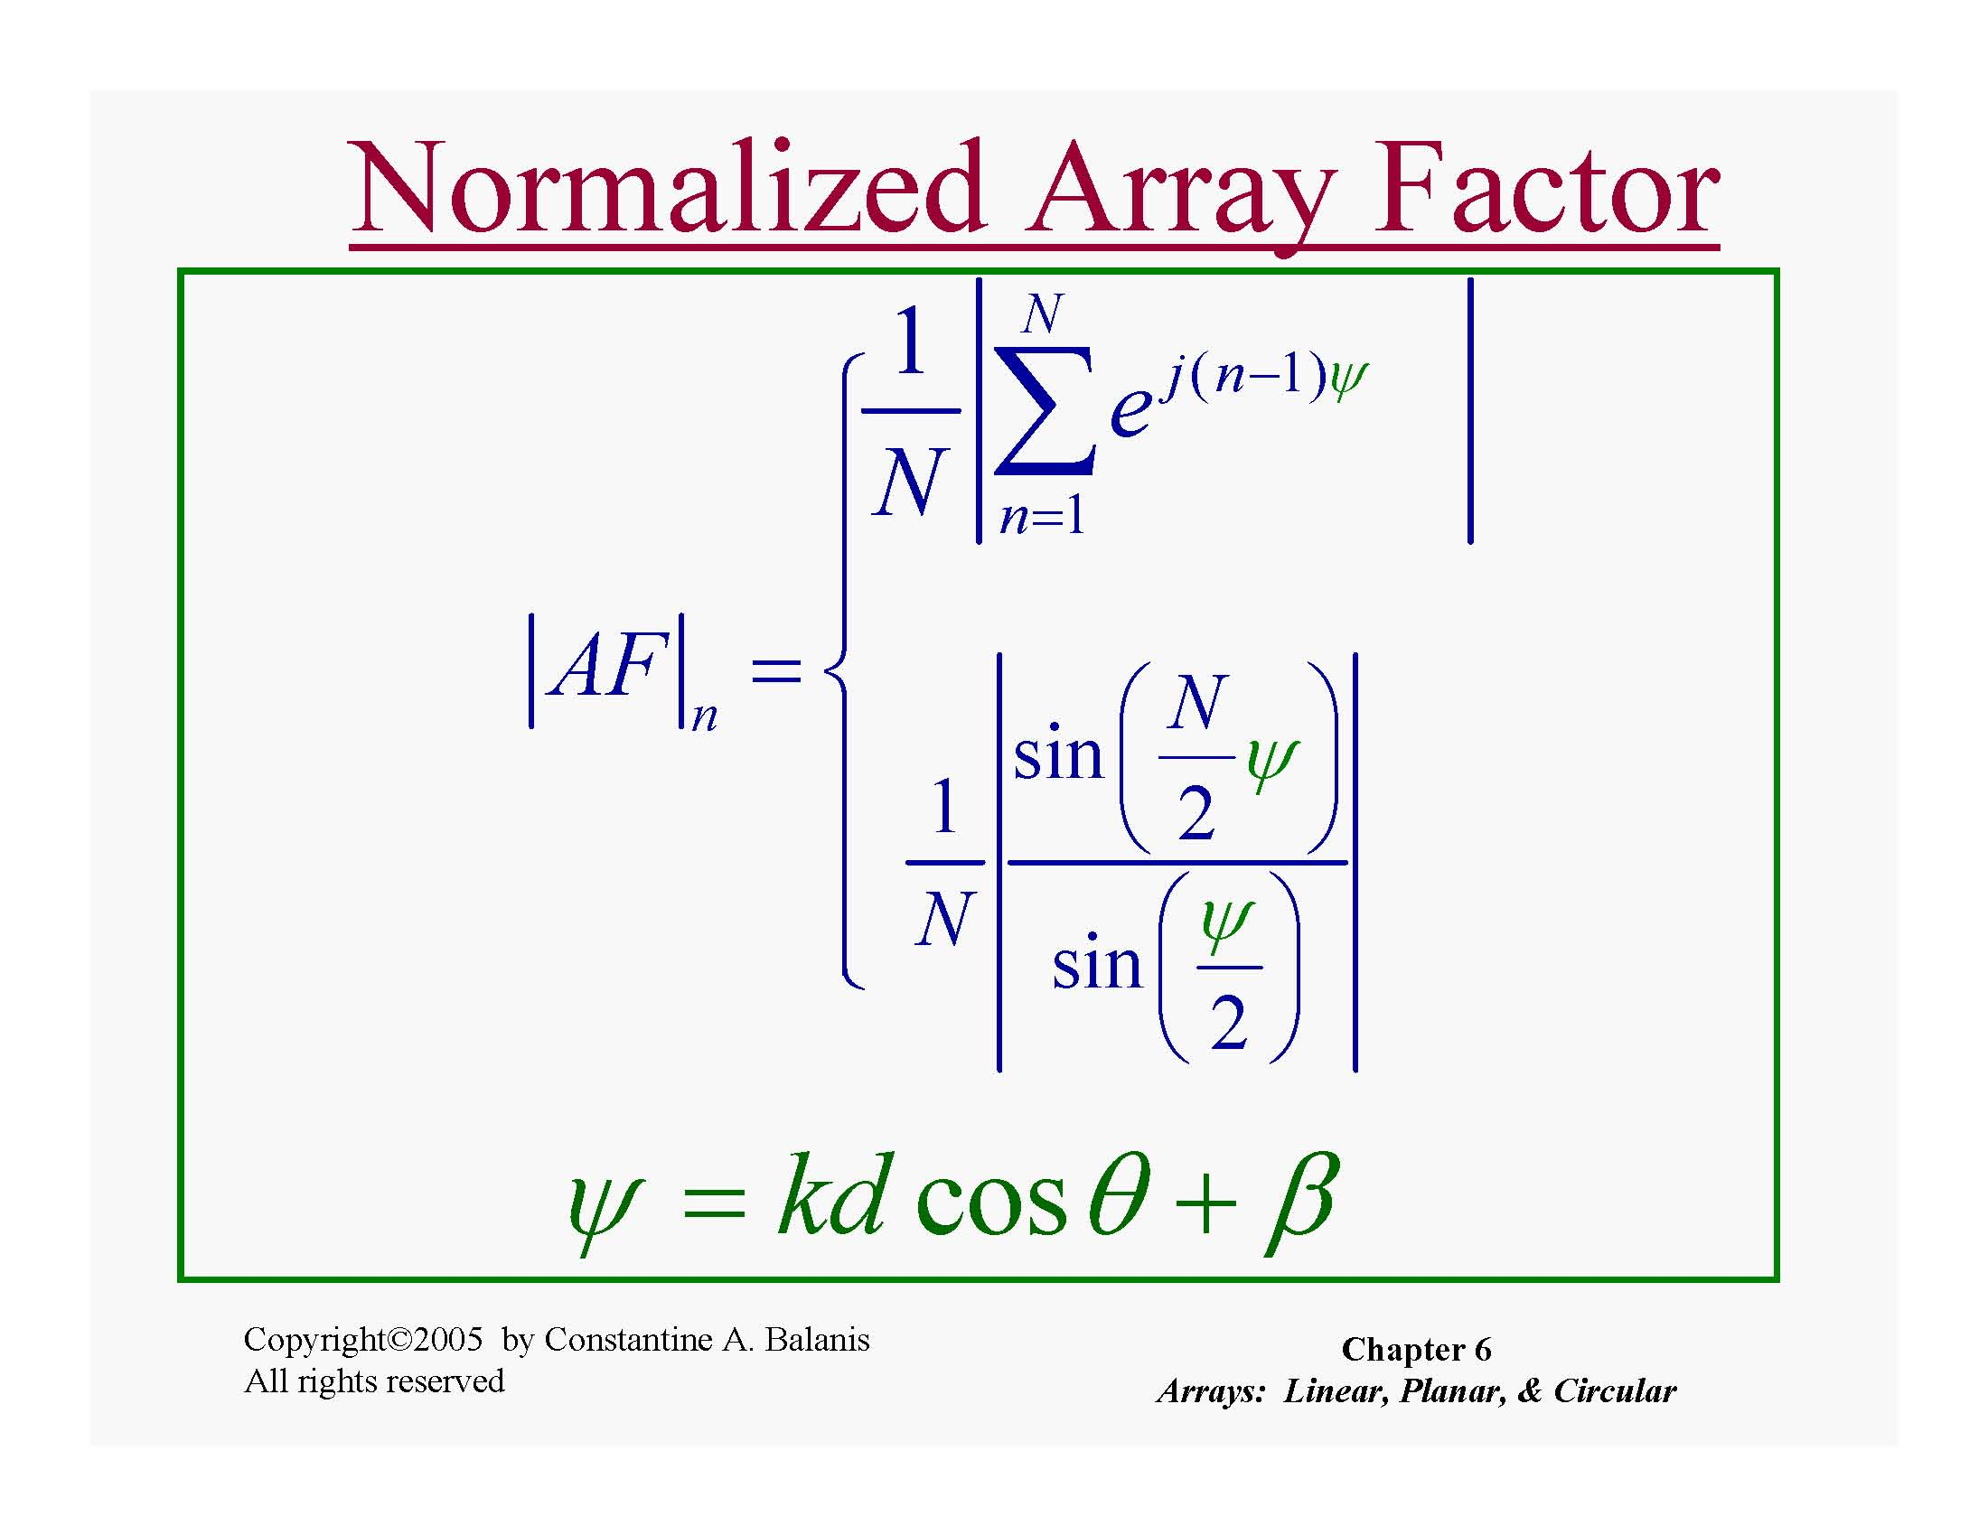

Slide 7
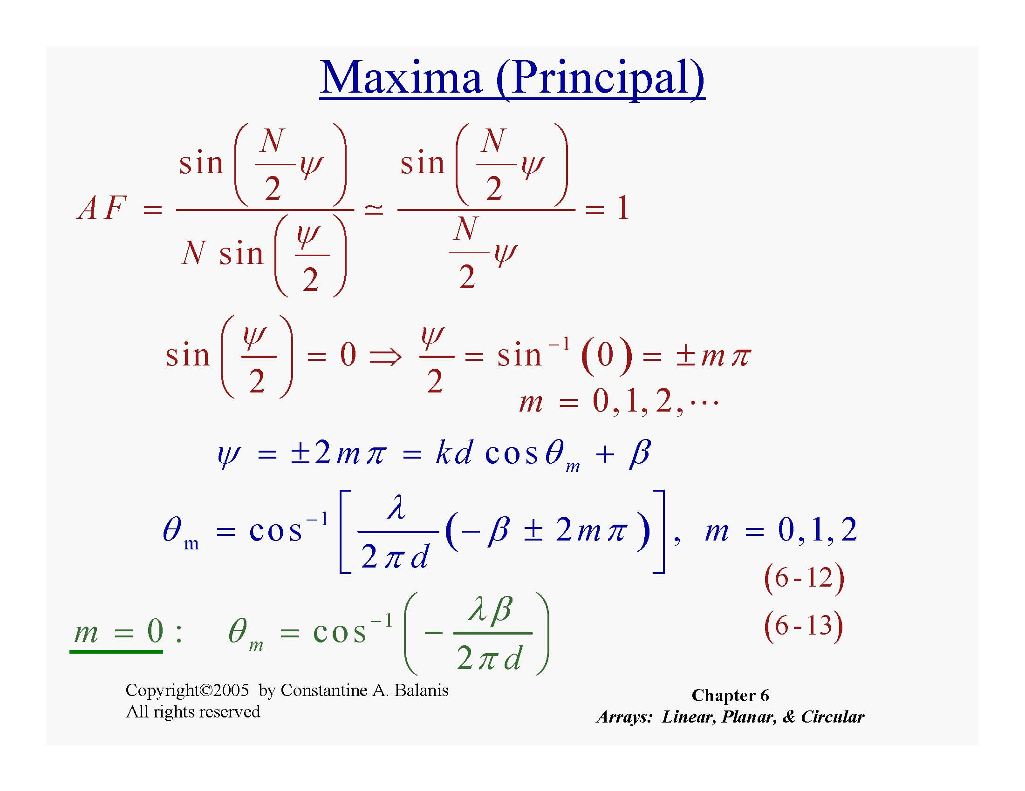

Slide 8

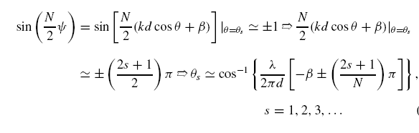
The maximum values of (iv) occur when it reduces to a sin(0)/0 form.
For the array factor of eqn (iv), there are secondary maxima (maxima of minor
lobes) which occur approximately when the numerator of (iv) attains its maximum
value. That is,

Slide 9




The array factor of (iv) has only one maximum and occurs when m = 0
That is,
which is the observation angle that makes ψ = 0
The 3-dB point for the array factor of (iv) occurs when
The half-power beam width can be found once the angles of the first maximum(θm) and the half-power point (θh) are determined. For a symmetrical pattern

Slide 10
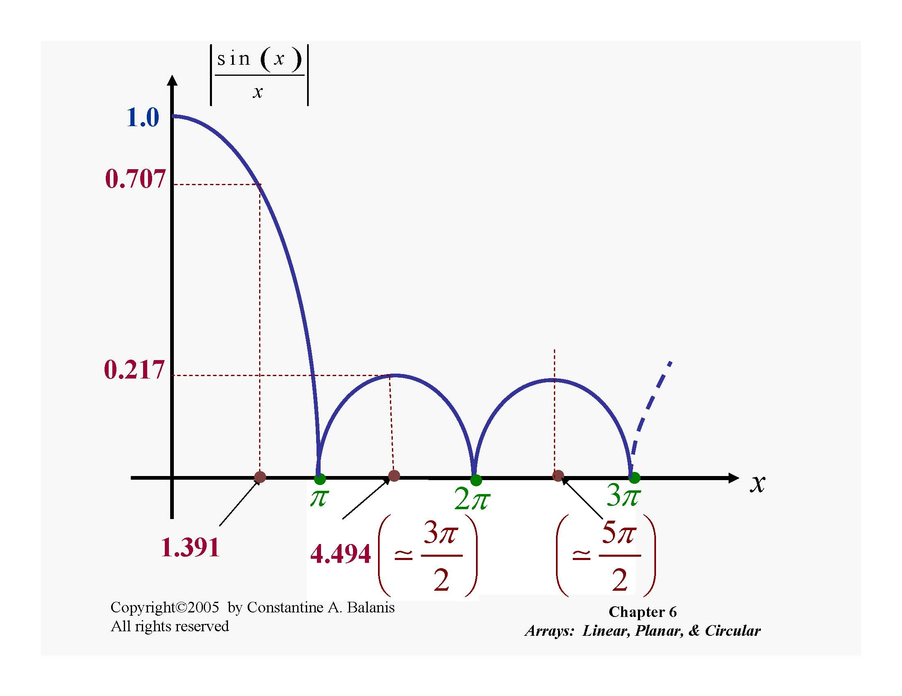

Slide 11
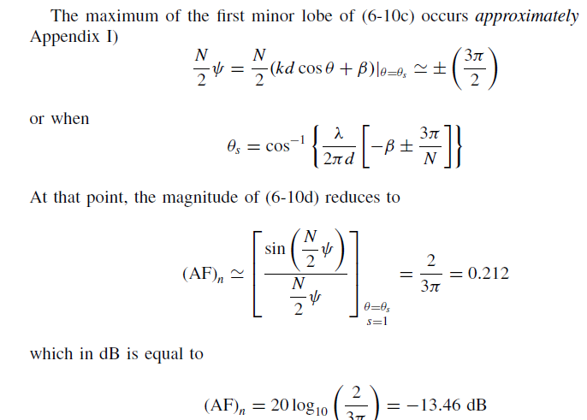

Slide 12

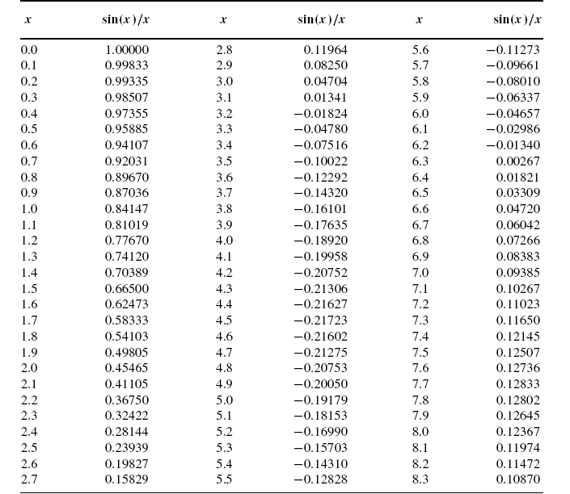

Slide 13
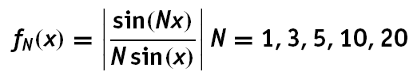
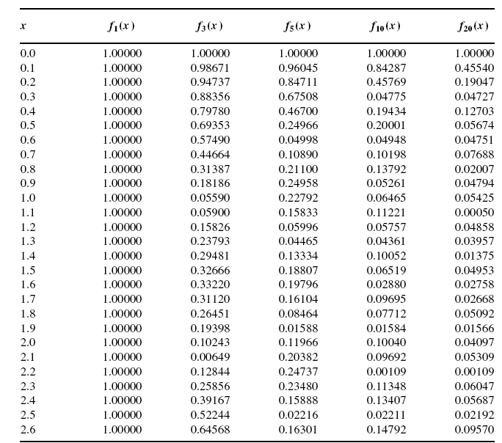

Slide 14
References :
[1]. Constantine A Balanis , “Antenna theory , Analysis and Design , 2nd Edition” Jhon Wiley and Sons 2007.

