Slide 1

Two element Antenna Array – POPM Examples
Presented by:
Dr. Amanpreet Kaur(Sr.)
Assistant Professor
Department of Electronics and Communication Engineering,
Thapar Institute of Engineering and Technology, Patiala

Slide 2

Principle of Pattern Multiplication :
The principle of pattern multiplication states that “the radiation pattern of an array of similar sources is - the product of the pattern of the individual antenna with the array pattern of isotropic point sources each located at the phase centre of the individual source, fed with same currents as the original sources.
***The phase centre of the array is the reference point for
the total phase pattern

Slide 3
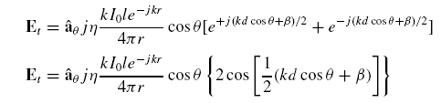
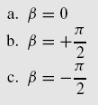


Examples: Consider the array of two infinitesimal dipoles with a total Electric field as:
Considering one case at a time for analysis purpose:

Slide 4

Plotting the radiation pattern of the individual source by equating Cos θ = 1 (for maxima points ) and Cos θ = 0 (for minima
and
multiplying it with the pattern of the array by equating
= 0 and =1 respectively

Slide 5

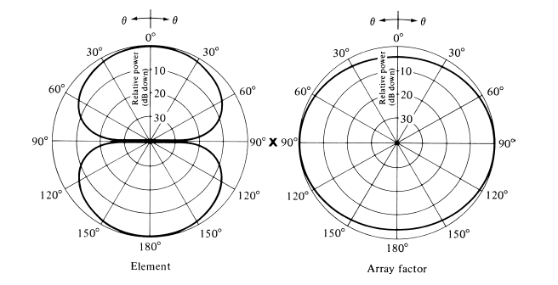
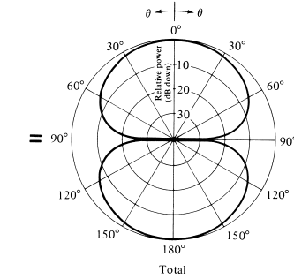


Slide 6



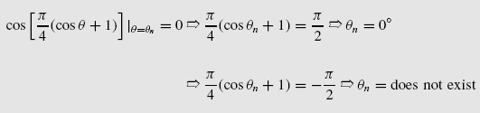
Similarly , for the same case taking the phase excitation difference
between the array elements as pi/2 , we get :

Slide 7
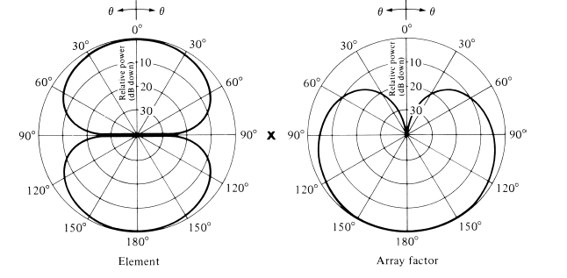
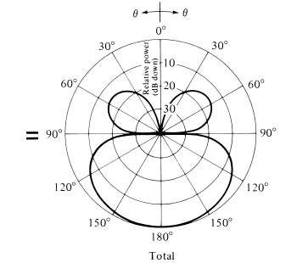

Slide 8




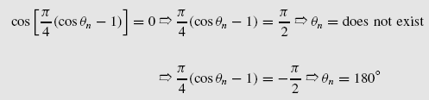
Similarly , for the same case taking the phase excitation difference
between the array elements as –pi/2 , we get

Slide 9
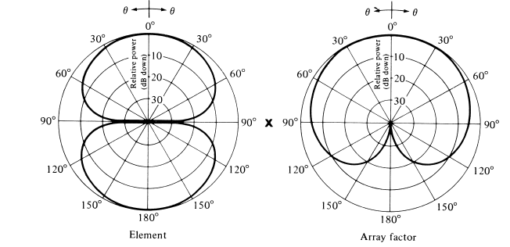
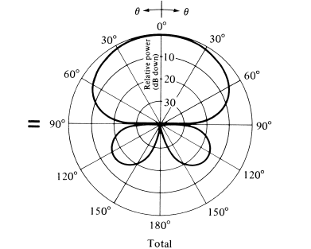

Slide 10
References :
[1]. Constantine A Balanis , “Antenna theory , Analysis and Design , 2nd Edition” Jhon Wiley and Sons 2007.

