Slide 1
Corporate Social Responsibility

Slide 2
Business of business is to do business

Slide 3
Definitions and Relationships
Corporate social responsibility (CSR) is the process by which businesses negotiate their role in society
In the business world, ethics is the study of morally appropriate behaviors and decisions, examining what "should be done”
Although the two are linked in most firms, CSR activities are no guarantee of ethical behavior
Notes:
Companies can engage in CSR activities even while they are acting in unethical ways. For example, Enron was a champion of community involvement, but used off-balance-sheet partnerships to bilk investors and eventually ruin the company. Similarly Parmalat helped many Parma people and gave $2 million to restore the sixteenth-century Correggio frescoes at Parma Cathedral. But he diverted hundreds of millions from publicly held Parmalat to family owned companies like soccer team Parma AC and Parmatour.
Companies can say one thing and do another.

Slide 4

Introduction to CSR
CSR stands for corporate social responsibility which is a broad term that covers concepts used by companies to maintain their socially good or responsible image in relationships with customers, shareholders, stakeholders.
“Corporate Social Responsibility (CSR) is a powerful way of making sustainable competitive profit and achieving lasting value for the shareholder as well as for stakeholders. CSR and the reporting thereof is a win-win opportunity, not just for companies and for financial investors but for society also.”

Slide 5

Cont…
In India, the term CSR might be new but the concept is not. It has been there since the earliest times,
Hindus call it ‘dharmmada’
Muslims call it ‘zakatah’
Sikhs call it ‘dashaant’
As individuals joined hands to form organizations, the same concept became embedded in the organizations.

Slide 6
The evolution of CSR
We are getting here
Good corporate citizenship
Investment in social development as part of the Business plan
Strategic Community investment
Strategic giving linked to business interest
Philanthropy
Passive donations to charities
Corporate profit
Pure self interest

Slide 7
Levels of Social responsibility
Nation Building
Grant making
Immediate Community development
Sanitation, education, environment
School for staff children, sanitation in staff colonies etc.
Welfare of staff families
Staff welfare
Occupational safety

Slide 8


Cont…
Today the Corporate social responsibility goes far beyond the old philanthropy of the past – donating money to good cause at the end of the financial year– and is instead an all year round responsibility that companies accept for the environment around them, for the best working practices, for the engagement of local communities.

Slide 9
The traditional way of organizing business, based on capitalist view of economy, basic goal of business is profit maximization without moral and social constraints.
Robert Owen in 1971 raised the voice for social responsibility and social control of business.
He proposed the first factory act: according to which children should not work in a factory till the age of ten years.

Slide 10
Many social philosophers opposed the bill in the starting. With the passage of time social responsibility of business organizations gained momentum.
Government played the major role in safeguarding the interests of workers, consumers and society.
Thus finally business corporate realized their social and moral responsibilities in addition to economic one.

Slide 11

Forces reinforcing corporate social responsibility program are :
Government
Globalization
Ethical consumerism
Changing market structure
Many business organizations have voluntarily accepted it.

Slide 12
India’s oldest steel producer TISCO, has voluntarily undertaken many measures for employee welfare and social and community development.
Employee welfare programs
Community development programs
Corporate philanthropy
Corporate citizenship
Trusteeship concept

Slide 13
Employee welfare programs
A socially responsible company is responsive to the various needs of its employees
Provide housing, health-care facilities
Open up schools, parks and playgrounds
Provide safe and hygienic work conditions
Counseling sessions

Slide 14
Community development programs
Increasing no. of companies are realizing that they need to be a good neighbor for the community.
IFFCO fertilizer company helps rural communities to create their own irrigation system
Conduct programs like adult literacy, primary education, health care etc.
Cause related marketing: to support some social cause, natural disaster etc.

Slide 15
Corporate philanthropy
Many of the activities mentioned above are also part of philanthropy.
donations

Slide 16
Corporate citizenship
It means sense of belongingness, with an obligation to work for the common good.
Consciously promoting the economic growth of the country.
Paying taxes, obeying laws, preserving environment, non renewable resources

Slide 17
Trusteeship concept
The common attitude of owners of businesses is that it’s their private property.
According to this theory business should consider themselves as trustees of business and should take care of all the parties:
shareholders
employees
Suppliers
local community

Slide 18
Some of the positive outcomes that can arise when businesses adopt a policy of social responsibility include
Company benefits | Benefits to the community | Environmental benefits
Product safety | Product safety and quality | Greater material recyclability
Improved financial performance | Corporate involvement in community education and employment | Better product durability and functionality
Greater productivity and quality | Employee volunteer programmes | Greater use of renewable resources
Enhanced brand image and reputation | Charitable contributions | Integration of environmental management tools into business plans
Increased sales and customer loyalty | Happy society | Healthy pollution free environment

Slide 19
Reasons for CSR Activities
CSR activities are important to and even expected by the public
  And they are easily monitored worldwide
CSR activities help organizations hire and retain the people they want
CSR activities contribute to business performance

Slide 20
Is industry voluntarily giving back something to the society?
Are these actions inspired by a sense of guilt to the society, earning good name in market, philanthropy, etc.?

Slide 21
Is it part of core business strategy?
Is it adopted by the board?

Slide 22
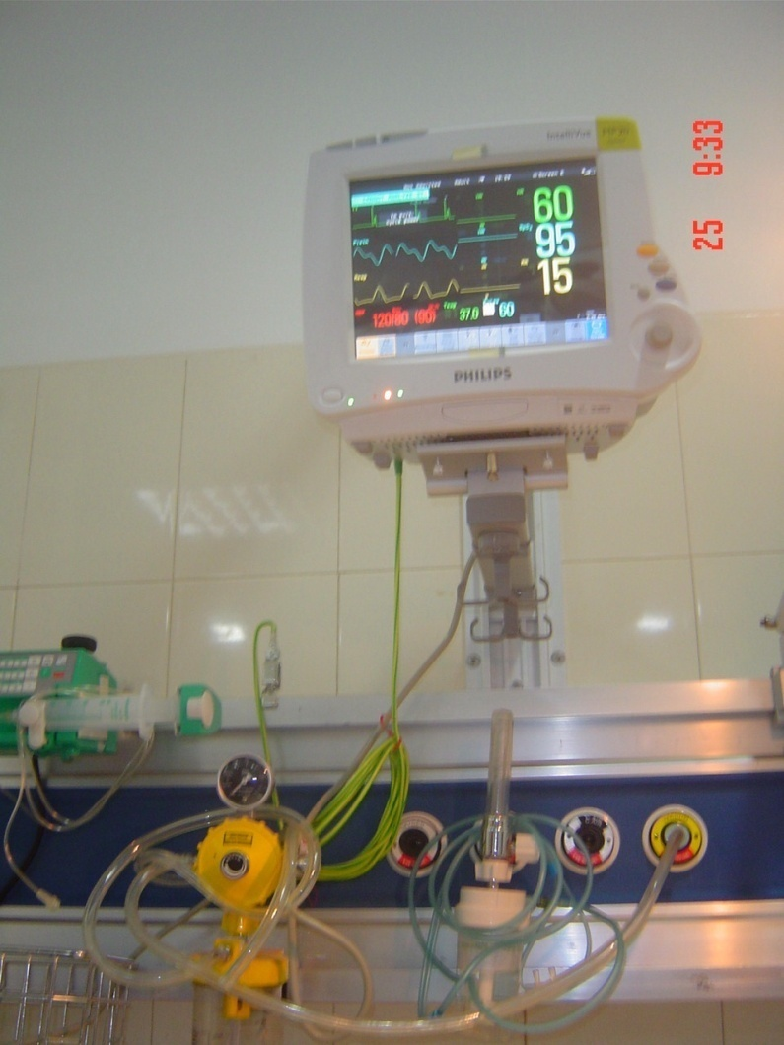
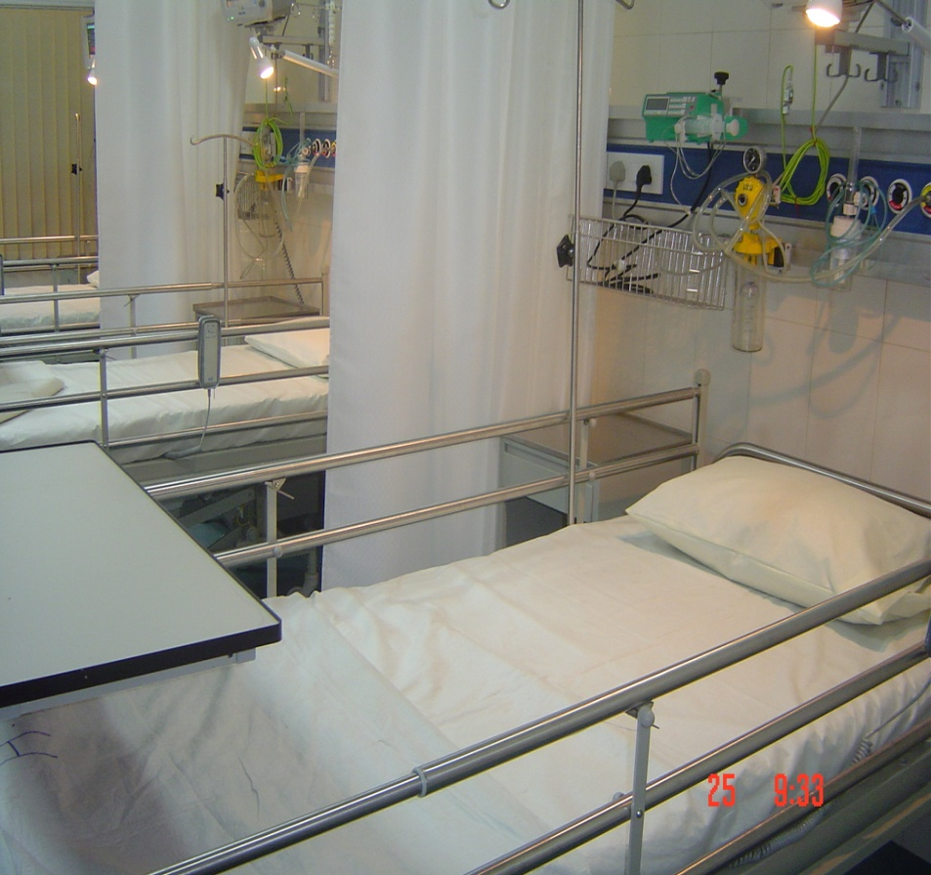
Company Project:Balco Hospital

Slide 23
Possible CSR Activities (Schedule VII)
Schedule VII of The Companies Bill draws attention to an illustrative list of activities that can be carried out under the CSR Agenda;
It could be worthwhile to concentrate our energies on some aspects of development where tangible results can be achieved within a relatively short period of time;
Some of these areas could be:
  Toilet and Sanitation Facilities in rural schools, particularly for girls;
  Education Projects;
  Provision of Health Facilities;
  Combating Malnutrition;
  Skill Development.

