Slide 1
Production

Slide 2
Introduction
Production refer to an economic term to describe the inputs that are used in the production of goods or services in the attempt to make an economic profit.
The factors of production include land, labor, capital and entrepreneurship.

Slide 3
Theory of production
Theory of production, in economics, an effort to explain the principles by which a business firm decides how much of each commodity that it sells (its “outputs” or “products”) it will produce, and how much of each kind of labour, raw material, fixed capital good, etc., that it employs (its “inputs” or “factors of production”) it will use.
The theory involves some of the most fundamental principles of economics. These include the relationship between the prices of commodities and the prices (or wages or rents) of the productive factors used to produce them.

Slide 4
The Organization of Production
Inputs
  Labor, Capital, Land
Fixed Inputs and Variable Inputs
Short Run
  At least one input is fixed
Long Run
  All inputs are variable

Slide 5
Production Function
An input is a good or service that goes into the production process.
An output, on the other hand, is any good or service that comes out of a production process.
A firm’s long run production function is of the form:
Q = f(Ld, L, K, M, T, t)
  where Ld = land and building; L = labour; K = capital; M =
materials; T = technology; and, t = time.

Slide 6
Production Function
Q = f(K, L)
Increasing production, Q, will require K and L, and whether the firm can increase both K and L or only L will depend on the time period it takes into account for increasing production, that is, whether the firm is thinking in terms of the short run or in terms of the long run.
In the short run firms can increase production only by increasing labour, since the supply of capital is fixed in the short run.
In the long run, the firm can employ more of both capital and labour, as the supply of capital becomes elastic over time.

Slide 7
Short-Run Production Function
Following assumptions are made:
  The firm operates in a short-run production period where labor is variable, capital is fixed.
  The firm uses both the inputs to produce a single product.
  The firm operates with a fixed level of technology.
  The firm operates at every level of output in the most efficient way.
  The short-run production function is affected by the law of diminishing returns.

Slide 8
Cont…
In the short run, capital is fixed Only changes in the variable labor input can change the level of output.
Labor is homogeneous.
Input prices are given.
Short run production function:
Q=f(L, K ), where K is constant
Q= bL
b= ΔQ/ ΔL

Slide 9
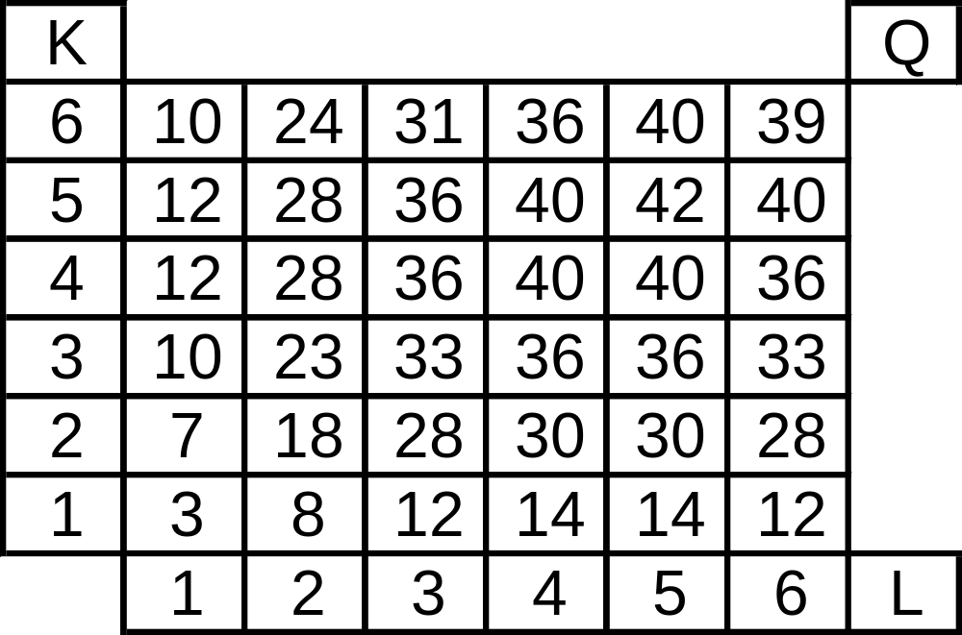
Production Function with Two Inputs
Q = f(L, K)

Slide 10
Production Function with One Variable Input
Total Product
TP = Q = f(L)
Average Product
Q
L
AP_{L} =
Marginal Product
ΔQ
ΔL
MP_{L} =
MP is change in total production, when we increase one worker, eg: from 3 workers now we have 4 MP= (4-3=1)
Production or
Output Elasticity
MP_{L}
AP_{L}
E_{L} =

Slide 11
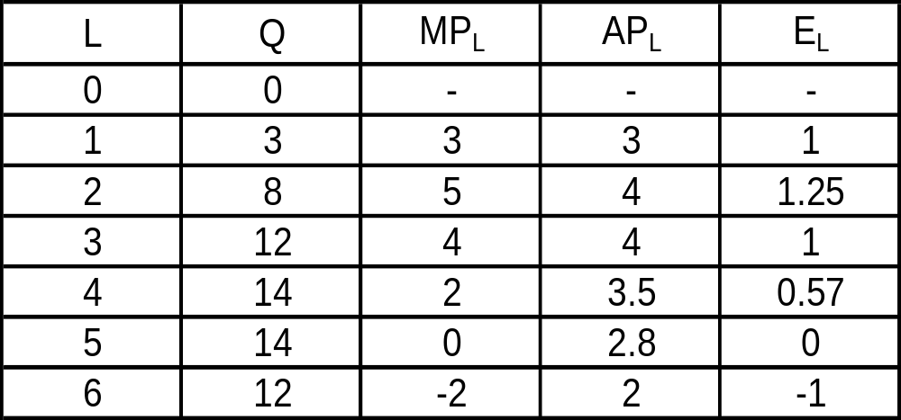
Cont…
Total, Marginal, and Average Product of Labor, and Output Elasticity

Slide 12
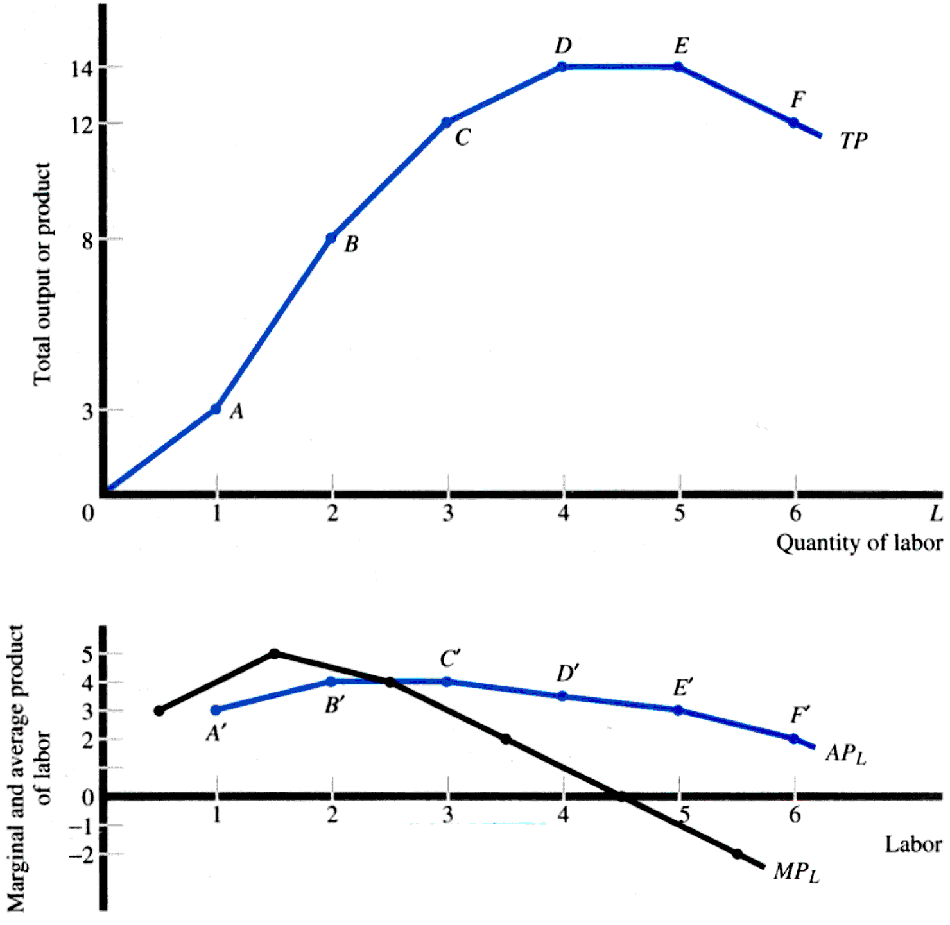
Cont…

Slide 13
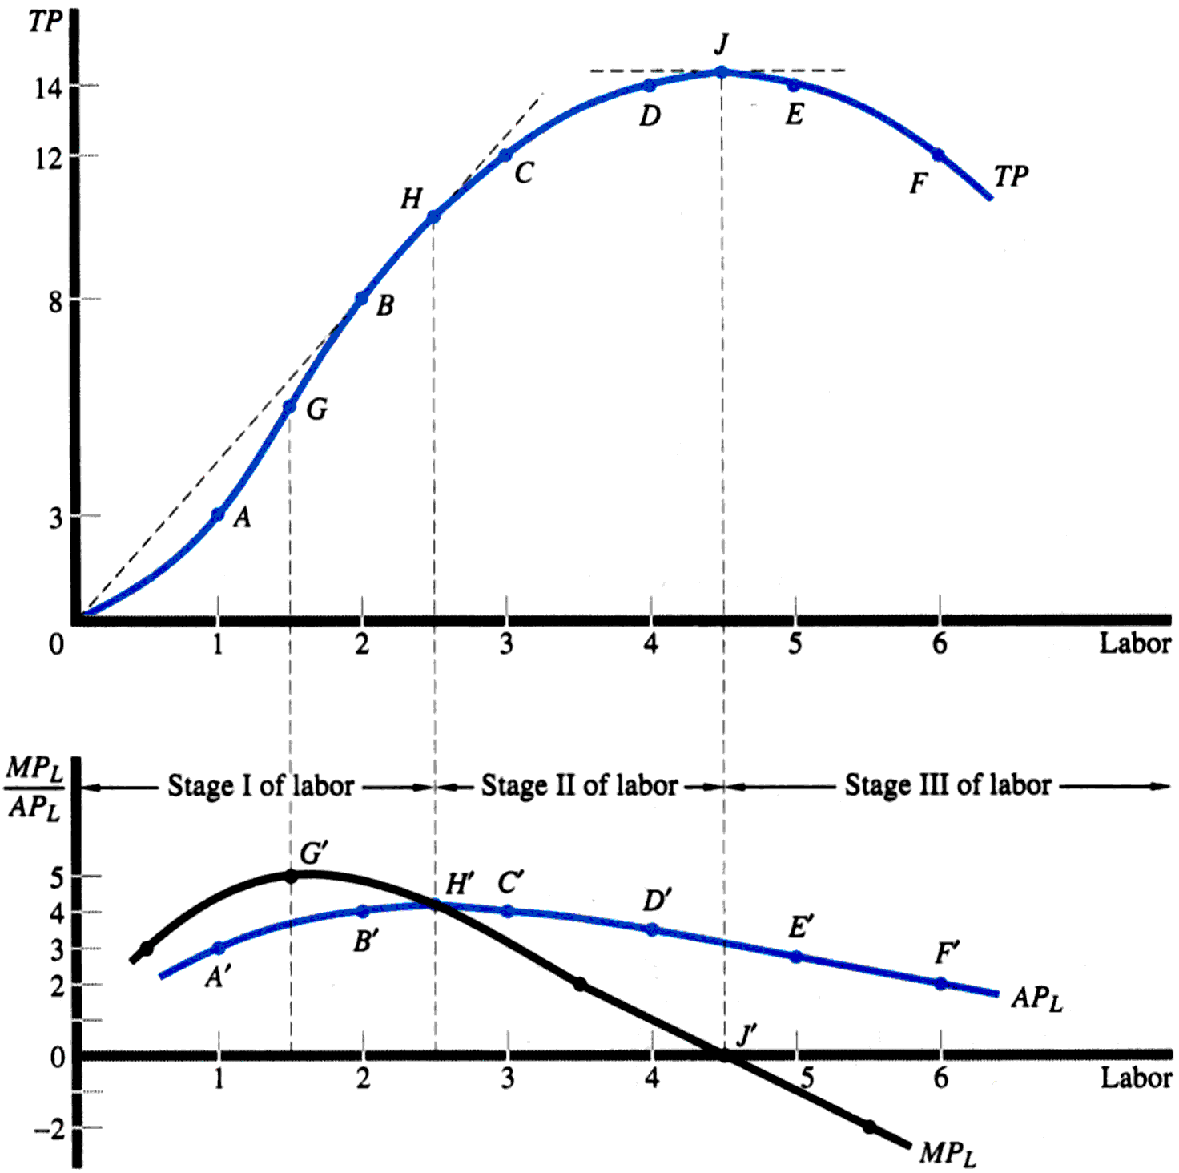
Cont…

Slide 14
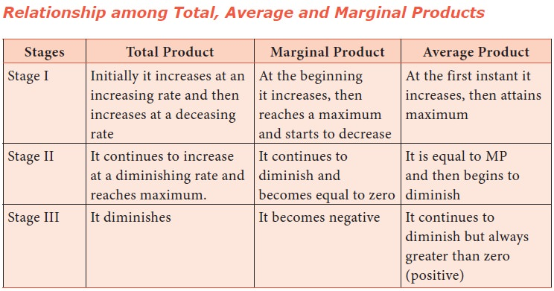
.
.

Slide 15
Law of Diminishing Return
In this example, the number of workers changed, while the land used, seeds planted, water consumed, and all other inputs remained the same.
If more than one input were to change, the production results would vary and the law of Diminishing returns may not apply if all inputs could be increased.

Slide 16
Determining Optimum employment of labor
How many workers will the firm employ for maximum profit.
  Number of workers to be employed depends upon the output that maximizes the firms profit.
  MC=MR (Marginal cost =marginal revenue)
  In the short run, labor is only variable input, so marginal cost= marginal wages, i.e., MC=MW
  MRP (Marginal revenue productivity)= MPL* P
  [MPL , Marginal physical productivity of labor multiplied by Price (P) of the product.]

Slide 17
Long run
All inputs are variable.
Output changed by varying usage of all inputs

Slide 18
Average & Marginal Products
•Average product of labor: AP = Q/L
•Marginal product of labor:
Average product of Capital: AP = Q/K
•
Marginal product of Capital
ΔQ
ΔL
MP_{L} =
ΔQ
ΔK
MPK =

Slide 19
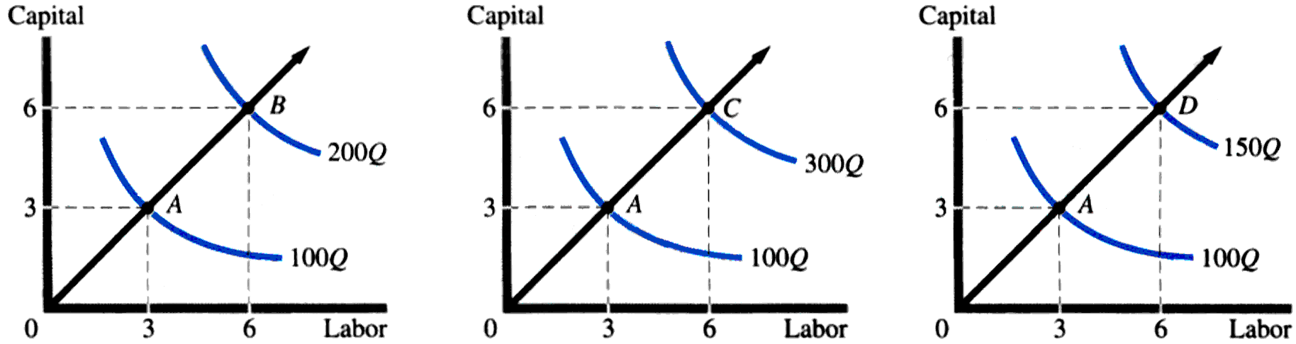
Returns to Scale
Constant Returns to Scale
Increasing Returns to Scale
Decreasing Returns to Scale

Slide 20
Returns to Scale
When a firm expands its scale, i.e., both the inputs proportionately then there are three possibilities:
  Total output may increase more than proportionately,
  Total output may increase proportionately,
  Total output may increase less than proportionately

Slide 21
Increasing Returns to Scale
When inputs K, and L are increased at a certain proportion and output increases more than proportionately, it exhibits increasing returns to scale.
  Eg: if quantities of both the inputs, K & L are successively doubled the resultant output is more than doubled, the returns to scale is said to be increasing.
  3K + 3L to 6k + 6L, Q changed from 100 to 300, that is increase of more than 150%.

Slide 22
Reasons for increasing returns to scale
Technical and managerial indivisibility
Higher degree of specialization
Dimensional relations
Notes:
1. Inputs like mechanical equipment and managers cant be used in fraction so when fully employed, output incr. exponentially by incr. in all the inputs.
2 with the incr. in scale of production we need to employee specialized work force
3 eg we increase length & breath of room to double now more labor & machinery can be employed so this will lead to ince in returns.

Slide 23
Constant Returns to Scale
  When increase in input is proportionate to increase in output, it exhibits constant returns to scale.
    3K + 3L to 6k + 6L, Q changed from 100 to 200, that is when input is doubled, output is doubled.
  This is attributed to the limits of the economies of scale.
  It occurs where factors of production are perfectly divisible. And technology is such that labor- capital ratio is fixed.
  When the factors of production are perfectly divisible, showing constant returns to scale.

Slide 24
Decreasing Returns to Scale
When a proportionate increase in inputs, K & L, leads to a less than proportionate increase in output.
When inputs are doubled and output is less than doubled, then it terms as a decreasing returns to scales.
  3K + 3L to 6k + 6L, Q changed from 100 to 150, K & L, are increased by 100% but output increase only by 80%.

Slide 25
Diseconomies of scale
Reason
The diminishing return to management, that is managerial economies.
As the size of the firms expands, managerial efficiency decreases.
Limitedness or exhaustibility of the natural resources.
  Eg: doubling of coal mining plant may double the coal output because of limitedness of coal deposits.

