Slide 1
Introduction to Economics

Slide 2
Economics
It’s the study of scarcity, the study of how people use resources and respond to incentives, or the study of decision-making.
It often involves topics like wealth and finance, but it’s not all about money.
Economics is a broad discipline that helps us understand historical trends, interpret today’s headlines, and make predictions about the coming years (American Economic Association).

Slide 3
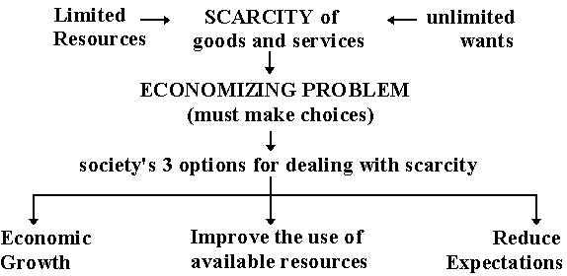
Basic Economic Problem
.

Slide 4
Traditional view of Economics:
  Consumption
  Production
  Exchange
  Distribution

Slide 5
Cont…
Modern view of Economics:
  Price theory
  Income theory Microeconomics (related to determination of price= f (D,S))
  Growth theory
  Employment theory Macroeconomics (Ecosystem as a whole)

Slide 6
Market Mechanism
Fundamental laws of market:
Law of Demand
Law of Supply

Slide 7
Demand

Slide 8
Demand
  The willingness and ability of buyers to purchase a good or service.
  Demand for a particular product or service represents how much people are willing to purchase at various prices.
  Thus, demand is a relationship between price and quantity, with all other factors remaining constant.

Slide 9
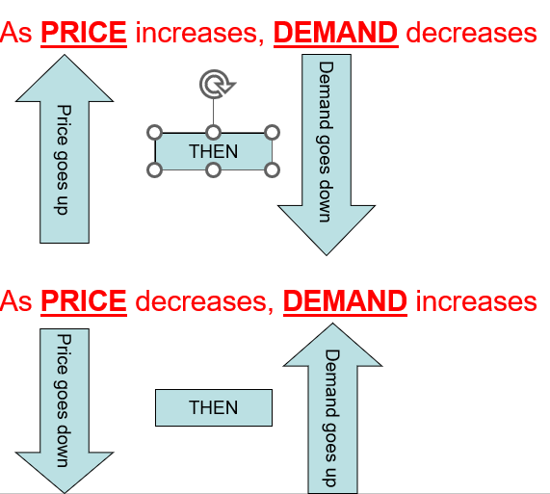
Law of demand
Generally the relationship between price and quantity is negative. This means that the higher is the price level the lower will be the quantity demanded and, conversely, the lower the price the higher will be the quantity demanded, all other factors remaining same.
Demand is represented graphically as a downward sloping curve with price on the vertical axis and quantity on the horizontal axis.

Slide 10
Demand Function
Demand function shows relation between P & Qd when all other variables are held constant

Slide 11
Demand Schedule

Slide 12
Demand Curve
A
The demand curve slopes downward
because price and quantity demanded
are inversely related.
5
Price (in INR)
B
4
C
3
E
2
F
Demand
1
G
0
1
2
3
4
5
Quantity

Slide 13
Exceptions to law of Demand
Luxuries
Giffen goods/ Inferior goods
Multiple uses of product
Ignorance

Slide 14
Determinants of Demand
Price of the Commodity
Income of Individual
Price of related good
Advertisement expenditure
Taste and Preference of individuals
Future expected Price
Target Population

Slide 15
Elasticity of Demand
The degree to which changes in price cause changes in demand
or
If we change the price, will demand change a lot or a little?

Slide 16
Elastic Demand
If Demand for a good is very sensitive to changes in price, the demand is ELASTIC
Or
If prices changes a little bit, demand will change a lot!

Slide 17
Shifting Demand versus Movements along a Demand Curve
A change in the price of a good causes a change in the quantity demanded,
but does not shift demand

Slide 18
Inelastic Demand
Demand for a good that consumers will continue to buy despite a price increase is INELASTIC
OR
Even if price changes a lot, demand changes very little

Slide 19
Example of Inelastic Demand
The price of soap goes up a lot, the demand stays almost the same.

Slide 20
Changes in Demand vs. Changes in Quantity Demanded
A price change would change the quantity demanded which involves movement along the demand curve.

Slide 21
Changes in Demand vs. Changes in Quantity Demanded
Movement along the demand curve.
Price ($’s)
Decrease
Increase
Demand
Quantity

Slide 22
Factors causing Shift in Demand
Tastes and Preferences
Substitutes and Complements
Income
Population
Price Expectations

Slide 23
Changes in Demand - Decrease
Demand Shifts LEFT
When:
Prices of substitutes decrease
Prices of complements increase
Normal good-income decreases
Inferior good-income increases
Population decreases
Tastes & preferences turn against the product
Price
D1
D2
Quantity

Slide 24
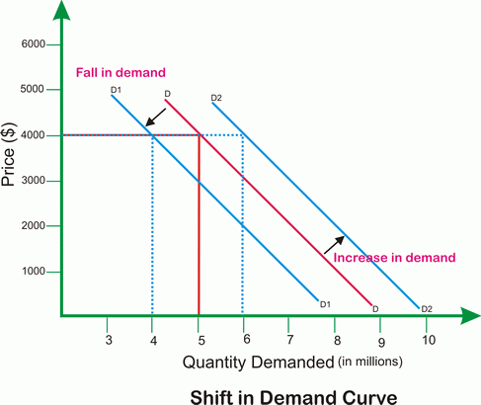
Changes in Demand – Increase
Demand Shifts RIGHT
When:
Prices of substitutes increase
Prices of complements decrease
Normal good-income increases
Inferior good-income decreases
Population increases
Tastes & preferences turn in favor of the product

