Slide 1


M.Tech Program
Advanced Industry Integrated Programs
Jointly offered by University and LTIMindTree
Project Title
A Hybrid Retrieval-Augmented Framework for Precedent Discovery and Argument Synthesis over Indian Case Law
PrecedentIQ
Presented By
Krithana A
VIT Vellore
Knowledge partner | Implementation partner

Slide 2

PrecedentIQ
Introduction
• The problem: Junior advocates and small law firms in India spend weeks manually searching thousands of Supreme Court and High Court judgments to locate relevant precedents — a slow, incomplete process.
• The scale: Indian courts carry over 5.4 crore pending cases (NJDG, 2025); senior lawyer research time costs ₹2,000–10,000 per hour, pricing thorough research out of reach for smaller practices.
• Beyond search: Even after finding a precedent, an advocate must manually separate the binding ratio decidendi from non-binding obiter dicta, then hand-draft a pro/contra argument with citations.
• Our approach: PrecedentIQ is a Retrieval-Augmented Generation (RAG) framework that automates this entire chain — retrieval, holding extraction, and citation-linked argument synthesis — grounded strictly in real Indian case law, not open-ended LLM generation.

Slide 3
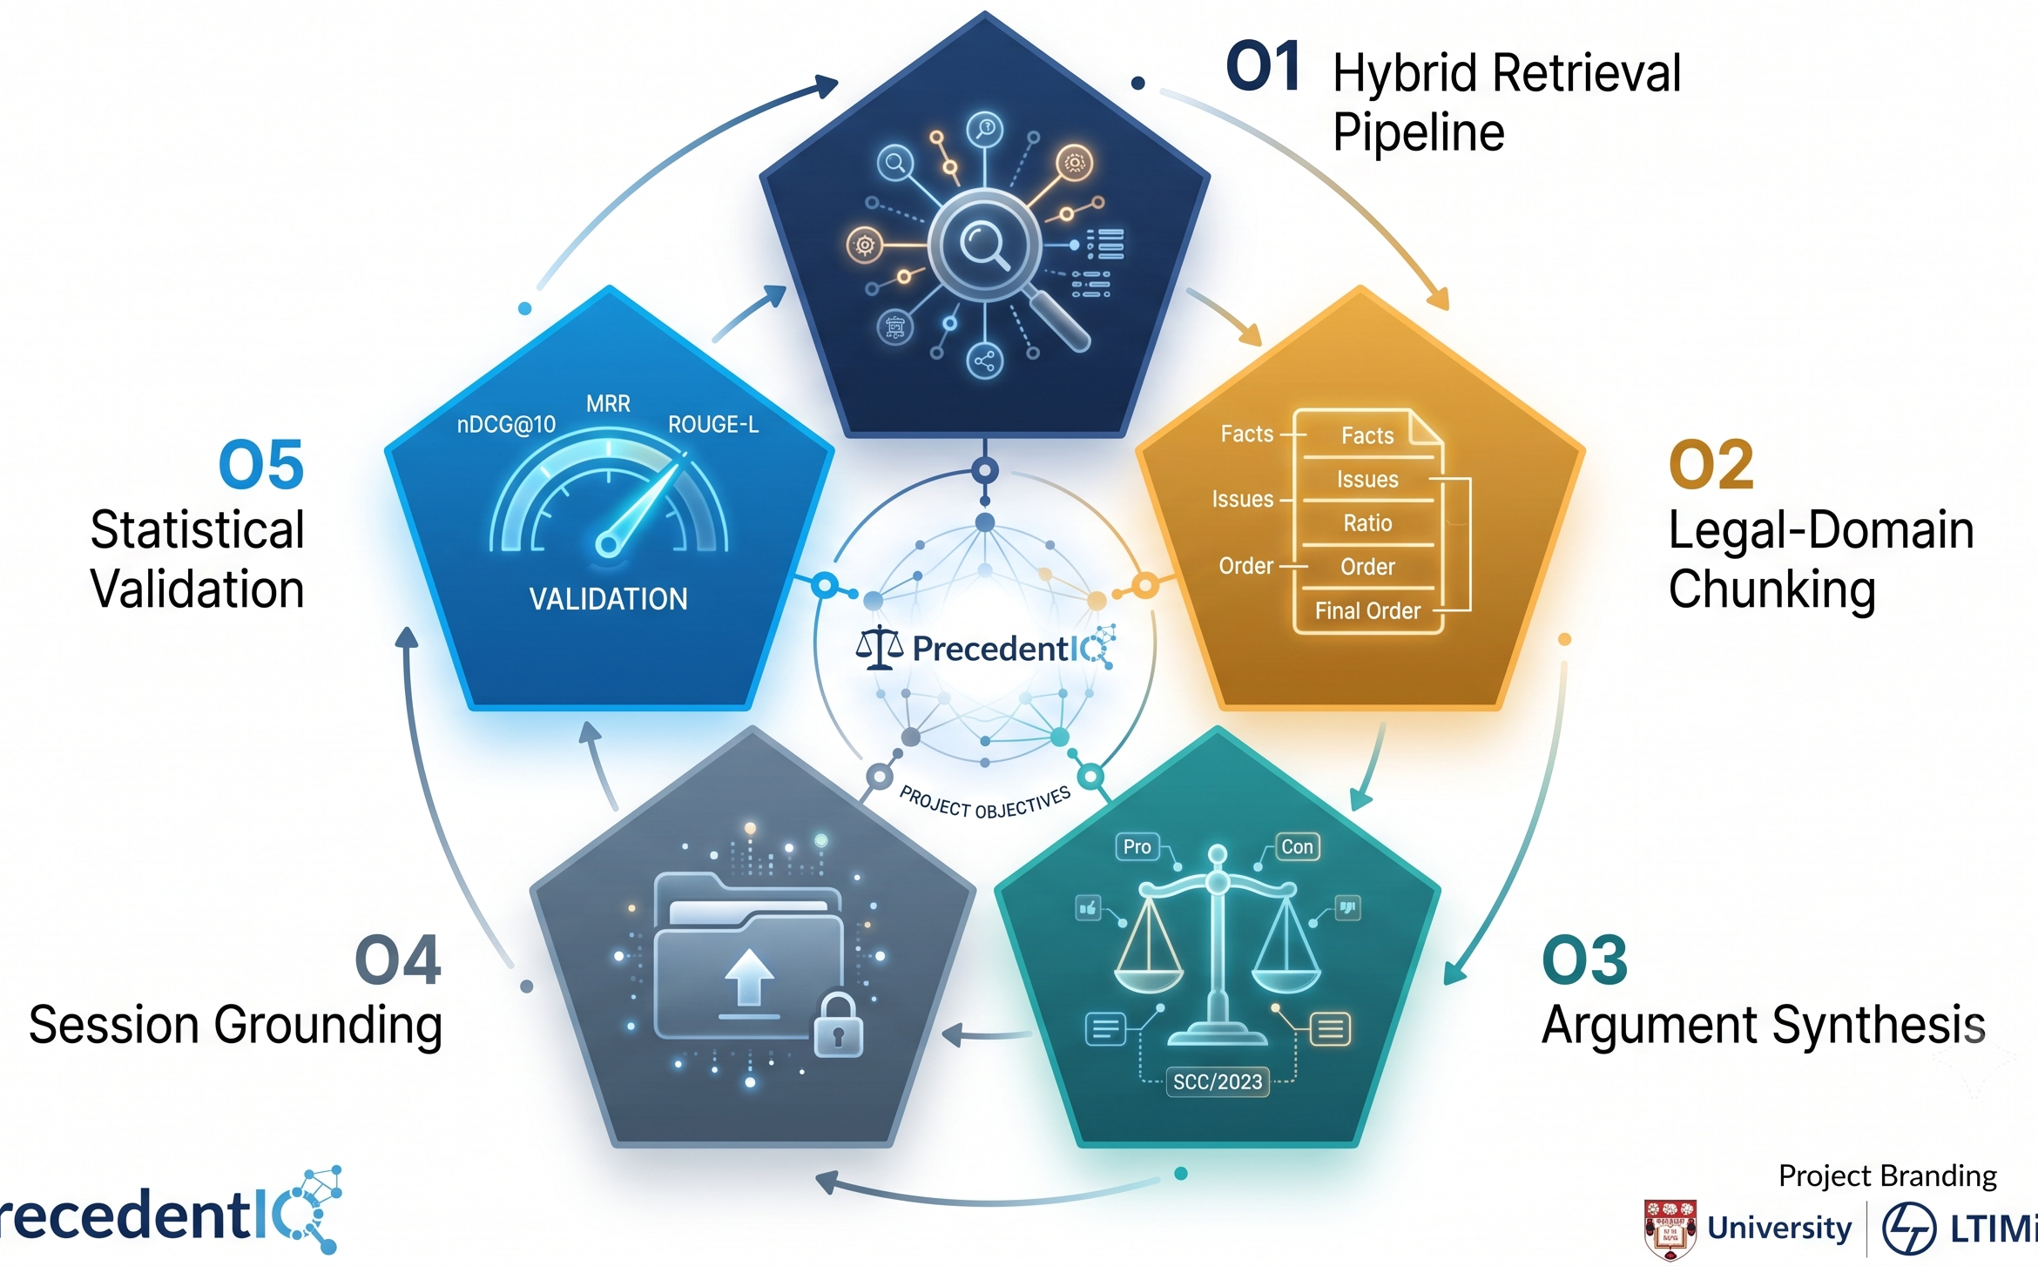
PrecedentIQ
Objectives
• O1: Build a legal-domain hybrid retrieval pipeline (dense + sparse, RRF-fused) achieving measurable nDCG@10 / MRR on a held-out precedent-relevance query set.
• O2: Implement structural chunking (Facts / Issues / Ratio / Obiter / Order) and an LLM-based holding summariser, validated against gold-annotated judgments (IL-TUR).
• O3: Deliver a citation-linked pro/contra argument-outline drafter where every generated claim traces back to a retrieved source judgment.
• O4: Support session-specific retrieval grounded in an advocate's own uploaded case file, alongside the corpus-wide index.
• O5: Statistically validate retrieval quality and holding-extraction accuracy using nDCG@10, MRR, bootstrap confidence intervals, and ROUGE-L against gold data.

Slide 4
PrecedentIQ
Project Scope
In Scope
English SC & High Court judgments (Indian case law)
Hybrid retrieval (semantic + exact match) with reranking
Structural chunking → holding extraction (ratio vs. obiter)
Citation-linked argument-outline drafting
Case-file upload for session-specific retrieval
Word export + statistical evaluation (nDCG@10, MRR, ROUGE-L)
Out of Scope
Regional languages, lower court orders
Case filing/management features
Final legal advice or outcome prediction — outputs are advocate-reviewed drafts only
Non-Indian case law
Production infrastructure (caching, autoscaling) — future work
Data Boundary
Corpus: AWS Open Data Registry (eCourts-sourced SC + HC judgments)
Validation: IL-TUR, ILDC, and LawSum (for retrieval and holding-extraction accuracy benchmarking)

Slide 5
PrecedentIQ
Literature Review
Title / Citation | Summary of Methods & Contribution | Gap Addressed by PrecedentIQ
ILDC for CJPE (Malik et al., 2021) | 35k Indian SC cases annotated with decisions + gold expert explanations; hierarchical occlusion model for judgment prediction & explainability. | Focuses on outcome prediction. PrecedentIQ shifts to extracting structured reasoning (ratio vs. obiter) and synthesizing new arguments.
LEGAL-BERT (Chalkidis et al., 2020) | Family of BERT models pre-trained on large-scale English legal corpora; outperforms general-purpose LMs on legal NLP tasks. | Provides embeddings only, no retrieval/generation framework. PrecedentIQ integrates domain-tuned embeddings in a two-stage hybrid RAG pipeline for Indian case law.
LexGLUE (Chalkidis et al., 2022) | Standardized benchmark for legal NLU across classification & QA tasks; legal-oriented models outperform generic ones. | Benchmarks classification/QA only; no generative framework. PrecedentIQ structures pro/contra arguments with strict citation-linking.
LLM Argument Mining (Al Zubaer et al., 2023) | Evaluates LLMs via few-shot prompting for classifying argumentative components (premises/conclusions) in legal text. | Mines isolated arguments; no cross-document synthesis. PrecedentIQ drafts structured, multi-case argument outlines grounded in retrieved precedents.
Legal IR & Entailment (Kim et al., 2024) | Transformer-based case law retrieval & entailment at sentence/paragraph level to find supporting precedents. | Limited to ranking/retrieval. PrecedentIQ combines retrieval with LLM-based holding extraction and argument synthesis — a full drafted outline, not just a ranked list.

Slide 6
PrecedentIQ
Summary of Literature Review
• Overall pattern: The five foundational papers above build the ingredients — Indian legal corpora (ILDC), domain embeddings (LEGAL-BERT), benchmarks (LexGLUE), argument mining, and case retrieval — but none combine them into one retrieval-to-drafting pipeline.
• Closest directly-related RAG work:
• NyayaRAG (Nigam et al., 2025, arXiv:2508.00709): RAG framework for Indian judgment prediction using facts, statutes & retrieved precedents — predicts outcomes, not precedent retrieval or argument drafting for practitioners.
• AQgR (Vishnuprabha V. et al., 2025, arXiv:2508.04710): Combines RAG with structured summaries for Indian case law retrieval, generating explanations — evaluated on a small FIRE-2019 subset, no argument-outline generation.
• Rhetorical-Role-Aware RAG (Sha et al., 2026, arXiv:2608.06828): RAG with rhetorical-role chunking, hybrid retrieval & cross-encoder reranking for SC judgment QA — focused on conversational QA, not citation-linked argument synthesis or holding/obiter separation.
• The gap PrecedentIQ closes: No reviewed system combines legal-domain hybrid retrieval with structured holding extraction AND citation-linked argument synthesis in one pipeline grounded in a practitioner's own case file.

Slide 7
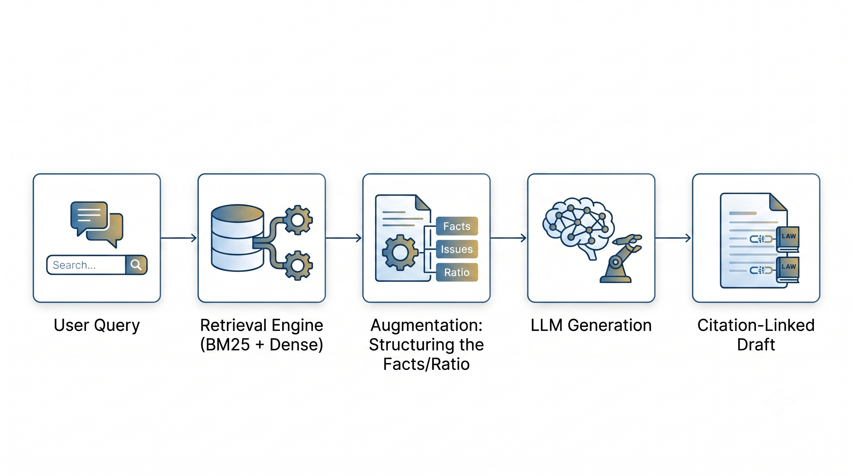
PrecedentIQ
How RAG is Implemented in PrecedentIQ
• RAG is the central operating principle, not one module: Every generated output in PrecedentIQ — holding summaries and argument outlines — is produced strictly from retrieved judgment text, never open-ended LLM generation.
• Retrieval (the “R”): Hybrid dense (legal embeddings) + sparse (BM25/SPLADE) search over legal-domain chunks, fused by Reciprocal Rank Fusion and cross-encoder reranked — this is what grounds every downstream claim in real precedent text.
• Augmentation (the “A”): Retrieved chunks are structurally labeled (Facts/Issues/Ratio/Obiter/Order) before being passed to the LLM, so the model reasons over correctly-scoped legal context rather than an unstructured document.
• Generation (the “G”): The LLM only summarises the retrieved ratio decidendi and drafts argument outlines from retrieved holdings — it never answers from parametric memory alone.
• Why RAG specifically, not a fine-tuned LLM alone: Case law changes continuously and must be citable to a real source; RAG lets PrecedentIQ stay current by updating the retrieval corpus, and lets every claim be traced and verified — a fine-tuned model cannot offer either guarantee.
• Result: Hallucination risk is structurally reduced, not just prompted against — the architecture itself enforces that no claim exists without a retrieved citation behind it.

Slide 8
PrecedentIQ
Modules to Cover
• Module 1: Data Ingestion, Legal-Domain Chunking & Embedding/Indexing
• Module 2: Hybrid Retrieval Engine (Core RAG Component)
• Module 3: Generation Layer — Holding Extraction & Argument Synthesis
• Module 4: Evaluation & Statistical Validation

Slide 9
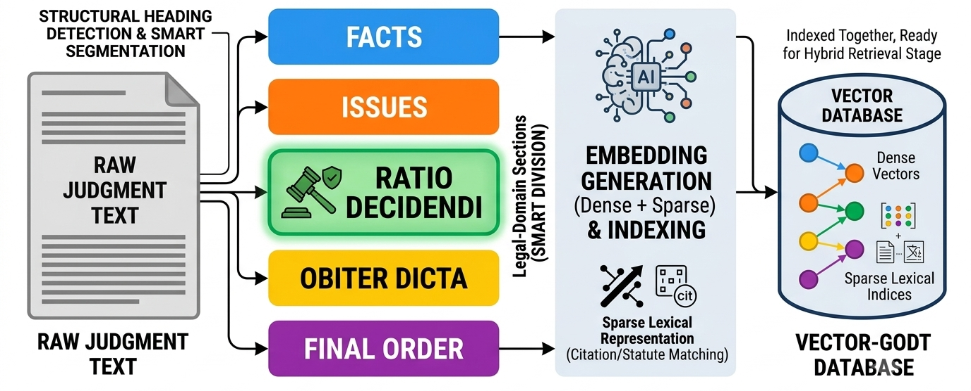
PrecedentIQ
Module 1: Data Ingestion, Chunking & Embedding
• Legal-domain chunking: Raw judgments are segmented into Facts / Issues / Ratio / Obiter / Order using structural heading detection, preserving the semantic boundary generic fixed-length chunking would destroy.
• Embedding: Each section chunk is embedded using domain-tuned legal embeddings (dense) alongside a sparse lexical representation for exact statutory/citation matching.
• Indexing: Dense vectors and Sparse vectors are indexed together, ready for the hybrid retrieval stage.
Vector
Database

Slide 10
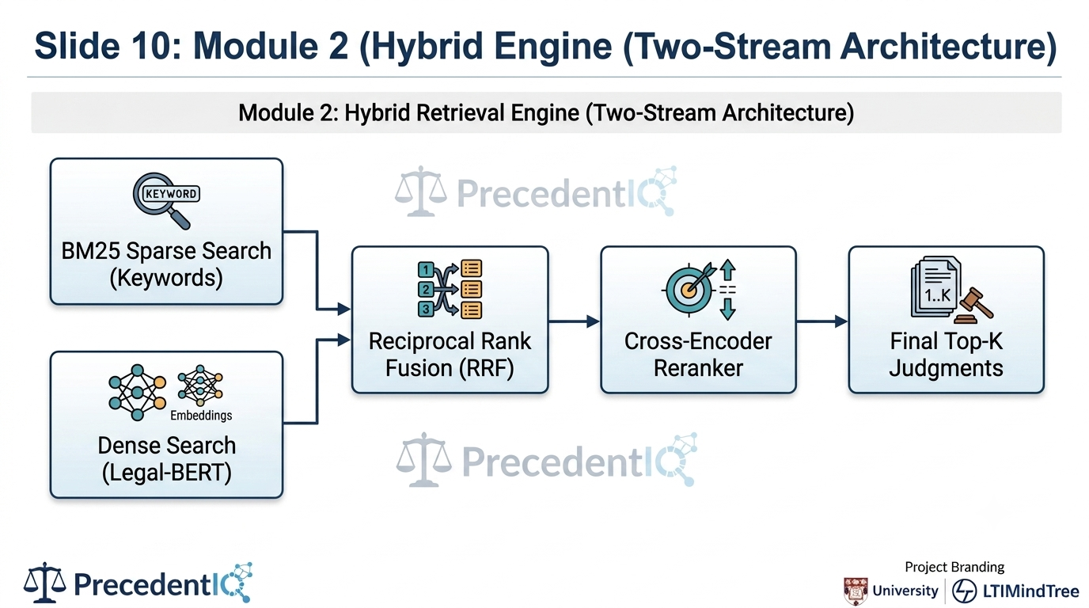
PrecedentIQ
Module 2: Hybrid Retrieval Engine (Core RAG Component)
• Dense retrieval: Catches conceptually related precedents even with no shared vocabulary (e.g. “raw material shortage” ≈ “unable to procure supplies”).
• Sparse retrieval: Catches exact statutory/citation matches that dense embeddings can blur (e.g. “Section 56”).
• Fusion & reranking: Reciprocal Rank Fusion combines both rankings by position, not raw score; a cross-encoder reranks the fused shortlist for final precision — this hybrid design is what grounds the entire downstream pipeline.

Slide 11
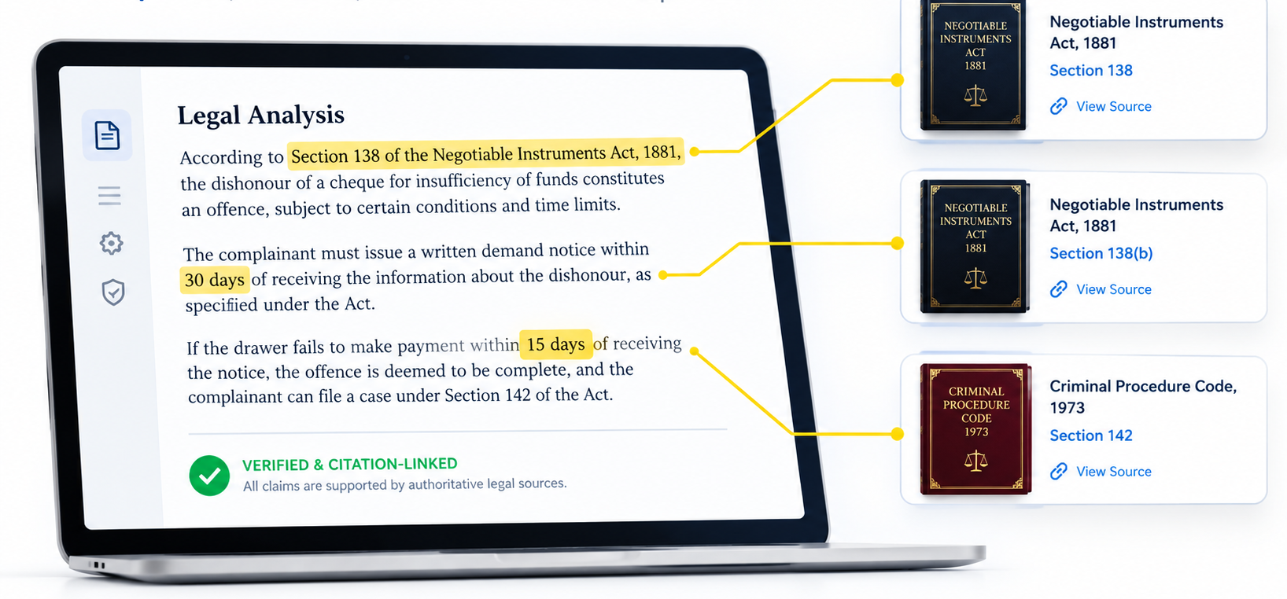
PrecedentIQ
Module 3: Generation Layer — Holding Extraction & Argument Synthesis
• Holding summariser: an LLM summarises only the already-isolated ratio decidendi chunk, reducing hallucination risk versus summarising an unsegmented judgment.
• Argument drafter: retrieved, summarised holdings are organised into a citation-linked pro/contra outline — every sentence traces to a source judgment ID by construction, not by prompt instruction alone.
• Session grounding: an advocate's uploaded case file is retrieved against alongside the corpus-wide index, contextualizing the outline to their specific facts.

Slide 12
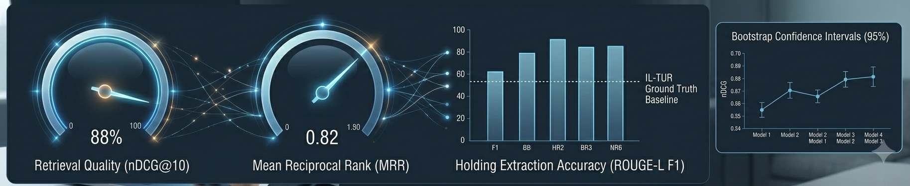
PrecedentIQ
Module 4: Evaluation & Statistical Validation
• Retrieval quality: nDCG@10 and MRR, reported with 95% bootstrap confidence intervals rather than a single point estimate.
• Significance testing: paired Wilcoxon signed-rank test comparing hybrid retrieval against BM25-only and dense-only baselines.
• Holding-extraction accuracy: ROUGE-L F1 against gold-standard holdings (IL-TUR expert annotations / hand-labeled validation set).

Slide 13
Thank you

