Slide 1


M.Tech Program
Advanced Industry Integrated Programs
Jointly offered by University and LTIMindTree
Review II
A Hybrid Retrieval-Augmented Framework for Precedent Discovery and Argument Synthesis over Indian Case Law
PrecedentIQ
Presented By
Krithana A
VIT Vellore
Knowledge partner | Implementation partner

Slide 2

PrecedentIQ
Introduction
• The problem: Junior advocates and small law firms in India spend weeks manually searching thousands of Supreme Court and High Court judgments to locate relevant precedents — a slow, incomplete process.
• The scale: Indian courts carry over 5.4 crore pending cases (NJDG, 2025); senior lawyer research time costs ₹2,000–10,000 per hour, pricing thorough research out of reach for smaller practices.
• Beyond search: Even after finding a precedent, an advocate must manually separate the binding ratio decidendi from non-binding obiter dicta, then hand-draft a pro/contra argument with citations.
• Our approach: PrecedentIQ is a Retrieval-Augmented Generation (RAG) framework that automates this entire chain — retrieval, holding extraction, and citation-linked argument synthesis — grounded strictly in real Indian case law, not open-ended LLM generation.

Slide 3
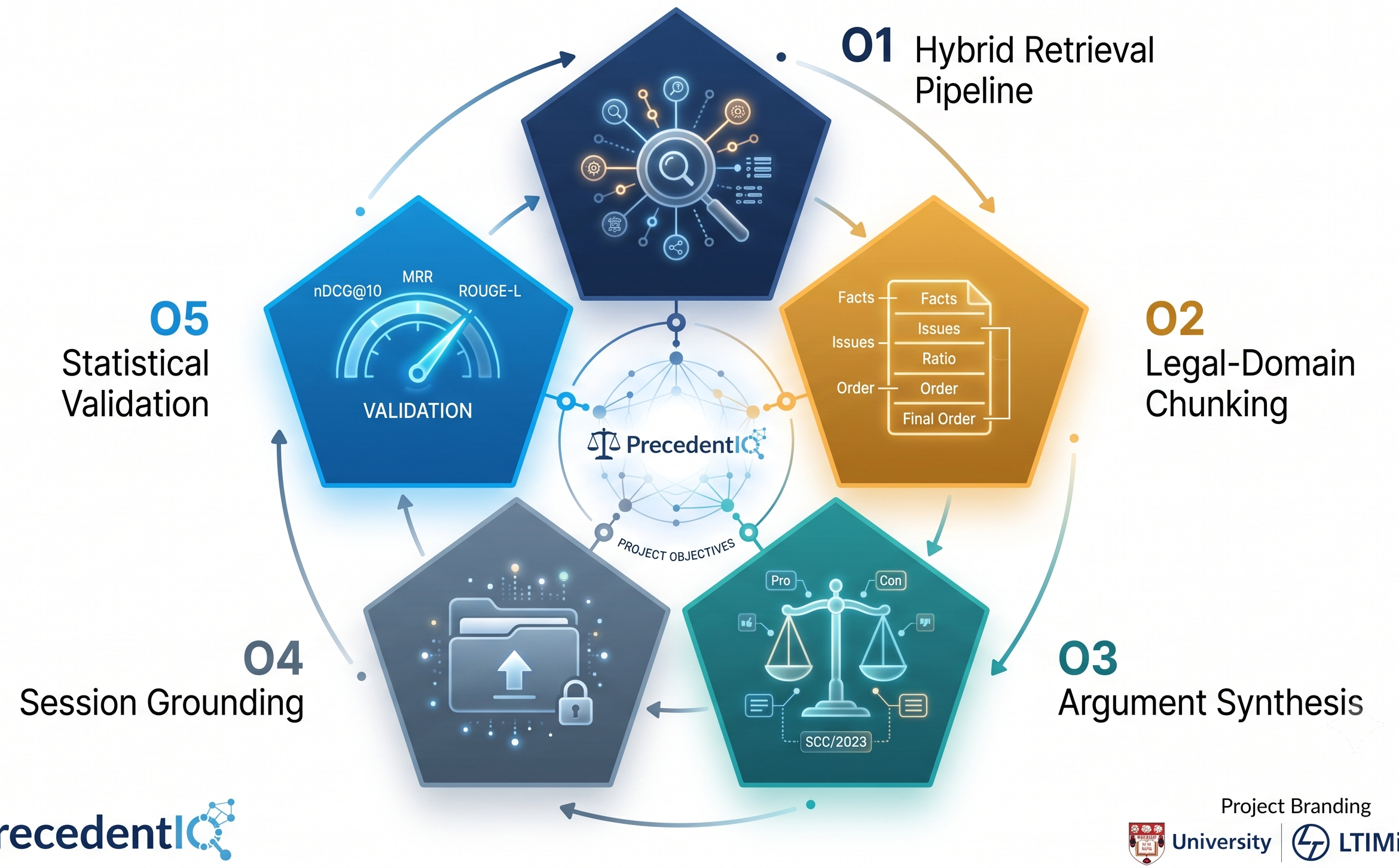
PrecedentIQ
Objectives
• O1: Build a legal-domain hybrid retrieval pipeline (dense + sparse, RRF-fused) achieving measurable nDCG@10 / MRR on a held-out precedent-relevance query set.
• O2: Implement structural chunking (Facts / Issues / Ratio / Obiter / Order) and an LLM-based holding summariser, validated against gold-annotated judgments (IL-TUR).
• O3: Deliver a citation-linked pro/contra argument-outline drafter where every generated claim traces back to a retrieved source judgment.
• O4: Support session-specific retrieval grounded in an advocate's own uploaded case file, alongside the corpus-wide index.
• O5: Statistically validate retrieval quality and holding-extraction accuracy using nDCG@10, MRR, bootstrap confidence intervals, and ROUGE-L against gold data.

Slide 4
PrecedentIQ
System Modules
Module 1: Data Ingestion, Legal-Domain Chunking & Embedding/Indexing
Module 2: Hybrid Retrieval Engine (Core RAG Component)
Module 3: Generation Layer — Holding Extraction & Argument Synthesis
Module 4: Evaluation & Statistical Validation
Module 5: Application / Delivery Layer: FastAPI Backend, Streamlit Legal Research Terminal & Word Export

Slide 5
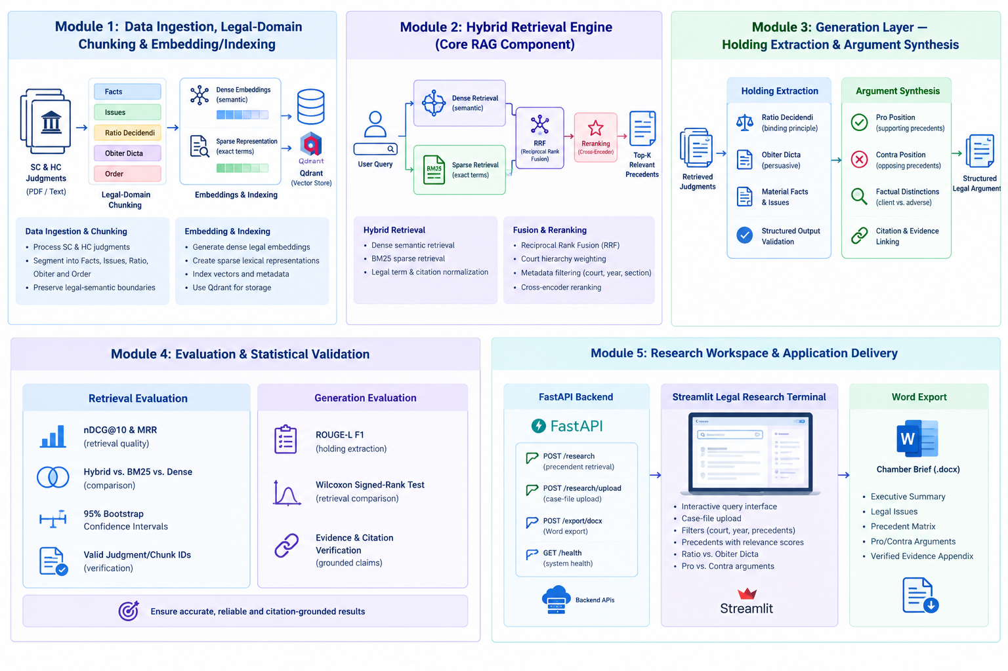
PrecedentIQ
Module 1: Data Ingestion, Legal-Domain Chunking & Embedding/Indexing
Data Ingestion & Chunking
Process SC & HC judgments.
Segment into Facts, Issues, Ratio, Obiter and Order.
Preserve legal-semantic boundaries.
Embedding & Indexing
Generate dense legal embeddings.
Create sparse lexical representations.
Index vectors and metadata for retrieval.

Slide 6
PrecedentIQ
Module 2: Hybrid Retrieval Engine (Core RAG Component)
Hybrid Retrieval
Dense semantic retrieval.
BM25 sparse retrieval.
Legal term and citation normalization.
Fusion & Reranking
Reciprocal Rank Fusion (RRF).
Court hierarchy weighting.
Cross-encoder reranking and metadata filtering.

Slide 7
PrecedentIQ
Module 3: Generation Layer — Holding Extraction & Argument Synthesis Holding Extraction
Holding Extraction
Ratio Decidendi extraction.
Obiter Dicta separation.
Material facts and legal issues extraction.
Argument Synthesis
Pro/Contra argument generation.
Factual distinctions.
Citation and evidence linking.

Slide 8
PrecedentIQ
Module 4: Evaluation & Statistical Validation
Retrieval Evaluation
nDCG@10 and MRR.
Hybrid vs. BM25 vs. Dense comparison.
95% bootstrap confidence intervals.
Generation Evaluation
ROUGE-L F1 for holding extraction.
Wilcoxon signed-rank testing.
Evidence and citation verification.

Slide 9
PrecedentIQ
Module 5: Application Delivery
FastAPI Backend
Research, upload, export and health APIs.
Case-file based automated research.
Streamlit Legal Research Terminal
Interactive query and case upload.
Filters and precedent discovery.
Ratio/Obiter and Pro/Contra views.
Word Export
Structured Chamber Brief.
Precedent Matrix and arguments.
Verified Evidence Appendix.

Slide 10
PrecedentIQ
Methodology / Modeling Plan
1. INPUT
Judgments
User Query / Case File
2. PREPROCESSING
Parsing +
Legal-Domain Chunking
3. RETRIEVAL
Dense + BM25
RRF + Reranking
4. GENERATION
Ratio / Obiter
Pro / Contra
5. VALIDATION
Evidence +
Citation Verification
6. OUTPUT
Streamlit
Word Chamber Brief
Core RAG Method
Structural chunking → Dense + BM25 retrieval
RRF fusion → Cross-encoder reranking
Grounded Generation
Ratio Decidendi / Obiter Dicta extraction
Pro / Contra synthesis with source evidence
Evaluation & Delivery
nDCG@10, MRR, ROUGE-L
FastAPI + Streamlit + Word export

Slide 11
PrecedentIQ
Data preprocessing
1. Document Parsing
Process Supreme Court & High Court judgments
Extract textual content from source documents
2. Text Normalization
Normalize legal terminology and citation formats
Handle variations such as “S. 138” / “Section 138”
3. Legal-Domain Structural Chunking
Segment judgments based on legal structure
Identify Facts, Issues, Submissions, Reasoning, Ratio Decidendi, Obiter Dicta & Order
4. Chunk Preparation
Preserve legal-semantic boundaries
Generate structured chunks for downstream retrieval and generation
5. Metadata Preparation
Associate chunks with Court, Year & Legal Section
Support filtering during retrieval

Slide 12
PrecedentIQ
Approach/Algorithms/Tools
Approach
Hybrid Retrieval-Augmented Generation (RAG)
Algorithms
Dense Retrieval: Sentence-Transformers / MiniLM / Nomic embeddings
Tools / Technologies
Python
Legal-domain structural chunking
Dense + Sparse retrieval with fusion
Cross-encoder reranking
Holding extraction and Pro/Contra argument synthesis
Evidence-first citation verification
Sparse Retrieval: BM25 with legal-term weighting
Fusion: Reciprocal Rank Fusion (RRF)
Reranking: Cross-Encoder + court-hierarchy weighting
Generation: Ratio Decidendi vs Obiter Dicta extraction
Validation: Citation-to-chunk verification
Ollama — local LLM inference
FastAPI — backend APIs
Streamlit — Legal Research Terminal
Sentence-Transformers — embeddings & reranking
BM25 — lexical retrieval
Microsoft Word / DOCX — chamber brief export
Qdrant — vector indexing/retrieval

Slide 13
PrecedentIQ
Project plan/Milestones progress
Phase | Major Activities | Progress
1. Data Preparation | Judgment collection, parsing, legal-domain chunking, metadata preparation | ✅ Completed
2. Retrieval Engine | Dense retrieval, BM25, RRF fusion, filtering and reranking | ✅ Completed
3. Holding & Argument Intelligence | Ratio/Obiter extraction, Pro/Contra synthesis, factual distinctions | ✅ Completed
4. Evaluation & Validation | nDCG@10, MRR, bootstrap CI, ROUGE-L, citation verification | 🔄 In Progress
5. Application Delivery | FastAPI APIs, Streamlit Research Terminal, Word export | 🔄 In Progress
6. Final Integration & Testing | End-to-end testing, UI testing, retrieval benchmarking and final refinement | ⏳ Planned

Slide 14
PrecedentIQ
Pipeline Structure
INPUT
Judgment Corpus + User Query / Uploaded Case File
INGESTION & CHUNKING
Parsing → Legal sections → Structured chunks
EMBEDDING / INDEXING
Dense embeddings + BM25 + metadata / Qdrant
HYBRID RETRIEVAL
Dense Retrieval + BM25
Reciprocal Rank Fusion (RRF)
RERANKING
Court hierarchy weighting
Cross-Encoder reranking
TOP-K PRECEDENTS
Relevant, citation-ready
judgment chunks
HOLDING EXTRACTION
Ratio Decidendi
Obiter Dicta + material facts
ARGUMENT SYNTHESIS
Pro + Contra
Factual distinctions
EVIDENCE VERIFICATION
Claim → retrieved chunk
Citation grounding
APPLICATION / DELIVERY
FastAPI → Streamlit Legal Research Terminal → Word Chamber Brief

Slide 15
Thank you

