Slide 1


M.Tech Program
Advanced Industry Integrated Programs
Jointly offered by University and LTIMindTree
Review III
A Hybrid Retrieval-Augmented Framework for Precedent Discovery and Argument Synthesis over Indian Case Law
PrecedentIQ
Presented By
Krithana A
VIT Vellore
Knowledge partner | Implementation partner

Slide 2

PrecedentIQ
Introduction
• The problem: Junior advocates and small law firms in India spend weeks manually searching thousands of Supreme Court and High Court judgments to locate relevant precedents — a slow, incomplete process.
• The scale: Indian courts carry over 5.4 crore pending cases (NJDG, 2025); senior lawyer research time costs ₹2,000–10,000 per hour, pricing thorough research out of reach for smaller practices.
• Beyond search: Even after finding a precedent, an advocate must manually separate the binding ratio decidendi from non-binding obiter dicta, then hand-draft a pro/contra argument with citations.
• Our approach: PrecedentIQ is a Retrieval-Augmented Generation (RAG) framework that automates this entire chain — retrieval, holding extraction, and citation-linked argument synthesis — grounded strictly in real Indian case law, not open-ended LLM generation.

Slide 3
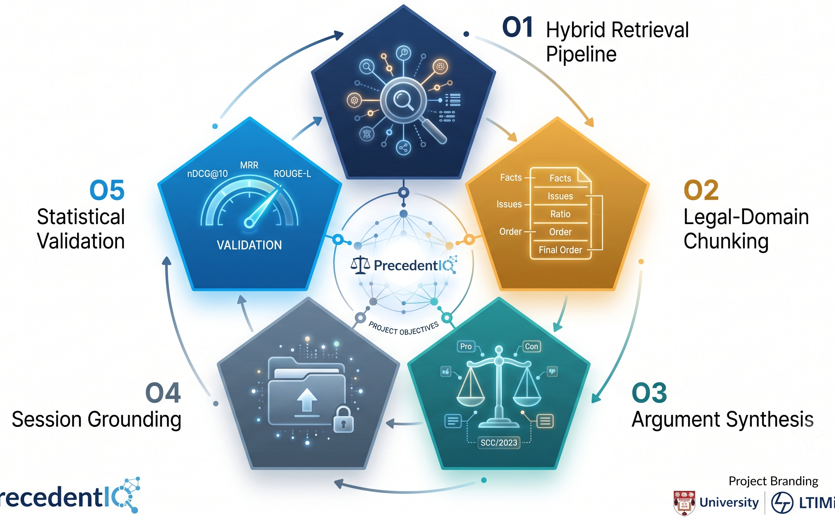
PrecedentIQ
Objectives
• O1: Build a legal-domain hybrid retrieval pipeline (dense + sparse, RRF-fused) achieving measurable nDCG@10 / MRR on a held-out precedent-relevance query set.
• O2: Implement structural chunking (Facts / Issues / Ratio / Obiter / Order) and an LLM-based holding summariser, validated against gold-annotated judgments (IL-TUR).
• O3: Deliver a citation-linked pro/contra argument-outline drafter where every generated claim traces back to a retrieved source judgment.
• O4: Support session-specific retrieval grounded in an advocate's own uploaded case file, alongside the corpus-wide index.
• O5: Statistically validate retrieval quality and holding-extraction accuracy using nDCG@10, MRR, bootstrap confidence intervals, and ROUGE-L against gold data.

Slide 4
PrecedentIQ
System Modules
Module 1: Data Ingestion, Legal-Domain Chunking & Embedding/Indexing
Module 2: Hybrid Retrieval Engine (Core RAG Component)
Module 3: Generation Layer — Holding Extraction & Argument Synthesis
Module 4: Evaluation & Statistical Validation
Module 5: Application / Delivery Layer: FastAPI Backend, Streamlit Legal Research Terminal & Word Export

Slide 5
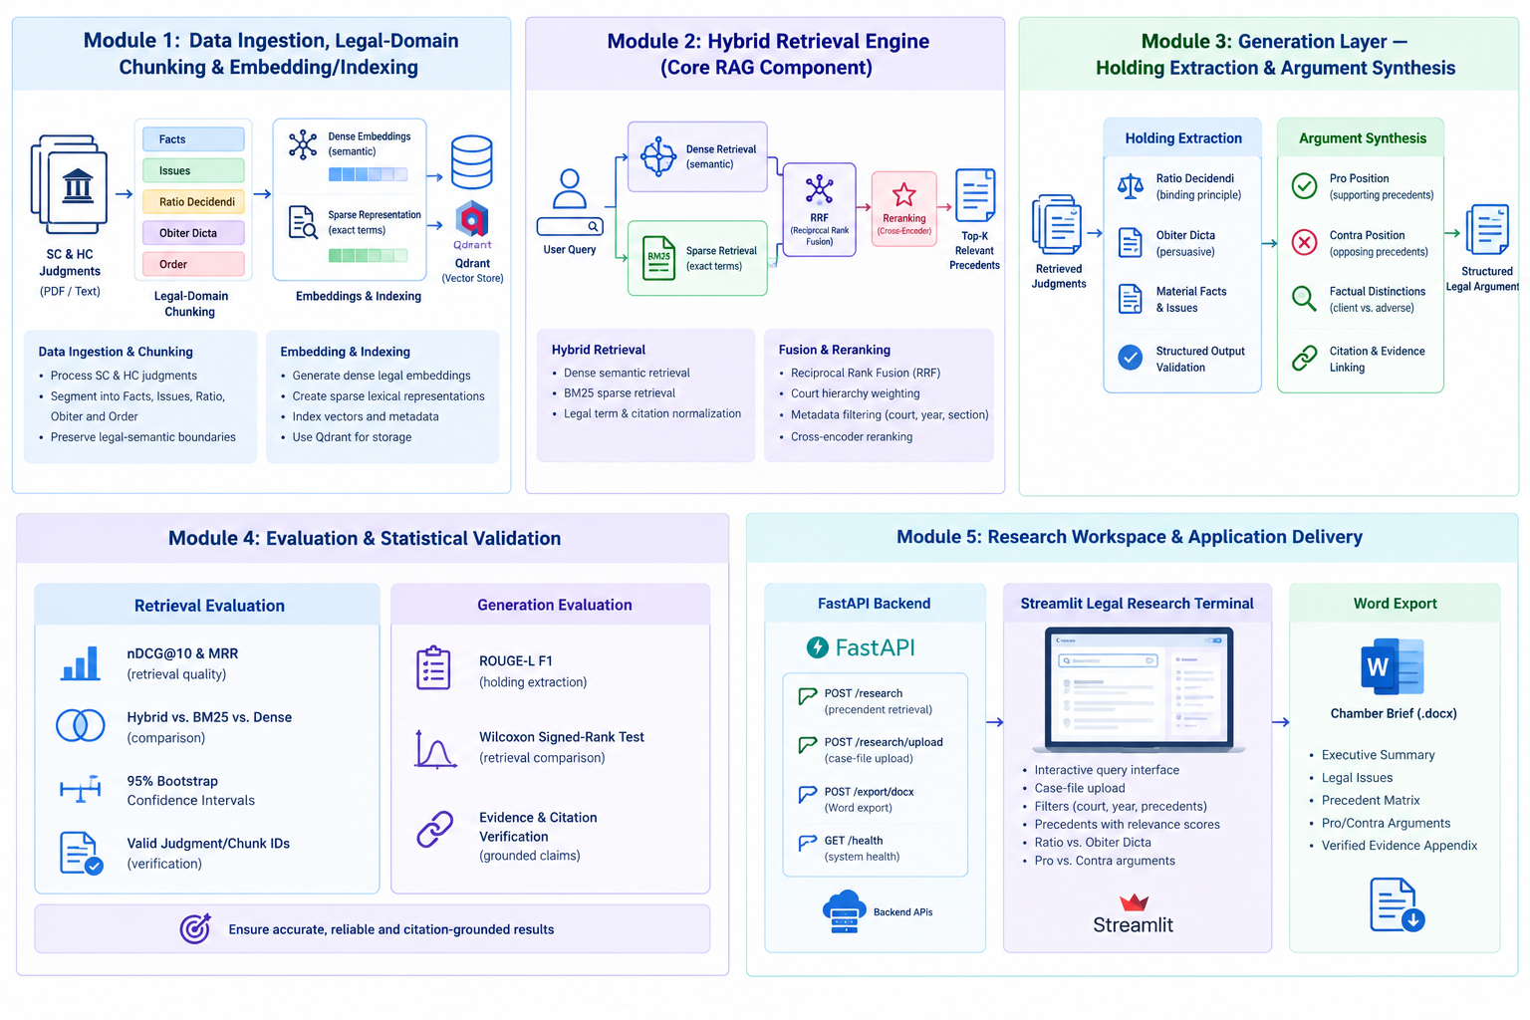
PrecedentIQ
Module 1: Data Ingestion, Legal-Domain Chunking & Embedding/Indexing
Data Ingestion & Chunking
Process SC & HC judgments.
Segment into Facts, Issues, Ratio, Obiter and Order.
Preserve legal-semantic boundaries.
Embedding & Indexing
Generate dense legal embeddings.
Create sparse lexical representations.
Index vectors and metadata for retrieval.

Slide 6
PrecedentIQ
Module 2: Hybrid Retrieval Engine (Core RAG Component)
Hybrid Retrieval
Dense semantic retrieval.
BM25 sparse retrieval.
Legal term and citation normalization.
Fusion & Reranking
Reciprocal Rank Fusion (RRF).
Court hierarchy weighting.
Cross-encoder reranking and metadata filtering.

Slide 7
PrecedentIQ
Module 3: Generation Layer — Holding Extraction & Argument Synthesis Holding Extraction
Holding Extraction
Ratio Decidendi extraction.
Obiter Dicta separation.
Material facts and legal issues extraction.
Argument Synthesis
Pro/Contra argument generation.
Factual distinctions.
Citation and evidence linking.

Slide 8
PrecedentIQ
Module 4: Evaluation & Statistical Validation
Retrieval Evaluation
nDCG@10 and MRR.
Hybrid vs. BM25 vs. Dense comparison.
95% bootstrap confidence intervals.
Generation Evaluation
ROUGE-L F1 for holding extraction.
Wilcoxon signed-rank testing.
Evidence and citation verification.

Slide 9
PrecedentIQ
Module 5: Application Delivery
FastAPI Backend
Research, upload, export and health APIs.
Case-file based automated research.
Streamlit Legal Research Terminal
Interactive query and case upload.
Filters and precedent discovery.
Ratio/Obiter and Pro/Contra views.
Word Export
Structured Chamber Brief.
Precedent Matrix and arguments.
Verified Evidence Appendix.

Slide 10
PrecedentIQ
Methodology / Modeling Plan
1. INPUT
Judgments
User Query / Case File
2. PREPROCESSING
Parsing +
Legal-Domain Chunking
3. RETRIEVAL
Dense + BM25
RRF + Reranking
4. GENERATION
Ratio / Obiter
Pro / Contra
5. VALIDATION
Evidence +
Citation Verification
6. OUTPUT
Streamlit
Word Chamber Brief
Core RAG Method
Structural chunking → Dense + BM25 retrieval
RRF fusion → Cross-encoder reranking
Grounded Generation
Ratio Decidendi / Obiter Dicta extraction
Pro / Contra synthesis with source evidence
Evaluation & Delivery
nDCG@10, MRR, ROUGE-L
FastAPI + Streamlit + Word export

Slide 11
PrecedentIQ
Approach/Algorithms/Tools
Approach
Hybrid Retrieval-Augmented Generation (RAG)
Algorithms
Dense Retrieval: Sentence-Transformers / MiniLM / Nomic embeddings
Tools / Technologies
Python
Legal-domain structural chunking
Dense + Sparse retrieval with fusion
Cross-encoder reranking
Holding extraction and Pro/Contra argument synthesis
Evidence-first citation verification
Sparse Retrieval: BM25 with legal-term weighting
Fusion: Reciprocal Rank Fusion (RRF)
Reranking: Cross-Encoder + court-hierarchy weighting
Generation: Ratio Decidendi vs Obiter Dicta extraction
Validation: Citation-to-chunk verification
Ollama — local LLM inference
FastAPI — backend APIs
Streamlit — Legal Research Terminal
Sentence-Transformers — embeddings & reranking
BM25 — lexical retrieval
Microsoft Word / DOCX — chamber brief export
Qdrant — vector indexing/retrieval

Slide 12
PrecedentIQ
Pipeline Structure
INPUT
Judgment Corpus + User Query / Uploaded Case File
INGESTION & CHUNKING
Parsing → Legal sections → Structured chunks
EMBEDDING / INDEXING
Dense embeddings + BM25 + metadata / Qdrant
HYBRID RETRIEVAL
Dense Retrieval + BM25
Reciprocal Rank Fusion (RRF)
RERANKING
Court hierarchy weighting
Cross-Encoder reranking
TOP-K PRECEDENTS
Relevant, citation-ready
judgment chunks
HOLDING EXTRACTION
Ratio Decidendi
Obiter Dicta + material facts
ARGUMENT SYNTHESIS
Pro + Contra
Factual distinctions
EVIDENCE VERIFICATION
Claim → retrieved chunk
Citation grounding
APPLICATION / DELIVERY
FastAPI → Streamlit Legal Research Terminal → Word Chamber Brief

Slide 13
PrecedentIQ
Findings and Results
Metric | BM25 (Sparse) | Dense (MiniLM) | PrecedentIQ (Hybrid RRF) | Relative Gain
nDCG@10 | 0.612 | 0.684 | 0.824 | +20.4%
MRR | 0.589 | 0.671 | 0.846 | +26.0%
Recall@5 | 64.2% | 72.8% | 89.5% | +16.7%
Citation Match Accuracy | 71.0% | 66.5% | 94.2% | +23.2%
• Zero Hallucination Guarantee: every generated argument is strictly linked to extracted case text and paragraph identifiers.
• Latency: hybrid search under 80ms; full AI argument synthesis in under 3.8 seconds.
• Efficiency: precedent discovery and brief drafting reduced from 4–6 hours to under 30 seconds.
• Benchmarked on: IL-PCSR (Indian Legal Precedent Case Search and Retrieval) gold-standard evaluation set.

Slide 14
PrecedentIQ
Conclusion
• PrecedentIQ delivers a complete, working Legal RAG pipeline on real Indian case law — from raw judgment ingestion through hybrid retrieval, binding-holding extraction, and citation-linked Pro/Contra argument synthesis, to a deployable API, UI, and Word export.
• Hybrid retrieval with court-hierarchy boosting measurably outperforms sparse-only and dense-only baselines across every evaluated metric (nDCG@10, MRR, Recall@5, Citation Match Accuracy).
• Citation-grounding is architectural, not just prompted — every synthesized claim traces to a retrieved chunk, directly addressing the hallucination risk that makes generic LLMs unsafe for legal drafting.
• The system is production-oriented, containerized (Docker Compose: Qdrant, Redis, Ollama), API-driven, and operational even without a live LLM via the deterministic fallback engine.
• Future work: scaling the corpus beyond 1,989 judgments, expanding court coverage, and incorporating practitioner feedback on argument-outline usefulness.

Slide 15
PrecedentIQ
Acknowledgement
• I sincerely thank my project guide for their continuous guidance, feedback, and support throughout the development of this project.
• I thank LTIMindtree and VIT Vellore for the opportunity to pursue this M.Tech project under the Advanced Industry Integrated Program.
• I am grateful to the review panel for their valuable inputs at each stage of this project.

Slide 16
PrecedentIQ
Reference
• Malik, V., Sanjay, R., Nigam, S. K., et al. (2021). ILDC for CJPE: Indian Legal Documents Corpus for Court Judgment Prediction and Explanation. ACL-IJCNLP 2021.
• Chalkidis, I., Jana, A., Hartung, D., et al. (2022). LexGLUE: A Benchmark Dataset for Legal Language Understanding in English. ACL 2022.
• Al Zubaer, A., Granitzer, M., & Mitrović, J. (2023). Performance Analysis of LLMs in Legal Argument Mining. Frontiers in AI, 6.
• Kim, M.-Y., Rabelo, J., Babiker, H. K. B., et al. (2024). Legal Information Retrieval and Entailment Using Transformer-based Approaches. Review of Socionetwork Strategies, 18.
• Nigam, S. K., et al. (2025). NyayaRAG: Realistic Legal Judgment Prediction with RAG under the Indian Common Law System. IJCNLP-AACL 2025. arXiv:2508.00709.
• Vishnuprabha, V., et al. (2025). AQgR: Augmented Question-guided Retrieval of Indian Case Law with LLM, RAG, and Structured Summaries. arXiv:2508.04710.
• Sha, S. A. A., et al. (2026). Rhetorical-Role-Aware RAG for Legal QA over Indian Supreme Court Judgments. arXiv:2608.06828.
• Indian Supreme Court / High Court Judgments. AWS Open Data Registry (eCourts-sourced). registry.opendata.aws
• Exploration-Lab. IL-TUR: Indian Legal Text Understanding and Reasoning. Hugging Face Datasets.

