Slide 1


Sakthi Hackathon 1.0
Problem Statement ID | SH21
Submission Team ID
Team Name | Electro Spark
Theme | IoT and AI in Everyday Life
Problem Statement Title | AI-Enhanced Smart Energy Distribution Monitor with Phantom Load Detection and Voice Alert System
College Name | St. Joseph’s College of Engineering

Slide 2
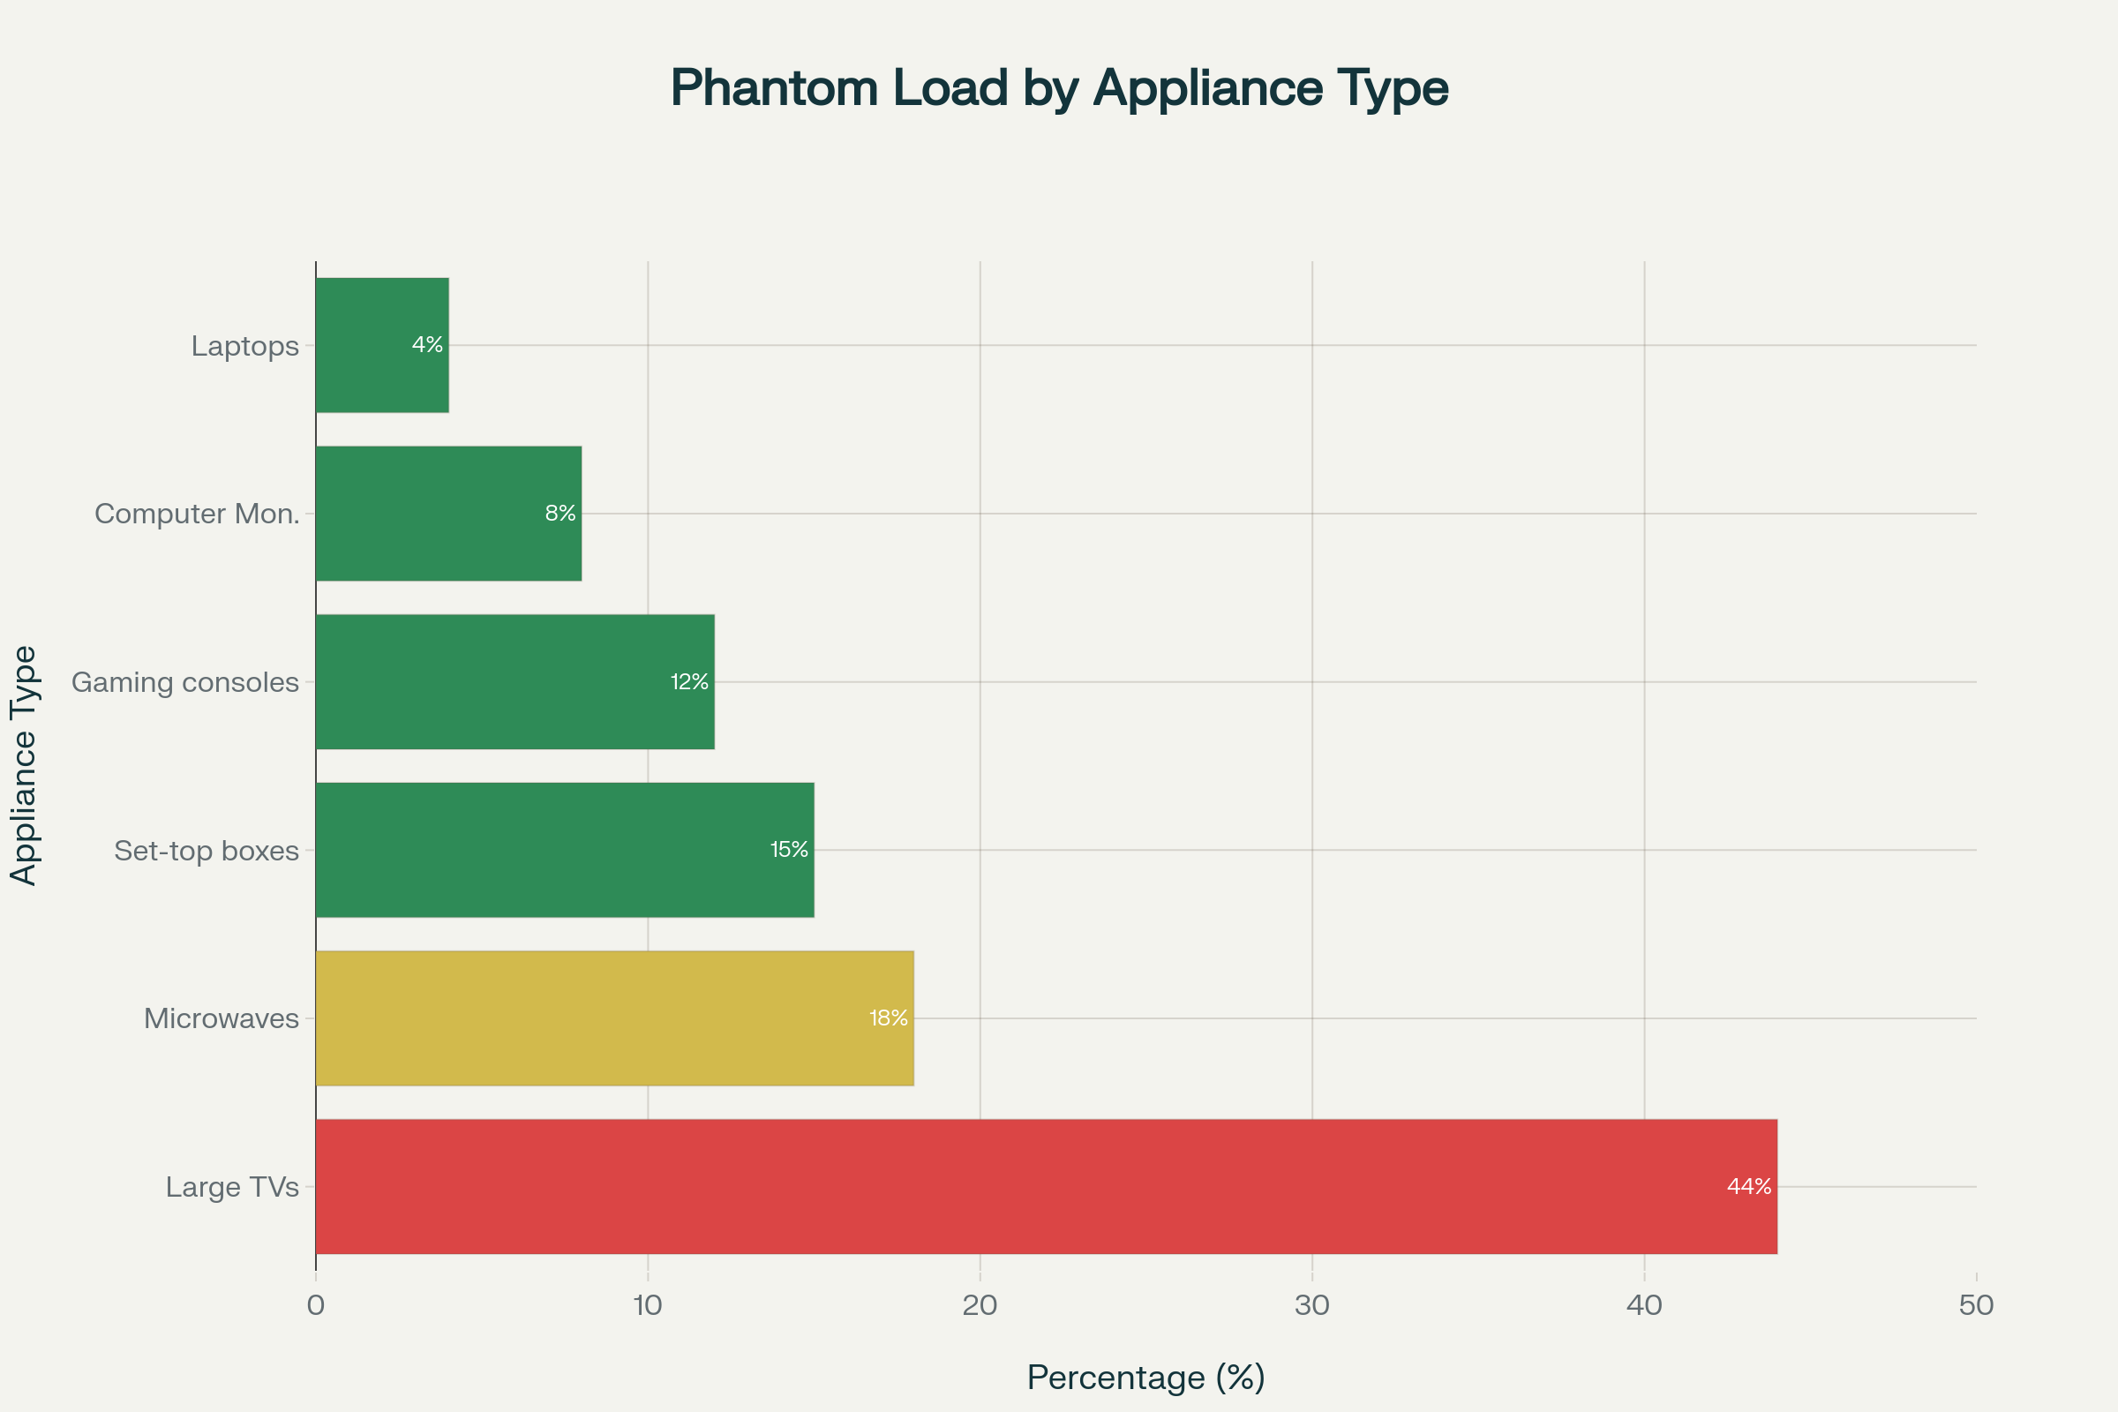
AI-Enhanced Smart Energy Distribution Monitor with Phantom Load Detection and Voice Alert System
Project Title: AI-Enhanced Smart Energy Distribution
Monitor Type: IoT-based smart home solution
Core Features: Detects and minimizes phantom (standby) loads
Enables voice-activated control of appliances
Problem Tackled:
Addresses energy waste in Indian households.
Phantom loads contribute to 5–10% of total power usage
Leads to ₹1,500–₹3,000 annual loss per home
Impact: Helps reduce unnecessary electricity usage through intelligent monitoring and AI-driven control.
How It Addresses the Problem
Reduces energy waste by detecting unnoticed phantom loads.
Improves appliance efficiency through real-time voice-controlled automation.
Empowers users with insights to optimize daily power usage.
Lowers household electricity bills by preventing unnecessary standby consumption.
Supports energy sustainability goals in Indian homes using smart, AI-driven systems.
Innovation & Uniqueness
AI-powered predictions paired with real-time IoT data for smarter energy control.
Voice-enabled automation for seamless and hands-free appliance management.
Targets phantom load reduction, a key but often overlooked energy drain.
Affordable and scalable design suited for both urban and rural homes.
Easily integrates with smart ecosystems like Google Home, Alexa, and Zigbee.

Slide 3
Technical Approach
C++ / MicroPython: For ESP32 firmware (sensor handling, relay control, MQTT communication)
Node.js / JavaScript / Python: For backend services like scheduling, device status, and UI
MQTT: Lightweight protocol for ESP32-to-cloud communication
REST APIs / WebSockets: Optional use for real-time web/mobile dashboards
ML libraries: For on-device AI like phantom load detection and anomaly analysis
Google Home / Alexa APIs: To enable voice control and energy alerts via cloud-linked ESP32 or backend service

Slide 4
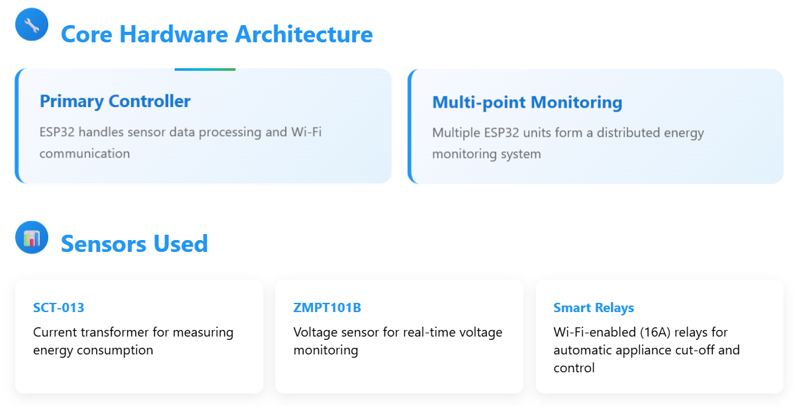
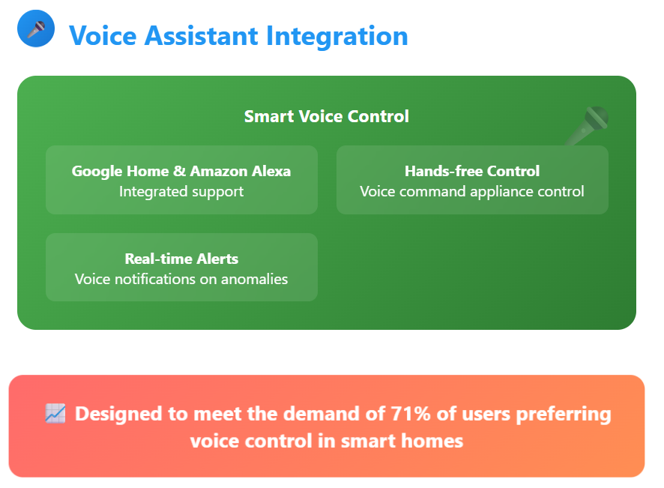
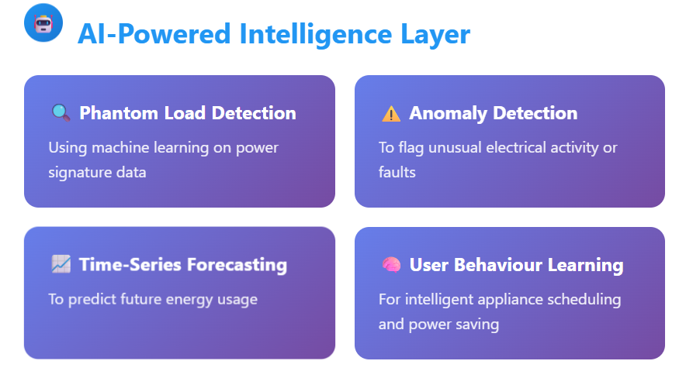

Slide 5
Implementation Methodology
1. Distributed Hardware Setup
Deploy ESP32 modules at key points: switchboards, major appliances, or distribution panel.
Connect each ESP32 to:SCT-013 (current sensor) ZMPT101B (voltage sensor)Smart Wi-Fi relays for circuit-level control
2. Firmware Development
Program ESP32 to : Continuously sample sensor data in real-time
To identify device states : Active, Phantom or Fault
Communicate via MQTT for cloud/backend sync
Operate relays and process voice commands from cloud
Run Edge ML models for local anomaly/event detection

Slide 6
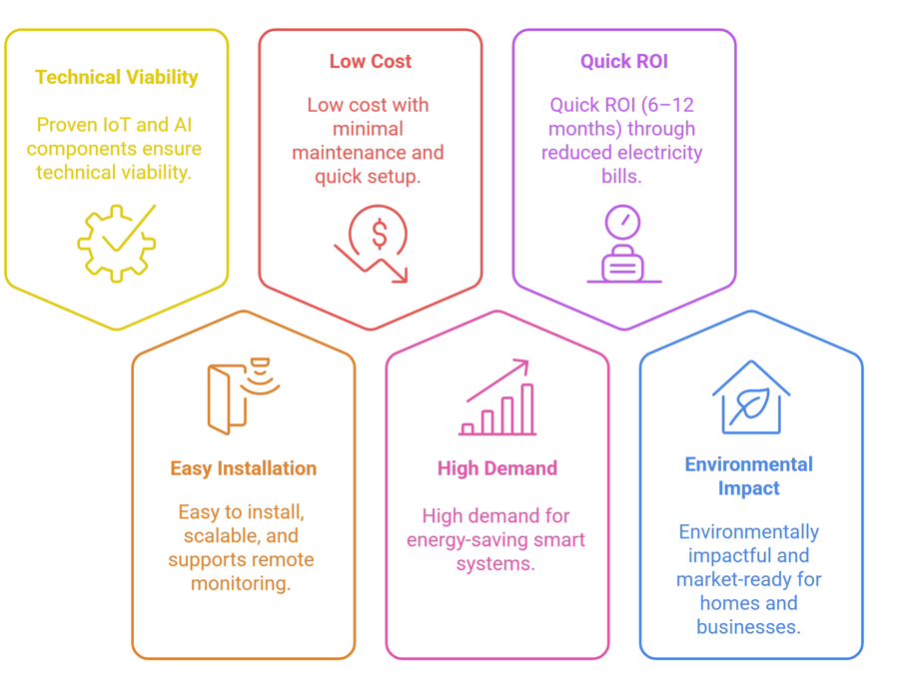
Feasibility and Viability

Slide 7
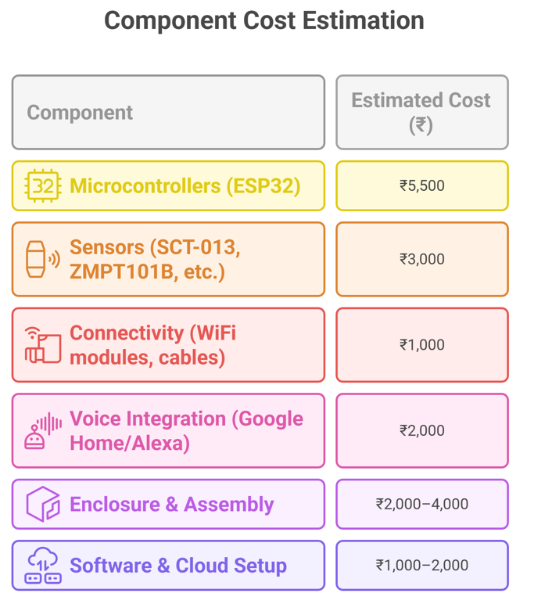
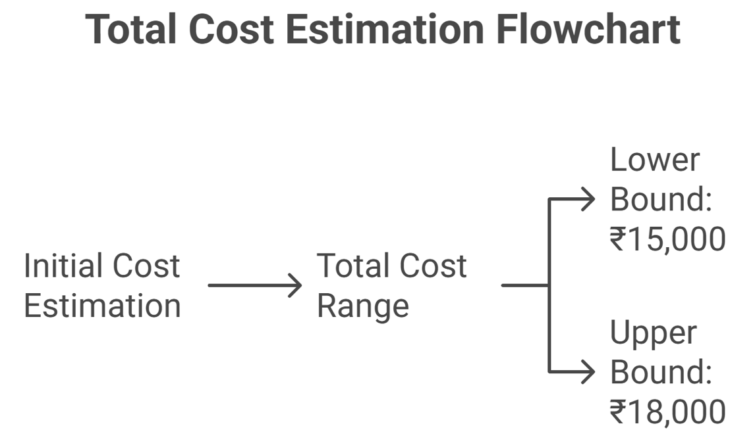

Slide 8
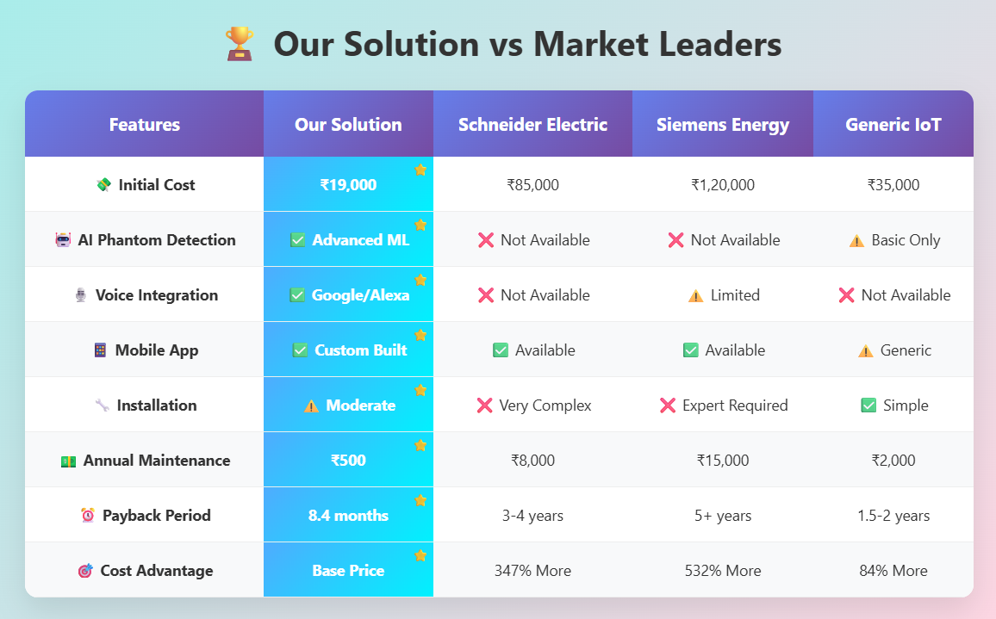

Slide 9
Impacts and Benefits
Detects and eliminates phantom (standby) loads
Reduces overall energy consumption by 15–30% and automatically cuts off unused appliances using smart relays
Saves ₹1,500–₹3,000/year per household from phantom load reduction alone
Optimized energy scheduling leads to lower electricity bills
Provides real-time voice alerts and mobile notifications with live tracking for energy spikes, faults, device control
Detects electrical faults, overloads, and anomalies
Helps prevent fire hazards by automatically switching off faulty loads
Predicts energy demand patterns and learns habits and schedules
Enables intelligent decision-making

Slide 10
Research and References
Topic Cluster | Publication / Resource | Key Take-Aways (abridged) | Link
Standby-Power Baseline | Pdf | Estimates 3-10% of household electricity; 200-400 TWh/year globally; outlines 1 W initiative. | Standby power use
Global Impact | Stanby power gov | Standby power 2% of OECD electricity (~1% of ); replacing high-standby devices cuts 70% of that load. | Global implications
Phantom Load Popular Article | Energy | Plain-language guide; lists high-draw devices; cites 5-10% bill impact for U.S. homes. | Phantom load
Whole-House Field Data | House gov | 14-169 W continuous standby in ten homes (5-26% usage); TVs, set-top boxes dominant. | Power gov

