Slide 1

Basic Details of the Team and Problem Statement
Ministry/Organization Name/Student Innovation:
Government of Gujarat
PS Code: 1362
Problem Statement Title: Student Dropout Analysis for School Education
Team Name: Data Dynamos
Team Leader Name: Deepesh kumar A S
Institute Code (AISHE): U-1153
Institute Name: Shiv Nadar University, Chennai
Theme Name: Smart Education

Slide 2
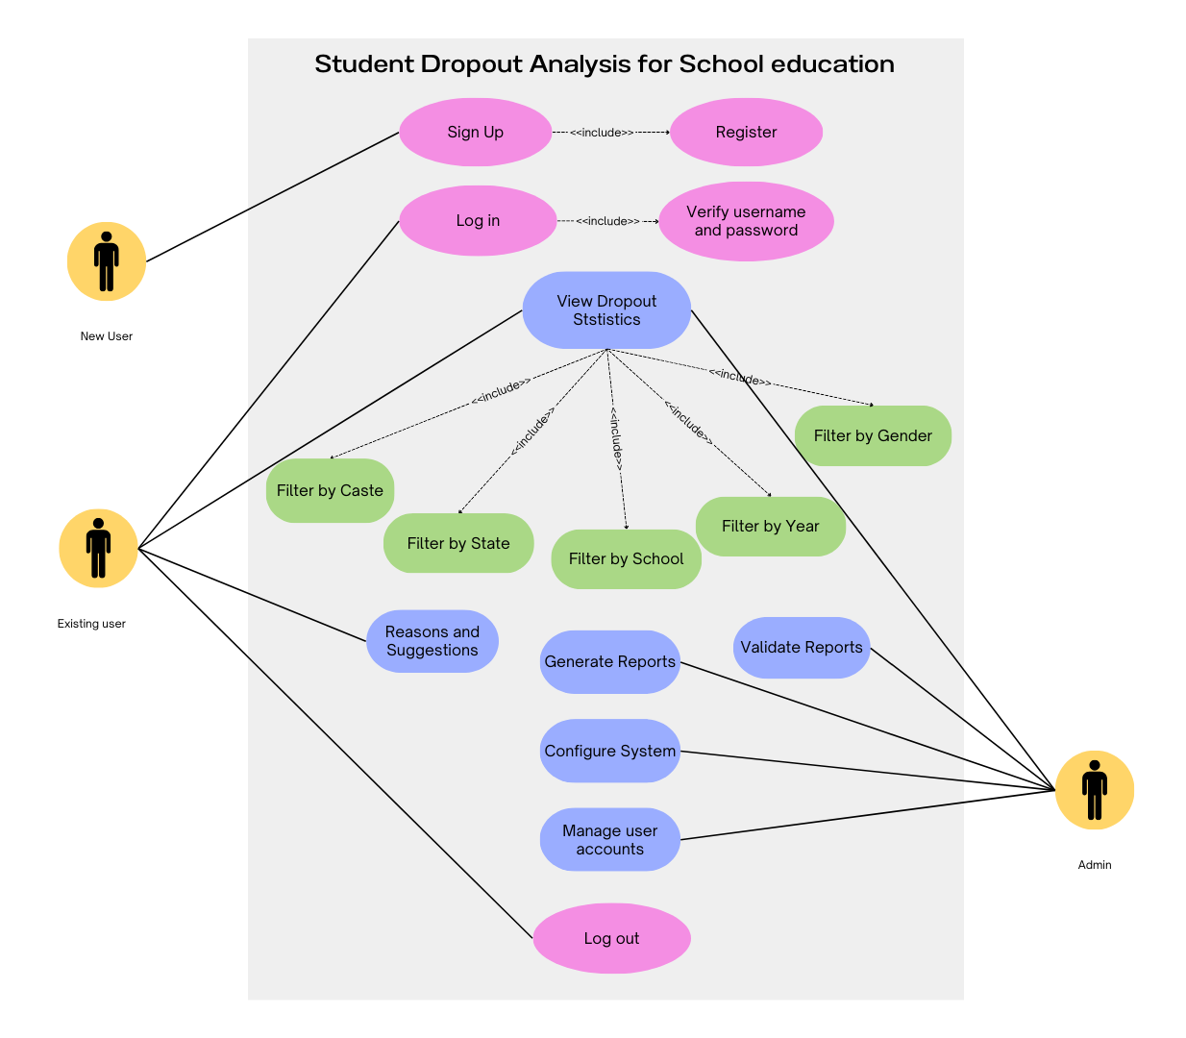
Idea/Approach Details
Describe your idea/Solution/Prototype here:
The "Student Dropout Analysis and Feedback Platform" is a web-based application that provides public access to vital education data and encourages citizen involvement in improving education outcomes.
Users can log in and select specific criteria to access dropout statistics through graphs and analysis. The platform includes an interactive feedback system for users to raise complaints, share insights into dropout reasons, and offer suggestions.
These insights are shared with government authorities, creating a vital link between citizens and policymakers to inform data-driven decisions and reduce student dropout rates.
Overall, the project integrates data visualization, citizen engagement, and government responsiveness to address the challenge of student dropouts in education.
Describe your Technology stack here:
Python Libraries:
- Plotly ( for data visualization)
- Pandas and Numpy (data preprocessing)
Flutter
Tableau embed
MS Excel

Slide 3
Idea/Approach Details
Describe your Use Cases here
Describe your Dependencies / Show stopper here
Researchers and policymakers can use the platform to analyze dropout rates, identify trends, and make data-driven decisions to improve education policies and programs.
School districts can use the platform to allocate resources more effectively by identifying schools or areas with higher dropout rates.
Students and parents can provide feedback on their experiences and challenges through the platform. Can be accessed by the Admin Department to filter out the complaints and forward it to the officials.
Teachers and school administrators can use the platform to identify schools at risk of dropouts and to initiate Early intervention to provide necessary support.
Dependencies
Data Availability
Data Integration
Technology Stack Setup
Design and User Interface
Authentication and Authorization
Show Stopper
Resource Constraints
Data Privacy and Compliance
Security Vulnerabilities
Technical Challenges
Data Merging

Slide 4
Team Member Details
Team Leader Name: Deepesh Kumar A S
Branch : Btech Stream : CSE(IoT) Year : III
Team Member 1 Name: Krithiga Ravikumar
Branch : Btech Stream : CSE(IoT) Year : III
Team Member 2 Name: Chunduri Suhasini
Branch : Btech Stream : AI&DS Year : III
Team Member 3 Name: Harshath U
Branch : Btech Stream : CSE(IoT) Year : III
Team Member 4 Name: Deepak S
Branch : Btech Stream : CSE(IoT) Year : III
Team Member 5 Name: Rajarajeswari S
Branch : Btech Stream : CSE(IoT) Year : III
Team Mentor 1 Name:
Category (Academic/Industry): Expertise (AI/ML/Blockchain etc): Domain Experience (in years):
Team Mentor 2 Name: Type Your Name Here
Category (Academic/Industry): Expertise (AI/ML/Blockchain etc): Domain Experience (in years):

