Slide 1
School Students Dropout Analysis-Gujarat

Slide 2
Case study
In the year 2022, a comprehensive study was conducted by collecting data from 54,629 schools, drawing from both the National Sample Survey Office (NSSO) and the Statistics of School Education Reports. The primary objective of this study was to assess and analyze the dropout rates within the Indian education system, shedding light on critical issues affecting students' continuity in school.
Key findings from the study included:
Dropout Rates: The study revealed the following dropout rates:
Primary Education: 1%
Upper Primary Education: 5.2%
Secondary Education: 23.7%
Electricity Access: Remarkably, 31 schools out of the surveyed pool lacked access to electricity, posing significant challenges for both students and educators.

Slide 3
Major Dropout Factors: The research identified several primary reasons for student dropouts, particularly among female students. These reasons included domestic labor and early marriage, emphasizing the need for addressing socio-cultural factors affecting education.
Language Barrier: An additional substantial concern highlighted by the study was the language barrier. The research noted that language issues played a significant role in dropout rates. Since teachers were selected based on merit from various regions of the state, only a limited number possessed knowledge of local dialects. This language gap hindered students' ability to comprehend their subjects effectively.
Other Contributing Factors: The study uncovered various other factors contributing to student dropouts, including financial crises, poor infrastructure, lack of interest in education, low awareness about the importance of education, and the considerable distance between schools and students' households.

Slide 4
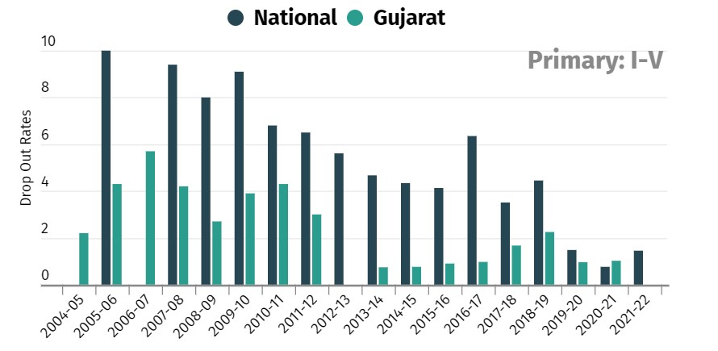
From the analysis made , the overall dropout rate of the nation is compared with that of Gujarat and is represented graphically.

Slide 5
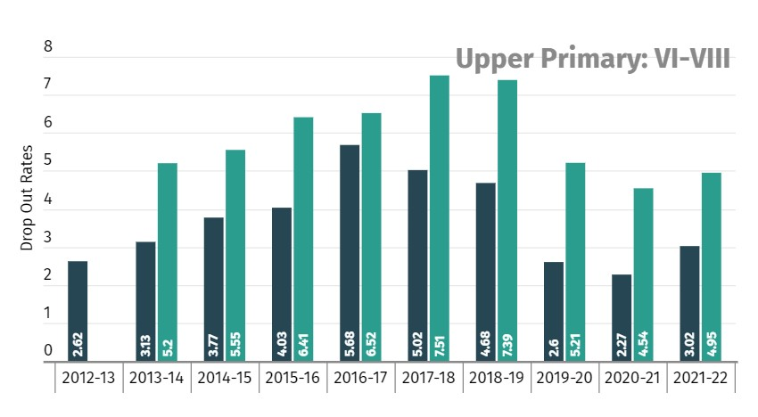

Slide 6
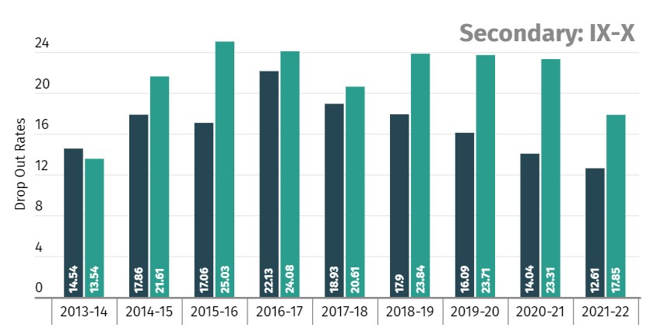

Slide 7
Interventions of the analysis
From the data from Department of Education ,Gujarat we have converted plain numbers into insightful dashboards.
While according to the National Family Health Survey-5 (NFHS-5), Gujarat ranks bottom in terms of the percentage of students who drop out of school each year in rural India.
Only over 45% of the roughly 96.4% of male primary school students enrol in higher secondary education. Around 97.3% of female students enrol at the primary level, but only about 29.2% continue to the upper secondary level in the state.
About 33% of female students drop out of school due to domestic labour, and 25% do so due to marriage

Slide 8
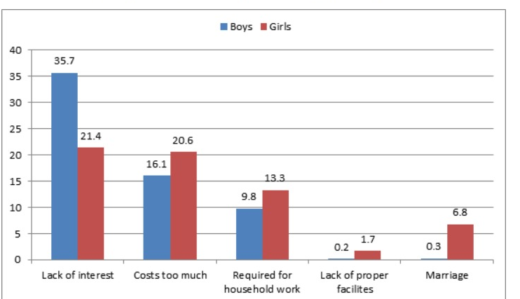

Slide 9
Flaws within the system
Gujarat has 1,657 schools with only one teacher to manage and teach the students.
Language barrier within the state
Free transportation for students from 1-12 have not been worked out from the government.
Gujarat third worst with 1 lakh kids out of school at primar .. SOURCE FROM : http://timesofindia.indiatimes.com/articleshow/98618400.cms?from=mdr&utm_source=contentofinterest&utm_medium=text&utm_campaign=cppst

