Slide 1


Automotive Electronics Mini Project
BRAKE FAILURE INDICATOR WITH SPEED LIMITER
Presentation By:
Team No. 11 | NAME | USN
 | KRITHIK K | 4NM20EC051
 | MANNA MOHAMMED ZISHAN | 4NM20EC055
 | PADMASHREE P.V | 4NM20EC065
Department of Electronics and Communication Engineering

Slide 2
1. Introduction
A brake failure system is a safety feature that detects when there is a problem with a vehicle's braking system and alerts the driver.
It is designed to prevent accidents and injuries caused by brake failure, which can occur due to a variety of reasons such as a malfunctioning component or low brake fluid.
If a problem is detected, the system will provide a warning to the driver through various warning methods such as warning lights, audible alarms, or brake pedal pulsation.
Brake failure systems are an important safety feature that can help save lives and prevent accidents on the road.

Slide 3
2. Literature Survey
"Brake fault diagnosis using machine learning algorithms" (2016) by M. F. Rahman et al.[1]
This paper presents a machine learning-based approach for brake fault diagnosis using data from various sensors in a vehicle's braking system
"Design of brake failure detection system based on multi-parameter fusion" (2018) by Y. Li et al. [2]
This paper proposes a brake failure detection system based on multi-parameter fusion, which combines data from various sensors to detect brake system failures.
"Development of a brake failure warning system for electric vehicles" (2021) by M. Mahyar et al.
This paper presents a brake failure warning system for electric vehicles using a combination of sensors and microcontrollers.

Slide 4
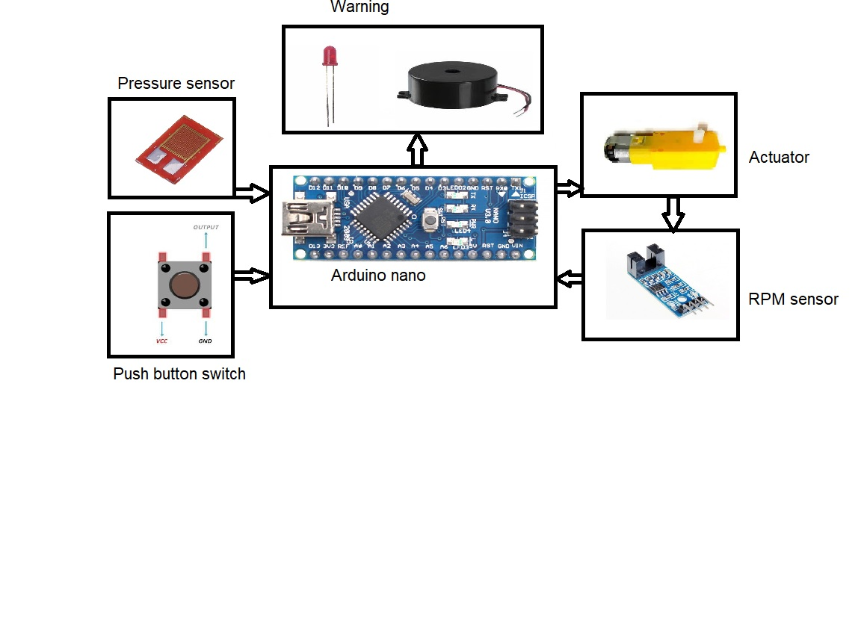
3. Block Diagram of the Proposed System

Slide 5
4. Requirements
RPM sensor
Brake pressure sensor
Microcontroller
Buzzer or alarm
Power supply
Breadboard
Wires
Switch

Slide 6
5. Design
Case 1: During Normal Operation.
An open switch indicates the normal operation of the system.
When the pressor sensor is active the speed of the motor decreases with increase in the pressure of the pressure sensor.
The Buzzer and the LEDs are OFF indicating normal operation.

Slide 7
Case 2: In case of brake failure.
A closed switch is used to show the operation of system in case of brake failure.
Even when the pressor sensor is active the speed of the motor remains same which is sensed by the RPM sensor indicating brake failure.
The Buzzer and the LEDs turns ON.
The Brake failure system is activated and the motor speed is reduced by the controller to ensure safety.

Slide 8
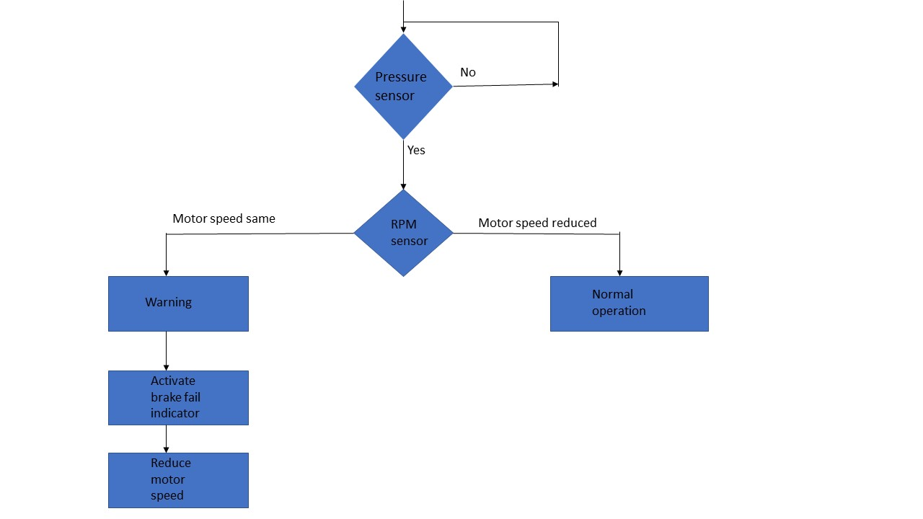
6. Flow chart
If pressure sensor value is <=600
If pressure sensor value is >=600

Slide 9
NORMAL OPERATION
IN CASE OF BRAK FAILURE
SPEED (RPM) | PRESSURE | FORCE
16530 | 0 | 0 N
1507 | 911 | 1 N
872 | 949 | 2 N
372 | 976 | 4 N
203 | 987 | 6 N
65 | 994 | 8 N
0 | 998 | 10 N
SPEED (RPM) | PRESUURE | FORCE
16530 | 0 | O N
16530 | 911 | 1 N
16530 | 949 | 2 N
16530 | 976 | 4 N
16530 | 987 | 6 N
16530 | 994 | 8 N
16530 | 998 | 10 N

Slide 10
7. Programming algorithm
Set up the microcontroller to read the input from the RPM sensor and brake pressure sensor.
Program the microcontroller to monitor the RPM and brake pressure.
Activate the break failure system in case of brake failure.
Reduce the speed of the motor using a controller ensuring driver safety.
Turn on Buzzer and LED to indicate brake failure.

Slide 11
8. Approximate Cost of the System
Components | Specifications | Cost (Rupees)
RPM sensor (Speed Measuring Sensor Groove Coupler Module For Arduino) | VCC: The positive 3.3-5 v power supply. GND: Connect power negative. DO: TTL switch signal output. AO: This is analog output. | 60
Brake pressure sensor (High Precision Resistance Strain Gauge) | Resistance:120 Ω,Strain Limit:2%,Sensitivity Coefficient:2.10 | 70
Microcontroller (Arduino nano) | Analog input pins 8 (A0 - A7);Analog input range 0-5V;ADC resolution10-bit (1024 levels) | 750-800
Buzzer or alarm | Piezoelectric or magnetic Operating voltage range 3-30V;Rated frequency range 1kHz - 20kHz (approximate) | 30
Breadboard | Distribution Strips are two; Withstanding Voltage is 1,000V;ABS plastic through color legend | 70
Wires | Copper wire | 30
Switch | 2 pin mini switch | 10

Slide 12
9. Market Availability
Most new vehicles come equipped with brake failure systems as a standard safety feature.
Additionally, many aftermarket companies offer retrofit brake failure systems that can be installed in older vehicles.
The availability of brake failure systems in automobiles varies depending on the market and the type of vehicle
In many developed countries, such as the United States, Europe, and Japan, brake failure systems are mandatory safety features in all new vehicles
It is important to note that brake failure systems are not a substitute for regular brake maintenance and inspection
It is essential to properly maintain and repair the braking system of a vehicle to ensure optimal safety and performance.

Slide 13
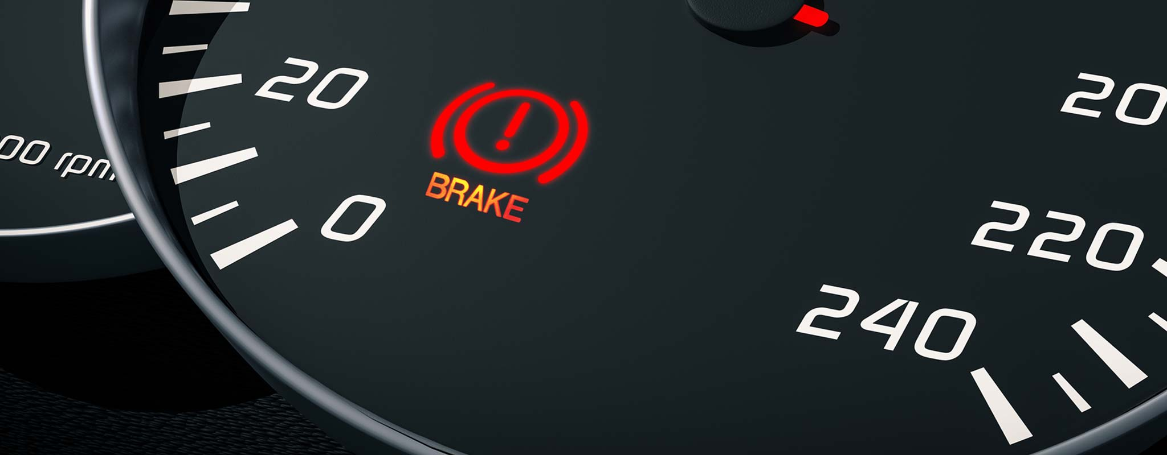
10. Existing System
Brake warning light:
Most vehicles have a brake warning light on the dashboard that comes on when there is a problem with the braking system. The light may come on if the brake fluid level is low or if there is a problem with the brake pads, calipers, or other components.

Slide 14
Brake pedal pulsation:
Some vehicles are equipped with a brake pedal that pulsates when there is a problem with the braking system. This may be caused by a malfunctioning ABS (anti-lock braking system) or other brake system components.

Slide 15
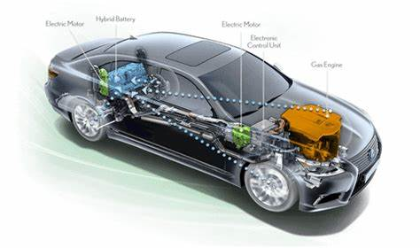
Electronic stability control:
Electronic stability control (ESC) is a safety feature that is designed to help drivers maintain control of their vehicles during sudden maneuvers or in slippery conditions. ESC systems can detect when there is a problem with the braking system and can apply the brakes automatically to help prevent accidents.

Slide 16
11. References
[1]https://www.researchgate.net/publication/341407743_Rahman_et_al2016.
[2]https://www.researchgate.net/publication/337608535_Li_et_al_2018_JOB
[3] “Design and Development of a Brake Failure Indicator with Extended Speed Limiter System" by P. C. Nagaraja and V. V. Rao(Research paper)
[4] Development of a Brake Failure Indicator System with Speed Limiter for Passenger Cars" by S. M. Farukuzzaman, M. M. Islam, and M. S. Hossain.(Research paper)

Slide 17


