Slide 1

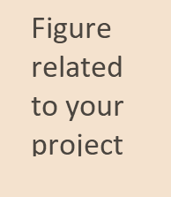
TechTreasury
Presented by
Guided by
Akshata Athreya (1RVU23CSE035)
Amogha V Prasad
(1RVU23CSE046)
Sritama Banerjee
Submitted for the partial fulfillment
of
BTech (Hons)
in
School of Computer Science and Engineering
School of Computer Science and Engineering
December - 2023

Slide 2
Content
Abstract
Introduction
Theory and fundamentals
Objectives
Related work
Methodology
Tools and technologies
Testing / Experimentation
Data collection / Data analysis
Findings and results
Applications
Conclusion
Future scope
References
TechTreasury
December - 2023
2

Slide 3
1. Abstract
This project introduces a user-friendly website designed for the seamless registration of electronic goods, catering to the growing need for efficient documentation and tracking of such products. The primary goal of this project is to address the absence of a comprehensive system for tracking electronic goods with a value below 350 USD. For consumers, the website offers a secure and organized platform to maintain records of their electronic purchases. By providing a user-friendly platform for registration, the project benefits individual users and manufacturers. TechTreasury aspires to be the catalyst for innovation in the electronic industry.
TechTreasury
December - 2023
3

Slide 4
2. Introduction
It is an online platform for selling and buying electronic goods.
In a world increasingly reliant on electronic devices, the lack of a centralized platform for registering and managing these goods poses challenges for consumers, manufacturers, and regulatory bodies alike.
In terms of broader societal impact, the website contributes to reducing electronic waste by fostering responsible ownership and disposal practices.
Additionally, it facilitates the tracking of stolen devices, acting as a deterrent to theft and promoting a safer electronic goods market.
TechTreasury
December - 2023
4

Slide 5
3. Theory and fundamentals
Clicking on a product in the catalog leads to the product details page.HTML incorporates details such as product images, specifications, pricing, etc.
CSS styling maintains consistency with the overall theme and ensures readability of product information.
JavaScript is used to enhance interactivity, such as implementing image sliders, form validation, and dynamic content loading.
TechTreasury
December - 2023
5

Slide 6
4. Objectives
Provide a seamless and user-friendly e-commerce experience for buyers, from product discovery to checkout.
Establish a comprehensive catalog of electronic components, covering a wide range of products.
Ensure the quality and authenticity of products by implementing a rigorous supplier verification process.
Develop a responsive website design for easy access on various devices.
Optimize performance to ensure quick load times and smooth navigation.
TechTreasury
December - 2023
6

Slide 7
6. Methodology
Utilize modern JavaScript features, such as ES6 modules, for better code organization and maintainability.
Organize JavaScript code into modules or classes, aligning with the component-based structure.
check(form), to encapsulate the form validation logic. This function should return true only when all validations pass, allowing the form to be submitted.
Employ modular validation functions (e.g., validate Password, validate Email) for individual form fields. These functions can be invoked as needed, promoting code modularity and reusability.
TechTreasury
December - 2023
7

Slide 8
7. Tools and technologies
Date and Time Display : display_datetime() Function
Auto Refresh Display: Image Slider Functions (initialslide(), plusSlides(n), showSlides(n))
TechTreasury
December - 2023
8

Slide 9
8. Implementations /Testing
Date and Time Display and Refresh: Manually observes accurate date and time. Checks for a display refresh every second.
Image Slider :Manually interacts with slider navigation. Observes smooth slide transitions.
User Feedback Prompt: Manually triggers and observes the feedback prompt. Checks if feedback is collected correctly.
Confirmation Prompt: Manually triggers and confirms/cancels the prompt. Validates the appearance of the confirmation prompt.
Form Validation: Manually submits the form with valid and invalid data. Confirms successful submission with valid data and appropriate error messages for invalid data.
TechTreasury
December - 2023
9

Slide 10
9. Data collection / Data analysis
Gathered comprehensive details for product registration encompassing essential attributes such as product name, cost, color, validity date, and a succinct product description.
Prioritized data integrity to maintain the accuracy and reliability of product information, establishing a foundation for effective management and future utilization.
Adopted a structured format to enhance accessibility and usability of the product data, fostering efficient handling, retrieval, and potential integration into diverse systems or applications.
TechTreasury
December - 2023
10

Slide 11
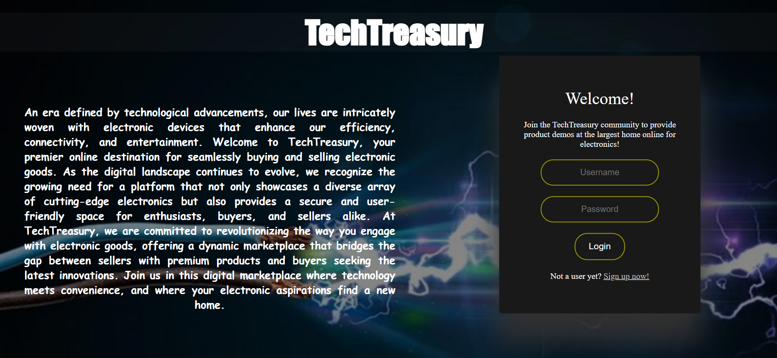
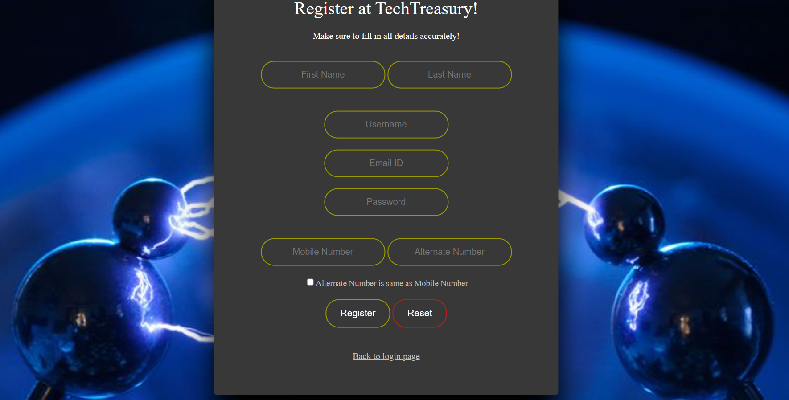
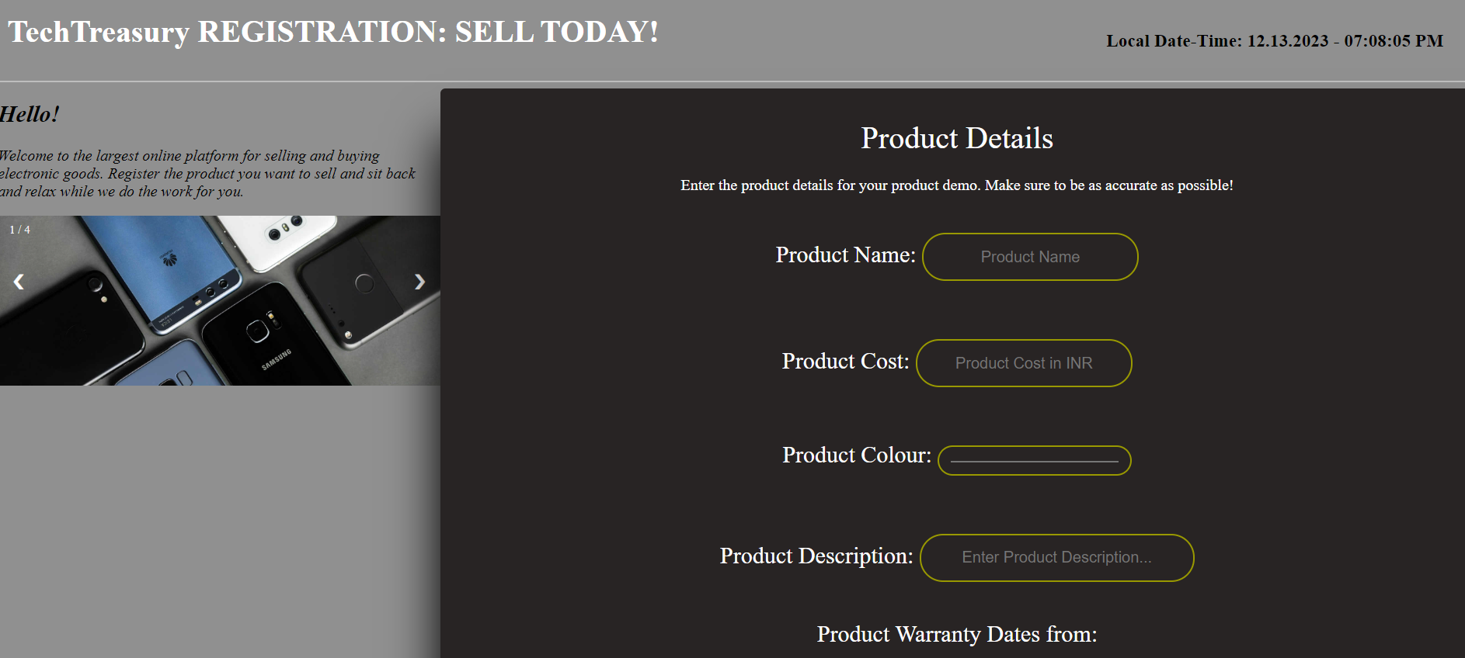
10. Findings and results
TechTreasury
December - 2023
11

Slide 12
10. Findings and Results
Successful Signup: User enters valid information in the signup form. System validates the data, registers the user, and displays a confirmation message.
Invalid Signup: User submits incomplete or invalid data. System prompts error messages for specific fields, guiding the user to correct the information.
Image Slider Interaction: User navigates through product images using the image slider. The slider provides a visual representation of the showcased products.
Date-Time Display: Current local date and time are dynamically displayed. Enhances user experience with real-time information.
TechTreasury
December - 2023
12

Slide 13
11. Applications
Online Marketplace: Facilitates buying and selling of electronic goods.
Interactive Features: Includes an image slider and live date-time display.
User Authentication: Enables secure user signup and login.
Structured Product Form: Offers a clear form for organized product registration.
TechTreasury
December - 2023
13

Slide 14
12. Conclusion
The provided webpage establishes an online marketplace for electronic goods, allowing users to effortlessly buy and sell products. Its interactive features, including an image slider and live date-time display, enhance user engagement. With a focus on user authentication, the platform ensures secure access through straightforward signup and login processes. The structured product registration form further simplifies the process, enabling users to input detailed information for effective and organized product listings.
TechTreasury
December - 2023
14

Slide 15
13. Future scope
The project aims to streamline the process of electronic goods registration, promoting transparency, accountability, and traceability.
Regulatory bodies can utilize the centralized database for monitoring the market and ensuring compliance with safety standards.
Community Engagement:
A dedicated community space allows users to share their experiences, seek advice, and connect with fellow electronic enthusiasts.
Regularly updated blogs, tutorials, and forums contribute to a vibrant and engaged user community.
TechTreasury
December - 2023
15

Slide 16


