Slide 1
Learning to Augment

Slide 2
What is Augmentation?
Augmentation improves the performance of supervised learning algorithms through improving the models ability to generalise.
Similar to other hyper-parameters, we can find the “optimal” augmentation that is applied consistently throughout learning.
Augmentation policies and schedules is a generalisation of standard augmentation. It enables the augmentation applied to be varied through training.

Slide 3
Why do we need Augmentation?
By learning augmentation policies, the agent can control what augmentation applied through training:
  For example: Increasing the variety of augmentation applied when the validation loss starts to converge might improve performance. However, applying all of the augmentation at the start might prevent initial learning.

Slide 4
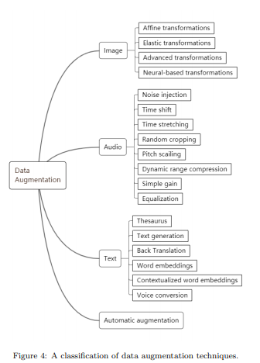
Types of Augmentation
Taken from https://arxiv.org/pdf/1908.00709.pdf

Slide 5
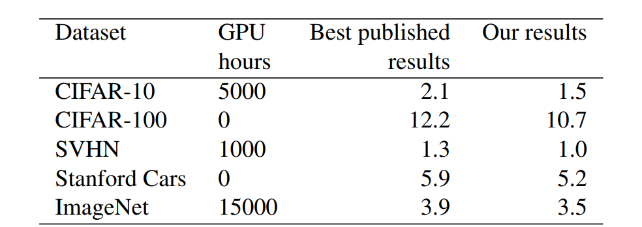
Reinforcement Learning
AutoAugment, was one of the first papers to use RL for learning augmentation policies. Whilst it pushed the SOTA, it was incredibly slow. PPO was the agent used to learn the policy.
Taken from https://arxiv.org/pdf/1805.09501.pdf

Slide 6
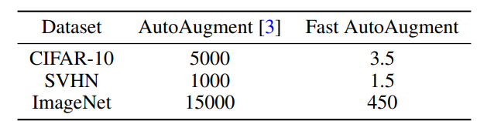
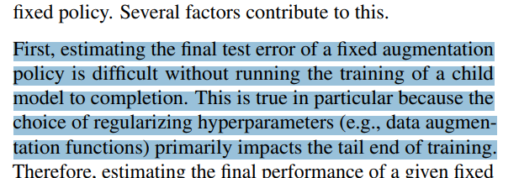
Bayesian Methods
Fast AutoAugment, was a follow up to this paper that maintained performance but drastically reduced computational cost; this was achieved through bayesian optimisation.
Taken from https://arxiv.org/pdf/1905.00397.pdf
Taken from https://arxiv.org/pdf/1905.05393.pdf

Slide 7
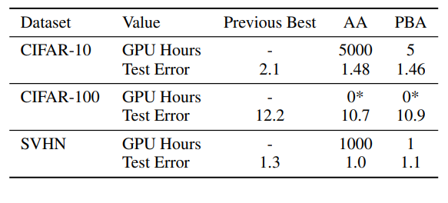
Population Based Methods
Population Based Augmentation, achieves similar speedups to Fast AutoAugment and a similar performance (although not directly compared in literature).
Uses Population Based Training (Jaderberg et al.) and rather than learning a policy, learns a schedule.
Taken from https://arxiv.org/pdf/1905.05393.pdf

Slide 8
Augmentation Policy vs Schedule
With a policy, the augmentation method is determined based on how the learning is progressing.
With a schedule, the augmentation methods are predetermined to occur at specific events or length of time.
  It appears from the Population Based Methods paper, schedules are easier to learn (more exploration needed to confirm).

Slide 9
Applications to Medical Problems
Improving the performance of models on small or imbalanced datasets.
Augmentation policies can be effectively transferred to similar problems.
Can be re-applied to “optimally” trained models for further performance improvements.

Slide 10
Tools to be used:
Standard small datasets during development: mnist, cifar-10, svhn
  http://yann.lecun.com/exdb/mnist/
  https://www.cs.toronto.edu/~kriz/cifar.html
  http://ufldl.stanford.edu/housenumbers/
Tensorflow
  https://www.tensorflow.org/
Ray (RL agents and search algorithms)
  https://docs.ray.io/en/latest/

Slide 11
Other papers I plan to look into:
GridMask Data Augmentation
Maximum-Entropy Adversarial Data Augmentation for Improved Generalization and Robustness
Exemplar VAE: Linking Generative Models, Nearest Neighbor Retrieval, and Data Augmentation

Slide 12
Other papers I plan to look into:
A Survey on Deep Learning of Small Sample in Biomedical Image Analysis
AutoML: A Survey of the State-of-the-Art

Slide 13
Going forward

