Slide 1

ASSESSMENT
Krithiksri Venkatachalam 29-03-2024

Slide 2
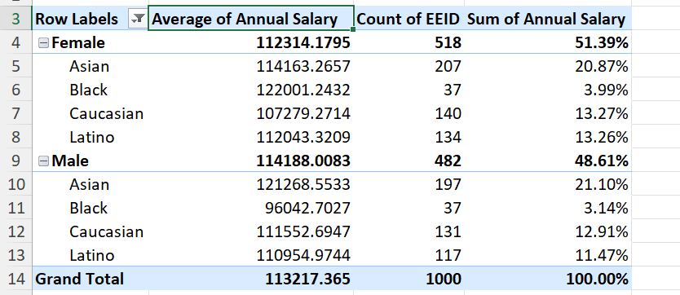
1)Summary of gender and ethnicity distribution
There are four ethnicity and has average salary of 113217 and maximum 51.39% for male salary

Slide 3
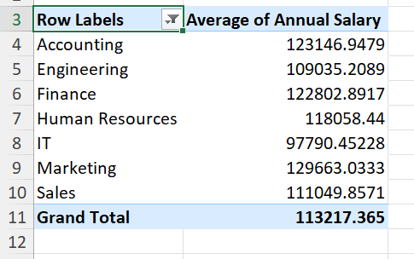
3)Difference in salary
The difference between the annual salary in departmentwised

Slide 4
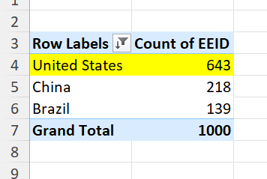
4)Highest number of employees

Slide 5
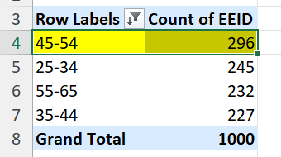
5)Age range-45-54

Slide 6
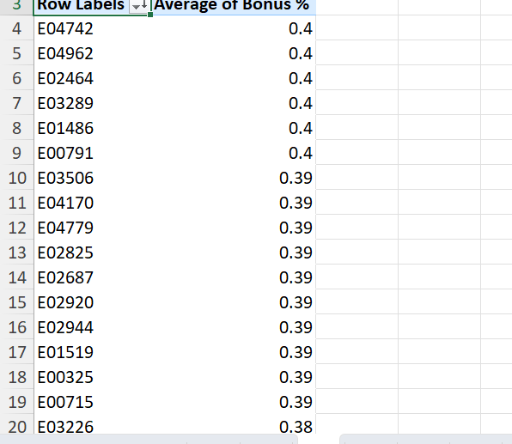
Q6)Bonus average

Slide 7
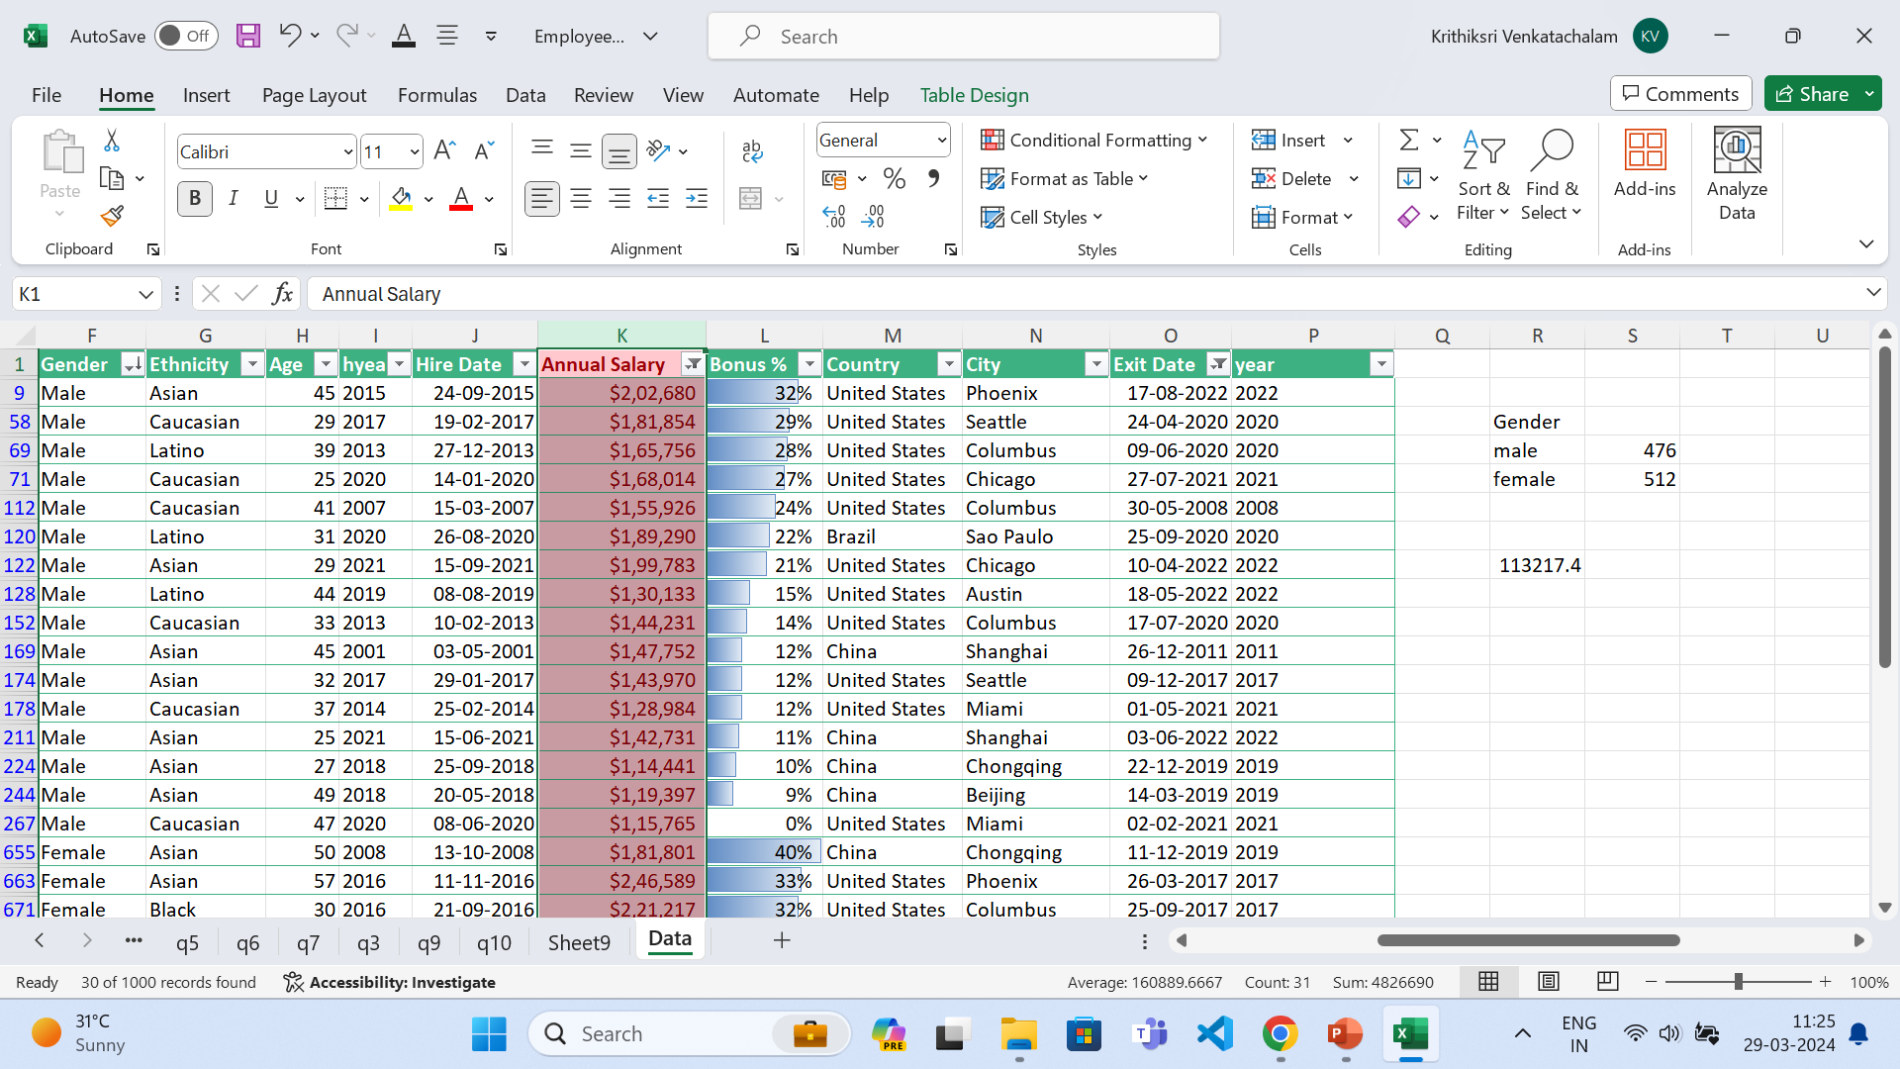
Q8)Primary reasons

Slide 8
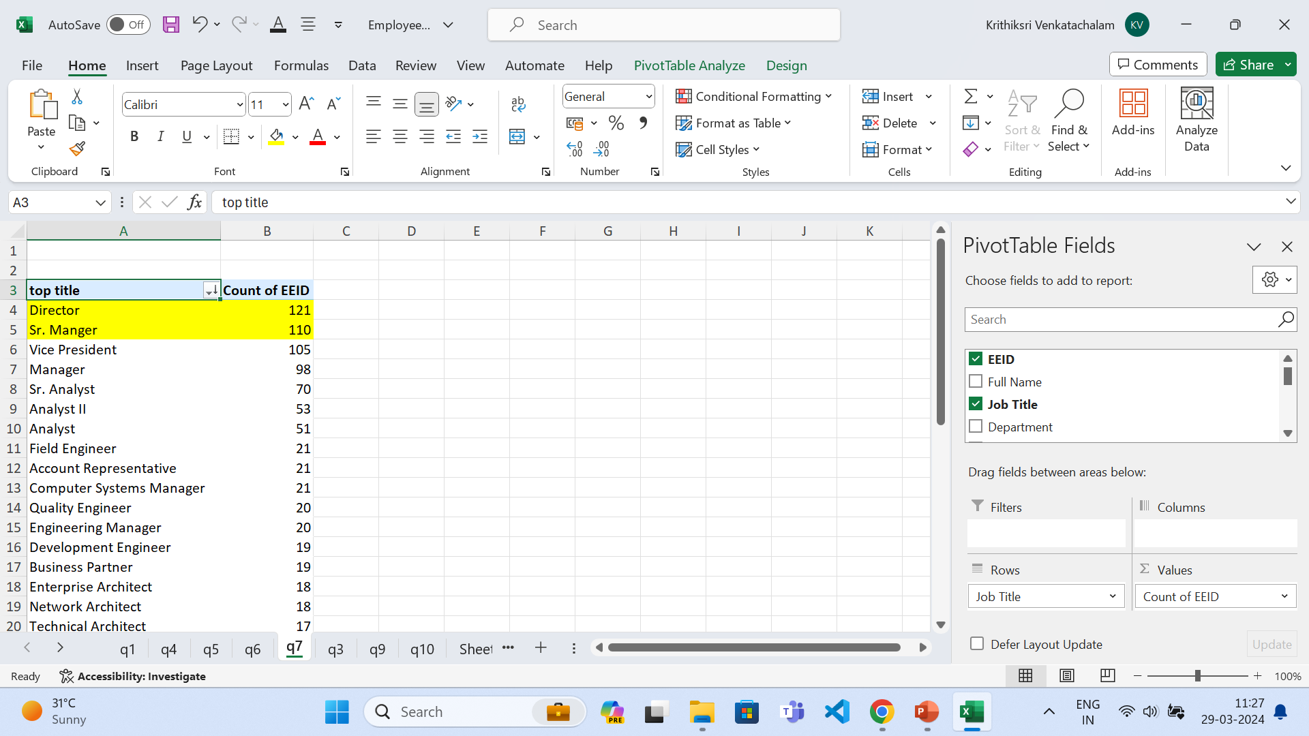
Q7)

Slide 9
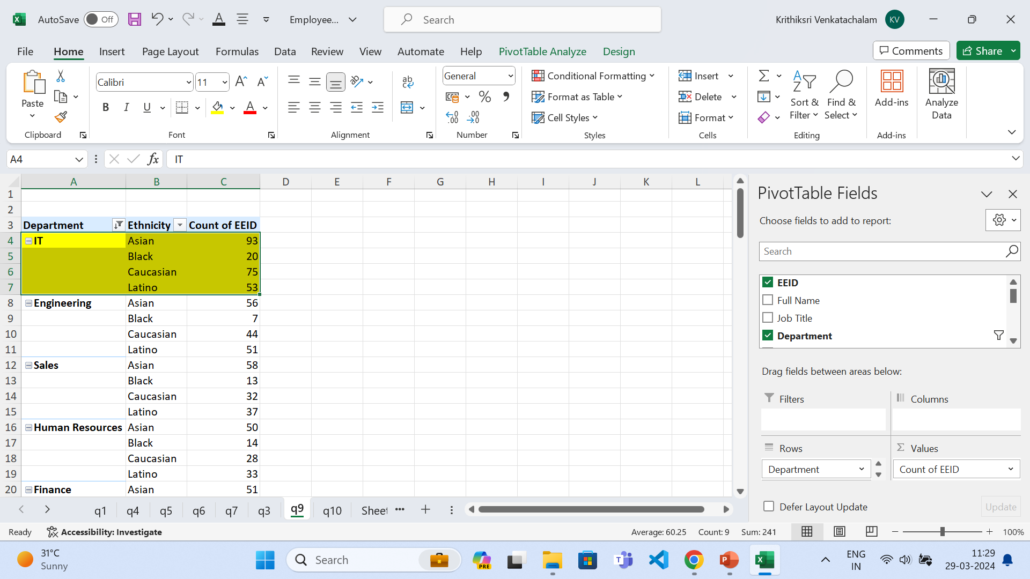
Q9)departmentwise

Slide 10
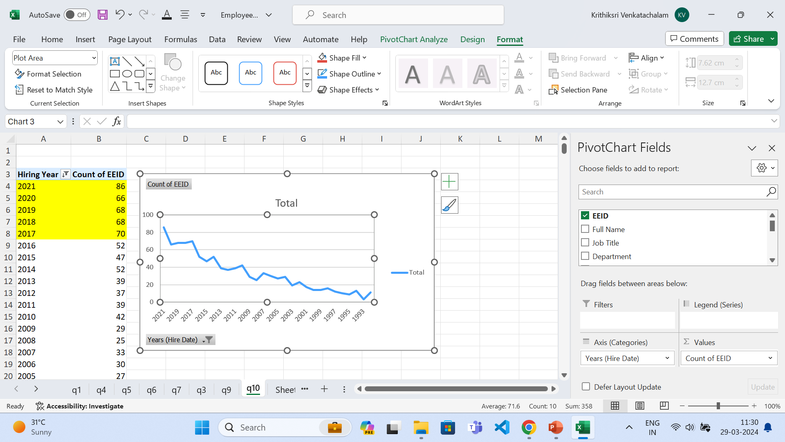
Q10)yearwise hike

