Slide 1

New York City
Abhinay Imandi Ryan kozlowski Adam Olderr Everardo Marquez Krithin Venkatesh
Team Lead Email
z1856513@students.niu.edu

Slide 2
NEW YORK CITY
New York City has a population of roughly 8.623 million people
NYCDOT says that 56% of all automobile trips are under 3 miles in distance, and 22% are under 1 mile
55% of New York City residents use public transportation, whereas 28% of citizens own a private vehicle such as a car, van, truck, or motorcycle
New York City is comprised of five harbors which increases the need for transportation because the influx of commerce brings more people to the city everyday

Slide 3
Bike share program
HOW DOES IT WORK?
Locate a citiBike station via the app or in person.
There are citiBike docks, and dockless bikes that allow you to leave the bike anywhere in the area
Buy a day pass or a membership and enter the ride code or member key into the bike and it is ready to go
citiBike program was introduced to New York City May 23, 2013
At the time of its debut, the 6,000 bikes in the citiBike program made NYC the largest bike share program in America
Citi Bike is operated by Motivate, the global leader in bike share. A full-service bike share operator and technology innovator
Bike share was created to reduce emissions, road wear, collisions, traffic congestion, public health

Slide 4
STORY
CitiBike for the New York Commute
By checking on the average usage of bike rides
Checking on the increasing subscribers and customers
Increase in the total number of bikes and stations over the years
To what extent people are using bikes.
Average bikes rides between the locations

Slide 5
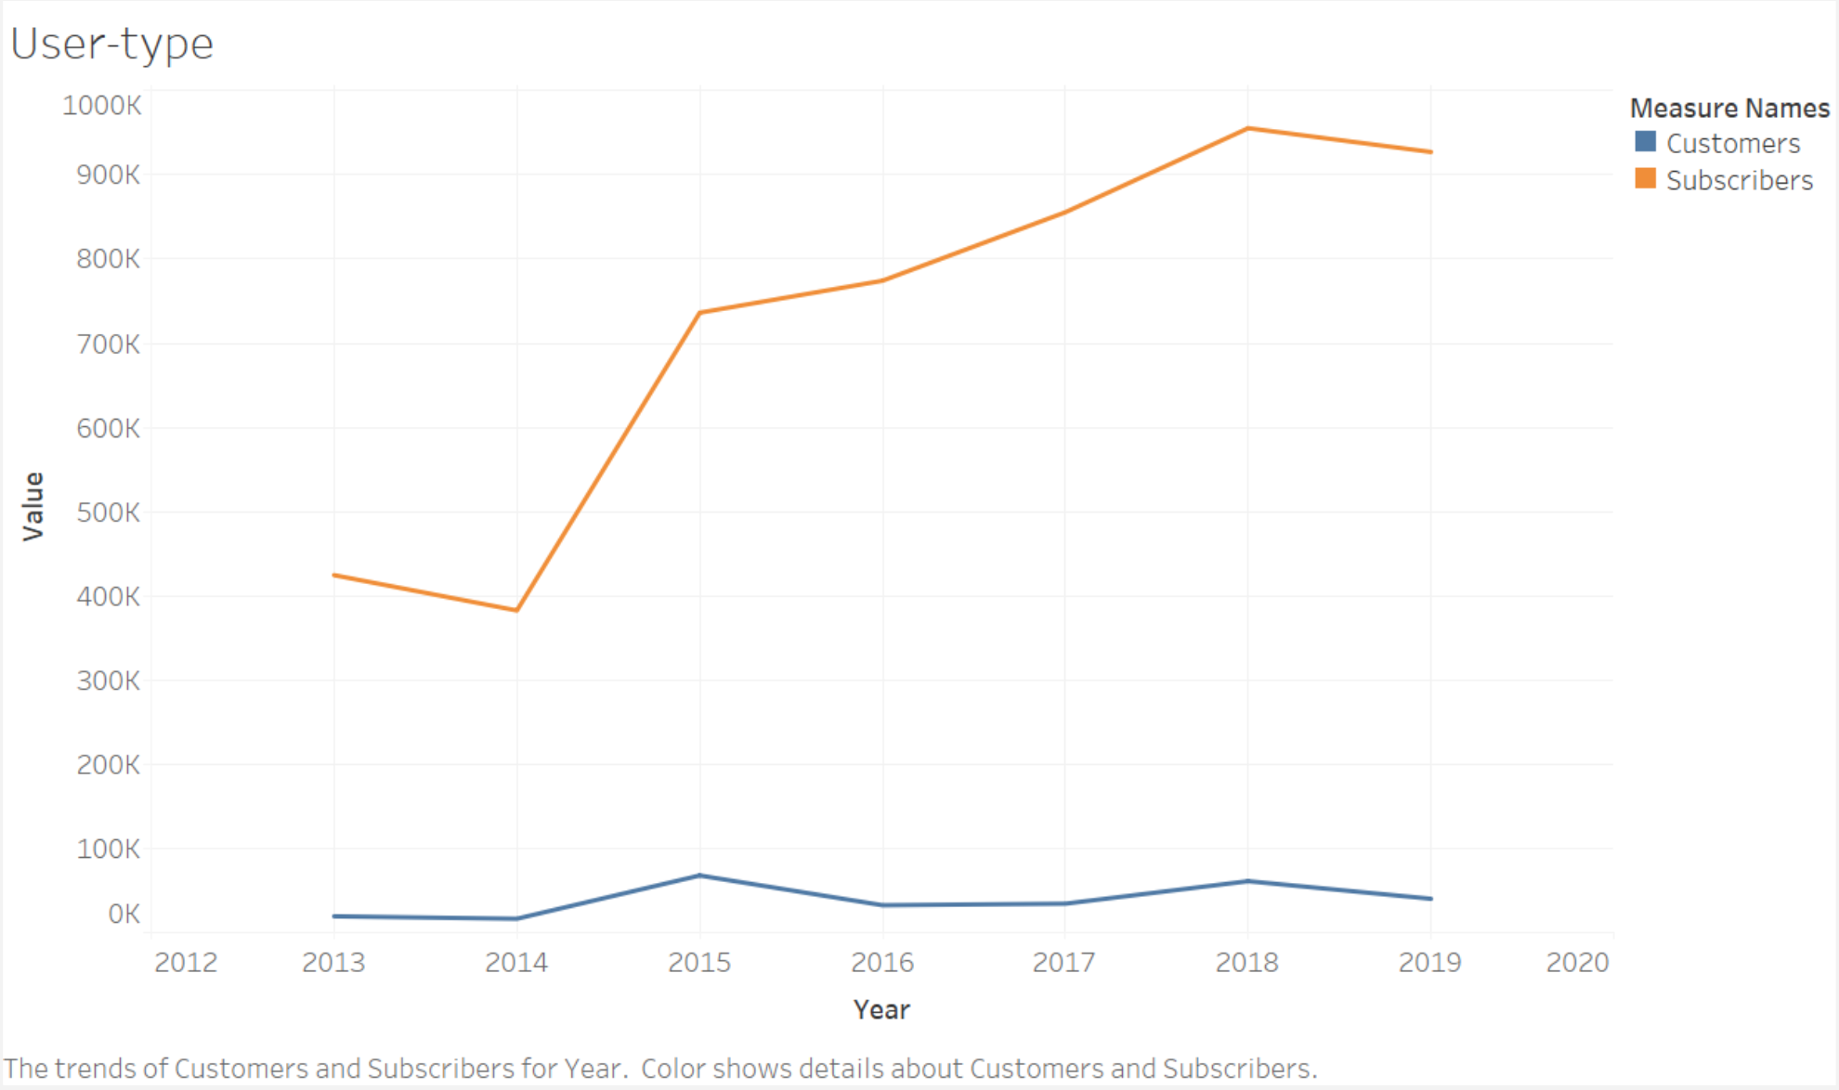
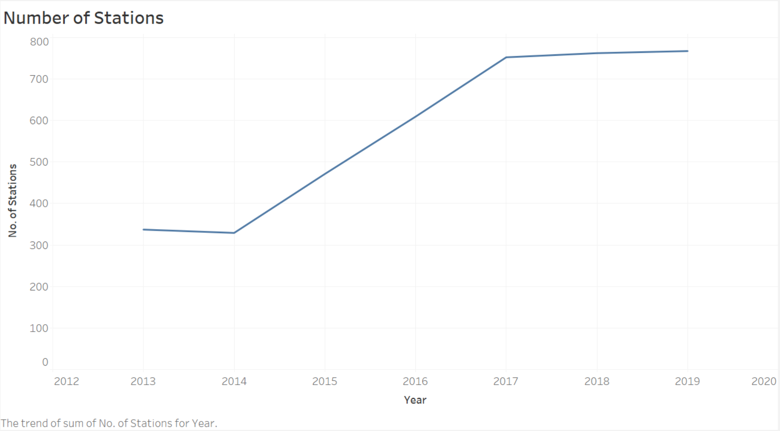
Subscribers vs Customers
Number of citiBike stations

Slide 6
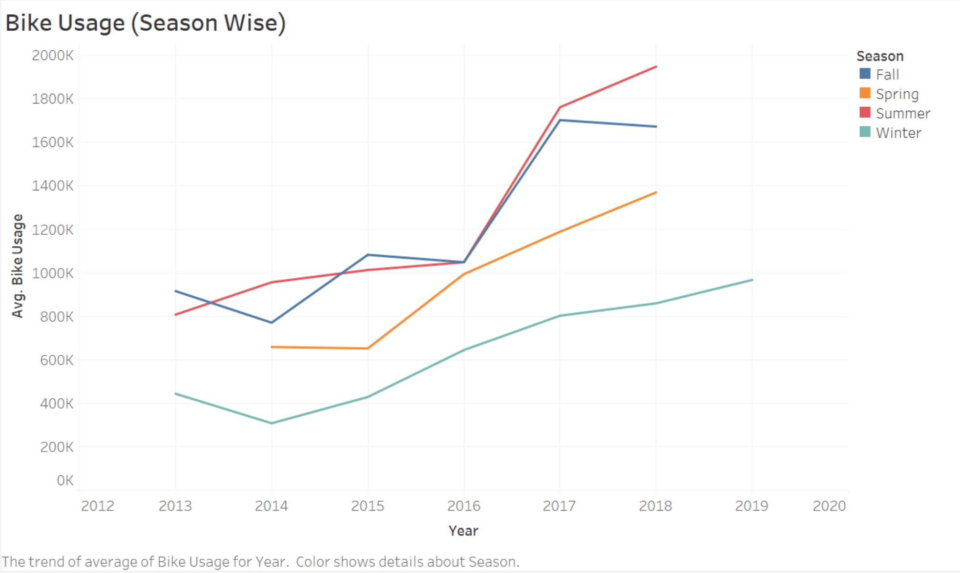
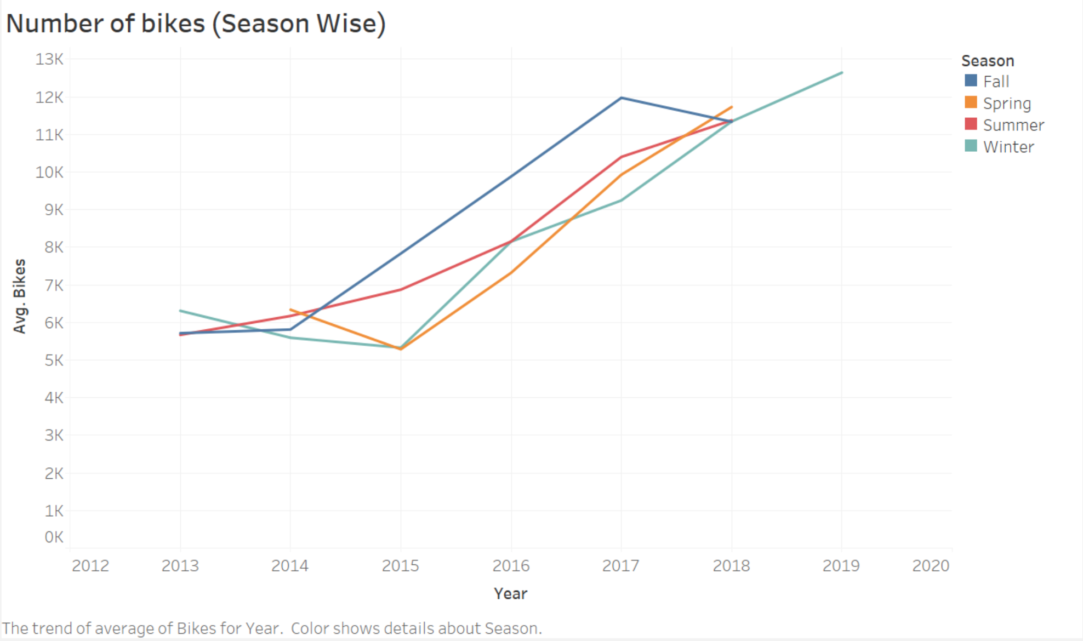
Bike usage & number of available bikes by season

Slide 7
Thanks!

