Slide 1
Implementing Data Science Solutions in the Energy Sector
Using AI to Optimize Efficiency, Reduce Costs, and Improve Sustainability

Slide 2
Introduction
The energy sector is undergoing a significant transformation, driven by the need for:
  Increased efficiency
  Reduced emissions
  Enhanced operational performance
Data science and AI are pivotal tools to achieve these objectives, as demonstrated by Vistra Corp.'s AI initiatives.

Slide 3
Problem Statement
Traditional energy operations face challenges including:
  Operational inefficiencies leading to high costs and wastage
  Unexpected downtime causing financial losses
  High carbon emissions contributing to environmental degradation
  Fragmented data systems hindering decision-making

Slide 4
Objectives
Enhance operational efficiency through data analytics.
Implement predictive maintenance to reduce downtime.
Reduce emissions and achieve sustainability goals.
Develop a unified data platform for informed decision-making.

Slide 5
Proposed Data Science Solutions
1. Predictive Maintenance: Use LSTM models to forecast equipment failures.
2. Energy Optimization: Apply reinforcement learning for dynamic adjustments.
3. Emission Monitoring: Use Random Forest for real-time tracking and reduction.
4. Integrated Data Platform: Centralize analytics and reporting.

Slide 6
Case Study: Vistra Corp.
Vistra Corp., in collaboration with McKinsey, implemented AI solutions to:
- Improve efficiency via Heat Rate Optimizer (HRO)
- Achieve $4.5M in annual savings
- Reduce 340,000 tons of carbon emissions
HRO provided recommendations every 30 minutes for optimized operations.

Slide 7
Implementation Plan
Phase 1: Assessment and Planning
- Evaluate current operations and data infrastructure.
Phase 2: Data Collection and Integration
- Deploy sensors and build a unified data platform.
Phase 3: Model Development and Testing
- Train and validate AI models for maintenance and optimization.
Phase 4: Deployment and Monitoring
- Implement models and establish performance tracking.

Slide 8
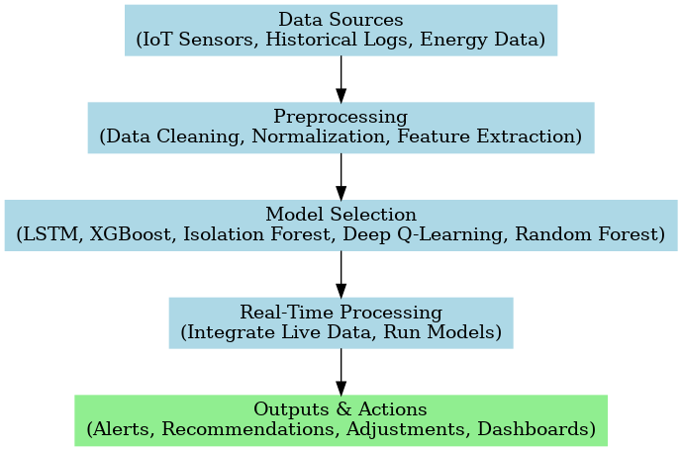
Algorithmic Flowchart

Slide 9
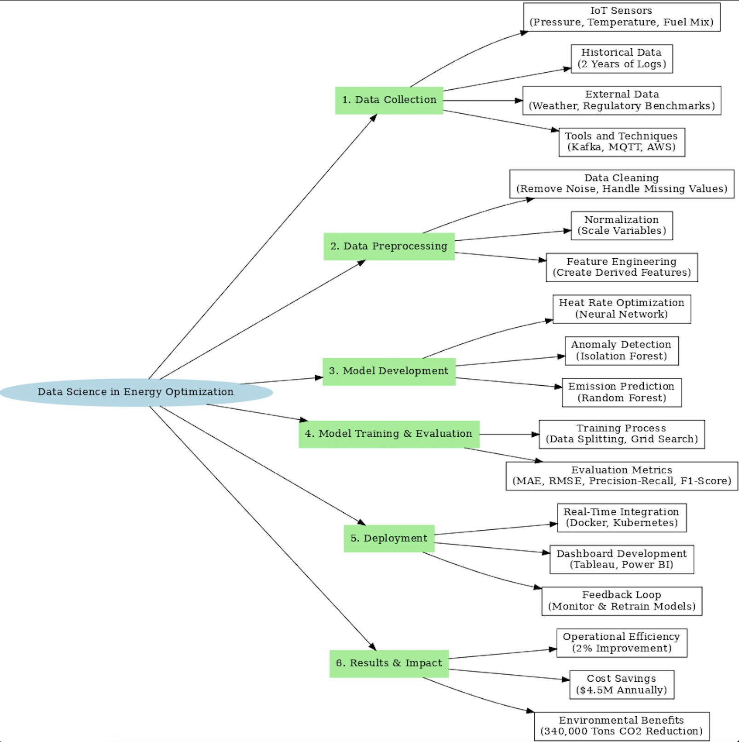
Detailed Flowchart

Slide 10
Expected Outcomes
1. Operational Efficiency: Anticipated 2-3% improvement.
2. Cost Savings: Projected $3-5M annually.
3. Emission Reduction: Estimated 300,000 tons of CO2 annually.

Slide 11
Conclusion
AI and data science can revolutionize the energy sector by:
- Enhancing efficiency
- Reducing costs
- Supporting sustainability goals
Drawing from Vistra Corp.'s success, this proposal provides a roadmap to position the organization as a leader in innovation.

