Slide 1
AI and Data Science for Energy Optimization
A Comprehensive Proposal for AI Implementation in the Energy Sector

Slide 2
Problem Statement
1. Operational inefficiencies lead to increased costs and energy wastage.
2. Unplanned downtime causes financial losses and service interruptions.
3. High carbon emissions contribute to environmental and regulatory challenges.
4. Fragmented data systems hinder comprehensive decision-making.

Slide 3
Objectives
1. Enhance operational efficiency using data science techniques.
2. Implement predictive maintenance to reduce downtimes.
3. Reduce carbon emissions and achieve sustainability goals.
4. Develop a unified data platform for holistic analysis and reporting.

Slide 4
Proposed Data Science Solutions
1. Predictive Maintenance: Use time-series analysis (LSTM) to forecast equipment failures.
2. Energy Optimization: Apply reinforcement learning (Deep Q-Learning) for dynamic adjustments.
3. Emission Monitoring: Use classification models (Random Forest) to track and reduce emissions.
4. Integrated Data Platform: Develop dashboards for real-time insights and reporting.

Slide 5
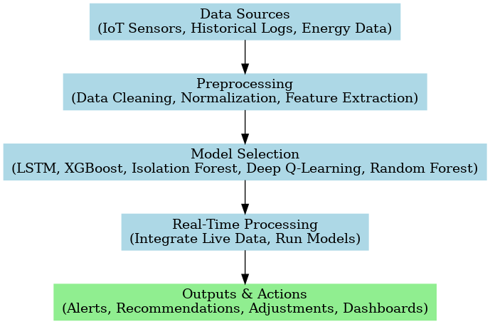
Algorithmic Flowchart

Slide 6
Case Study: Vistra Corp.
1. Heat Rate Optimizer (HRO):
- AI models provided real-time recommendations to improve thermal efficiency.
2. Results:
- 2% increase in efficiency within three months.
- $4.5 million in annual savings.
- 340,000 tons of CO2 reduction, equivalent to removing 66,000 cars annually.

Slide 7
Implementation Plan
Phase 1: Assessment and Planning
- Evaluate current operations and data infrastructure.
Phase 2: Data Collection and Integration
- Deploy sensors and build a unified data platform.
Phase 3: Model Development and Testing
- Train and validate models for predictive maintenance and optimization.
Phase 4: Deployment and Monitoring
- Implement models and monitor performance.

Slide 8
Expected Outcomes
1. Operational Efficiency: Anticipated 2-3% improvement.
2. Cost Savings: Projected $3-5 million annually.
3. Emission Reduction: Estimated 300,000 tons of CO2 reduction annually.

