Slide 1
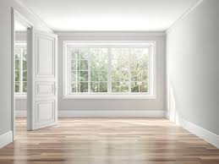
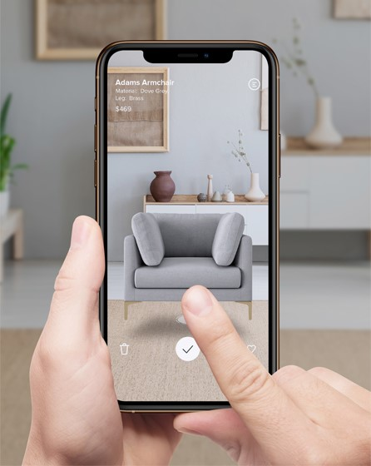
SnapAR
Home designing
and visualizer app

Slide 2
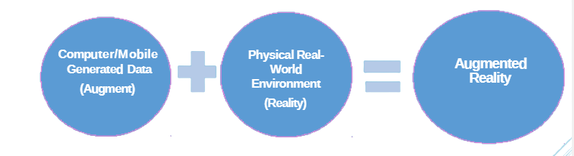

What is AR?
A combination of a real scene viewed by a user and a virtual scene generated by a computer that augments the scene with additional information.

Slide 3
Where we use?
Education: Interactive concepts better engage students
Healthcare: Organ modeling helps save lives
Fashion and beauty:Try before you buy
Marketing: Augmented reality makes ads pop
Interior designing and Visualization
Manufacturing: 3D augmented reality save time and money

Slide 4

Problems facing while shopping
Don’t know how a new sofa would look in your apartment in real time?
Are you taking risk that you are paying for something that doesn't fit?
Cannot visualize the size, color, and placement of the furniture prior to purchasing?
Decorating your house but no idea where to place your decorative items and what paint color to choose for your wall?
So many problem you are facing but do not know the solution?

Slide 5
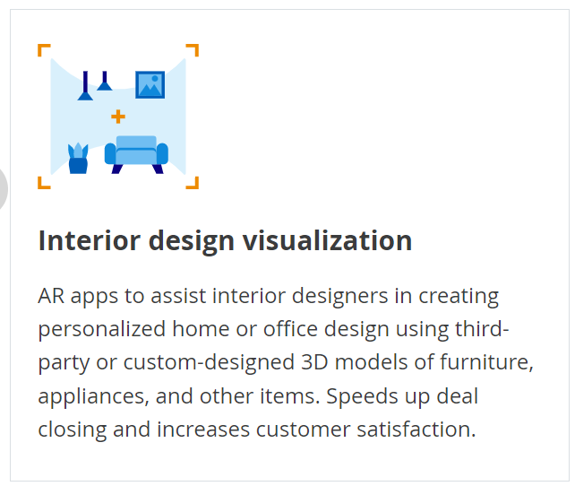

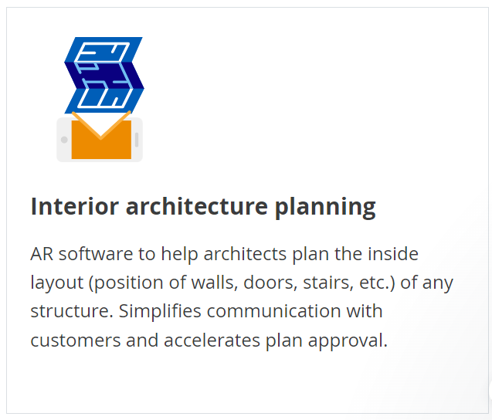
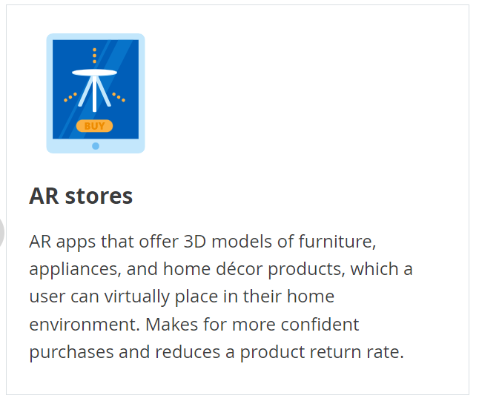
Let’s talk about solution

Slide 6


Slide 7
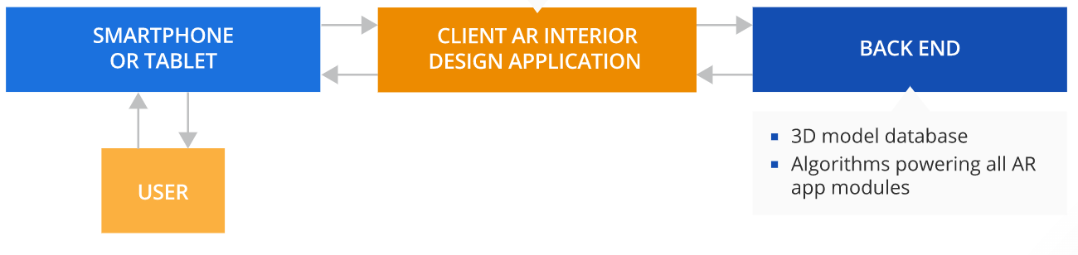
AR Interior Design Solution Architecture
The key elements are the client app and the back end. While all the key processes of an AR app perform on the client side, the algorithms that power these processes run on the back end. Thus, the client AR app always remains lightweight and fast-functioning.

Slide 8
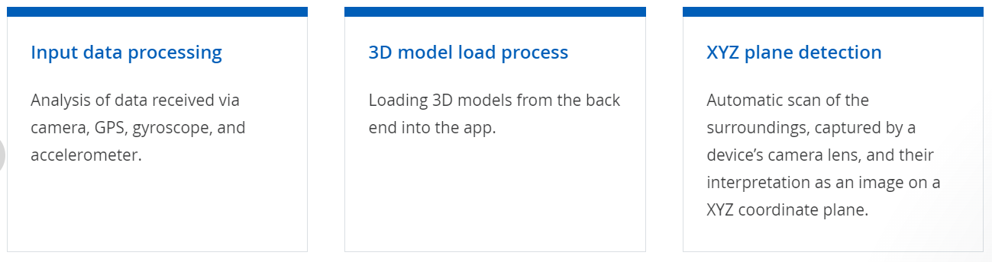
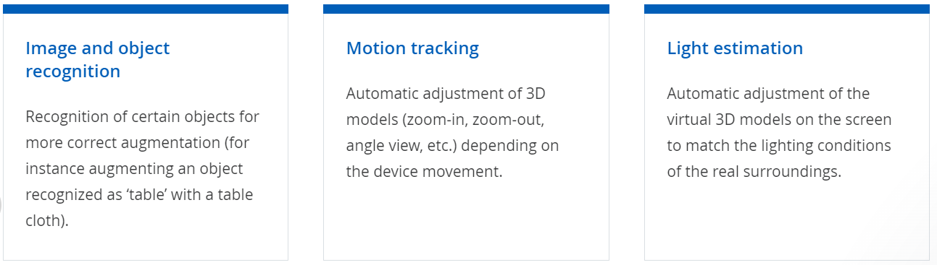
The key modules of the AR app are responsible for:

Slide 9
Tech Stacks
Constraints
Android version >=7
Mobile with working camera
Permission for the app to use the camera.
Storage required: 200MB
3D Modelling: Blender
Designing: Figma
AR Application: Unity3d, ARCore, ARFoundation
Languages: C#
Cloud Services: Google Cloud

Slide 10
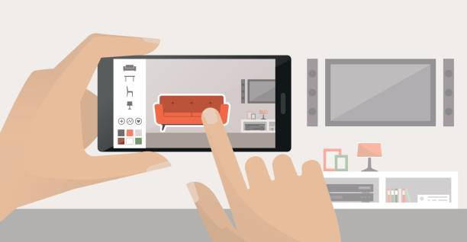
How to use the app
Download apk and install it in your phone and allow the app to access your camera
Using the camera on your phone, the app can place a selected product into your space on-screen.
Simply choose product model, press the button, and the item will appear on the screen.
If want to change color of wall or color of product, then choose the color
Use the touchscreen to move the item around the room and place it where you want it.

Slide 11
Thank you
Team: Duplets
Kriti Kumari

