Slide 1




Slide 2





OBJECTIVE
To construct a process flow that will populate a CbyC Tax Return data report for FYI 2021 and subsequent years using Alteryx.

Slide 3
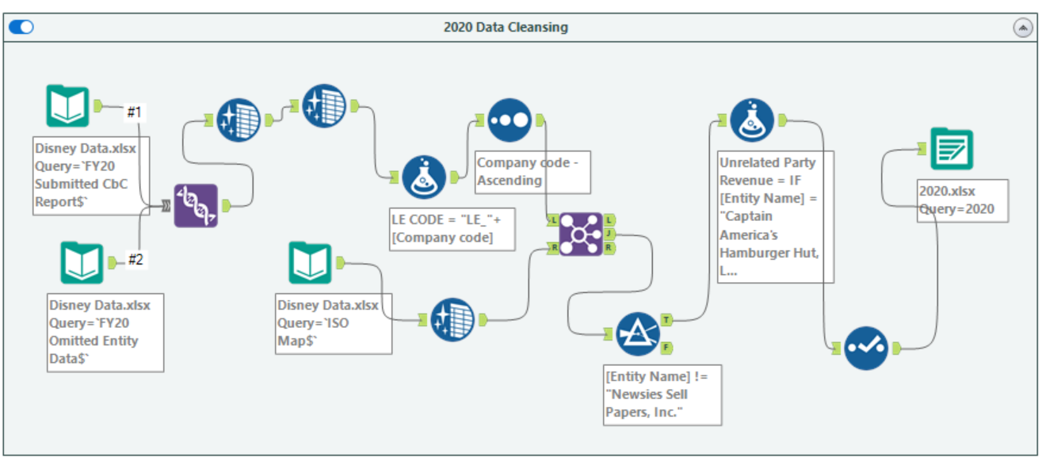
Workflow 1 – 2020 data

Slide 4
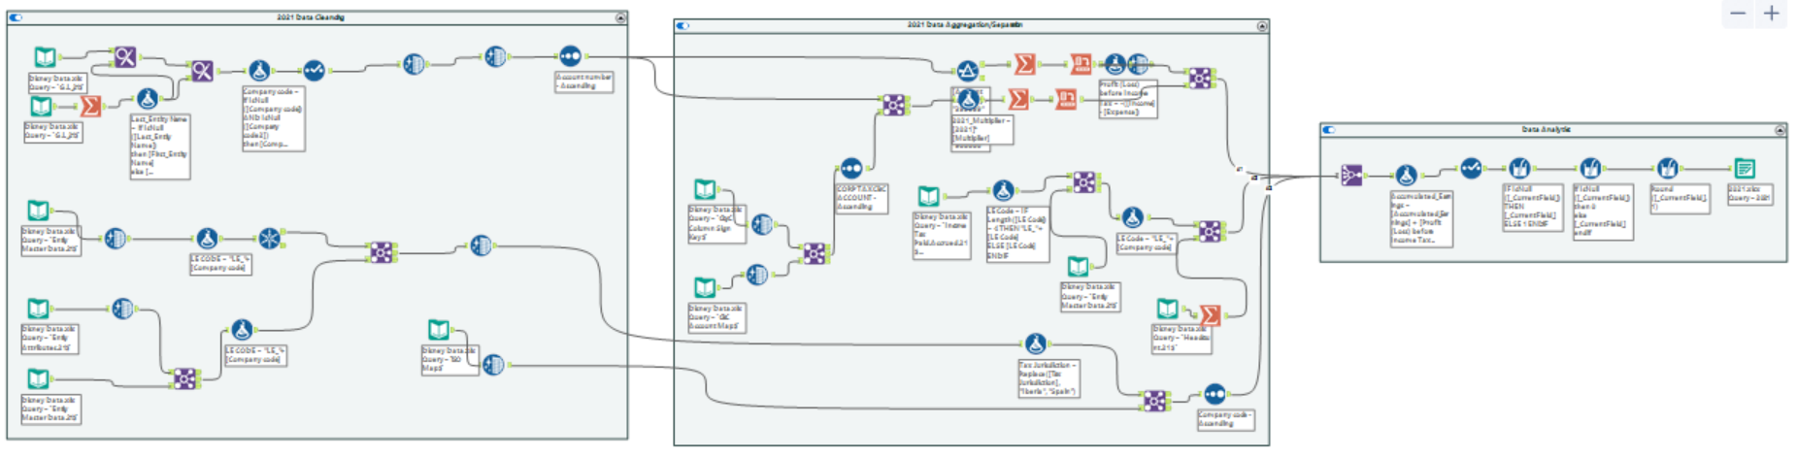
Workflow 2 – 2021 data
Data Cleansing -> Data Aggregation/Separation -> Data Interpretation & Reporting

Slide 5
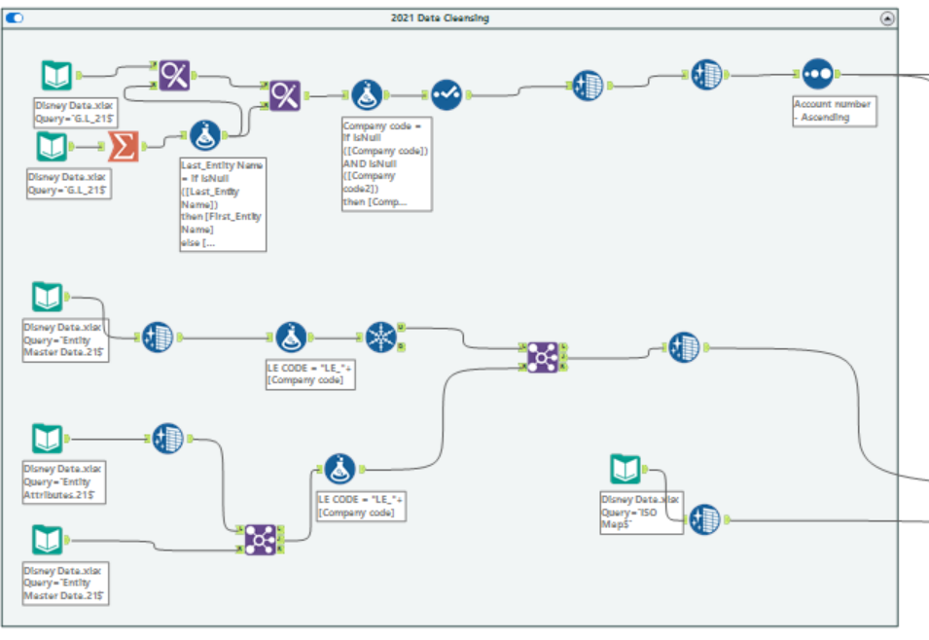
Workflow 2_breakdown – 2021 data

Slide 6
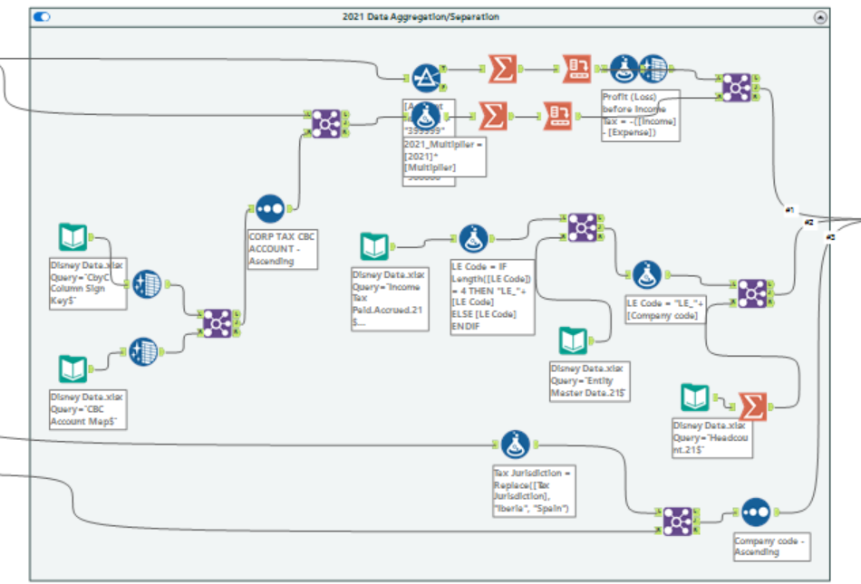
Workflow 2_breakdown – 2021 data

Slide 7
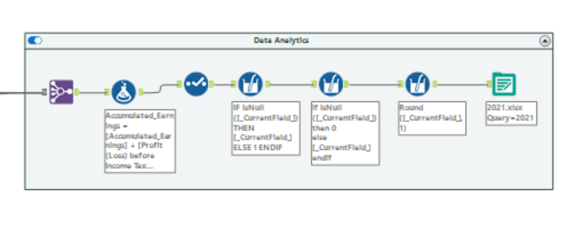
Workflow 2_breakdown – 2021 data

Slide 8
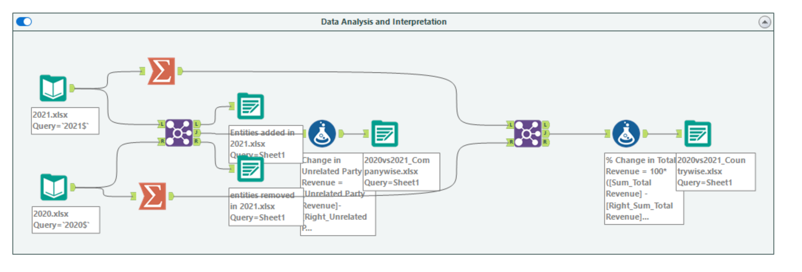
Workflow 3 – 2020 vs 2021 data

Slide 9
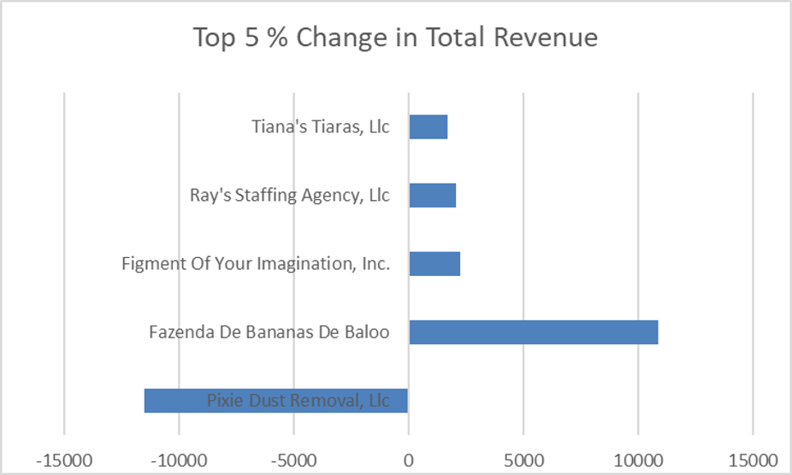
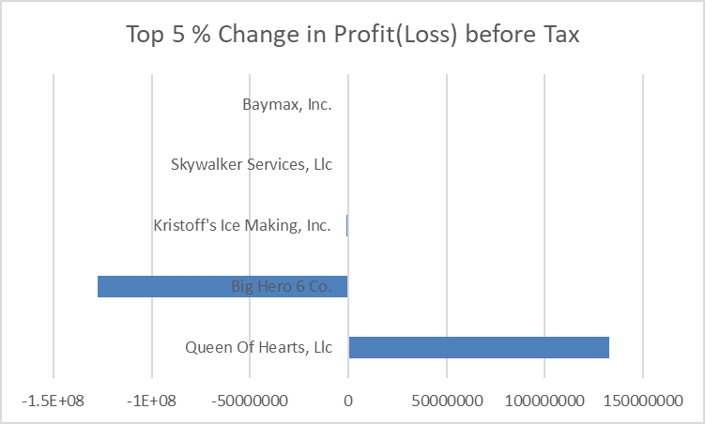
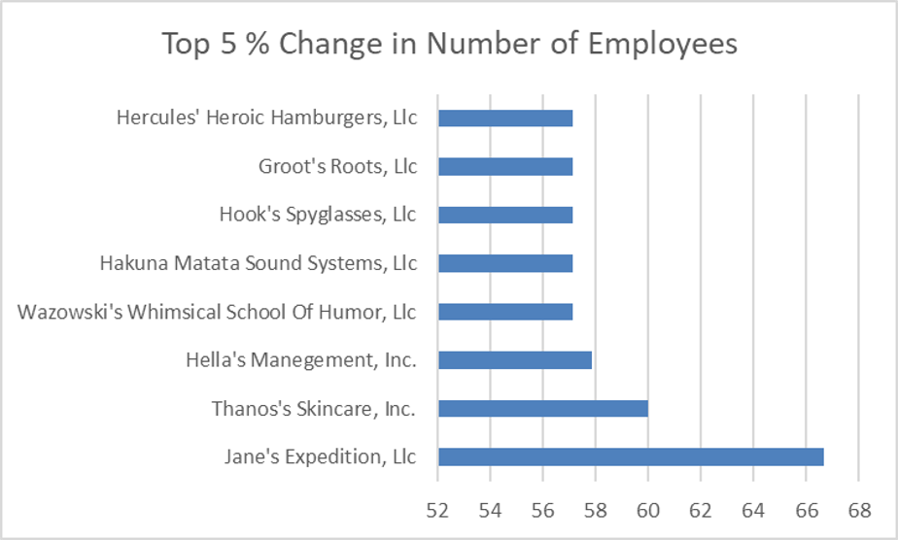
Entity-wise Data Analysis (2020 Vs 2021)

Slide 10
Top 5 largest Entities in terms of Total Revenue

Slide 11
Top 5 largest Entities in terms of Profit(Loss) before Tax

Slide 12
Top 5 largest Entities in terms of Tax Paid

Slide 13
Entities Added Newly in 2021 & Entities Dropped in 2021
Entities Added in 2021 | Entities Removed in 2021
La Aventura Conelada De Anna, Slu | Dissolved Dave's Dishwashing Services, Inc.
Banner's Anger Manegement, Inc. | Captain America's Hamburger Hut, LLC
Disney -, LLC | Rocket's Radical Mod Company
Pepa's Meteorologist Service, LLC | Liquidated Larry's Lunchtime Supply Co.
La Tienda De Magia De La Familia Madrigal | Encanto, Inc.

Slide 14
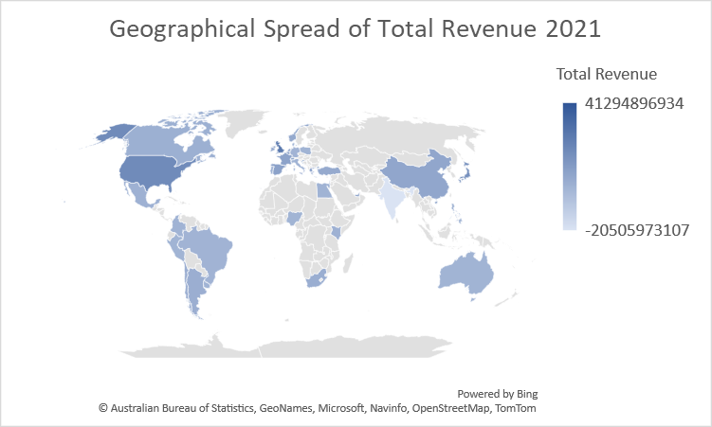
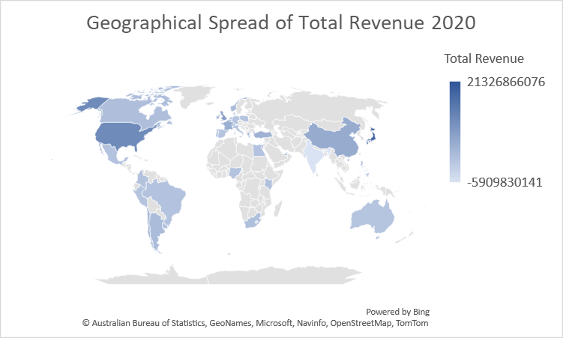
Geo Spread of Total Revenue (2020 Vs 2021)

Slide 15
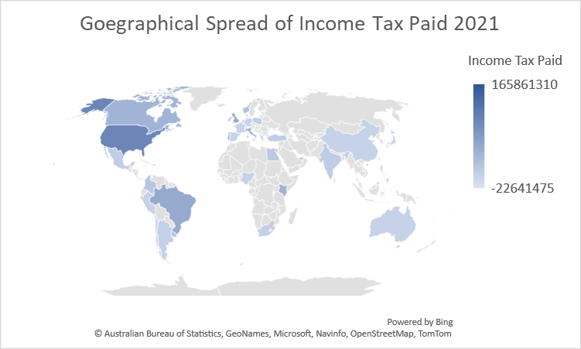
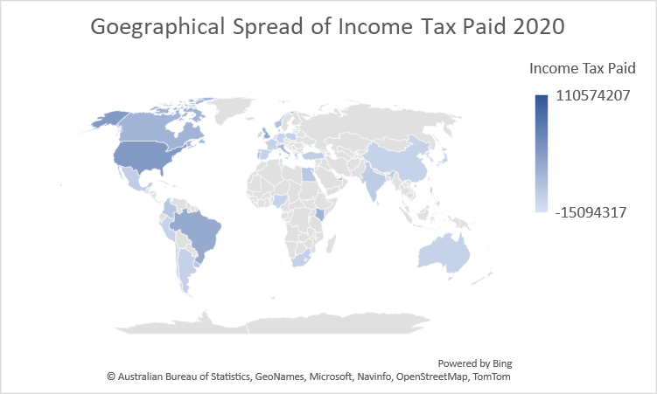
Geo Spread of Income Tax analysis (2020 Vs 2021)

Slide 16
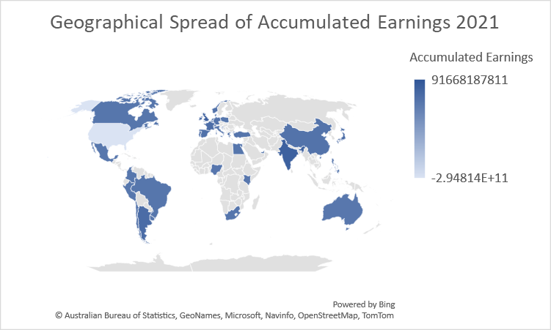

Geo spread of Accumulated Earnings (2020 Vs 2021)

Slide 17
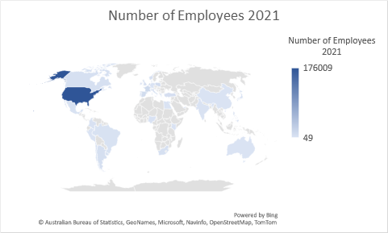
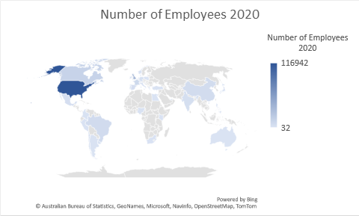
Geo Spread of Employee Head Count (2020 Vs 2021)

Slide 18
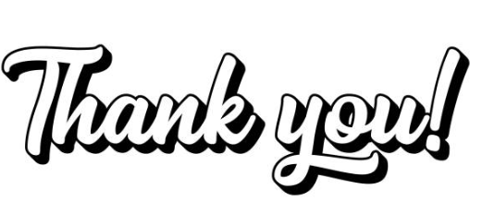
PRESENTED BY:
Group 13

Slide 19


