Slide 1

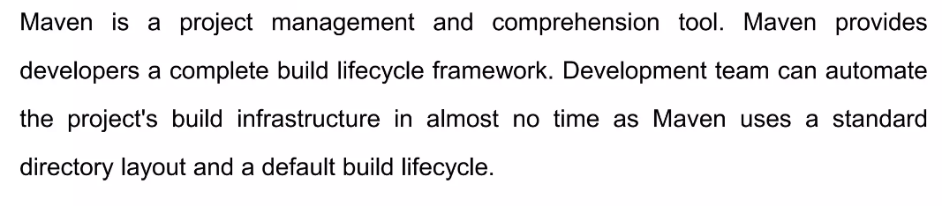
What is Maven?

Slide 2
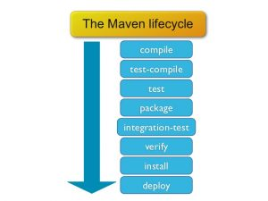
Maven Lifecycle

Slide 3
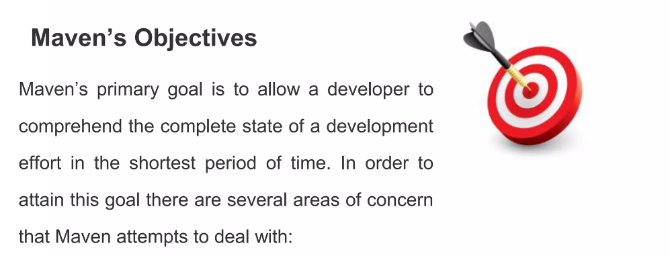
GOAL
Making the build Process easy.
Providing a uniform build system.

Slide 4
Advantages of Maven
Standardization: Maven enforces a consistent build process, reducing repetition and errors.
Reusability: Maven promotes code reuse through libraries and dependencies.
Dependency Management: Maven manages dependencies automatically, eliminating conflicts and versioning issues.
Automation: Maven automates tedious tasks, freeing developers to focus on core development.
Improved Collaboration: Maven fosters collaboration by providing a shared build process and tools.

Slide 5

USAGE OF MAVEN
Maven is widely used in Java development, but can also be used for
other languages and projects.
Many frameworks and libraries provide Maven plugins for integration.
Developers can create custom plugins to extend Maven's functionality.
Maven facilitates the execution of unit tests using the test phase.
Developers can import Maven projects into popular Integrated
Development Environments (IDEs) like Eclipse, IntelliJ IDEA, and NetBeans.

Slide 6
THANK YOU
SLIDE BY - KRITIK ARORA AND RATNESH SHUKLA

