Slide 1

Fetal Health Classification Final-Project Presentation
Presented By: Kritika Garg (UIN-662632356)

Slide 2


Project Overview
CONCLUSION
PROBLEM STATEMENT
FETAL HEALTH
ANALYSIS OF RESULTS
DATA DESCRIPTION
METHODOLOGY

Slide 3
Problem Statement

Slide 4
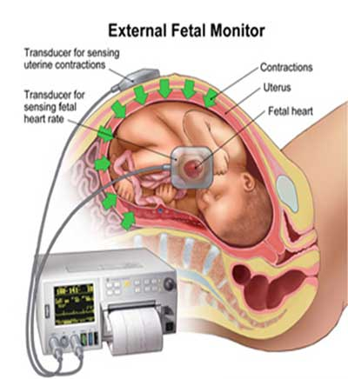
Project Domain
AIM: The project aims to reduce the fetal and maternal mortality rate by examining fetal health using Cardiotocograms (CTGs). CTGs evaluate fetal health based on parameters like uterine contractions, fetal movement, decelerations etc. A multiclass classification model that can predict fetal health based on these features beforehand will give will give the doctor enough time to take necessary actions and prevent death of newborns and their mothers.
Cardiotocograms (CTGs)
Simple and fast method to use
Can be made vastly available.
Can be applied in low-resource settings where mortality rate is high.
1
2
3

Slide 5
Dataset Description

Slide 6
Data Description
2126 records of 21 features
Results from Cardiotocograms (CTGs) exams
Baseline value
Accelerations
Fetal movement
Uterine contractions
Light decelerations
Severe decelerations
Prolonged decelerations
Abnormal short term Variability
Mean value of short term variability
Percentage of time with abnormal long term variability
Mean value of long term variability
Histogram width
Histogram min
Histogram max
Histogram number of peaks
Histogram number of zeroes
Histogram mode
Histogram mean
Histogram median
Histogram tendency
NORMAL (Class 1)
THREE CLASSES
SUSPECT (Class 2)
PATHOLOGICAL (Class 3)
Ayres de Campos et al. (2000) SisPorto 2.0 A Program for Automated Analysis of Cardiotocograms. J Matern Fetal Med 5:311-318

Slide 7
Methodology

Slide 8




Steps Followed
Data Standardization
Exploratory Data Analysis (EDA)
Predictive Model Building
Parameter Tuning
Evaluation of results
B2B PROPOSALS
The performance of each model was done through confusion matrix and classification report.
Parameters evaluated: Accuracy, Precision, Recall
Identify important features that influence fetal health.
Using sklearn.preprocessing.StandardScaler
Standardized features by removing the mean and scaling to unit variance.
Thus, mean=0, S.D=1
Distribution of features.
Correlation among the features.
Statistical description for the numerical variables.
Data visualization
Two classification algorithms : KNN and Random Forest were used for classification.
Among the two, best model was selected based on their efficiency to classify.
GridSearchCV was used to tune the parameters that will give the best possible score for each model.

Slide 9
Analysis of Results

Slide 10
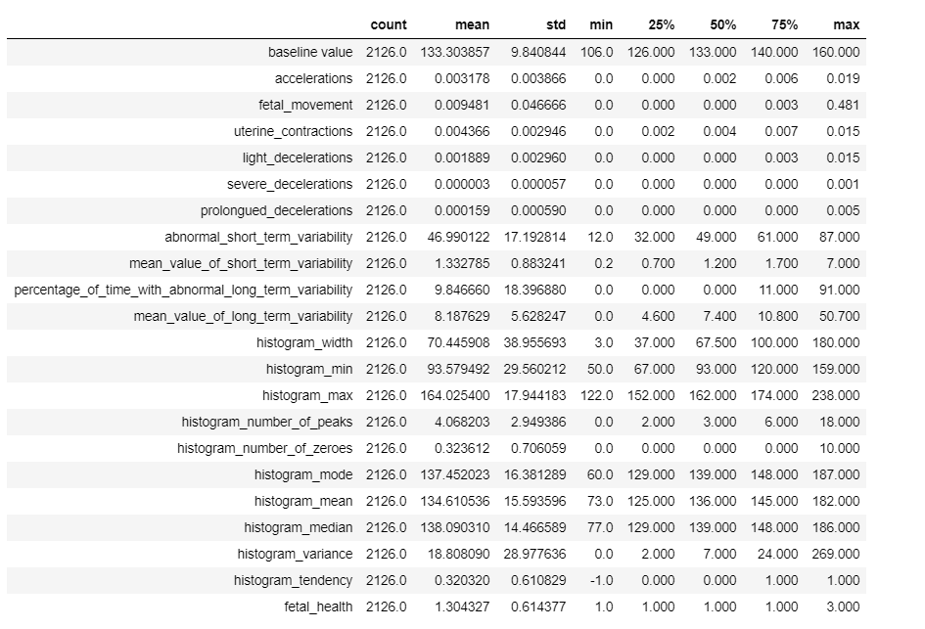
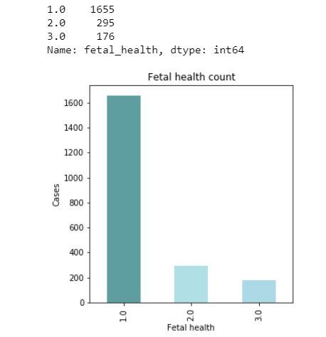
Exploratory Data Analysis (EDA)
Statistical description of the variables
Distribution of the fetal health classes
Very low variation in this feature
The above bar chart shows that the data is not balanced. Thus, Precision and Recall must be considered for model evaluation.

Slide 11
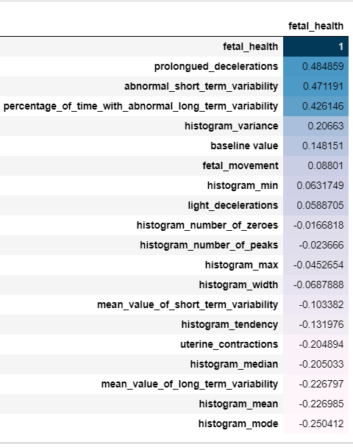
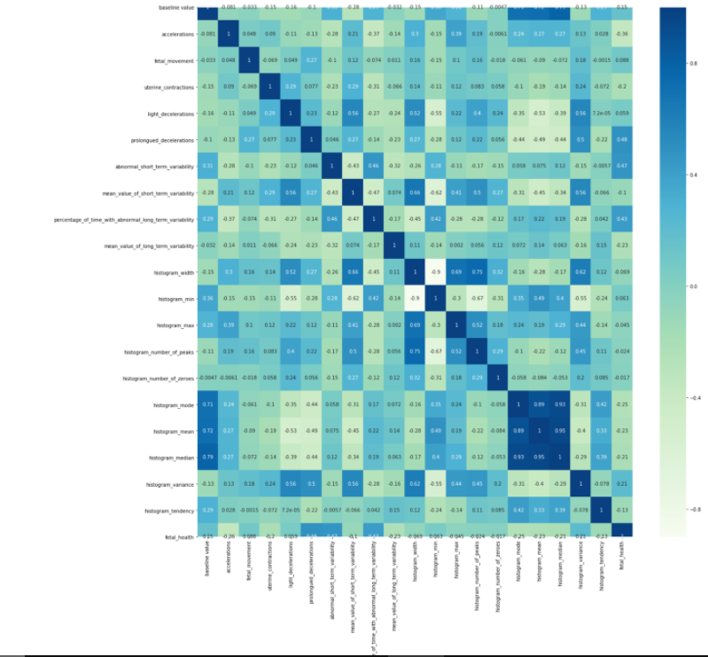
Correlation of attributes with the class: Fetal health
Heatmap to study the correlation between the variables
These features have highest correlation with fetal health. Thus, they may influence the class mostly.

Slide 12
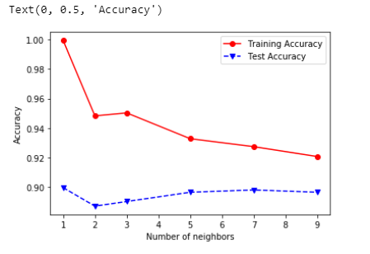
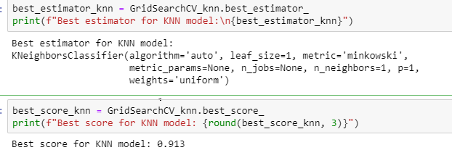
KNN model
Accuracy curve
Testing data: 30% Training data: 70%
KNN model
Number of neighbours??
GridSearch CV
Accuracy = 89.8%
According to GridSearchCV, these are the best estimators.
According to accuracy curve, n_neighbours = 7 gives good accuracy on training as well as testing data. It avoids overfitting and underfitting.
Accuracy = 91.3%

Slide 13
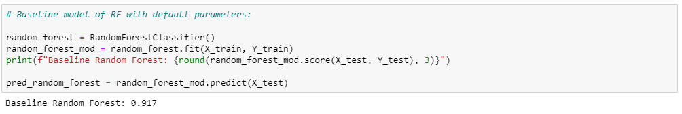
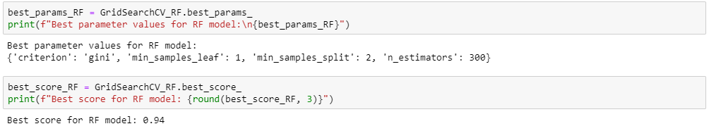
Random Forest
Baseline model with default parameters
Accuracy = 91.7%
RF model using GridSearchCV-selected parameters
Accuracy = 94.0%

Slide 14
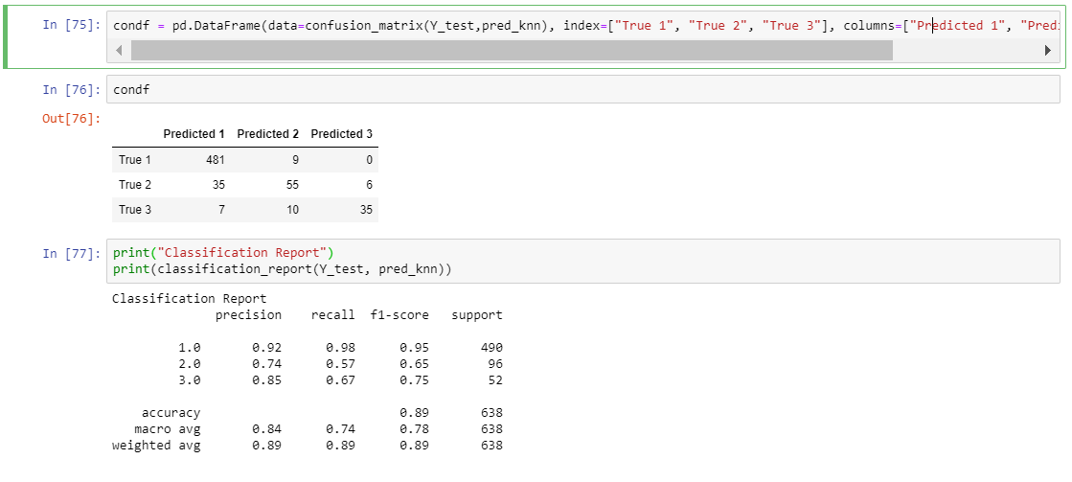
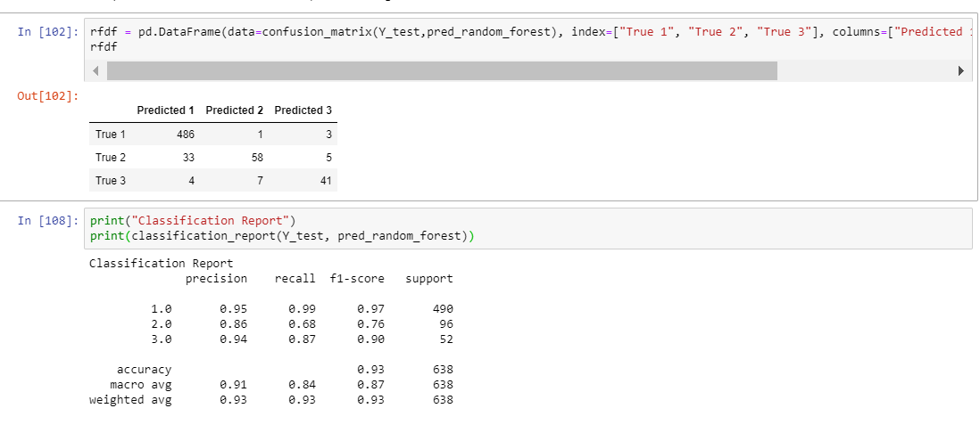
Confusion matrix
KNN model
Random Forest model

Slide 15
Conclusions

Slide 16
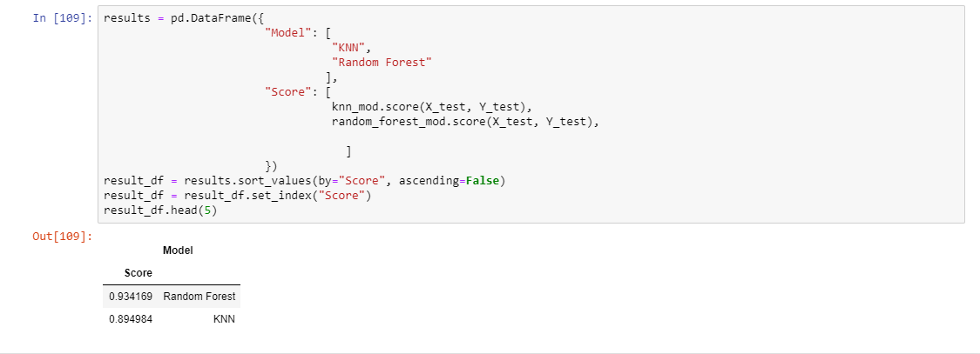
Final comparison of scores
Score | Model
0.93419 | Random forest
0.894984 | KNN
It can be concluded from the above results that the random forest model classified the fetal health more efficiently than the KNN model.

Slide 17
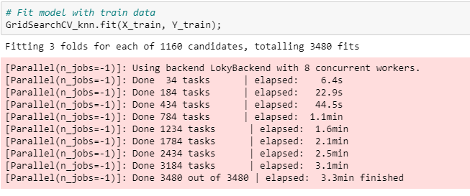
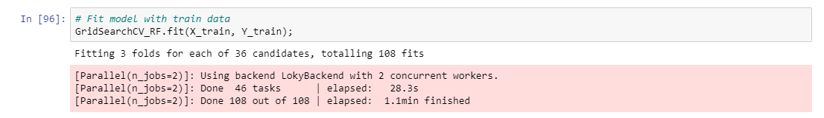
Conclusions
Random forest perform better because:
The algorithm is not biased as it has multiple trees and each tree works on a subset of the data. This also makes the algorithm robust and stable.
As it works on subset of the data, it is fast and can handle data with large number of features.
In this case, the computation time of Random forest (1.1 mins) is also much better than KNN classification model (3.3 min). The difference is also large. (Three times)

Slide 18
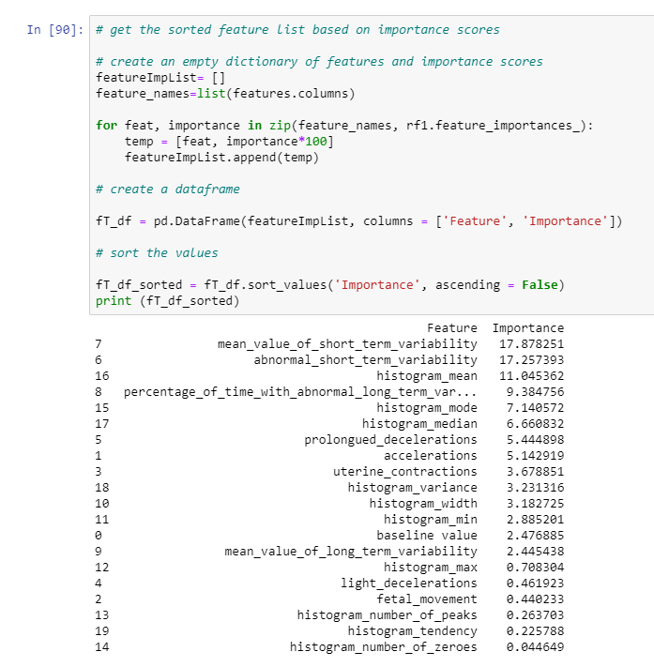
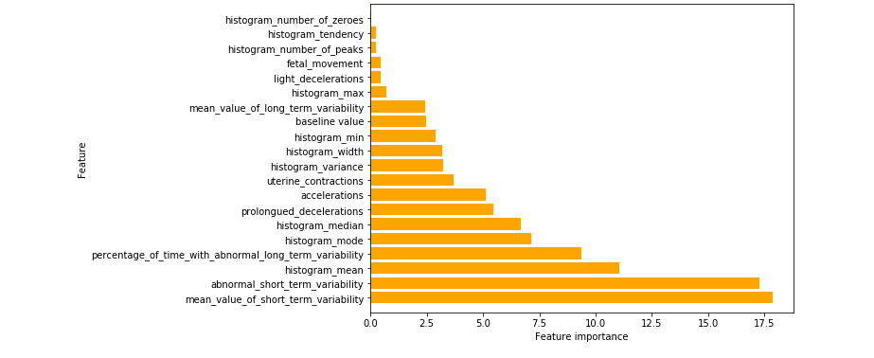
Selecting important features that effect the fetal health
Most important features

Slide 19
References

Slide 20
References
Shee, Hassan & Cheruiyot, Kipruto & Kimani, Stephen. (2014). Application of k-Nearest Neighbour Classification in Medical Data Mining. 4.
Fawagreh, K., Gaber, M.M. Resource-efficient fast prediction in healthcare data analytics: A pruned Random Forest regression approach. Computing 102, 1187–1198 (2020). https://doi.org/10.1007/s00607-019-00785-6
Daly N, Brennan D, Foley M, O'Herlihy C. Cardiotocography as a predictor of fetal outcome in women presenting with reduced fetal movement. Eur J Obstet Gynecol Reprod Biol. 2011 Nov;159(1):57-61. doi: 10.1016/j.ejogrb.2011.07.002. Epub 2011 Sep 6. PMID: 21899943.
Ayres de Campos et al. (2000) SisPorto 2.0 A Program for Automated Analysis of Cardiotocograms. J Matern Fetal Med 5:311-318
Data retrieved from https://www.kaggle.com/andrewmvd/fetal-health-classification

Slide 21
Thank You

