Slide 1

Customer Analytics: Key Insights & Actions
This presentation summarizes key findings from customer data, focusing on purchasing behavior, loyalty, and opportunities for strategic action. Our analysis aims to enhance customer lifetime value and optimize operational efficiencies.

Slide 2
Dataset Overview: A Glimpse into Customer Behavior
Rows
2,000
Columns
18
Key Columns
Customer_ID, Customer_Name, Age, Gender, Location, Product_Category, Purchase_Date, Purchase_Amount, Payment_Method, Rating, Feedback_Comments, Customer_Lifetime_Value, Loyalty_Score, Discount_Applied, Return_Status, Customer_Segment, Preferred_Shopping_Channel
Date Range
15 days (approx. Jan 15-30, 2020)
Unique Customers
1,378
Unique Products
1,018
Our dataset provides a comprehensive snapshot of customer interactions over a 15-day period, enabling granular analysis of purchasing patterns and demographic insights.

Slide 3
Data Quality: Addressing Missing Values
Feedback Comments
Rating
Approximately 45% missing, indicating a potential area for enhanced customer engagement strategies.
Around 15% missing, which could impact the accuracy of sentiment analysis and product satisfaction metrics.
Customer Name & Age
Purchase Date & Customer Segment
Minor gaps (1% and 0.8% respectively) require attention for personalized marketing efforts.
Minimal missing data (0.3% and 0.5%), suggesting high reliability for transactional and segmentation analysis.
Addressing these missing value hotspots is crucial for improving data integrity and the reliability of future analyses.

Slide 4



Key Metrics: Understanding Customer Value
44
277 USD
Average Age
Avg. Purchase Amount
Our customer base has an average age of 44 years, with a standard deviation of 15 years.
The average purchase amount is $277 USD, with a median of $242 USD, indicating varied transaction sizes.
2512 USD
49
Avg. CLV
Avg. Loyalty Score
Average Customer Lifetime Value stands at $2,512 USD, reflecting the long-term profitability of our customers.
Customers show an average loyalty score of 49 out of 100, suggesting room for loyalty program enhancements.
These core metrics provide a foundation for segmenting customers and tailoring engagement strategies.

Slide 5


Rating & Purchase Behavior Insights
The distribution of ratings reveals a largely satisfied customer base, with 62% of ratings at 4 or 5 stars. However, lower ratings are associated with higher return rates.
Discount Impact & Returns
36% of all transactions benefited from a discount, suggesting strategic application rather than widespread use.
22% of purchases resulted in a return, indicating a need for deeper investigation into product satisfaction and quality.
Returns are more common among VIPs (26%) and customers utilizing both online and in-store channels (28%).

Slide 6

Customer Segmentation & Channel Preference
Regular Customers
1
Comprising 45% of our base, these customers represent a significant opportunity for growth and increased engagement.
VIP Customers
2
A crucial 30% of our customer base, showing higher spend and loyalty. They warrant tailored experiences.
New Customers
3
Representing 25%, these customers are prime candidates for onboarding campaigns and initial loyalty building.
Understanding these segments allows us to develop targeted strategies for acquisition, retention, and growth across all customer types.

Slide 7
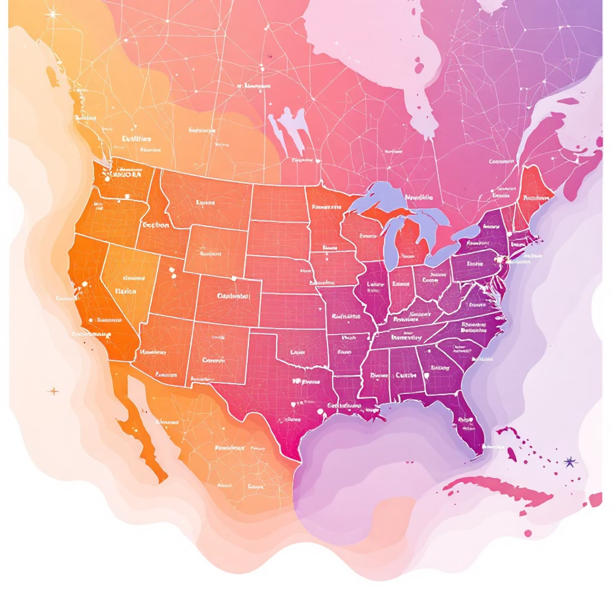

Geographic & Product Category Focus
Top 5 Locations
Top 5 Product Categories
New York (22%)
Books (19%)
Los Angeles (13%)
Toys (17%)
Houston (12%)
Home Appliances (16%)
Chicago (11%)
Clothing (15%)
San Francisco (10%)
Electronics (13%)
These insights help prioritize marketing efforts and inventory management, focusing on key markets and high-demand products.

Slide 8



High-Value vs. Low-Value Customers
High-Value (Top 5% CLV)
Low-Value (Bottom 5% CLV)
Avg CLV: ~$7,800 USD
Avg CLV: ~$450 USD
Avg Loyalty: ~78
Avg Loyalty: ~22
Avg Purchase: ~$460 USD
Avg Purchase: ~$92 USD
Discount Applied: 85%
Discount Applied: 30%
VIP Segment: 70%
Regular Segment: 70%
Shopping Channel: 60% Online
Shopping Channel: 45% In-store
Targeted strategies are essential to nurture high-value customers and uplift low-value segments.

Slide 9

Key Insights: Driving Strategic Decisions
Revenue Concentration
A mere 10% of customers generate approximately 40% of the total purchase amount, highlighting the importance of high-value retention.
VIP Behavior
VIP customers spend twice as much per transaction and exhibit higher loyalty scores compared to Regular or New customers.
Discount Efficacy
Discounted transactions are ~15% larger, suggesting discounts effectively incentivize higher-value purchases rather than just increasing volume.
Returns Analysis
Returns are more prevalent among VIPs and customers using both online and in-store channels, warranting specific attention.
Channel Performance
Online shoppers have a slightly higher average basket, while customers using both channels show the highest average CLV.
Rating Correlation
High ratings correlate with elevated loyalty and CLV, whereas low ratings are linked to increased return rates.

Slide 10





Strategic Recommendations: Actions for Growth
Boost CLV
Target Regular/New customers with personalized offers in high-margin categories and promote multi-channel shopping to increase their lifetime value.
Reduce Returns
Analyze return patterns within the 'Toys' segment and among VIPs; implement stricter quality checks and clearer return policies for high-value items.
Improve Rating
Conduct follow-up surveys for low-rated customers (1-2 stars), especially those who returned items, to identify and address pain points effectively.
Optimize Discounts
Shift discount allocation towards loyal customers with lower basket sizes to increase frequency without eroding margins on already high-spending VIPs.
Channel Strategy
Encourage in-store shoppers to adopt online or hybrid (click-and-collect) channels to elevate their average spend and loyalty.

