Slide 1
SORTING VISUALIZER
Disha Bansal(2100681540017)
Shagun Chauhan​ (2100681540042)
Shradha (2100681540044)

Slide 2
TABLE OF CONTENT
1.Introduction​
2.Methodology
3.Proposed Work
​4.Project modules description
5.Technology Used
6. Conclusion
​7.References

Slide 3
INTRODUCTION
“Sorting Visualizer” is an online learning project which can be used to learn algorithms like searching , Sorting and path-finding algorithm through visualization. Visualization gains more attention than theoretical study and it is easy way of learning process. It helps to understand fundamental concept of algorithms such as searching, sorting, path-finding method in simpler manner.
.The main objective of this platform is to help students to learn about algorithm through visualization as well as help teachers to teach with visualization. This video-tape allows students to watch the behavior of the algorithm instead of try to imagine its actions from a verbal explanation or from static images.

Slide 4
II. METHODOLOGY
In this project, we aim to develop an effective algorithm visualizer tool that can engage students to remain on platform and improve learning outcomes. To achieve this goal, we analyze the pedagogy, usability and accessibility goals of the online students and incorporate the features of the above goals to design effective user interactions and visualizations for an online algorithm visualizer tool. In this design process, we involve three basic activities:
Establishing requirements
Designing alternatives and prototyping
Evaluation

Slide 5
III. PROPOSED WORK
SYSTEM ARCHITECTURE
USER INTERFACE
JAVASCRIPT
HTML
CSS
BACKEND FUNCTIONALITY

Slide 6
DESCRIPTION OF PROPOSED WORK
The back-end code is comprised of HTML5, CSS, and JavaScript. All three types of code are contained in one .html file and can be run solely from this file. One of the advantages of HTML 5 is that it is not necessary to include different types of web languages in a single file. Therefore, each type could have been separated, making a total of three files (plus the miscellaneous sound and image files). This is good practice for readability and keeping related code together.
HTML5 and CSS are used for the interface. The HTML5 communicates with the JavaScript code and vice versa to launch the appropriate algorithms and update the interface accordingly, as seen with a single, bidirectional arrow.
MODEL
Sorting Algorithms
updates
VIEW
HTML User Interface
User-input
notifies
updates
CONTROLLER
JavaScript

Slide 7
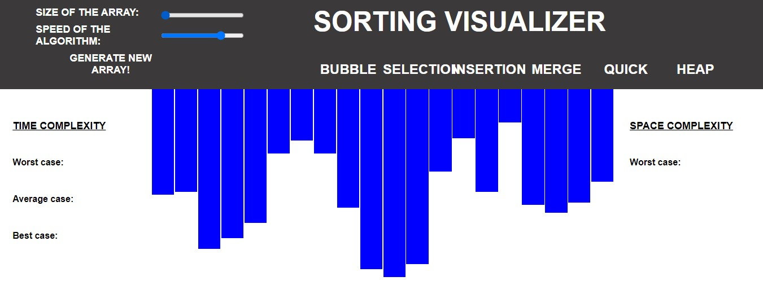
IV. PROJECT MODULES DESCRIPTION Size of the Array:- Speed of the array:-
This is used increase or decrease of an array.
This is used to manage the speed of the bars or an array.

Slide 8
Implemented algorithms:
Bubble sort
Selection sort
Insertion sort
Merge sort
Quick sort
Heap sort
Features:
Colored representation of step being executed. 1.1) Blue : default 1.2) Yellow: Being compared 1.3) Red: Identified as in incorrect position and to be moved 1.4) Green: In correct position
3 Controls for visualizations :- 2.1) Speed of visualization (5 speed levels) 2.2) Data size () 2.3) Generation of new data (Randomly generate new data).
Time and Space complexity of algorithm being visualized.

Slide 9
V. TECHNOLOGY USED
HTML(Hyper Text Markup Language)
CSS (Cascading Style-Sheet)
JavaScript

Slide 10
VI. CONCLUSION
Through much time and effort, I have successfully created a working web-based animation tool for visualizing the following sorting algorithms: Selection Sort, Bubble Sort, Insertion Sort, and Merge/Insertion Sort and path finding, search algorithm. Even with its memory overhead, it received overall positive feedback from the students who explored it. I am not surprised that there was not a significant difference in learning the material, which reflects what I found in my previous research. There remains, however, a strong mindset to research and create animations like these to improve learning in the classroom, which I agree with completely.

Slide 11
VII. REFERENCE
[1] https://digitalcommons.ric.edu/cgi/viewcontent. cgi?article=1129&context=honors_projects
[2] http://citeseerx.ist.psu.edu/viewdoc/download?d oi=10.1.1.110.9207&rep=rep1&type=pdf
[3] https://theses.cz/id/3w4s3a/Mykhailo-Klunkobc-thesis.pdf
[4] https://www.geeksforgeeks.org/fundamentalsof-algorithms/
[5] https://panthema.net/2013/sound-of-sorting/
[6] https://algorithm-visualizer.org/
[7] https://clementmihailescu.github.io/PathfindingVisualizer/.

Slide 12
THANK YOU

