Slide 1
HVE Use Case – Albertsons
Leveraging HVE Agents using GitHub Skill
GitHub Copilot Skills | Instructions | Prompts
Multi Region Resiliency Assessment
Notes:
Welcome. This session walks through how we automated the entire resiliency review process for a five-service e-commerce platform using GitHub Copilot Skills and structured prompt engineering. By the end, you will understand both what the skill does and why it matters for scaling this practice across every repository.

Slide 2



HVE-Powered Assessment Approach
Powered by GitHub Copilot
Albertsons Project • AI-Accelerated Discovery & Assessment
The Challenge
The HVE Approach
Impact & Value
Task Researcher Agents
Standardized, evidence-based discovery using architecture docs, full codebases, customer context & Microsoft best practices
Business context & approved Arch/design docs
Pre-defined output templates & solution patterns
Customer-specific documentation
Full app codebases across all relevant repositories
MSFT best practices and engineering guidelines
Task Planner Agents
Auto-generate research docs, recommendation reports & JIRA/ADO-ready backlogs
Human-in-the-Loop Review
Architect / SME review ensures quality, accuracy & governance
AI tools like GitHub Copilot accelerate discovery — but lack of standardization leads to:
60%
Inconsistent assessment outcomes
High manual effort across teams
Variable quality and rework
reduction in assessment effort
23 Repos
Architect + Developer
Automated research replaces manual discovery
Reports generated with minimal manual effort
JIRA-ready Excel eliminates manual story creation

Slide 3
The Vision: Consistent, Automated, Repeatable
What if every repository could be analyzed for resiliency risk — consistently, in minutes — by any engineer on the team?
1
Any Repo
2
Any Stack
3
One Output
Point the skill at any repository
C#, Node.js, Python, IaC — all covered
P0→P3 findings with file+line evidence
Notes:
The vision was simple: make the highest-quality resiliency review available to any engineer on any team, for any repository, in a repeatable and auditable way. Not a checklist — a full evidence-grounded analysis that produces actionable, prioritized output.

Slide 4
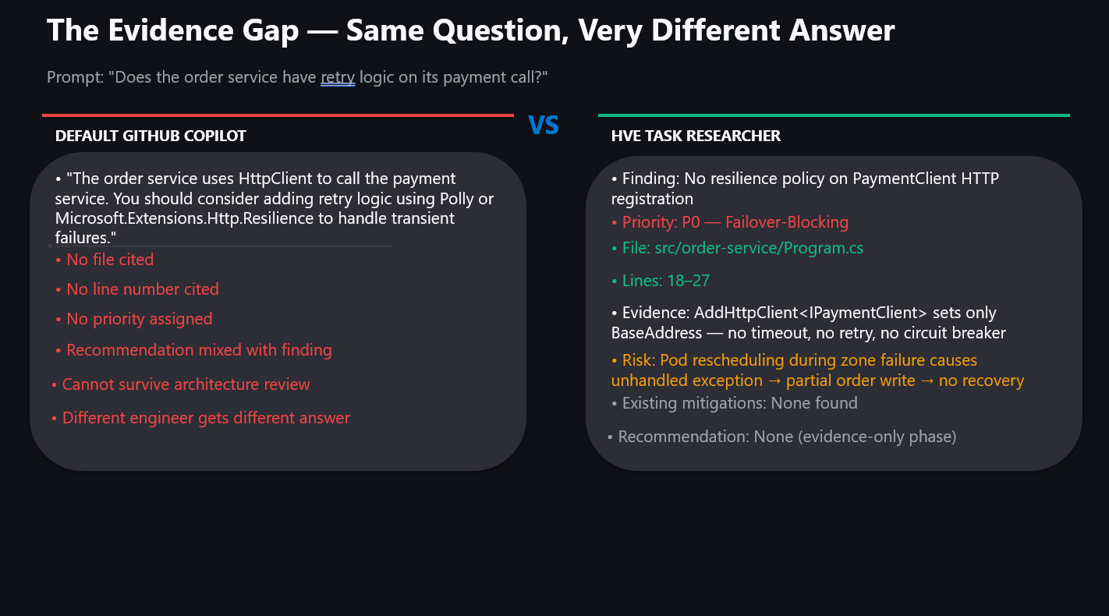

Slide 5
The Challenge: Resiliency Reviews That Don't Scale
TIME-INTENSIVE
INCONSISTENT
DOESN'T SCALE
• Senior architect required for every review
• No standard finding format
• Active/active transition = dozens of repos
• Weeks of manual code analysis
• P0 risks buried in prose
• Each service is different tech stack
• 30+ services across the platform
• Evidence lost in email threads
• No shared knowledge base
Notes:
Manual resiliency reviews have three fundamental problems. They take too long, they produce inconsistent outputs that can't be compared across teams, and they simply don't scale when you have 30 or 40 services all moving toward an active/active architecture simultaneously.

Slide 6
The HVE Resiliency Research Skill
WHAT IT IS
WHAT IT PRODUCES
• A GitHub Copilot Skill — a structured prompt orchestration framework
• Consolidated Research Report — evidence-only forensic analysis
• Lives in the repository alongside the code it analyzes
• Master Report — executive-level prioritized findings
• Invoked with a single command: /resiliency-research
• Developer Guide — before/after code fixes with file+line
• Automatically routes through 4 phases — no manual prompt selection
• Code-Level Assessment — WAF-aligned, full finding matrix
Notes:
The skill is a structured prompt orchestration framework built on GitHub Copilot. It lives in the repository, it knows the platform context, and when invoked it runs autonomously through four phases — producing four structured deliverables at the end. No analyst hours required.

Slide 7
Four Phases. One Automated Pipeline.
CORE RESEARCH
SERVICE ANALYSIS
CONSOLIDATION
PLANNING
PHASE 1
PHASE 2
PHASE 3
PHASE 4
• Prompts 0–7
• Prompts 8–19
• Consolidation prompt
• Planner prompts 0–3
• Architecture walkthrough
• Service-specific deep dives
• Merges all research outputs into a single forensic artifact
• Generates Master Report
• Zone failure analysis
• Only confirmed dependencies
• Developer Guide with before/after fixes
• Dependency inventory
• AKS + Istio
• Evidence-only
• State classification
• APIM + App Gateway
• No recommendations included
• Code-Level Assessment
• Failure mode mapping
• Cosmos DB + SQL
• WAF alignment applied
• Single source of truth for planning
• Cross-service dependencies
• Key Vault + Networking
• Shared dependency risks
• Entra ID + Redis
• Logging gaps
Notes:
Phase 1 and 2 are strictly evidence-only — no recommendations, no code examples. The AI acts as a forensic analyst. Phase 3 consolidates everything. Phase 4 is where the planning prompts take all the evidence and produce the deliverables the team can act on immediately.

Slide 8
Evidence-Only Research: The Key Design Decision
RESEARCH PHASES 1–3 RULES
WHY THIS MATTERS
• No recommendations allowed
• Eliminates hallucinated findings not backed by code
• No code examples
• Separates what IS from what SHOULD BE
• Every finding requires: file path + line number
• Planning phase cannot contradict research evidence
• Priority classification: P0 / P1 / P2 / P3
• Findings survive code reviews and architecture boards
• Existing mitigations captured with evidence
• Teams trust the output because every claim is traceable
• Service Exclusion Rule: only confirmed dependencies analyzed
Notes:
The most important design decision was separating evidence collection from planning. The research phases are forensic — the AI is not allowed to recommend fixes. This means the planning phase works from a grounded evidence base, not from speculative analysis. Every finding that makes it into the final reports has a file path and line number behind it.

Slide 9
Three Deliverables Built for Three Audiences
MASTER REPORT
DEVELOPER GUIDE
CODE-LEVEL ASSESSMENT
• Audience: Leadership / Architecture Board
• Audience: Engineering Teams
• Audience: Architect Review Board
• Executive summary and prioritized finding matrix
• File+line evidence for every finding
• WAF alignment and IaC gap analysis
• Current code blocks and fix code blocks
• Full finding matrix with standards references
• Dependency map and open questions
• Health probe contracts and testing notes
• Microsoft Standards and reference architecture links
• External provider considerations
• Format: Self-contained — no architect needed to interpret
• Format: Review-board ready, TOC-navigable
• Format: P0→P3 with business impact language
Notes:
The skill produces three distinct documents tailored to three different audiences. Leadership gets the Master Report. Engineering teams get the Developer Guide they can execute independently. The Architecture Review Board gets the WAF-aligned Code-Level Assessment with standards references. One run of the skill — three audiences served.

Slide 10
The Automation Story: What Changed
Dimension | Before (Manual) | After (Skill)
Time to complete | 3–4 weeks (senior architect) | ~1 hour (any engineer)
Evidence quality | Varies by reviewer | 100% file+line cited
Finding consistency | Prose, no standard format | P0→P3, structured JSON-ready
Output artifacts | 1 Word document | 4 structured deliverables
Reproducibility | Not repeatable | Run again after code changes
Scale | 1 repo per engagement | Any repo, any stack
Notes:
This table captures what actually changed. The most important dimension is reproducibility — the skill can be re-run after code changes to verify findings are resolved. That closes the loop between research, implementation, and validation in a way that manual reviews simply cannot.

Slide 11
What You Can Do With This Today
1
Add the Skill to Your Repository
2
Update Platform Context
Copy the skill, prompts, and platform context to your repo's .github/ folder
Edit platform-context.instructions.md with your customer name, regions, and target state
3
Run /resiliency-research
4
Deliver Three Reports
Point Copilot at your repository and let the skill execute all four phases automatically
Share Master Report with leadership, Developer Guide with engineering, Code-Level Assessment with architecture board
REUSABLE ACROSS EVERY ENGAGEMENT
• The skill is designed to be reused across repositories. Add new service-specific prompts as your platform grows.
• Re-run after each sprint to verify resolutions. One skill — every repository, every customer.
Notes:
The call to action is simple. The skill is a template. You copy it, update the platform context for your customer, and run it. The entire framework — prompts, instructions, skill orchestration — is designed to be carried from engagement to engagement with minimal customization.

Slide 12
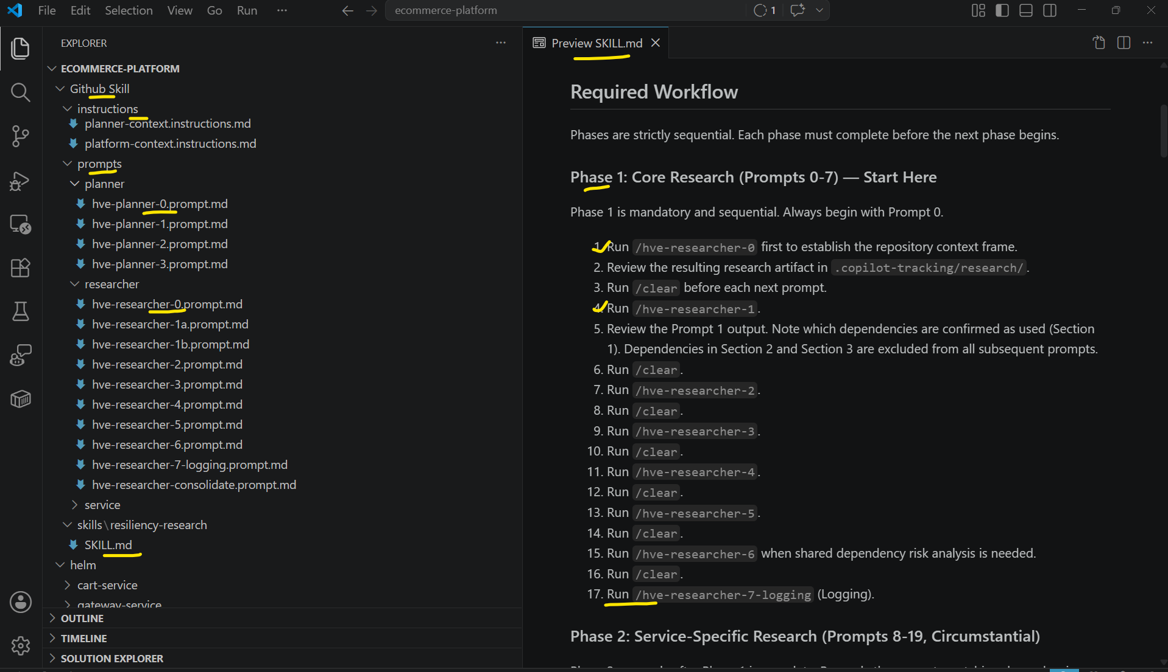
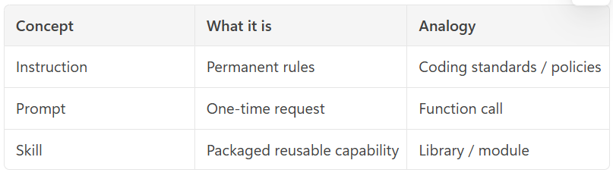
VS Code – Instructions, Prompts & Skill

Slide 13
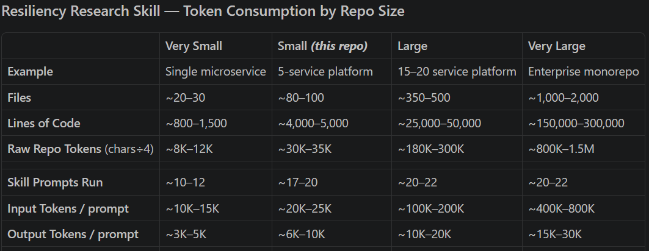
Token Consumption

Slide 14
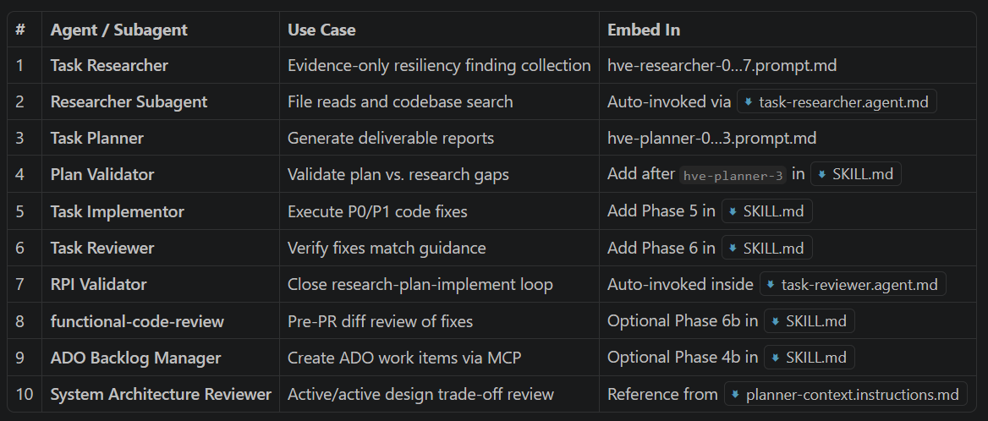
HVE Agents Usage

