Slide 1

Nagar Yuwak Shikshan Sanstha’s DATTA MEGHE COLLEGE OF ENGINEERING Airoli, Navi Mumbai
DEPARTMENT OF ARTIFICIAL INTELLIGENCE AND DATA SCIENCE
Sem VI Academic Year 2024 -25
Mini Project Presentation (2B)
Project Title:
(Presentation Controller Using Hand Gestures)
Students Name | Roll No.
Kritika Bansode | 06
Aditya Chaurasiya | 17
Dhiraj Jadhav | 39
Ayushkumar Jha | 46
(Prof. Swati Parhad)
Supervisor

Slide 2
CONTENTS
Introduction
Problem Statement
Literature Survey
Work done (till date )
Results
Implementation
Conclusion
References

Slide 3
INTRODUCTION
Traditional Methods: Conventional remotes and keyboards limit presenter and interrupt the flow of presentation
Need for Innovation: Modern presentation demand flexibility and hands-free approach. Especially in dynamic or constrained environments.
Solution Overview: Introducing the hand gestures presentation
Controller, utilizing gestures recognition technology for slide navigation.
Benefits: Provides natural hand movement control, enhancing mobility and ensuring a seamless presentation experience.

Slide 4
PROBLEM STATEMENT
Presenters face movement restrictions and disruptions using remotes or keyboards for slide navigation. Hands-free operation is needed for smoother, more dynamic presentations.

Slide 5
LITERATURE SURVEY
Sr.No. | Author, Title, Journal & Year of publication | Important findings
1 | Authors: Sai Ram Patro, Kushagra Choudhary, Anjali Vastrakar, Suman Lodhi, Kavita Sahu, Muskan Naik Title: “Hand Gesture Controlled Presentation Using OpenCV” Journal: International Research Journal of Modernization in Engineering, Technology, and Science Year: April 2024 | Achieved 80% accuracy using OpenCV for hands-free presentation control. Eliminates the need for physical devices, with plans to add facial expression detection.
2 | Authors: Bhairavi Pustode, Vedant Pawar, Varun Pawar, Tejas Pawar, Samiksha Pokale Title: “Smart Presentation System Using Hand Gestures” Journal: Published on Research Square Year: February 2023 | Achieved 95% accuracy in gesture-based slide control using Python and OpenCV. Limited by detection range, with potential for adding more functions like speech recognition.

Slide 6
WORK DONE
Work Done
Capture of gestures
Detection of gestures
Recognize of gestures
Mapping of gestures

Slide 7
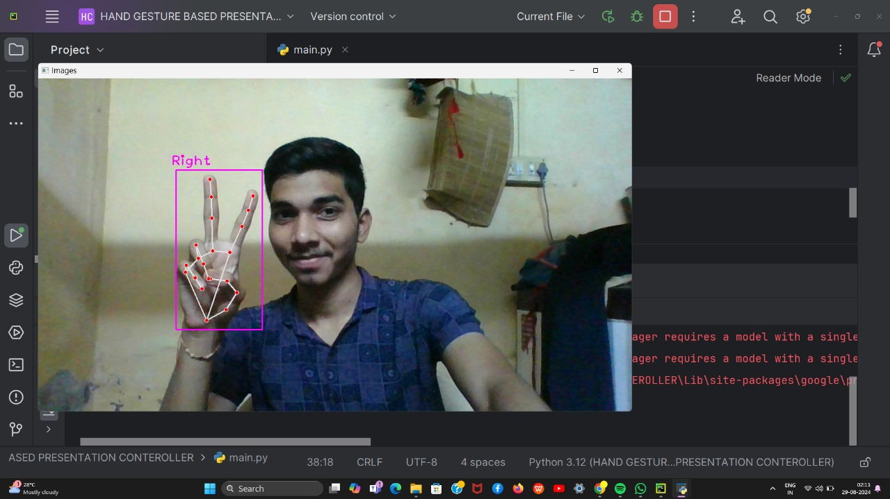
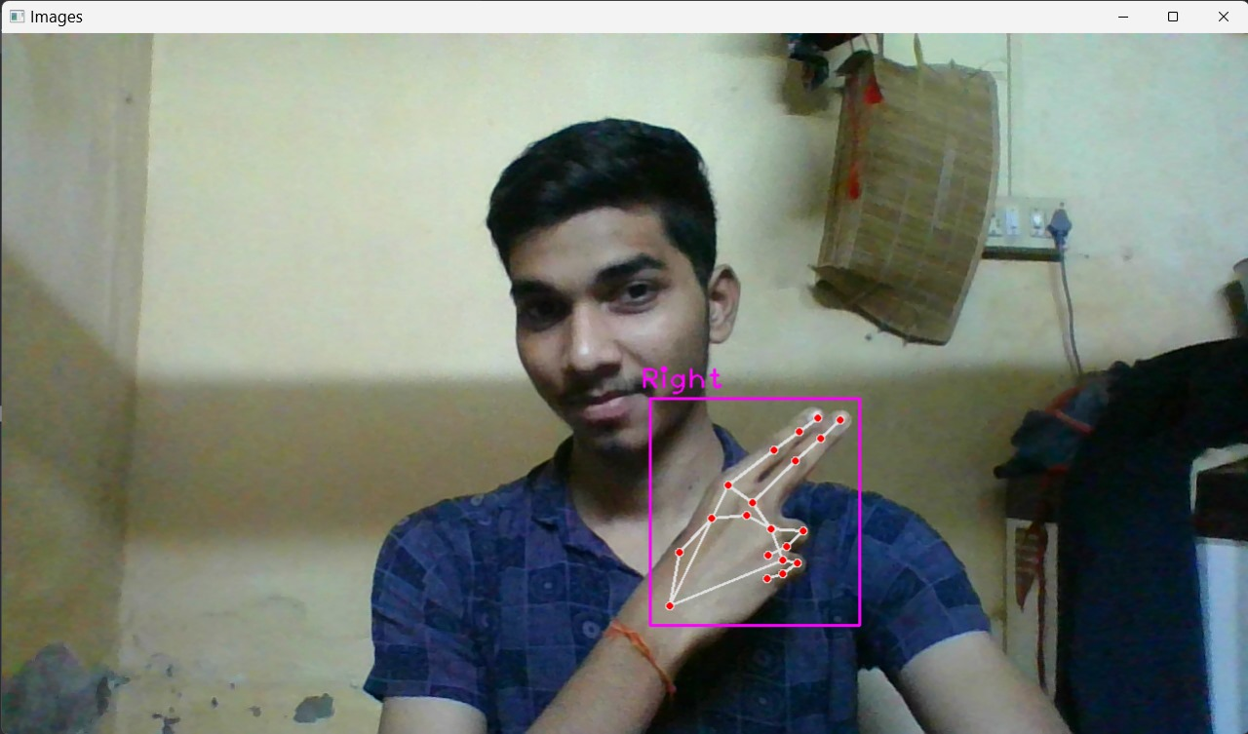
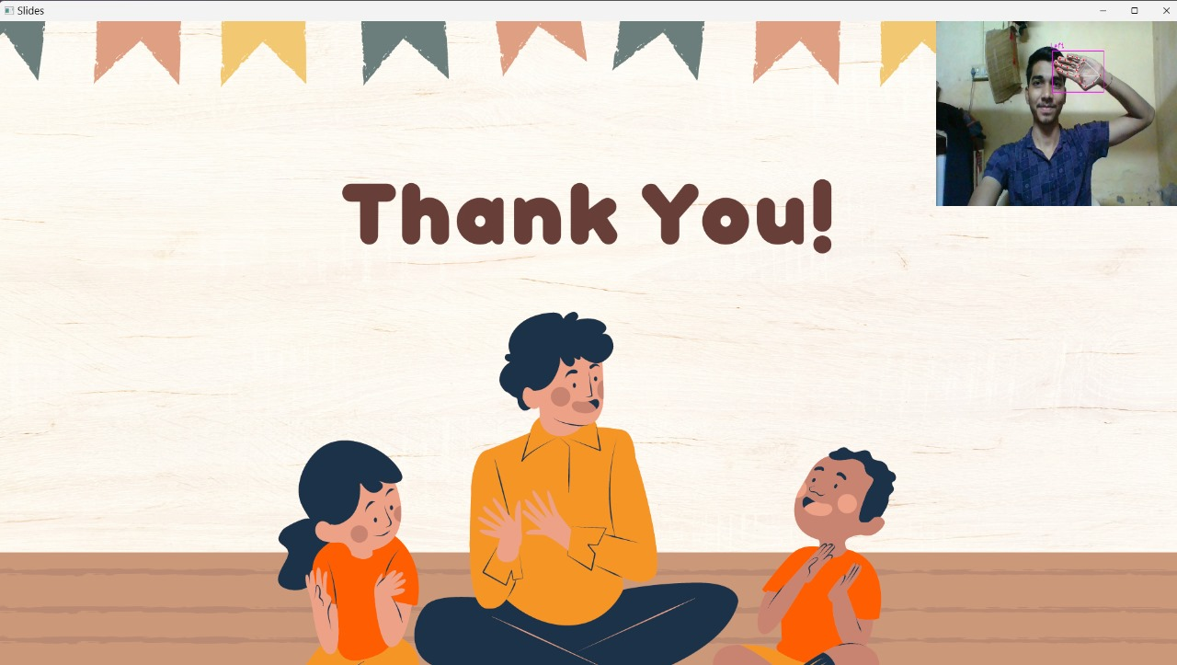
RESULT

Slide 8
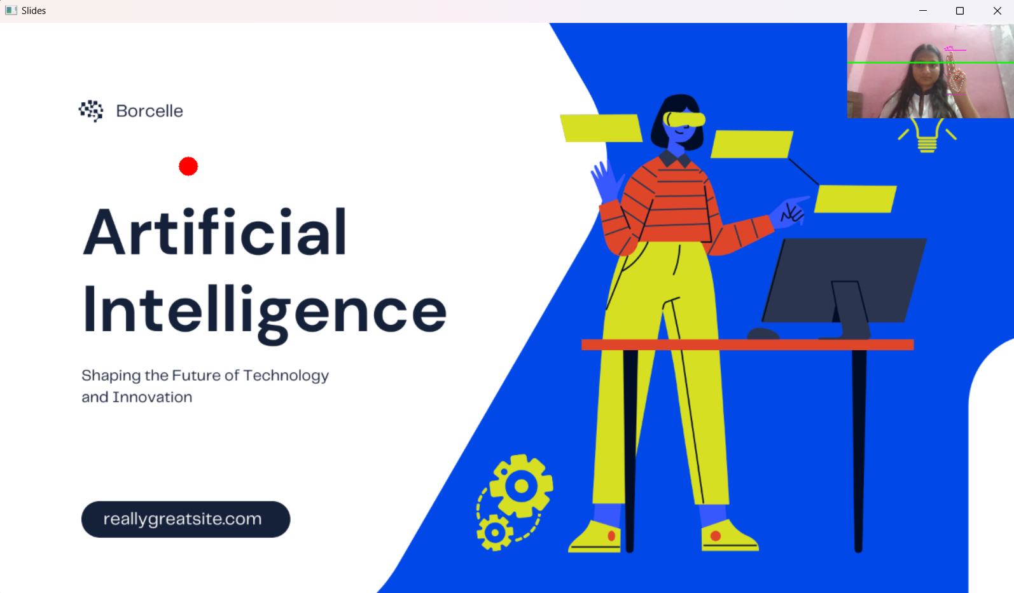
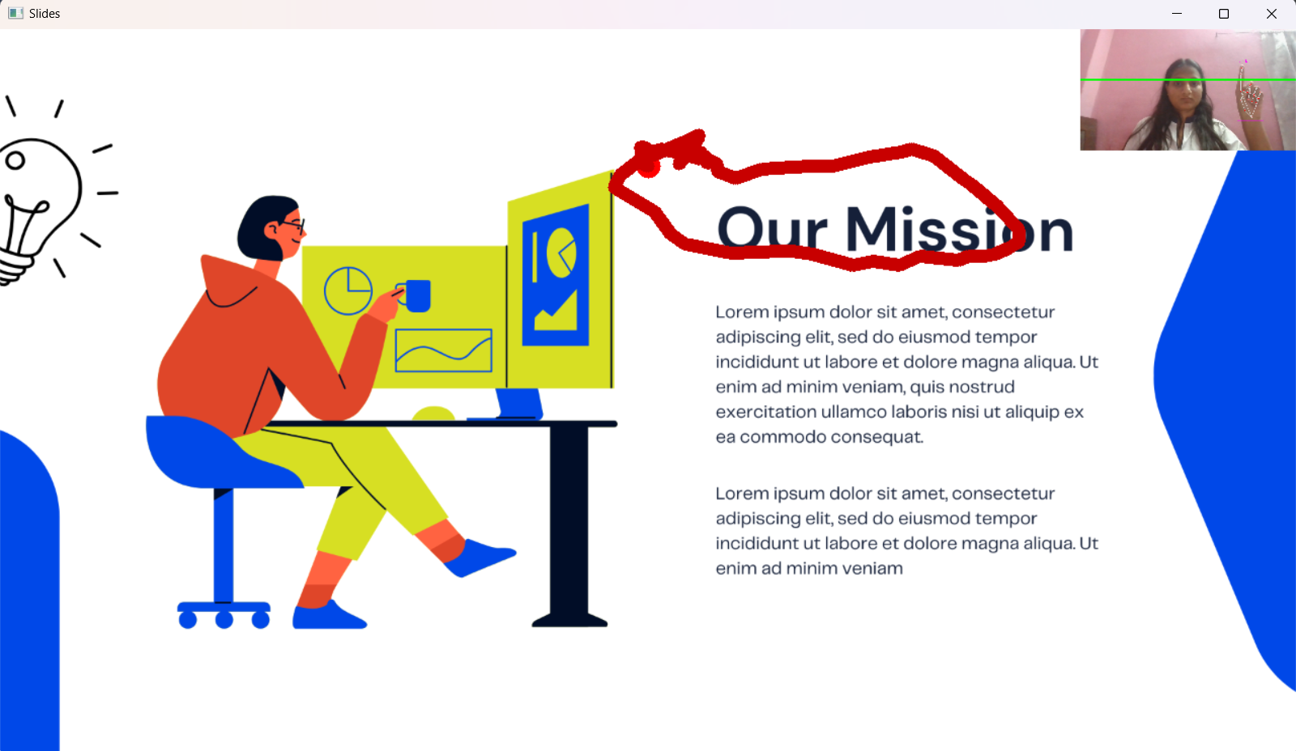
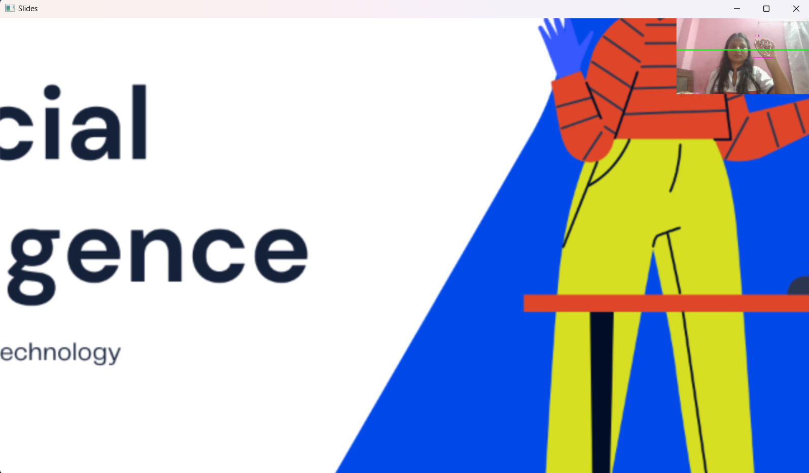

RESULT

Slide 9
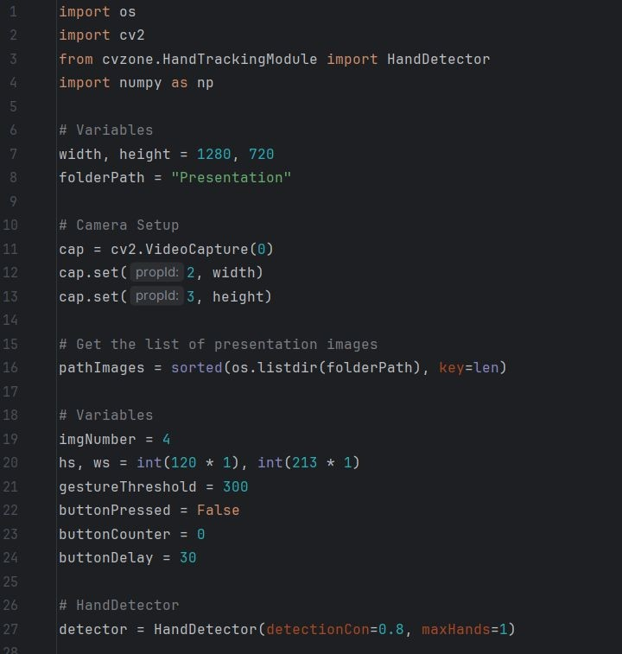
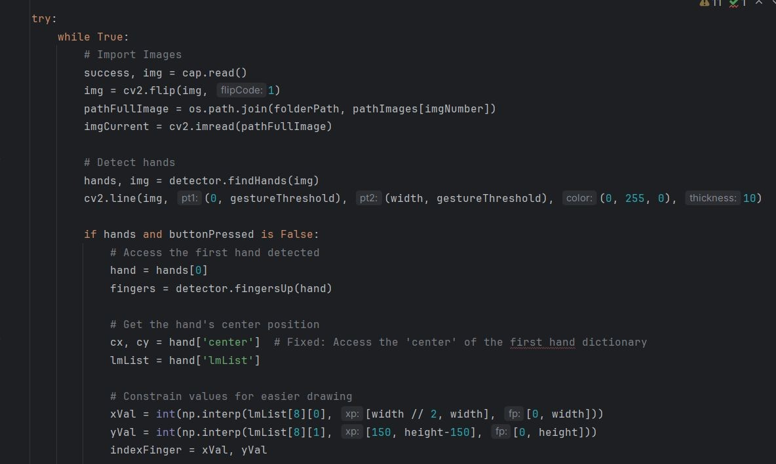
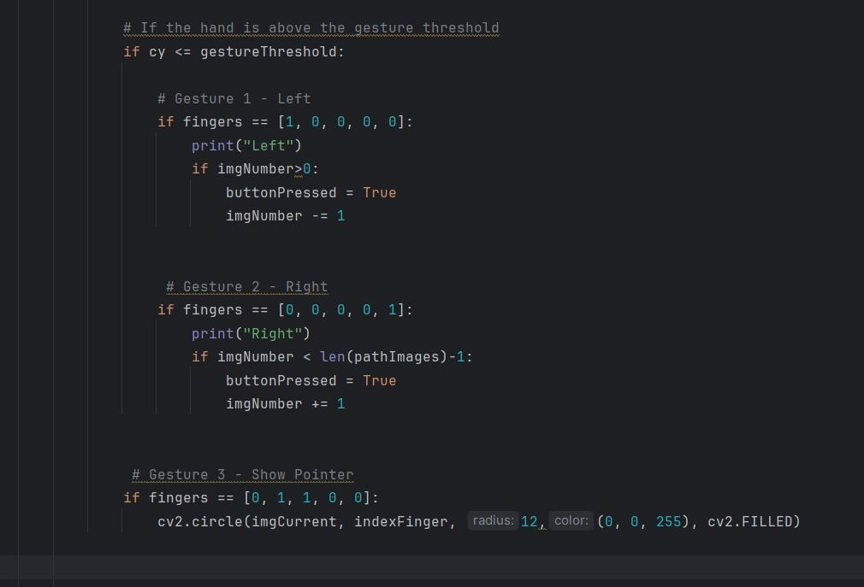
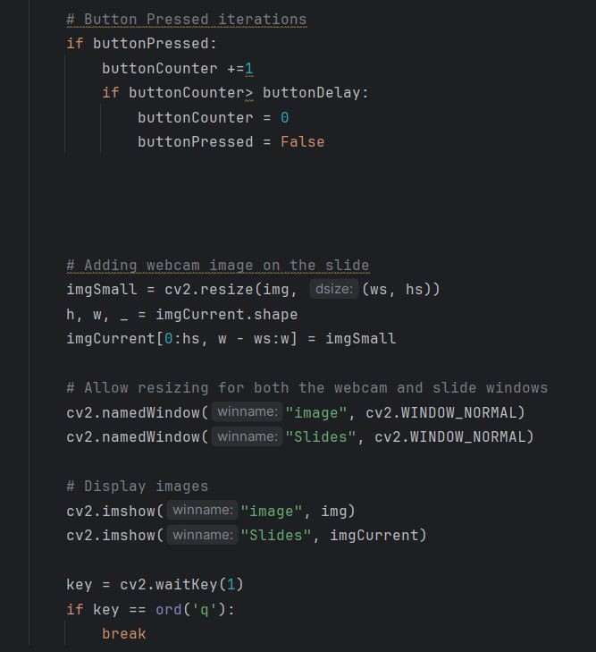
IMPLEMENTATION

Slide 10
CONCLUSION
The hand gesture-controlled presentation system enhances interactivity by utilizing computer vision and machine learning for real-time gesture recognition.
It provides a natural interface that improves user engagement during presentations.
The technology has broader applications beyond presentations and can be further enhanced with expanded gesture recognition, better environmental adaptability, and user customization.

Slide 11
REFERENCE
Sai Ram Patro, Kushagra Choudhary, Anjali Vastrakar, Suman Lodhi, Kavita Sahu, and Muskan Naik. "Hand Gesture Controlled Presentation Using OpenCV." International Research Journal of Modernization in Engineering, Technology and Science, Vol. 6, Issue 6, April 2024, pp. 1585-1589.
Bhairavi Pustode, Vedant Pawar, Varun Pawar, Tejas Pawar, and Samiksha Pokale. "Smart Presentation System Using Hand Gestures." Vishwakarma Institute of Technology, February 2023. DOI: 10.21203/rs.3.rs-2549833/v1.

Slide 12
Thank You!!

