Slide 1
AI-Powered Log Analysis Using
Small Language Models
in Offline / Air-Gapped Environments
DRDO Undergraduate Internship Project · 12-Week Program · Final Presentation
Notes:
Final presentation for the 12-week DRDO internship project: an end-to-end offline log analysis system built on a fine-tuned small language model.

Slide 2
The Problem
Modern systems generate massive volumes of logs; manual triage is slow and error-prone.
Cloud AI log tools (Datadog, OpenAI-based analyzers) require internet connectivity.
Defence, banking and healthcare networks are air-gapped — no data may leave the machine.
Need: an AI analyst that runs entirely on a local machine with zero internet dependencies.
Why offline?
Security: logs contain sensitive operational data
Compliance: regulated / classified networks
Reliability: edge sites and factory floors lack connectivity
Notes:
Frame the air-gap constraint as the defining requirement, not an afterthought.

Slide 3
The Solution — Offline SLM + Local RAG
Qwen2.5-3B-Instruct: a small language model that runs on a single local machine.
QLoRA fine-tuning on ~2,000 instruction examples built from real log datasets.
Local RAG: FAISS vector index of historical incidents, retrieved as context.
Structured output: severity, incident type, root cause, summary, recommended actions.
Delivered as REST API + interactive dashboard + one-command offline installer.
3B
0
5
12
parameters — runs on CPU
internet calls at runtime
structured output fields
weeks, D1–D10 delivered
Notes:
SLM not LLM: 3B parameters is the sweet spot for a single air-gapped workstation.

Slide 4
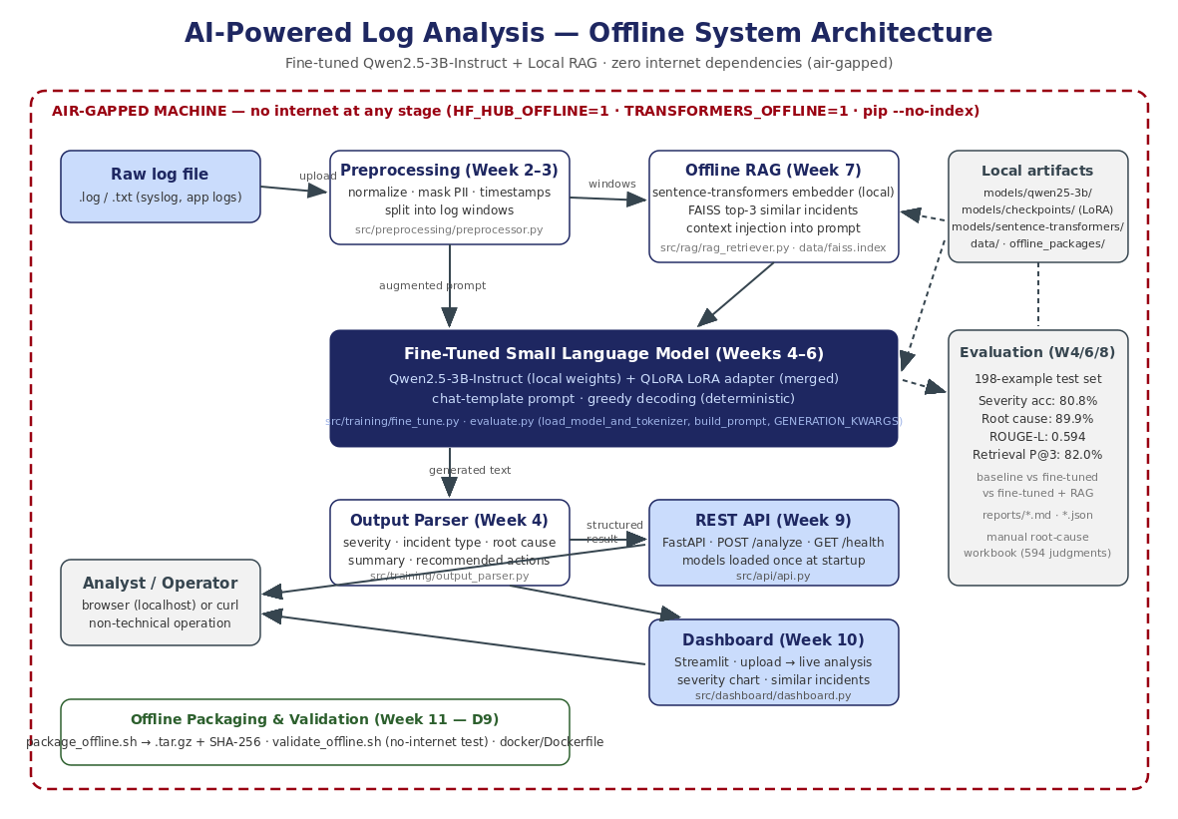
System Architecture
Notes:
Walk the pipeline left to right: raw logs, preprocessing, RAG retrieval, fine-tuned SLM, parser, then the two front-ends. Everything inside the red dashed boundary is offline.

Slide 5
12-Week Engineering Journey
W1
W2–3
W4
W5–6
W7
Offline environment + wheels
Log preprocessing + tests
Dataset + zero-shot baseline
QLoRA fine-tuning + eval
Offline RAG (FAISS)
W8
W9
W10
W11
W12
Full evaluation report
FastAPI REST API
Streamlit dashboard
Offline install package
Docs + final presentation
Each week: audit → requirements from document → implementation → self-audit · previous weeks frozen
Notes:
Emphasize the disciplined weekly workflow and the freeze policy that kept earlier deliverables stable.

Slide 6
Data & Preprocessing (Weeks 2–4)
Source: LogHub public log datasets (cloned locally before going offline).
Normalization: timestamps, IPs, paths and IDs replaced with stable placeholders.
PII masking built into the pipeline — no sensitive values reach the model.
Sliding log windows group related lines into analyzable units.
Instruction dataset: ~2,000 examples, 80/10/10 train/val/test split (198 test examples).
Every example: instruction + log window input + structured reference analysis.
198
held-out test examples (never seen in training or RAG index)
80/10/10
train / val / test split
Notes:
The test set is fully held out - the RAG index is built from train.jsonl only, so there is no leakage.

Slide 7
Fine-Tuning with QLoRA (Weeks 5–6)
Base model: Qwen2.5-3B-Instruct, weights stored locally (models/qwen25-3b/).
QLoRA: 4-bit quantized base + low-rank adapters — trainable on modest hardware.
Only the small LoRA adapter is trained; base weights stay frozen.
Training monitored with loss curves; checkpoint selection guarded against overfitting.
At inference the adapter is merged — one deterministic model, greedy decoding.
4-bit
quantized base during training
<1%
of parameters trained (LoRA)
0.0%
parse failures after fine-tuning
Notes:
Fine-tuning is what teaches the model the exact structured output format - parse failures drop from 8.1% to zero.

Slide 8
Offline RAG — Similar-Incident Retrieval (Week 7)
Historical incidents from the training set embedded with a local sentence-transformer.
FAISS vector index (data/faiss.index) — cosine similarity search, fully offline.
Top-3 similar incidents injected into the prompt as context before generation.
Retrieval quality: precision@3 = 82.0% (target > 70%) on 198 test queries.
Strict corpus hygiene: index built from train.jsonl only — no test leakage.
82.0%
retrieval precision@3 (target > 70%)
top-3
similar incidents injected as context
Notes:
RAG gives the model precedent: what did similar incidents look like and how were they resolved.

Slide 9
Results — Baseline vs Fine-Tuned vs RAG
Metric | Baseline | Fine-tuned | Fine-tuned + RAG | Target
Severity accuracy | 43.9% | 73.7% | 80.8% | —
Severity F1 (macro) | 0.31 | 0.67 | 0.81 | —
ROUGE-L (summaries) | 0.121 | 0.594 | 0.464 | > 0.55
False positive rate | 33.3% | 8.7% | 20.6% | < 10%
Root cause accuracy (human eval) | 58.6% | 89.9% | 85.4% | > 75%
Parse failure rate | 8.1% | 0.0% | 0.0% | —
198 held-out test examples · greedy decoding · identical evaluation pipeline for all three systems
Notes:
Fine-tuning is the big jump on every metric. RAG further improves severity accuracy and F1; ROUGE-L and FPR trade off because retrieved context shifts summary wording and makes the model more sensitive. Root-cause accuracy comes from a 594-judgment manual evaluation.

Slide 10
Fine-Tuning Impact at a Glance
Notes:
Both headline metrics: accuracy nearly doubles from baseline to the deployed system, and root-cause plausibility clears the 75% target with margin.

Slide 11
REST API (Week 9 — FastAPI)
POST /analyze — full pipeline: preprocess → retrieve → generate → parse.
GET /health — {status, model, offline: true} liveness check.
Pydantic request validation (top_k_context 0–20, max_tokens 1–2048).
Robust errors: 400 empty input, 422 validation, 500 inference/parse, 503 not loaded.
Models and index loaded once at startup — never per request.
OpenAPI docs served locally at /docs + written API reference (reports/API_Reference.md).
$ curl -X POST /analyze -d '{
"logs": "ERROR [db-service]
Database connection timeout",
"top_k_context": 3 }'
{ "severity": "HIGH",
"incident_type": "database_outage",
"root_cause": "Connection pool
exhausted ...",
"recommended_actions": [...],
"similar_incidents": [...] }
Notes:
Live demo alternative: show the /docs Swagger page and one curl round-trip.

Slide 12
Dashboard (Week 10 — Streamlit)
Drag-and-drop log file upload — no terminal, no documentation needed.
Live analysis: progress bar, windows rendered as each completes.
Per-window card: severity badge, root cause, actions, similar incidents.
Severity distribution chart across all windows in the file.
Model loaded once per server (st.cache_resource); results survive UI interactions.
Interrupted analyses resume — completed windows are never recomputed.
Severity: CRITICAL
Incident Type: database_outage
Root Cause: Connection pool exhausted after upstream retry storm
Recommended Actions:
1. Restart db-service connection pool
2. Raise pool ceiling + retry backoff
3. Add queue-depth alerting
▓▓▓▓▓▓▓▓░░ window 8 / 10
Operable by a non-technical user — Section 10.1(4) verified at runtime
Notes:
This is the 2-minute demo video deliverable (D8): upload, live analysis, results.

Slide 13
Offline Packaging & Deployment (Week 11 — D9)
package_offline.sh → single .tar.gz install archive + SHA-256 checksum.
Contains everything: code, wheels, model weights, LoRA adapter, FAISS index, datasets.
setup_offline.sh: one-command environment install from local wheels (pip --no-index).
validate_offline.sh: automated no-internet validation — asserts network isolation, all assets, all imports, full pipeline inference and API health.
docker/Dockerfile: offline container build (--network=none compatible).
Deploy on air-gapped VM
1. Copy .tar.gz by secure media
2. sha256sum -c (integrity)
3. tar -xzf (extract)
4. bash setup_offline.sh
5. bash validate_offline.sh
→ must print SUCCESS
Notes:
D9 acceptance: clean offline install tested on a VM with no internet - the validation script is the automated proof.

Slide 14
Engineering Discipline
Document-driven
Weekly freeze policy
Deterministic evaluation
Every requirement traced to a section of the internship document; requirements vs engineering decisions always separated.
Completed weeks are frozen; later weeks import frozen code — never duplicate or modify it.
Greedy decoding + identical pipeline for baseline / fine-tuned / RAG; all metrics reproducible from committed scripts.
Local version control
Honest measurement
Tested & audited
Full Git history, one commit per deliverable, local only per the document's security rule.
Manual root-cause evaluation: 594 human judgments; CPU latency reported as measured, targets marked met or missed.
Preprocessing unit tests, RAG tests, per-week audit reports, automated offline validation suite.
Notes:
The process is a deliverable too: auditability matters in defence contexts as much as accuracy.

Slide 15
Conclusion
A complete AI log analyst that never touches the internet
80.8%
89.9%
82.0%
D1–D10
severity accuracy
(from 43.9% baseline)
root-cause accuracy
(target > 75%)
retrieval precision@3
(target > 70%)
all deliverables
complete & audited
Future work: GPU inference for the < 5 s latency target · larger incident corpus · quantized deployment build · continuous dataset growth from operator feedback
Thank you — questions welcome
Notes:
Close on the three cleared targets and the honest future-work list, led by GPU inference for the latency target.

