Slide 1
Healthkraft Better starts here

Slide 2
Website description
Healthkraft provides a wide range of features which are not present in a single website on the internet. This sets the website apart from the other healthcare websites. Healthkraft is a healthcare website which provides precise and quick information which a visitor needs about his/her health in a very few steps.
Nutrition is the intake of food considered in relation to the body’s dietary needs. Good nutrition – an adequate, well balanced diet combined with regular physical activity – is a cornerstone of good health. Poor nutrition can lead to reduced immunity, increased susceptibility to disease, impaired physical and mental development, and reduced productivity and thus our website gives information on the best food essential nutrition like carbohydrates, proteins etc.

Slide 3
Website description
This website also gives information on different types of diets like atkins, ketogenic etc. It gives information like what food items should be taken for the respective diet, what are the benefits etc.
A few healthy recipes are provided like recipes for salads, smoothies and soups along with the nutrition facts like the calorie intake, the amount of fat, protein and carbohydrate per serving. The information about the food essentials in the form of food pyramid (proteins, fats etc) can also be accessed.
The most important feature is the login page where user details are captured. Trending articles on healthcare are also provided.

Slide 4
Website description
The features provided by our website includes calculating BMI (Body mass index) which is a key index for relating weight to height. Along with the value it tells us whether a person is overweight, underweight or normal which gives an idea to the user on what needs to be done in order to achieve the normal condition.
The website also gives some meaningful information about fitness. The website has audio videos on Fitness that have been chosen and linked from youtube to be made readily available to view so that people are able to maintain their most optimum weight with exercise and are able to avoid many health problems.

Slide 5
Link to where the website is hosted
http://kritikakapoor.pythonanywhere.com/

Slide 6
Individual Contribution of each member
We divided the work equally to get the website done in the most efficient way. Each of us worked on some specific web pages to understand the topic and work on it in a better way.
S Sriya: home page, diets webpages, healthy recipes
Kritika Kapoor: Login , sign up, bmi calculator
Lavanya L: Food essentials, Fitness, About us

Slide 7
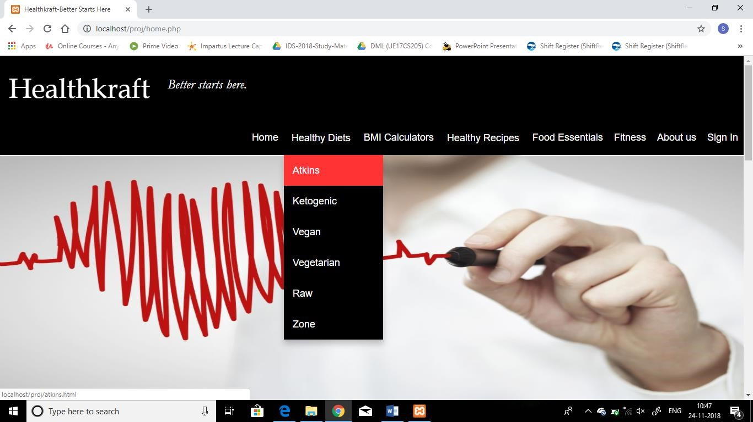
Screenshots

Slide 8
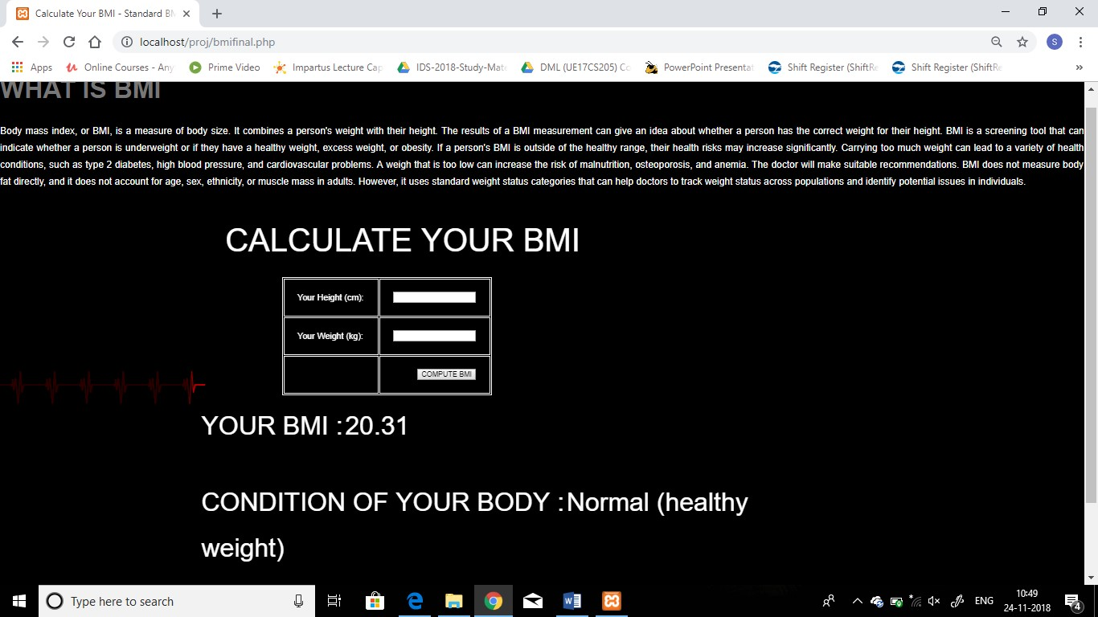

Slide 9
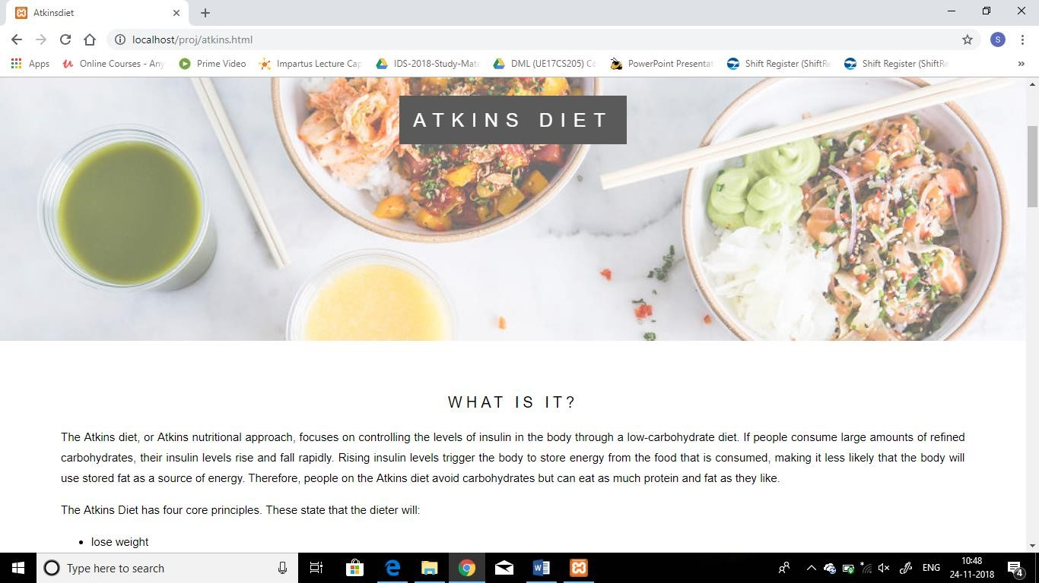

Slide 10
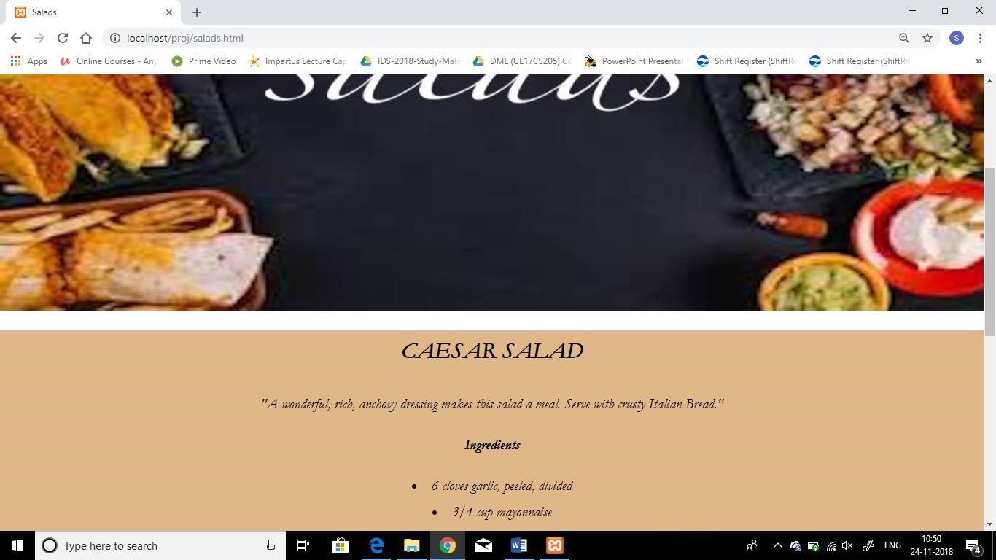

Slide 11
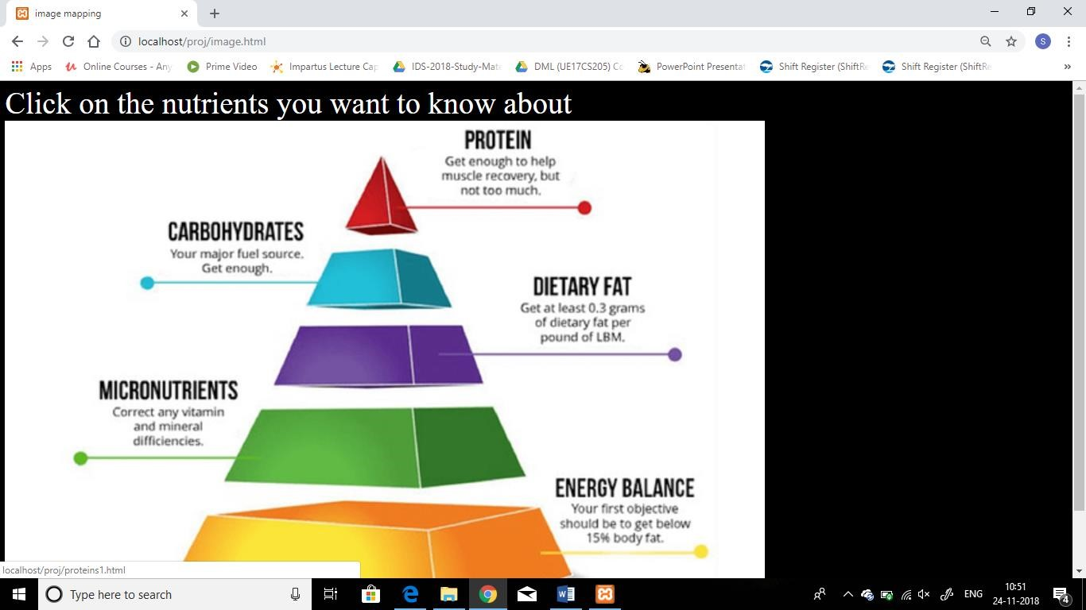

Slide 12
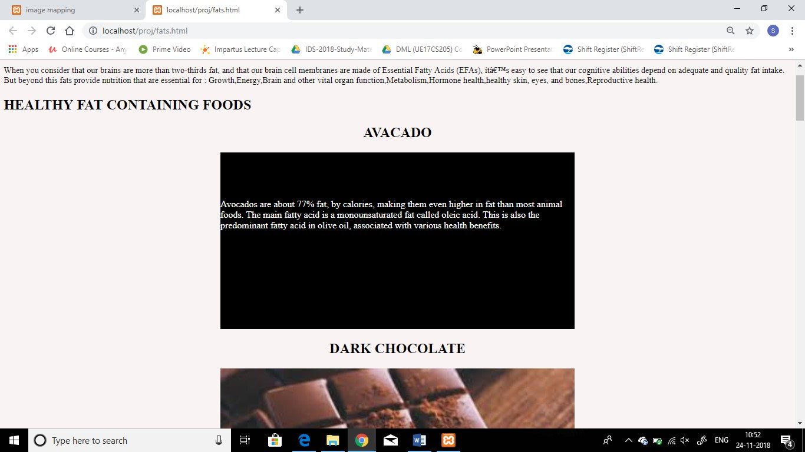

Slide 13
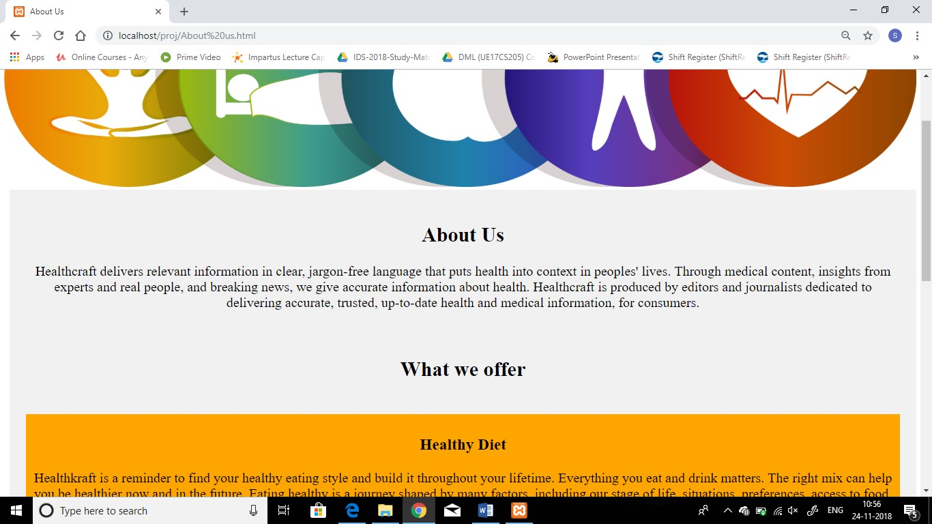

Slide 14
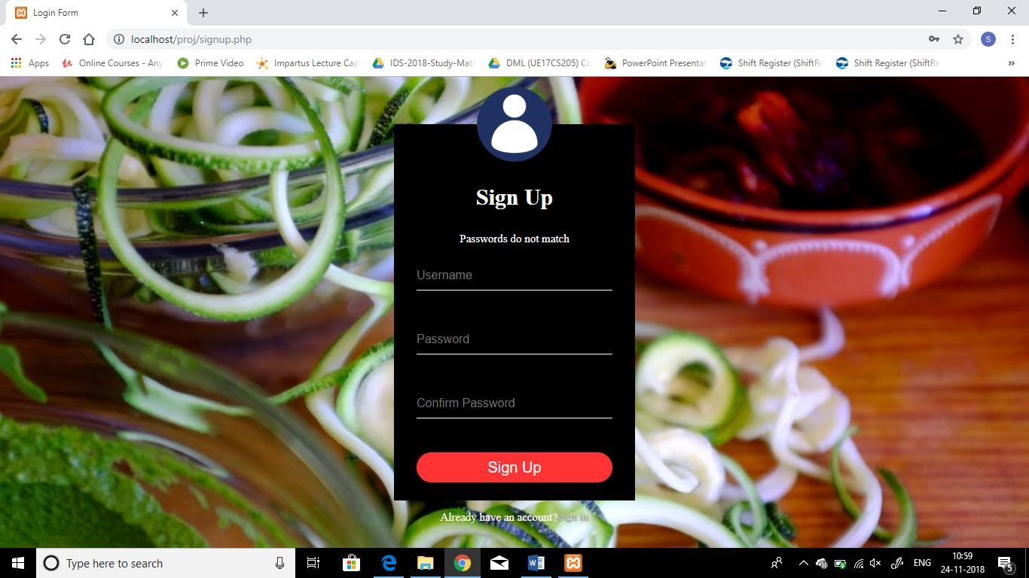

Slide 15
Takeaways
We learnt how to make a full fledged website using django with much more better features than just using html or css
While making the website in django, it was much easier with the built in administrative interface which enables to mange the data easily.

Slide 16
Challenges
Converting the php script to Django was a challenge when it came to dynamic webpages.
Linking static images in different webpages of the website was a challenge.
Sign up and login using Django was tricky compared to the usual php.

Slide 17
Contact info
Name: S Sriya
USN : PES1201700048
Email id: sriyasamptur@gmail.com
Name: Kritika Kapoor
USN: PES1201701868
Email Id:kritika90mahi@gmail.com
Name: Lavanya L
USN: PES1201700798
Email id: lavanyakumar2102@gmail.com

