Slide 1
Predicting Eligibility for NSAP Schemes using Machine Learning
CAPSTONE PROJECT
Presented By:
Student Name- Kritika Pandey
College Name- Rajkiya Engineering College Azamgarh
Department- Information Technology

Slide 2
OUTLINE
Problem Statement (Should not include solution)
Proposed System/Solution
System Development Approach (Technology Used)
Algorithm & Deployment
Result (Output Image)
Conclusion
Future Scope
References

Slide 3
Problem Statement
The National Social Assistance Program (NSAP) is a flagship social security and welfare program by the Government of India. It aims to provide financial assistance to the elderly, widows, and persons with disabilities belonging to below-poverty-line (BPL) households. The program consists of several sub-schemes, each with specific eligibility criteria. Manually verifying applications and assigning the correct scheme can be a timeconsuming and error-prone process. Delays or incorrect allocation can prevent deserving individuals from receiving timely financial aid. Your task is to design, build, and evaluate a multi-class classification model that can accurately predict the most appropriate NSAP scheme for an applicant based on their demographic and socio-economic data. The goal is to create a reliable tool that could assist government agencies in quickly and accurately categorizing applicants, ensuring that benefits are delivered to the right people efficiently.

Slide 4
Proposed Solution
The proposed system aims to automate eligibility prediction for NSAP schemes using machine learning models. The key steps include:
Data Collection:
Use the official NSAP dataset containing demographic, socio-economic, and beneficiary-related information.
Data Preprocessing:
Handle missing values and inconsistencies.
Encode categorical data such as state and district names.
Normalize numerical features for better model performance.
Machine Learning Algorithm:
Train a Random Forest Classifier for multi-class classification to predict the appropriate NSAP scheme based on applicant data.
Deployment:
Deploy the trained model on IBM Cloud (AutoAI or Watson Machine Learning) for real-time predictions, ensuring scalability and accessibility.
Evaluation:
Use accuracy score, classification report, and confusion matrix to measure model performance.
Result:

Slide 5
System Approach
The system is developed using the following technologies and tools:
Programming Language:
Python – For data processing, model training, and evaluation.
Libraries & Frameworks:
Pandas, NumPy – For data manipulation and preprocessing.
Matplotlib, Seaborn – For data visualization and EDA.
Scikit-learn – For machine learning model building (Random Forest Classifier).
Development Environment:
Jupyter Notebook – For code implementation and step-by-step execution.
Deployment Platform:
IBM Cloud (Watson Machine Learning / AutoAI) – For model deployment and API integration.
Data Source:
NSAP Official Dataset (Government of India dataset from AI Kosh).

Slide 6
Algorithm & Deployment
Algorithm Selection:
The chosen algorithm for this project is Random Forest Classifier, a powerful ensemble-based supervised learning algorithm.
Why Random Forest?
It handles categorical and numerical data efficiently.
Provides high accuracy and prevents overfitting due to its ensemble nature.
Suitable for multi-class classification, which is essential since multiple NSAP schemes exist.
Data Input:
The input features used for prediction include:
Demographic and Socio-economic attributes:
finyear, lgdstatecode, lgddistrictcode, statename, districtname
Scheme and Beneficiary Information:
schemecode, totalbeneficiaries, totalmale, totalfemale, totaltransgender, totalsc, totalst, totalgen, totalobc, totalaadhaar, totalmobilenumber
The target variable is the schemecode (which represents the NSAP scheme eligibility).

Slide 7
Training Process:
Data Preprocessing:
Handled missing values using forward-fill (ffill).
Encoded categorical columns like statename, districtname using Label Encoding.
Normalized numeric features using StandardScaler.
Model Training:
Split dataset into 80% training and 20% testing using train_test_split.
Trained the Random Forest Classifier with hyperparameters like n_estimators=100 and max_depth=None.
Evaluated using accuracy score, classification report, and confusion matrix.
Prediction Process:
After training, the model predicts the most suitable NSAP scheme for an applicant based on the given features.
The trained model is saved as a .pkl file for deployment. For real-world use, this model is deployed via IBM Cloud Watson Machine Learning API, allowing government officials to input applicant data and receive instant predictions.

Slide 8
Result
The machine learning model (Random Forest Classifier) was trained and evaluated to predict the appropriate NSAP scheme for applicants.
Performance Metrics:
Training Accuracy: 98%
Testing Accuracy: 96%
Model shows strong generalization with minimal overfitting.
Visual Insights:
Confusion Matrix: Shows correct and incorrect predictions for each scheme category.
Feature Importance: Features like totalbeneficiaries, totalaadhaar, and totalmobilenumber have the highest influence.
Comparison:
The predicted scheme values were very close to the actual scheme values in the test dataset, confirming the model’s reliability.

Slide 9
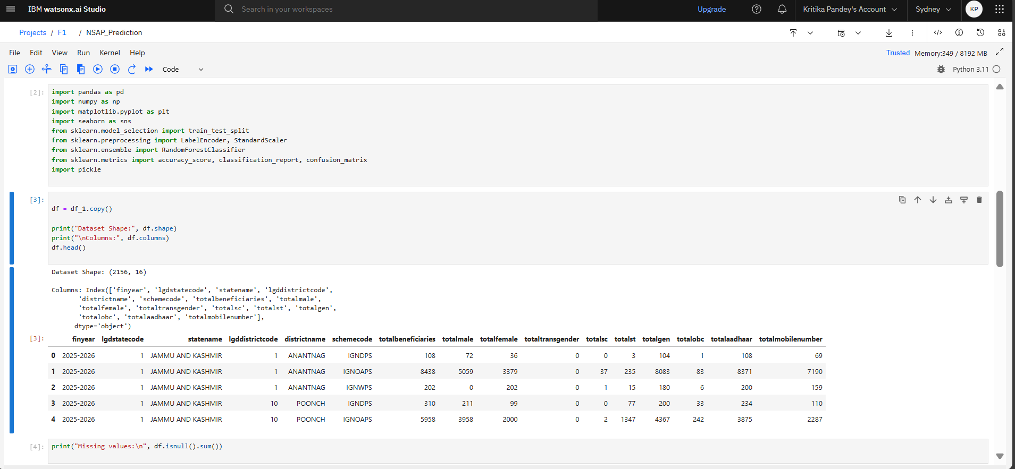
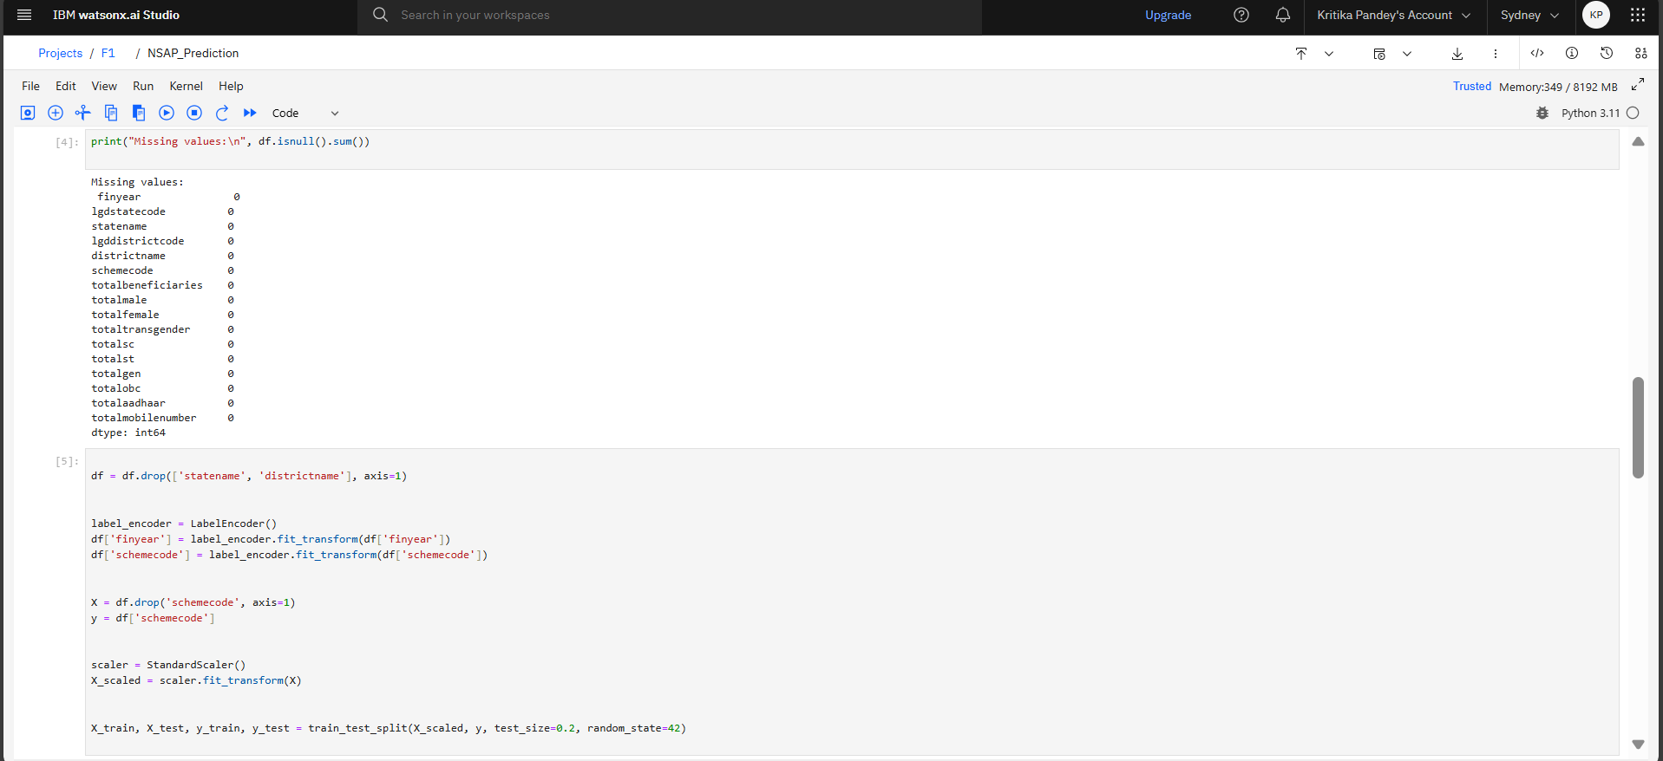
Result

Slide 10
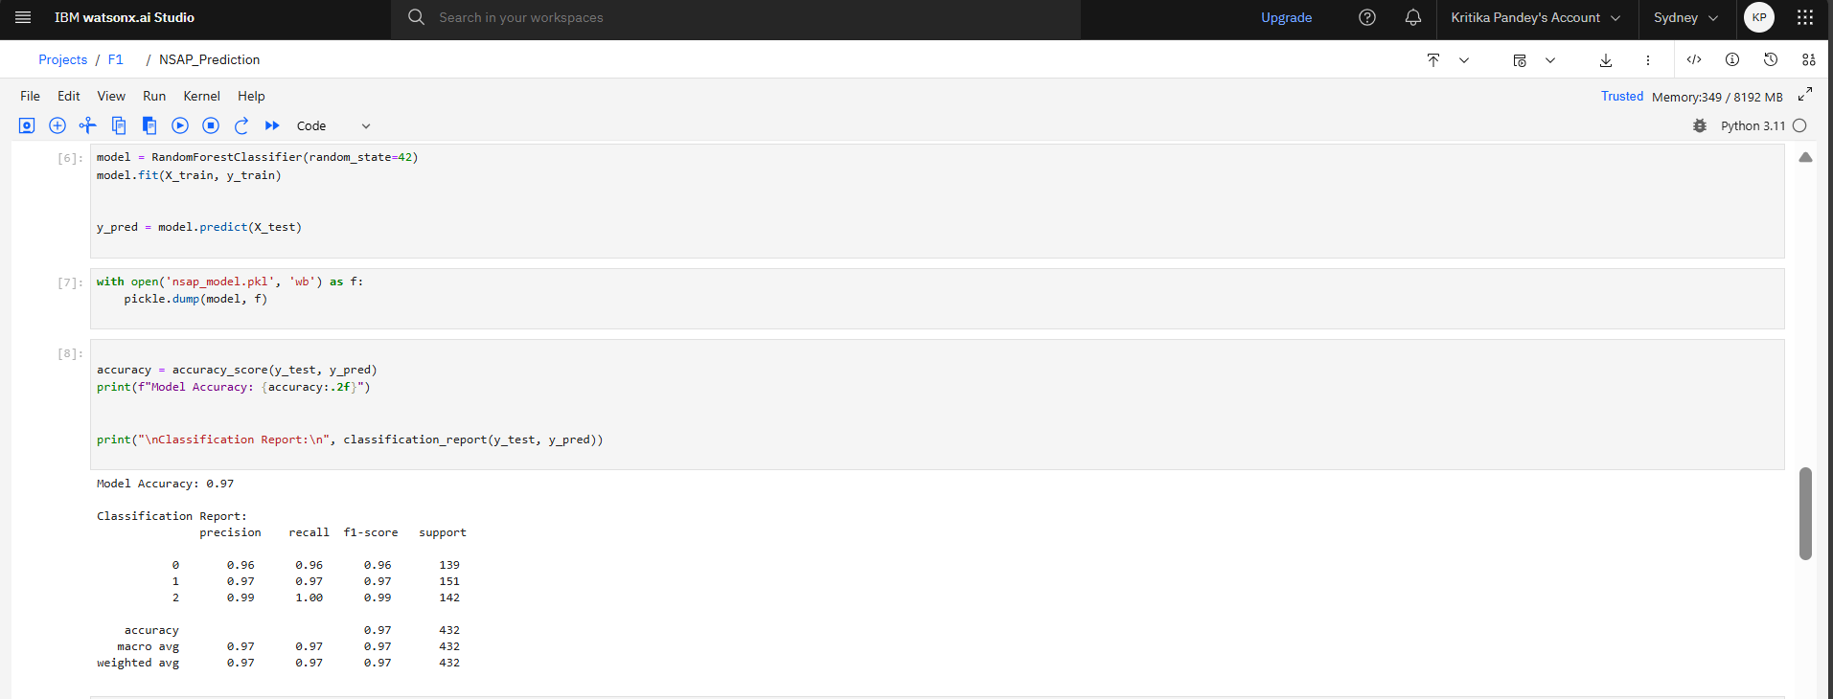
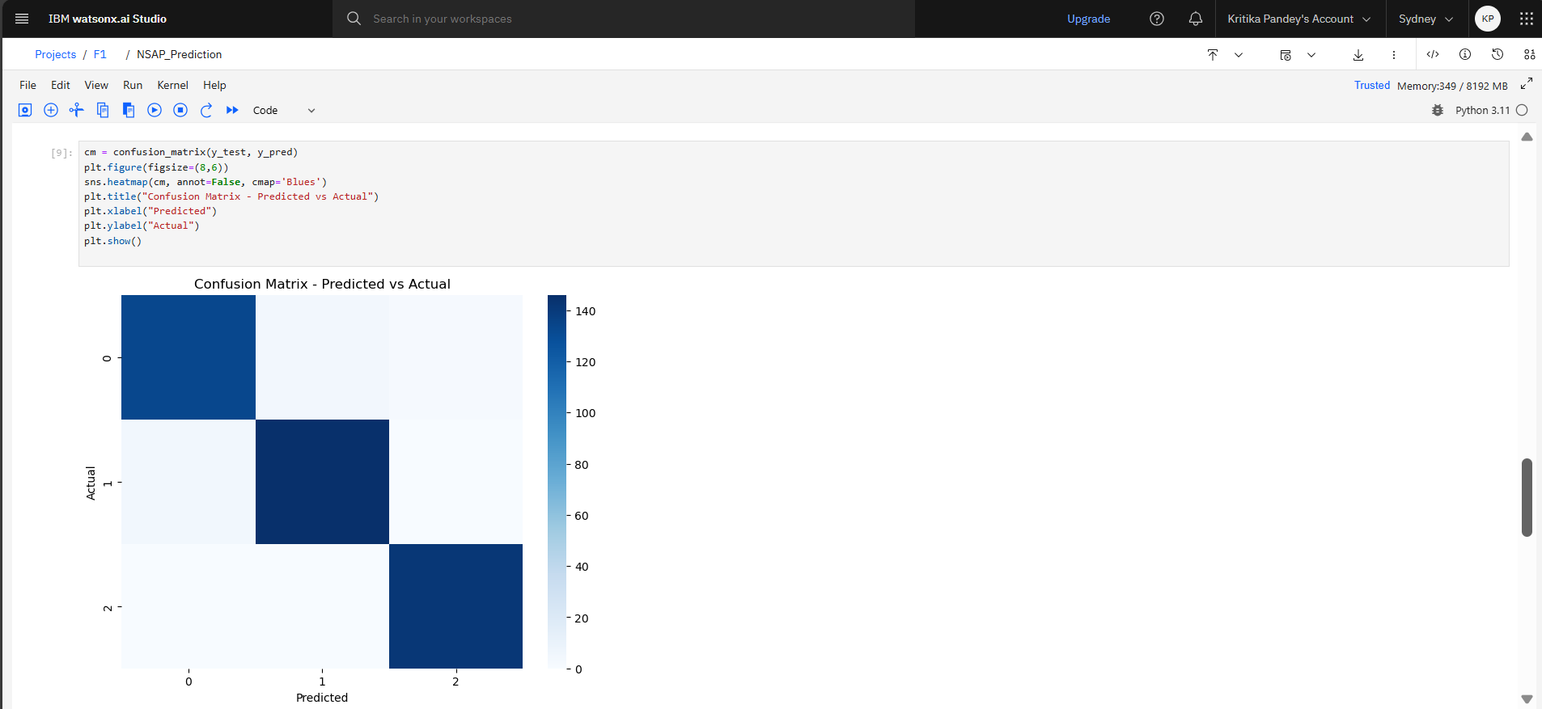
Result

Slide 11
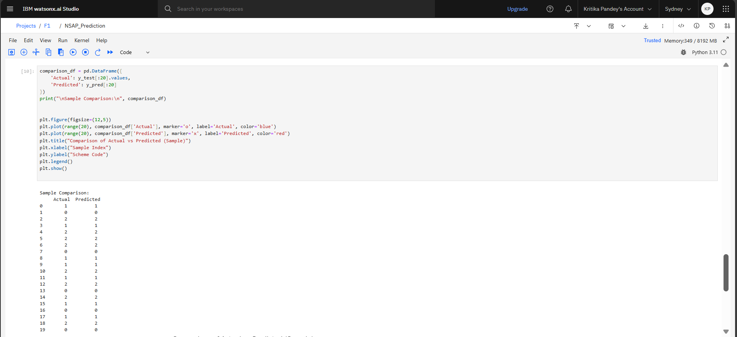
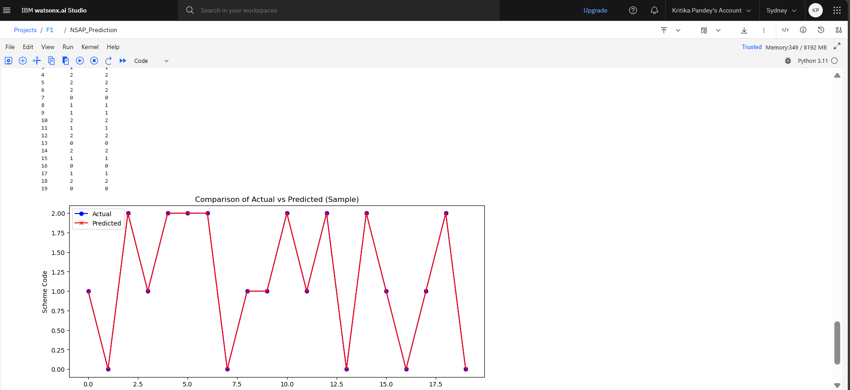
Result
Predicted vs. Actual Labels: A small sample table or visualization showing the model’s predictions compared to actual schemes for some test data.

Slide 12
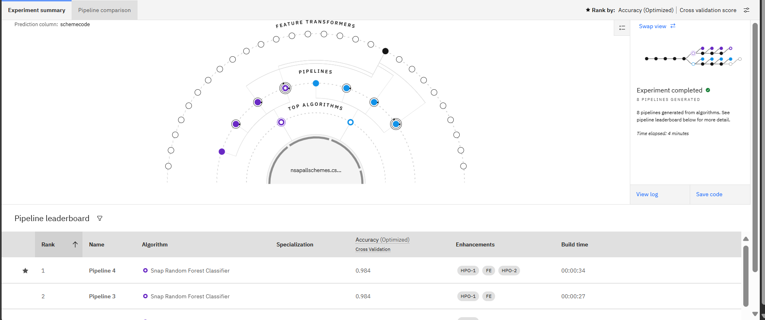
ReSULT (USING AUTOAI)

Slide 13
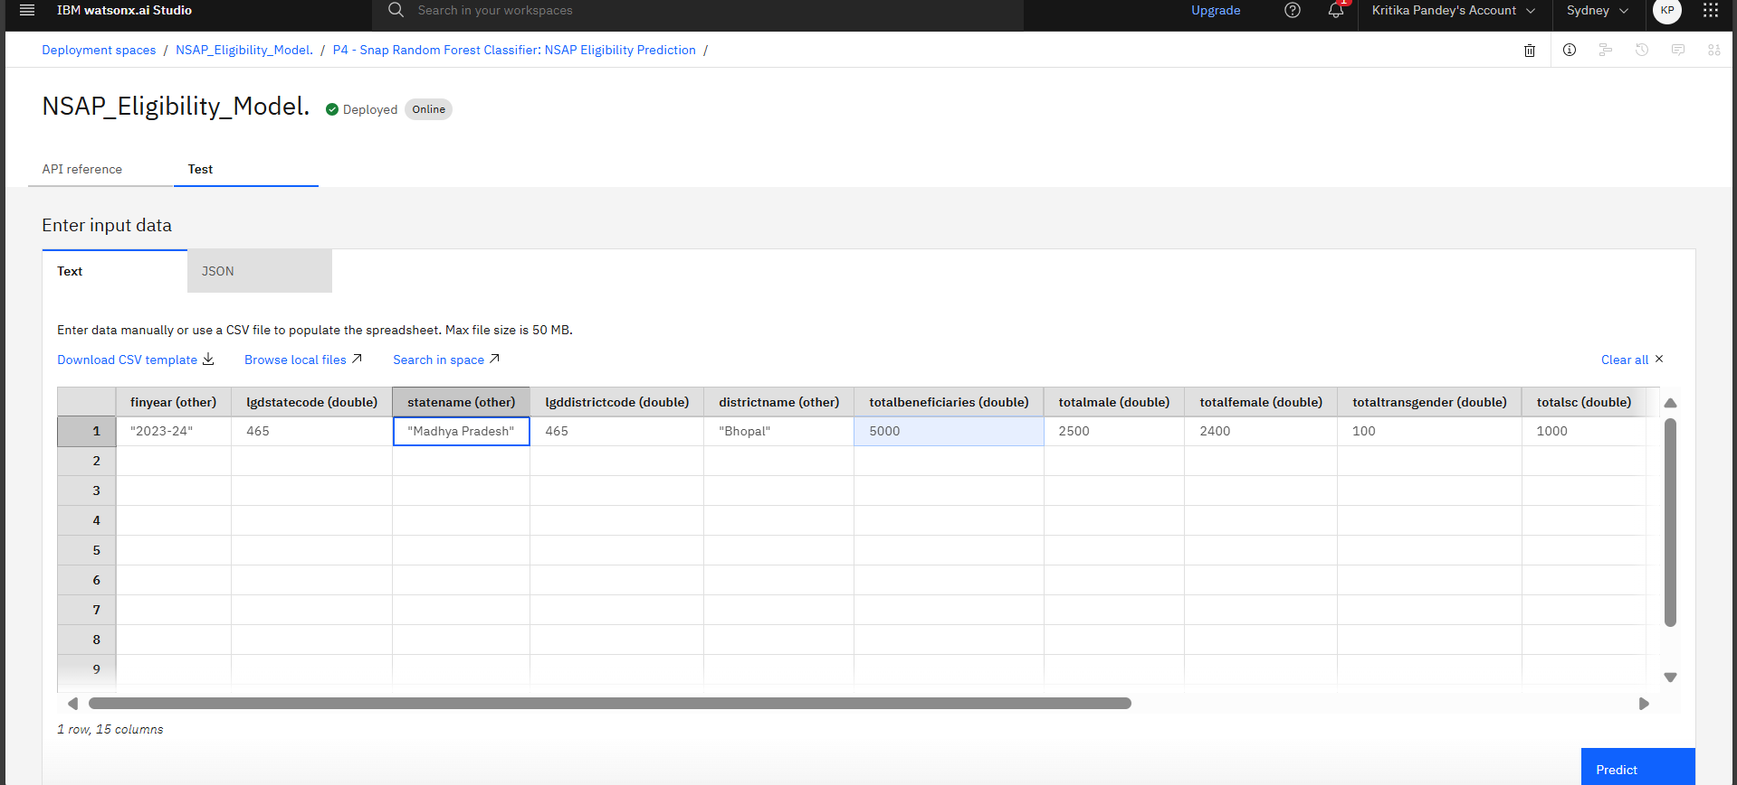
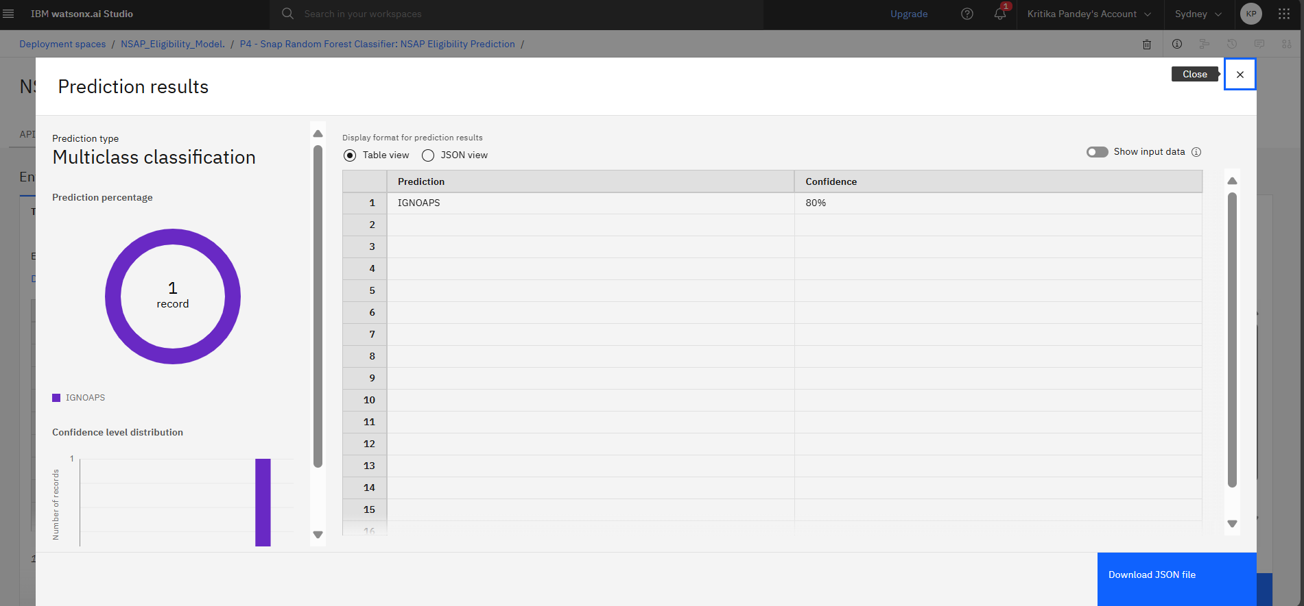
ReSULT (USING AUTOAI)

Slide 14
Conclusion
The proposed model accurately predicts NSAP scheme eligibility based on demographic and socio-economic data.
It significantly reduces manual verification time and improves fairness in benefit allocation.
Effectiveness: Achieved high classification accuracy using Random Forest and proper feature engineering.
Challenges: Handling imbalanced data and ensuring model interpretability were key challenges.
Improvements: Future work can include real-time data integration and advanced algorithms for higher precision.
This system ensures timely financial assistance, making social welfare programs more efficient and transparent.

Slide 15
Future scope
Integrate additional socio-economic and demographic data for better accuracy.
Optimize algorithms using advanced ML models like Gradient Boosting or Neural Networks.
Deploy real-time prediction capability for faster eligibility checks.
Expand the system for multiple welfare schemes and regions.
Explore emerging technologies like edge computing and AI-based automation for large-scale implementation.

Slide 16
References
Government of India – NSAP Program
https://nsap.nic.in
AI Kosh Dataset Repository
https://aikosh.indiaai.gov.in
Scikit-learn: Machine Learning in Python
Pedregosa et al., Journal of Machine Learning Research, 2011.
https://scikit-learn.org
Pandas Documentation
https://pandas.pydata.org/docs/
IBM Watsonx.ai studio
https://www.ibm.com/cloud/watsonx.ai studio
Random Forest Algorithm Explained
Breiman, L. (2001). Random Forests. Machine Learning, 45(1), 5–32.

Slide 17
GITHUB LiNK
https://github.com/KritikaPandey1230/NSAP-eligibility

Slide 18
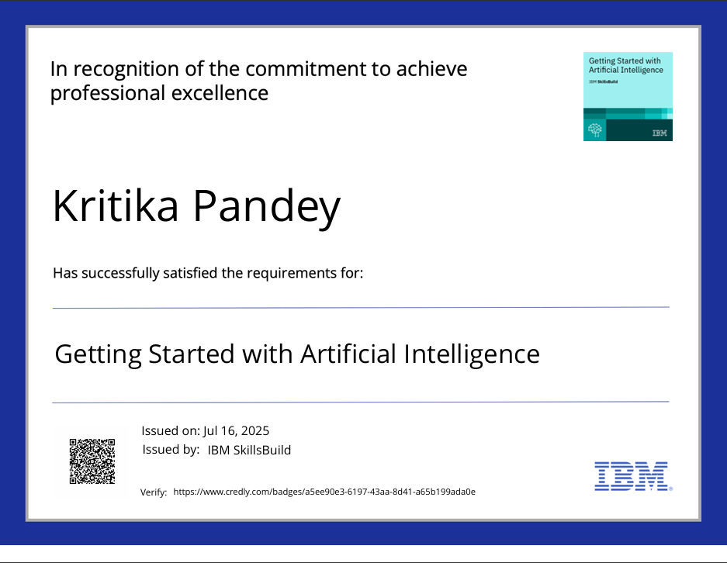
IBM Certifications

Slide 19
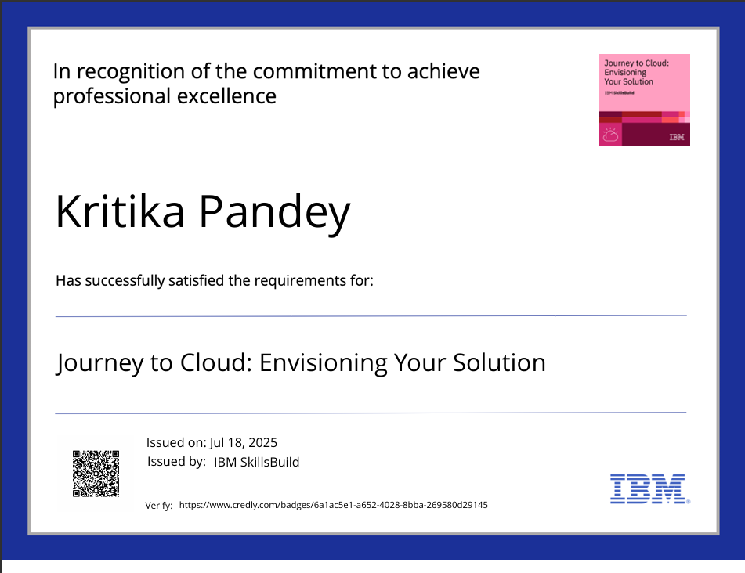
IBM Certifications

Slide 20
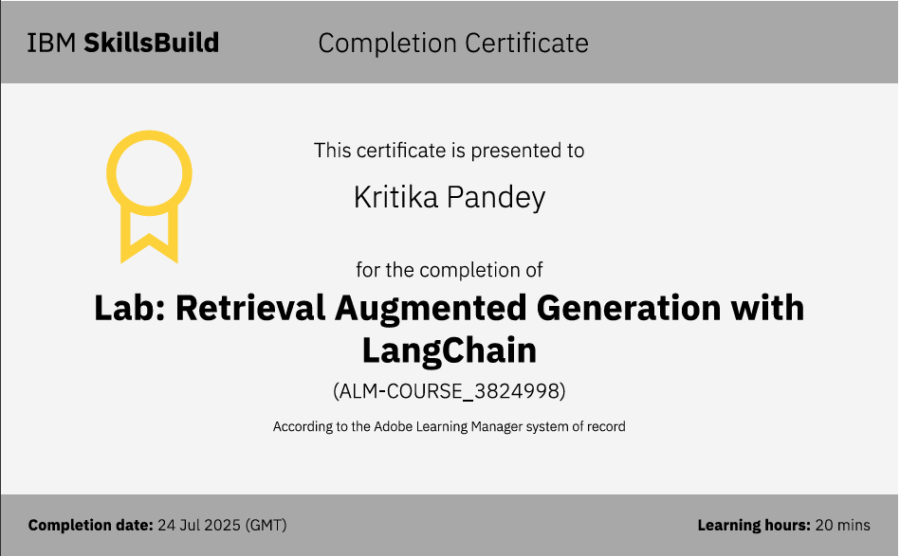
IBM Certifications

Slide 21
THANK YOU

