Slide 1
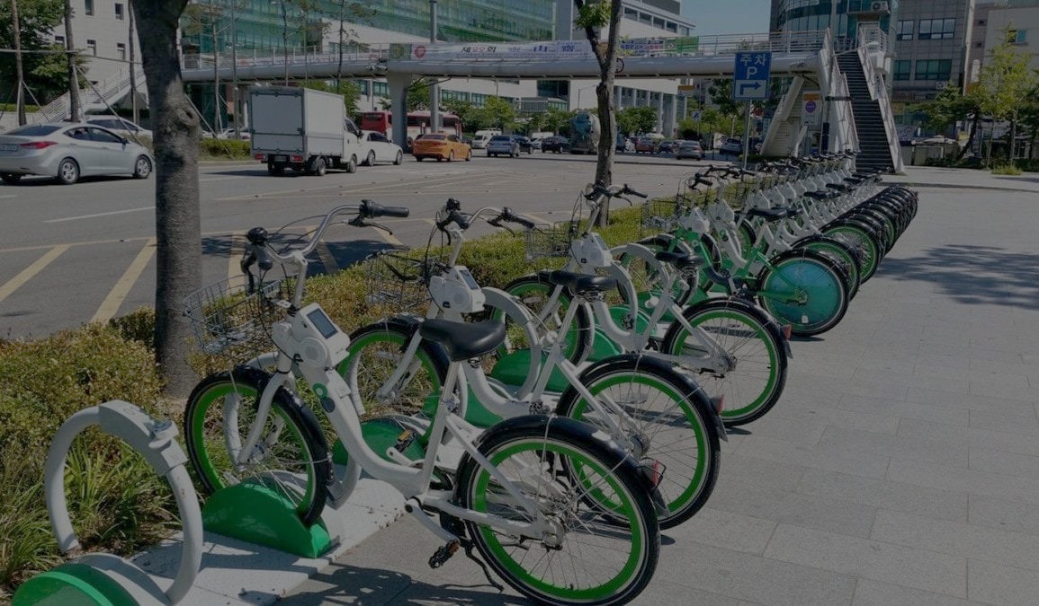

CAPSTONE PROJECT 2
Bike Sharing Prediction : Predicting bike count each hour
Team Member : Kritika Sharma

Slide 2
CONTENTS
1.Problem Statements
2.Data Summary
a) Data sets
b) Important Variables
c) Missing Value
3. Exploratory Data Analysis
a) EDA on rented bike count
b) EDA on seasons
c) Customers
4.Feature Engineering
a) Correlation
b) Multicollinearity
5.Model Formulation
6.Challenges
7.Conclusion

Slide 3

PROBLEM STATEMENTS
Currently Rental bikes are introduced in many urban cities for the enhancement of mobility comfort. It is important to make the rental bike available and accessible to the public at the right time as it lessens the waiting time. Eventually, providing the city with a stable supply of rental bikes becomes a major concern. The crucial part is the prediction of bike count required at each hour for the stable supply of rental bikes.
The objective of the project is to come with a machine learning model to predict bike rental.

Slide 4
DATA SUMMARY
We are using single data set for analysis
SeoulBikeData.csv :- rented bike count details
DETAILS OF DATA SET PROVIDED
SR.NO. | DATA SET | VARIABLES | NO. OF VARIABLES | NO. OF OBSERVATIONS
1 | SeoulBikeData | Date, Rented Bike Count, Hour, Temperature, Humidity, Wind speed, Visibility, Dew point temperature, Solar Radiation, Rainfall, Snowfall, Seasons, Holiday, Functioning Day | 14 | 8760

Slide 5
Important Variable
Date : Date on which bike is rented.
Hour : Time at which bike is rented.
Temperature : Temperature of the city from which bike is picked.
Humidity : indicate the humidity of the city.
Windspeed : indicates the rate at which air is moving in a particular area.
Seasons : Indicates 4 types of seasons – Winter, Summer, Spring, Autumn.
Holiday : 2 categorization – 1. holiday
2. working day(non holiday)
Functioning Day : the fact of working or operating.

Slide 6

Exploratory Data Analysis

Slide 7
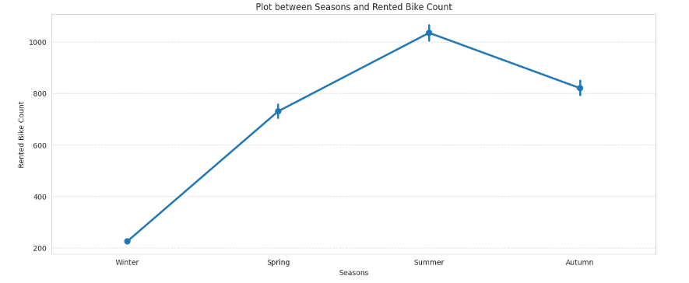
Plot Between Seasons v/s Rented Bike Count

Slide 8
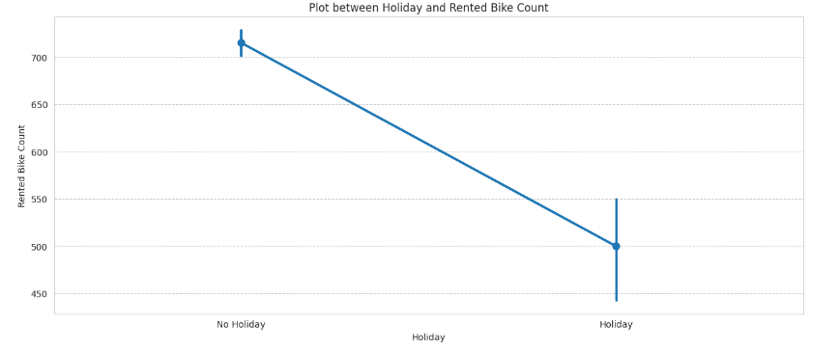
Plot Between Holiday v/s Rented Bike Count

Slide 9
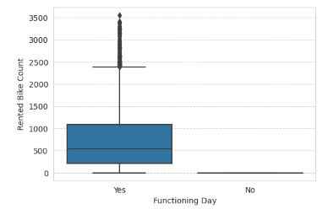
Plot Between Rented Bike Count v/s Functioning day

Slide 10
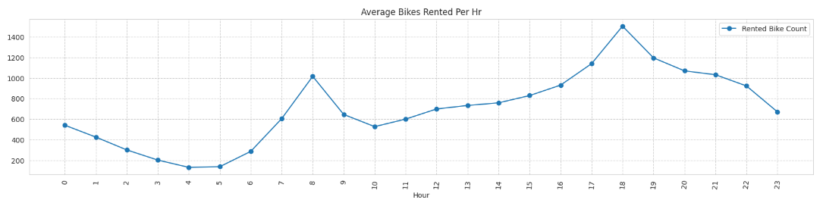
Plot Between Average bike Rented per Hour

Slide 11
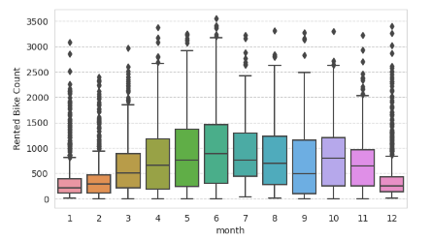
Plot Between Rented Bike Count v/s Month

Slide 12

Feature Engineering

Slide 13
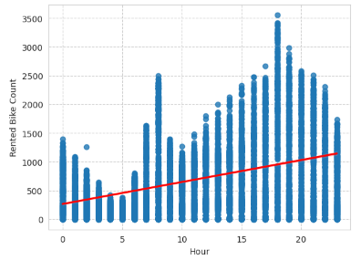
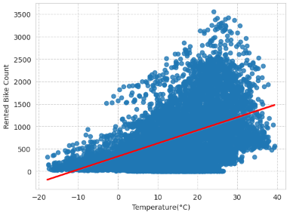
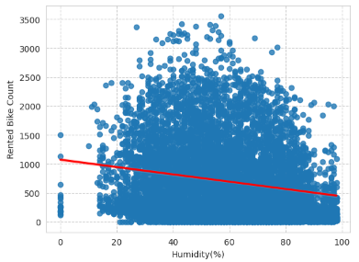
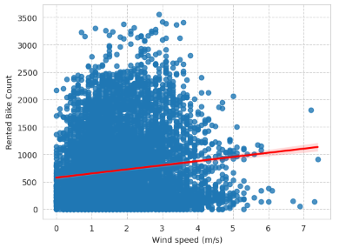
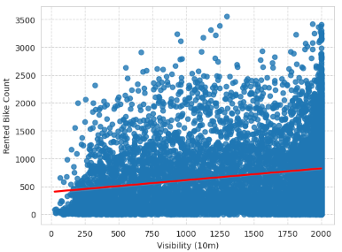
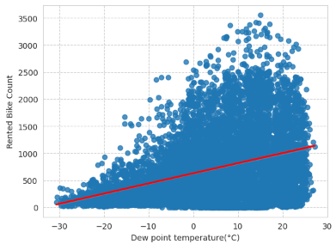
Correlation between Independent Features and Sales

Slide 14
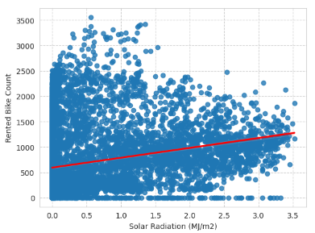
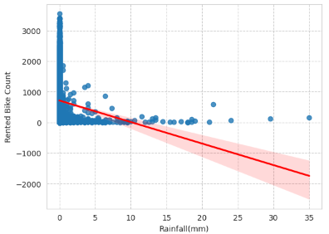
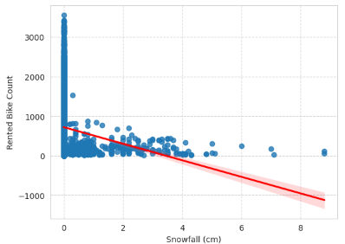
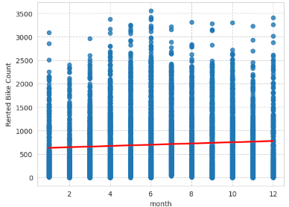
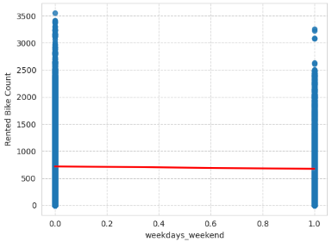
Correlation between Independent Features and Sales

Slide 15
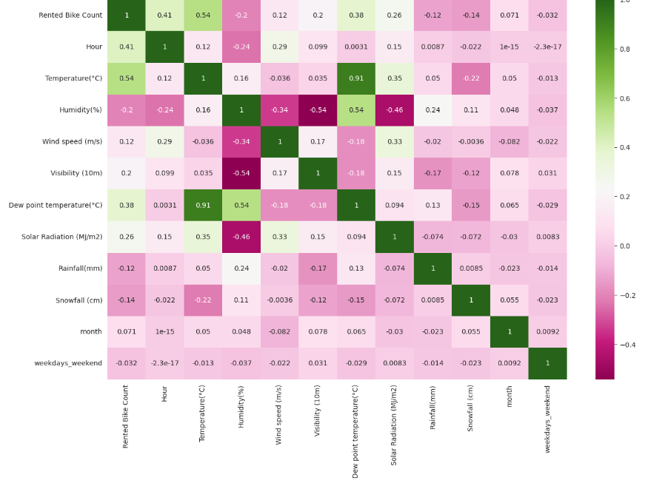
Correlation Heatmap

Slide 16
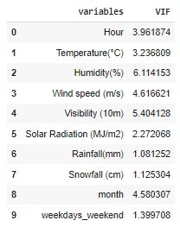
Multicollinearity

Slide 17
Model Formulation

Slide 18
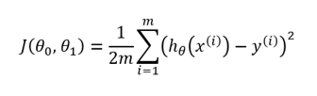

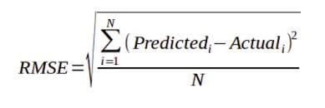

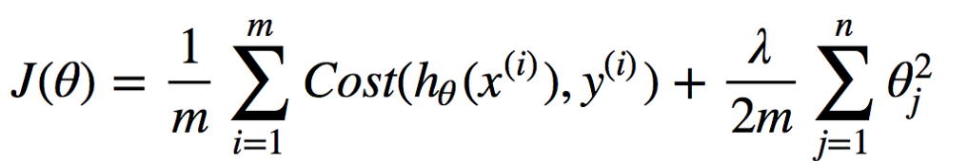

Important Formulae
Sr. No. | Functions | Formulae
01 | Cost Function
02 | R Square
03 | RMSE
04 | Lasso
05 | Ridge
06 | Elastic Net

Slide 19
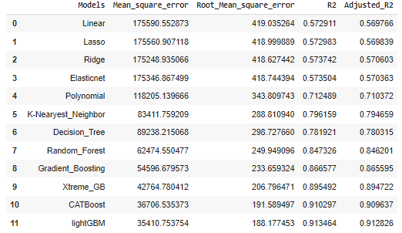
MSE , RMSE, RMPSE & R2 values
Light GBM and CATBoost is the best suitable model

Slide 20
Shape of CAT Boost and Light GBM
CAT BOOST
LIGHT GBM

Slide 21
Challenges
Handling large amount of sales data (8,760 observations on 14 variables)
Some stores were closed. Unable to fill the gap of bike renting for those stores.
Choosing right kind of model.

Slide 22
Conclusion
1.In holiday or non-working days there is demands in rented bikes.
2.There is a surge of high demand in the morning 8AM and in evening 6PM as the people might be going to their work at morning 8AM and returing from their work at the evening 6PM.
3.People preffered more rented bikes in the morning than the evening.
4.When the rainfall was less, people have booked more bikes except some few cases.
5.The Temperature, Hour & Humidity are the most important features that positively drive the total rented bikes count.
6.After performing the various models the lightGBM and Catboost found to be the best model that can be used for the Bike Sharing Demand Prediction since the performance metrics (mse,rmse) shows lower and (r2,adjusted_r2) shows a higher value for the lightGBM and Catboost models !
7.We can use either lightGBM or catboost model for the bike rental stations.

Slide 23


