Slide 1


FINAL PROJECT PRESENTATION
Bank Marketing Campaign
Analysis Dashboard
An interactive Tableau dashboard analyzing bank marketing campaign performance and customer subscription behavior
Presented by: [ Kritika Singh ] | [ ABES Engineering College / B.tech ]

Slide 2


What We'll Cover -
01
Introduction & Problem Statement
02
Project Objectives
03
Dataset Description
04
Proposed Dashboard Features
05
Dashboard 1: Campaign Performance Analysis
06
Dashboard 2: Customer Behavior Analysis
07
Expected Outcomes & Conclusion
2

Slide 3
Campaign Overview at a Glance
A large-scale bank marketing dataset containing customer demographics, financial profile, and campaign outcomes
This project analyzes a real-world Portuguese bank telemarketing dataset to understand who subscribes to term deposits, when to contact them, and how many outreach attempts are worthwhile. The findings power a two-part Tableau dashboard covering campaign performance and root-cause diagnosis. This project analyzes a real-world Portuguese bank telemarketing dataset to understand who subscribes to term deposits, when to contact them, and how many outreach attempts are worthwhile. The findings power a two-part Tableau dashboard covering campaign performance and root-cause diagnosis.
45,211
17
11.7%
2
Customer records
Data attributes
Subscription rate
2 Analytical dashboards
3

Slide 4
Problem Statement
The Challenge
Our Approach
Analyzing 45,211 customer records across 17 features using spreadsheets is time-consuming and difficult.
Customer demographics, financial profiles, contact history, and previous campaign outcomes make it challenging to identify the factors driving subscriptions.
Marketing teams cannot easily determine which customer segments respond best, the ideal contact frequency, or the best time for follow-up.
Without interactive visualization, important patterns and business opportunities may be overlooked.
Develop two interactive Tableau dashboards to evaluate campaign performance and uncover the reasons behind campaign outcomes.
Use KPIs and interactive visualizations to analyze customer behavior, subscription trends, and campaign effectiveness.
Compare customer segments based on job, education, marital status, previous campaign history, and communication channels.
Provide data-driven insights to improve customer targeting, optimize contact strategy, and support future marketing decisions.
4

Slide 5
Project Objectives
1
Two-Dashboard Design — Build a linked Tableau report separating campaign performance from root-cause diagnosis.
2
Segment-Level Insight — Visualize subscription rate across job, education, marital status, and financial profile.
3
Evaluate Campaign Performance — Analyze the impact of contact frequency, call duration, previous campaign outcomes, and contact recency on subscription success.
4
Generate Business Insights— Surface who to target, when to contact them, and how many attempts are worthwhile.
5
Data Transparency — Flag data quality limitations, such as unknown prior campaign outcomes, within the dashboard.
5

Slide 6
Dataset Description -
"Bank Marketing Dataset" — UCI Machine Learning Repository
SOURCE
COVERAGE
FORMAT
UCI Machine
Learning Repository
45,211 customers,
Portuguese bank
17 Attributes
Structured tabular dataset
The dataset offers a comprehensive view of customer profile and campaign behavior — capturing demographics, financial standing, contact history, and campaign outcomes for every customer contacted during the bank's telemarketing effort.
6

Slide 7
Dataset Variables
Key fields captured for every customer record
Age
Job
Marital Status
Education
Default Status
Account Balance
Housing Loan
Personal Loan
Contact Type
Day / Month
Campaign Contacts
Pdays (Recontact Gap)
Previous Contacts
Previous Outcome
Call Duration
Subscribed (Target)
7

Slide 8
Dashboard Feature: KPI Cards
Dashboard 1 — Performance
Dashboard 2 — Diagnosis
Total Customers
Previous Campaign Success %
Subscription Rate
Customers Recontacted
Average Balance
Avg Days Before Recontact
Average Call Duration
Avg Contacts: Subscribers vs Non-Subscribers
Avg Contacts / Customer
8

Slide 9
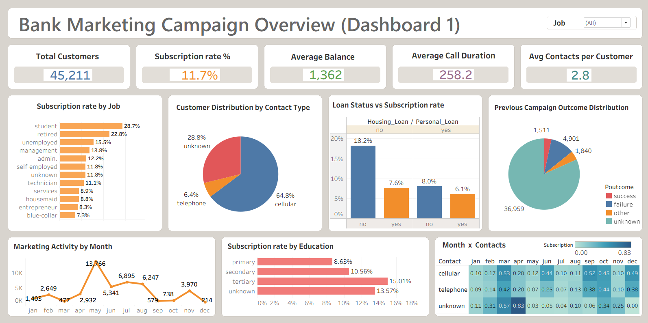
Live Dashboard Demonstration
Dashboard 1 — How did the campaign perform?
Link: https://public.tableau.com/app/profile/kritika.singh4876/viz/BankMarketingCampaignAnalysisDashboard1/Dashboard1

Slide 10
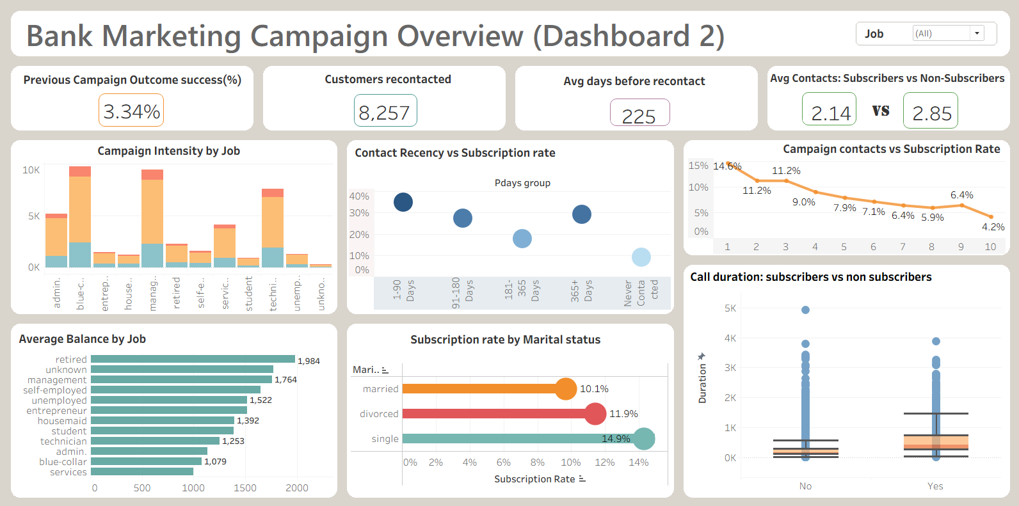
Live Dashboard Demonstration
Dashboard 2 — Why did it perform that way, and what's next?
Link: https://public.tableau.com/app/profile/kritika.singh4876/viz/BankMarketingCampaignAnalysisDashboard2/Dashboard2

Slide 11
Expected Outcomes & Conclusion
Transform raw campaign data into meaningful business insights through Tableau dashboards.
Enables clear comparison of subscription performance across customer segments.
Provide data-driven insights to optimize customer targeting, contact frequency, and follow-up timing based on campaign performance and customer behavior analysis.
Demonstrates the practical application of Business intelligence and data visualization techniques in a real-world bank marketing scenario
The Bank Marketing Campaign Analysis Dashboard transforms raw Bank marketing dataset into an interactive decision-support tool — showing not just how the campaign performed, but why, and what actions to take next to improve conversion efficiency.
Thank you

