Slide 1
PUNJAB CENSUS
District-wise Exploratory Data Analysis
Source: data.gov.in (Government of India Open Data)
Scope: 23 Districts • Census Years 1991, 2001, 2011 • 105 Variables
Tools: • Pandas • Matplotlib • Scikit-learn • Plotly • Seaborn
Population Trends
Workforce Analysis
Sex Ratio
Statistical Analysis
ML
Presented by: Kritika Thakur

Slide 2
PROJECT OVERVIEW
📊
census.xlsx
📋
23 Districts
🔢
105 Columns
📅
1991–2011
Dataset
Records
Features
Time Span
from data.gov.in
all of Punjab
demographic variables
three census years
Data Cleaning Steps
EDA Goals
1. Loaded data using pd.read_excel()
2. Stripped whitespace & lowercased all column names
3. Replaced missing values (NA) with 0 using
fillna(0)
4. Converted columns to numeric with
pd.to_numeric(errors='ignore')
Analyze population growth 1991–2011
Identify gender imbalance patterns
Understand workforce participation
Examine Sex Ratio
Apply ML technique ( Clustering)

Slide 3
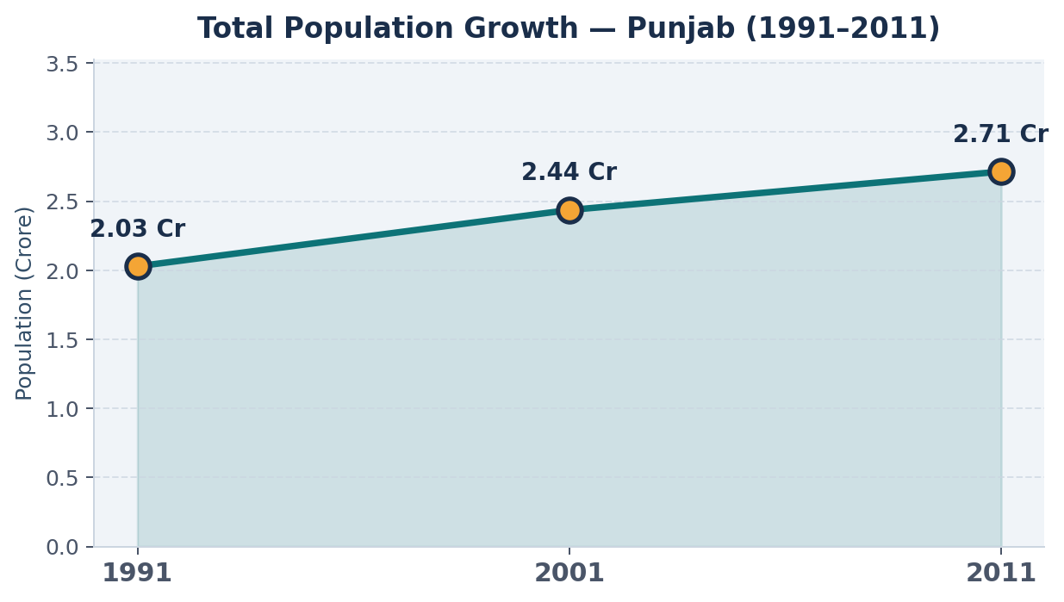
TOTAL POPULATION GROWTH (1991 – 2011)
Population Trend
📈 1991: 2.03 Cr
2001: 2.44 Cr
2011: 2.71 Cr
🔢 Decade growth:
1991→2001: +20.1%
2001→2011: +11.4%
📊 Total growth
over 20 years:
+33.8%
🏙️ Urbanisation &
migration drove
most of the rise
📉 Growth rate
slowed slightly
in second decade

Slide 4
POPULATION OVERVIEW (2011)
2.71 Cr
23
14.8%
896
Total Population
(2011)
Districts
Growth Rate
(2001–2011)
Avg Sex Ratio
(per 1000 males)
Population Growth Trend
1991
2.03 Cr
2001
2.44 Cr
2011
2.71 Cr
Overall growth 1991→2011: +33.8%

Slide 5
SEX RATIO (2011)
Key Findings
🟢 Highest
Hoshiarpur (961)
SBS Nagar (954)
🔴 Lowest
Bathinda (868)
Amritsar (889)
📊 Punjab Avg
896 (below national
avg of 940)
⚠️ Child SR
Rural child sex ratio
ranges 818–884
📌 Concern
Most districts below
900 mark

Slide 6
WORKFORCE ANALYSIS (2011)
👷 Main Workers
~45.1 Lakh
🔧 Marginal Workers
~8.9 Lakh
🏠 Non-Workers
~1.38 Cr
📊 Worker Rate
~27–35%
⚖️ Dependency Ratio
High in rural

Slide 7
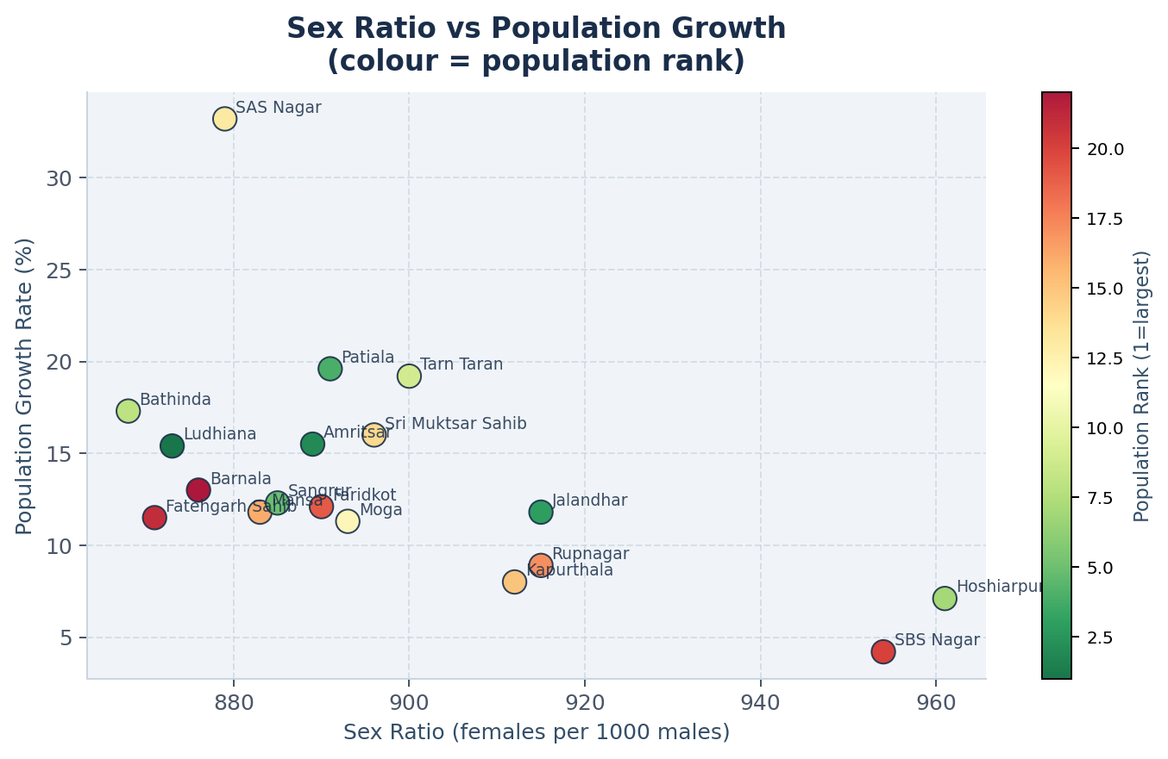
SEX RATIO vs POPULATION GROWTH — SCATTER PLOT
findings
X-axis:
Sex Ratio
(females/1000 males)
Y-axis:
Population
growth rate (%)
Colour:
Population rank
(green=large dist.)
🔍 No clear link:
high growth doesn't
need high sex ratio
📌 SAS Nagar:
highest growth but
avg sex ratio
✅ Hoshiarpur:
best sex ratio &
moderate growth

Slide 8
STATISTICAL ANALYSIS
Descriptive Statistics — Population 2011
Key Statistical Insights
Statistic | Pop 2011 | Child Pop (Rural)
Count | 23 | 23
Mean | 1,233,788 | 88,432
Std Dev | 765,906 | 38,011
Min | 215,168 | 42,559
25th %ile | 678,605 | 53,524
Median | 999,310 | 86,383
75th %ile | 1,612,950 | 121,990
Max | 3,498,739 | 148,970
📊 Correlation
Pop-2011 vs Pop-2001: r = 0.879
📈 Growth Outliers
SAS Nagar 33.2%, Patiala 19.6%
🔗 Literacy–Work
literacy positively correlated with main workers
👶 Child Pop
Mean 88K rural children; Max 148,970(1.48L)

Slide 9
FEATURE ENGINEERING
Growth Rate
Sex Ratio
((Pop₂₀₁₁ − Pop₂₀₀₁) / Pop₂₀₀₁) × 100
(Female₂₀₁₁ / Male₂₀₁₁) × 1000
Insight: SAS Nagar: 33.2% | Patiala: 19.6%
Insight: Females per 1000 males by district
Use: ML feature, trend analysis
Use: Gender analysis, ML feature
Worker Rate
Dependency Ratio
(Total Workers / Pop₂₀₁₁) × 100
Non-Workers / Total Workers
Insight: % of population actively working
Insight: Economic burden per active worker
Use: ML target variable
Use: Socio-economic profiling
Urbanization Ratio
Literacy Gap
Urban Total / (Rural + Urban Total)
Male Literate − Female Literate
Insight: SAS Nagar highest urbanized district
Insight: All 23 districts = Low Equality
Use: Rural-urban split analysis
Use: Gender equity tracking

Slide 10
ML MODEL — K-MEANS CLUSTERING (District Grouping)
Clustering Details
Applied K-Means clustering (k = 3) to group districts
Features used:
Population (2011)
Worker Rate
Sex Ratio
Districts grouped into:
Cluster 0 (Small Districts) Low population, moderate workforce-Mansa
Cluster 1 (Medium Districts) Average population, mixed characteristics-Patiala
Cluster 2 (Large Districts) High population, more urban & developed-Ludhiana
from Scikit-learn.cluster import KMeans
kmeans = KMeans(n_clusters=3)
data['cluster'] = kmeans.fit_predict(X)
Features used: Population 2011 · Sex Ratio 2011 · Worker Rate Algorithm: KMeans(n_clusters=3)

Slide 11
SUMMARY & CONCLUSIONS
EDA
Statistical Analysis
Machine Learning
Punjab grew 34% in 20 years (1991–2011)
Pop 2011 vs 2001 correlation: r = 0.879
KMeans (k=3): 3 district clusters identified
Ludhiana: most populous (3.5M)
gender gap exists everywhere
Cluster 3 = large urban districts (Ludhiana)
19/23 districts showed population growth
Child pop mean: 88,432 per district
KMeans (k=3): 3 district clusters identified
Average sex ratio of 896 is below national average.
High dependency ratio and significant non-worker population indicate economic challenges, especially in rural areas.

Slide 12
Thank You

