Slide 1
STUDENTS EXCURSION FORM
Submitted by:
R.P.KRITIKA
4th -B.E CSE
Dr.N.G.P.IT

Slide 2
DESCRIPTION
This is a registration form (HTML) which collects data from students for the excursion. The form is created with the help of different special elements known as 'controls' in HTML such as drop-down, checkbox, submit buttons, etc. CSS has been used to describe the presentation and design of this form. Interactive behaviour has been added to this form with the help of JavaScript.
This form needs input for:
1. Name
2. Class
3. Section
4. Place to be visited
5. Name of the parent
6. Phone number and
7. Address
Working:
1. Fill up the form with correct details.
2. Once every field has been filled, click on the checkbox to accept the details.
3. Click the SUBMIT button, it directs to another page which contains a table format of those details.

Slide 3
Coding:
<html>
<head>
<title> Students Excursion </title>
<style>
#titleName{
text-align: center;
font-size: 30;
font-weight: bolder;
font-family: Arial, Helvetica, sans-serif;
color: #fff;
background-image: linear-gradient(#111d5e, #11698e);
border: 1px transparent;
border-top-left-radius: 20px;
border-top-right-radius: 20px;
height: 50;
padding-top: 15;
}

Slide 4
#tableTitleName{
text-align: center;
font-size: 30;
font-weight: bolder;
font-family: Arial, Helvetica, sans-serif;
color: #fff;
background-image: linear-gradient(#111d5e, #11698e);
border: 1px transparent;
border-radius: 20px;
height: 50;
width: 30%;
padding-top: 15;
margin-bottom: 30px;
}
#boxStyle{
background-color:transparent;
height: 550;
width: 400;
margin: auto;
border: 2px transparent;
border-radius: 20px;
box-shadow: black 4px 4px 10px;
opacity: 1;
display: block;
}

Slide 5
#bg{
background-image: url("travel.jpg");
height: 100%;
opacity: 0.7;
background-repeat: no-repeat;
background-size: cover;
margin-top: 0;
}
#nameId,#placeId,#parentId,#phoneId{
height: 30;
width: 250;
/* text-align: center; */
padding-left: 20;
margin-top: 20;
border-radius: 20px;
border: 1px solid black;
background-color: #b4d3fd;
font-family: Georgia, 'Times New Roman', Times, serif;
font-size: 20;
color: black;
}

Slide 6
#classId,#sectionId{
height: 30;
width: 100;
/* text-align: center; */
padding-left: 10;
margin-top: 20;
border-radius: 20px;
border: 1px solid black;
background-color: #b4d3fd;
font-family: Georgia, 'Times New Roman', Times, serif;
font-size: 20;
color: black;
margin-right: 20; }
#addressId{
height: 100;
width: 250;
/* text-align: center; */
padding: 15;
margin: 20;
border-radius: 20px;
border: 1px solid black;
background-color: #b4d3fd ;
font-family: Georgia, 'Times New Roman', Times, serif;
font-size: 20 color: black; }

Slide 7
#accept{
color: black;
font-weight: bold;
}
#submitButton{
margin-top: 20;
height: 30;
width: 90;
background-image: linear-gradient(#111d5e, #11698e);
border: 2px transparent;
font-weight: 500;
font-size: 15;
opacity: 0.7;
transition: 0.2s;
cursor: pointer;
color: white;
}

Slide 8
#copyright{
position: absolute;
bottom: 20;
left: 41%;
font-size: 18;
color: black;
}
#tableId{
display: none;
}
table, th, td {
border: 1px solid black;
text-align: center;
height: 50;
font-size: 20;
}

Slide 9
</style>
<script>
function nextPage()
{
var nameVal = document.getElementById("nameId").value;
if(nameVal!="" || nameVal.length>3)
{
if(document.getElementById("classId").value!="Class")
{
if(document.getElementById("sectionId").value!="Section")
{
if(document.getElementById("placeId").value!="Places")
{
if(document.getElementById("parentId").value.length>3 )
{
if(document.getElementById("phoneId").value.length==10)
{
if(document.getElementById("addressId").value.length>20 )
{
if(document.getElementById('accept').checked)
{
resultScreen();
}

Slide 10
else { alert("Please agree to submit detail!"); }
}
else { alert( "Please provide valid address!" );}
}
else { alert( "Please provide valid phone number!" );}
}
else { alert( "Please provide valid parent name!" );}
}
else { alert( "Please provide place!" );}
}
else { alert( "Please provide section!" );}
}
else { alert( "Please provide class!" ); }
}
else { alert( "Please provide valid name!" ); }
}

Slide 11
function resultScreen()
{ boxStyle.style.display = "none";
tableId.style.display = "block";
var nameVal = document.getElementById("nameId").value;
document.getElementById("spanName").innerHTML=nameVal;
var classVal = document.getElementById("classId").value;
document.getElementById("spanClass").innerHTML=classVal;
var sectionVal = document.getElementById("sectionId").value;
document.getElementById("spanSection").innerHTML=sectionVal;
var placeVal = document.getElementById("placeId").value;
document.getElementById("spanPlace").innerHTML=placeVal;
var parentVal = document.getElementById("parentId").value;
document.getElementById("spanParent").innerHTML=parentVal;
var phoneVal = document.getElementById("phoneId").value;
document.getElementById("spanPhone").innerHTML=phoneVal;
var addressVal = document.getElementById("addressId").value;
document.getElementById("spanAddress").innerHTML=addressVal; }

Slide 12
function backButton()
{
boxStyle.style.display = "block";
tableId.style.display = "none";
}
</script>
</head>
<body>
<div id="bg">
<br><br><br>
<div id="boxStyle">
<div id="titleName">
STUDENTS EXCURSION
</div>
<center>
<input id ="nameId" type="text" name="Student Name" placeholder="Name" size="15" required>
<br>

Slide 13
<select id ="classId">
<option value="Class">Class</option>
<option value="VIII">VIII</option>
<option value="IX">IX</option>
<option value="X">X</option>
<option value="XI">XI</option>
<option value="XII">XII</option>
</select>
<select id ="sectionId">
<option value="Section">Section</option>
<option value="A">A</option>
<option value="B">B</option>
<option value="C">C</option>
<option value="D">D</option>
</select>

Slide 14
<select id="placeId">
<option value="Places">Places</option>
<option value="MADURAI">Madurai</option>
<option value="COCHIN">Cochin</option>
<option value="YERCAUD">Yercaud</option>
<option value="OOTY">Ooty</option>
<option value="CHENNAI">Chennai</option>
</select>
<br>
<input id="parentId" type="text" name="name of the parent" placeholder="Name of the parent" size="20" required/>
<br>
<input id="phoneId" type="number" name="phone number" placeholder="Phone Number" size="10" required/>
<br>
<textarea id="addressId" rows="4" cols="30" name="Address">Address
</textarea>
<br>
<input type="checkbox" id="accept" name="Accept" value="Accept">
<label id="Accept">I Accept to submit details for trip</label>
<br>
<input type="submit" id="submitButton" onclick="nextPage()">
</center>

Slide 15
</div>
<div id="tableId">
<center>
<div id="tableTitleName">
STUDENTS EXCURSION
</div>
<table style="width: 50%">
<tr>
<th>Name</th>
<td><span id="spanName">-</span></td>
</tr>
<tr>
<th>Class</th>
<td><span id="spanClass">-</span></td>
</tr>
<tr>
<th>Section</th>
<td><span id="spanSection">-</span></td>
</tr>
<tr>
<th>Place</th>
<td><span id="spanPlace">-</span></td>
</tr>

Slide 16
<tr>
<th>Parent name</th>
<td><span id="spanParent">-</span></td>
</tr>
<tr>
<th>Phone number</th>
<td><span id="spanPhone">-</span></td>
</tr>
<tr>
<th>Address</th>
<td><span id="spanAddress">-</span></td>
</tr>
</table>
<input type="submit" id="submitButton" onclick="backButton()" value="Back">
</center>
</div>
<center>
<div id="copyright">
&copy; All Rights Reserved 2021 by Kritika
</div>
</center>
</div>
</body>
</html>

Slide 17
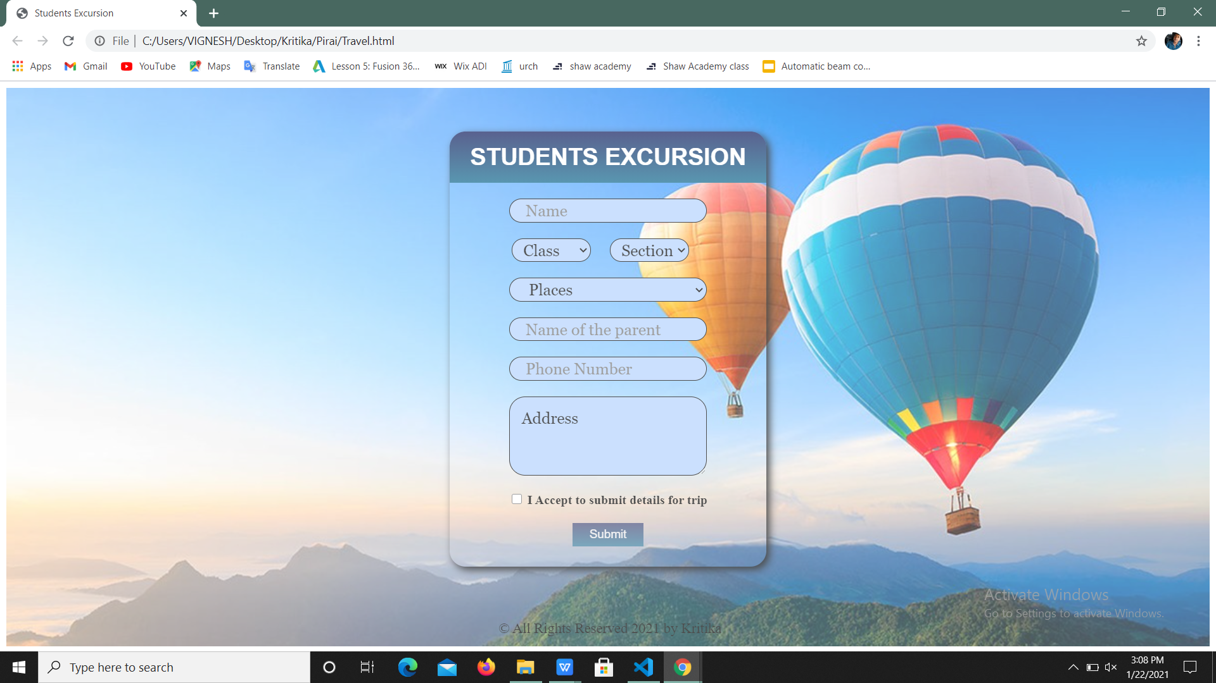

Slide 18
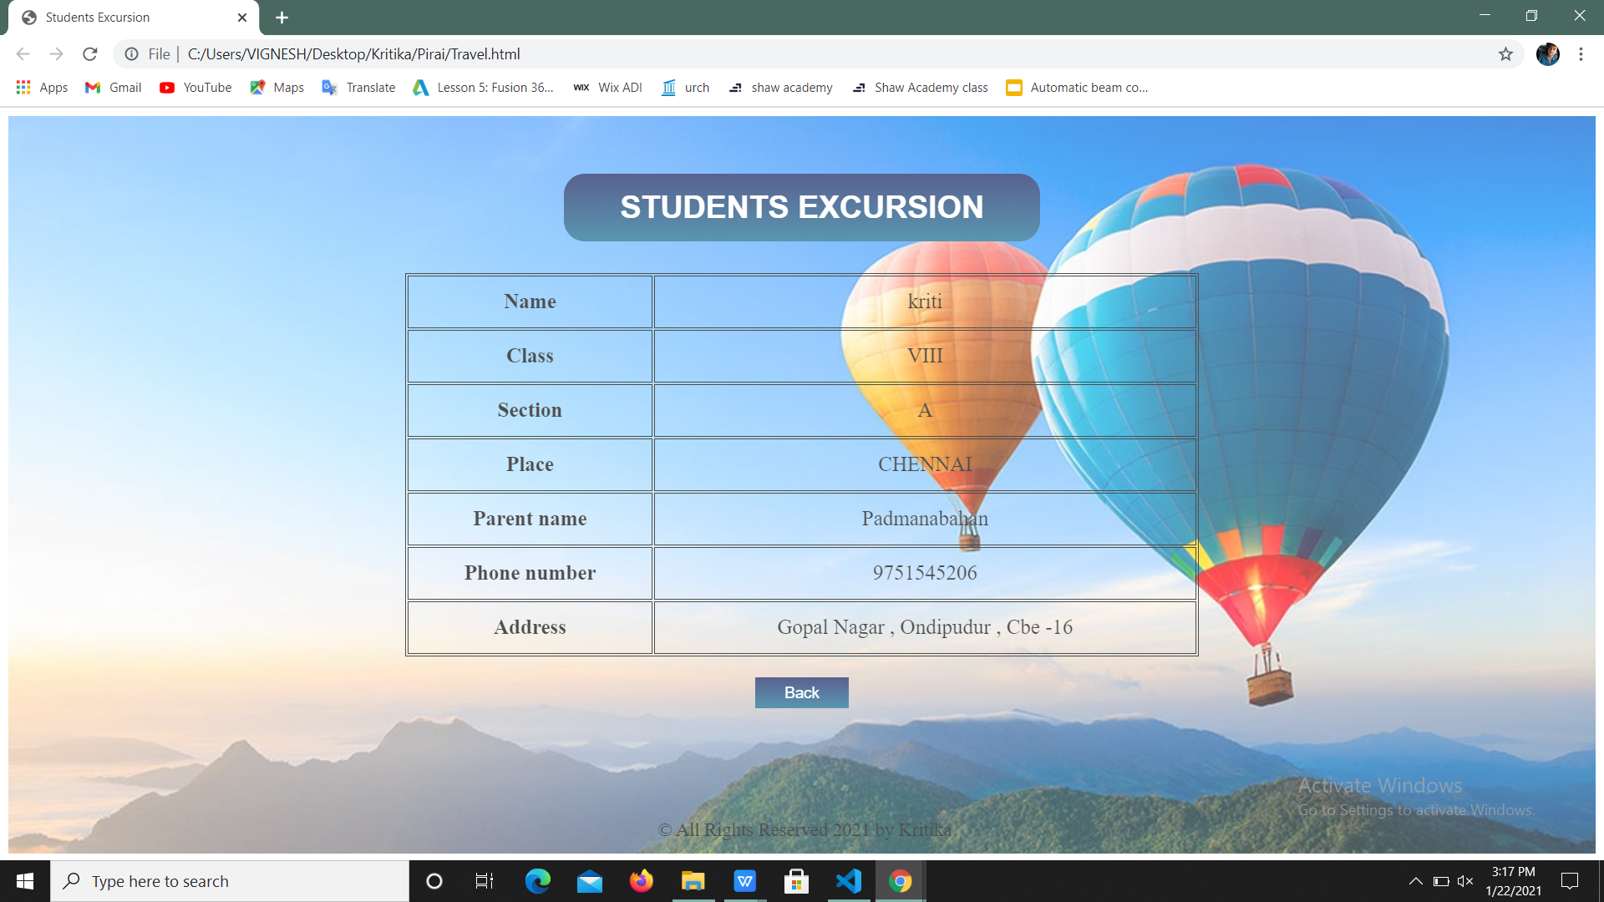

Slide 19
THANK YOU

