Slide 1
Introduction
Portable Solar System
I have opt for Portable Solar system as it involves converting analog to digital which is sunlight to power.
The sensor used for this project is: 16Bit I2C ADS1115 with an address of 0x4B.
The functionalities and built design of including a servo motor have not been implemented as opposed to the proposal. It is excluding the rotating function in order to capture maximum light.
Otherwise, the brief description of planned purchase was more likely. DAC was replaced by ADC.
For the integration part, my project will act as a portable source of energy to power the Broadcom development platform and its sensors connected to it.
I have collaborated with the prototype lab for:
Giving me advice on how to check if sensor is working
Helped me to make an acrylic casing for my project.
My Github link: https://github.com/Kritish007/portablesolarsystem

Slide 2
Budget
The budget was for $230. However only $160 was needed for the progress till now. The components I used for this semester is:
Mini encapsulated solar cell Epoxy $14
Raspberry Pi 3 Kit $113
ADS1115 16Bit ADC $15
Pi cobbler $20
Printed Circuit Board, 8 pins socket, customized acrylic casing and other needed utilities were provided by the Prototype Lab.
The plan for next semester is to use the following already purchased components:
Polymer Charger $19
Lithium Polymer Battery $16
Male DC Power Adapter $4
NCP1402 5 volts voltage regulator $7 – Still need to purchase

Slide 3
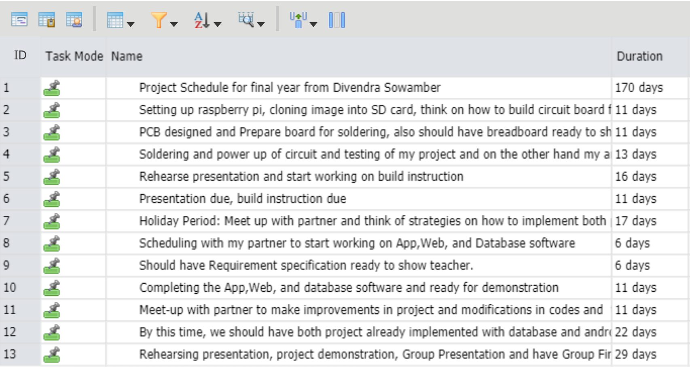
Project Plan According to my project schedule I have succeeded within the time frame predicted. I have completed: 1. Rehearsed presentation and starting to work on build instructions which I should finish by Week14. - The printed-circuit-board took most of the time expected as I had problem in the connection. - My next plan scheduled is on the Holiday period where I will setup a meeting with my 2 partners to discuss and plan our integration of our project.

Slide 4
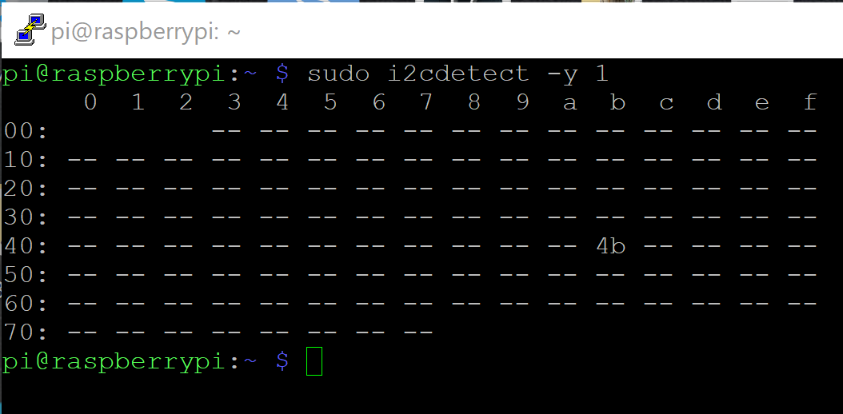
Address Change
I had to connect the ADDR to SCL pin through a jumper wire in order for me to have an address of 0x4B
Then I ran: sudo i2cdetect –y 1 which is the command to check if an i2c is connected with the Raspberry Pi

Slide 5
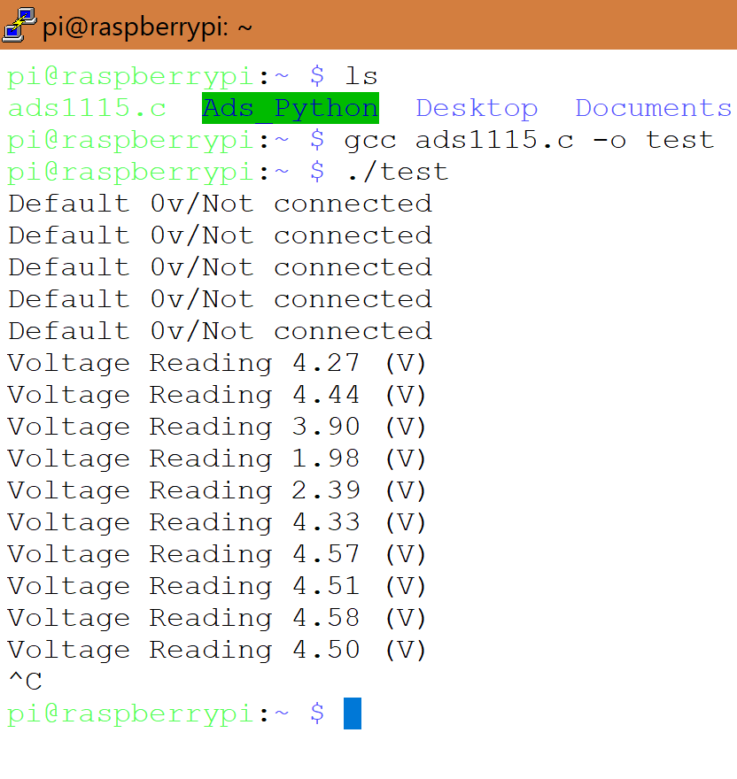
Screenshot of readings The program I used is from: http://openlabtools.eng.cam.ac.uk/Resources/Datalog/RPi_ADS1115/code/ADS1115_sample.c At first, I left the solar panel unconnected to check if default voltage is set properly. After connecting, I started receiving values. I then checked by covering the panel with a dark cover and the result was decreasing which means the sensor works

Slide 6
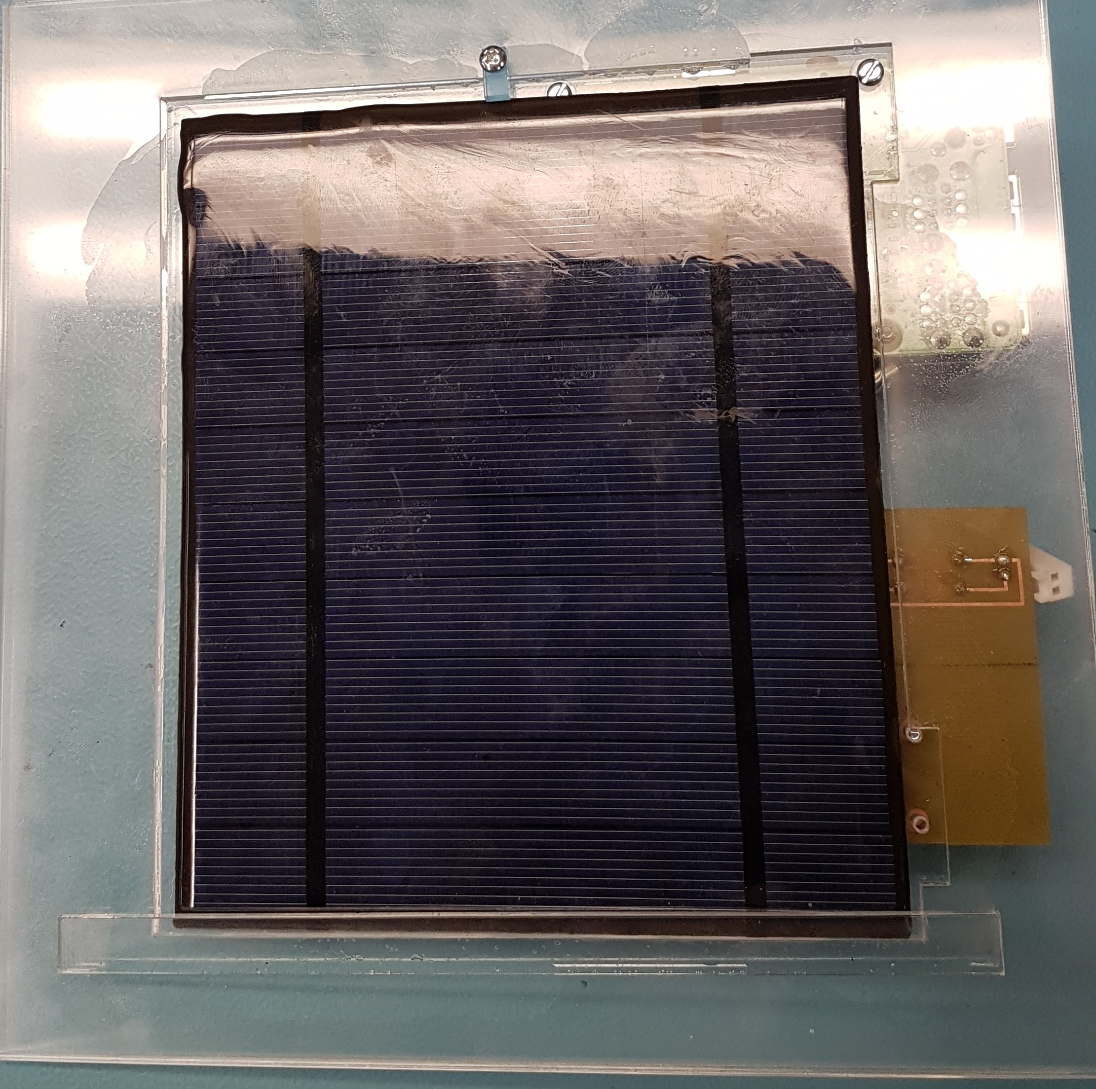
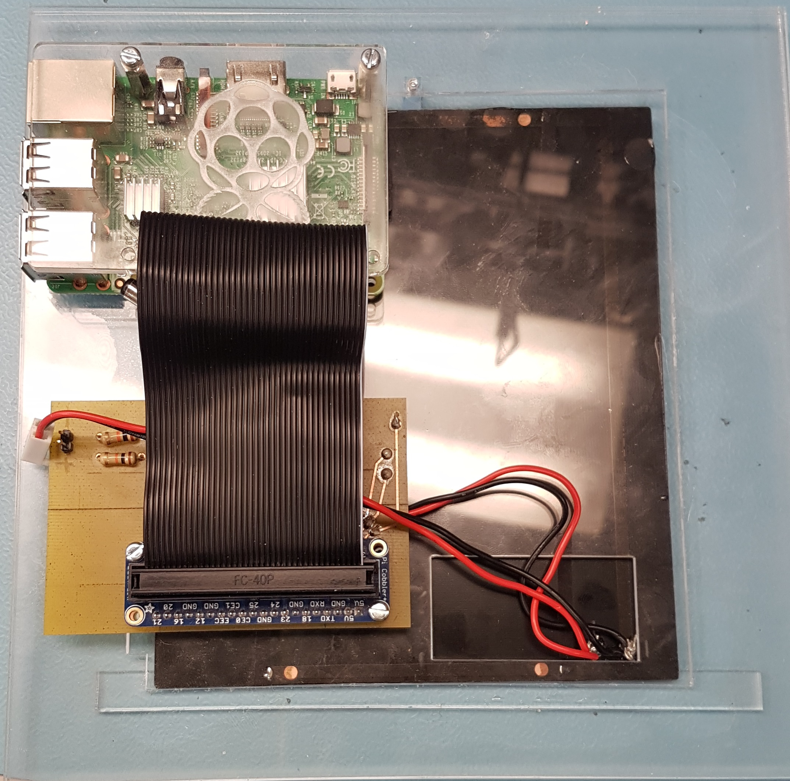
Enclosure The design was made in CorelDraw software and printed using a laser cut machine. Finally, I used a special glue to stick the casing in its appropriate position

Slide 7
Courses knowledge utilized from previous courses
Programming fundamentals from semester 1 to have a strong basic understanding of how simple coding works.
Technical C from semester 2 to have an on-hand Broadcom development platform which I could practice using c programs and learn the functionalities.
Unix Internals from semester 4 to have a strong knowledge on how to navigate using remote connections such as Putty.
Embedded Systems from semester 4 to once again focus on the root of how the Broadcom development platform work and how to write c programs to access all the functionalities.

