Slide 1
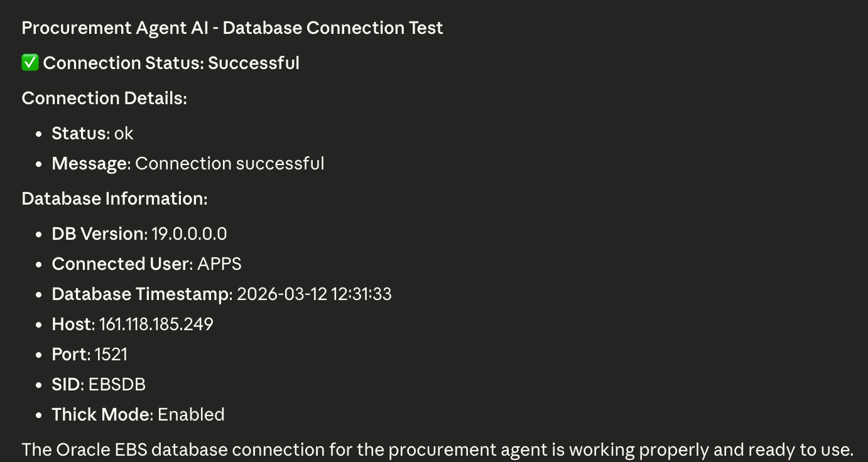
Procurement Agent AI
for Oracle EBS R12
From exception overload to buyer-ready action
U2X AI • March 2026
Notes:
The Procurement Agent AI reads live Oracle EBS procurement and planning data, spots what matters, and produces auditable next actions instead of another backlog report.

Slide 2
Why Procurement Teams Need This
Business-first explanation for non-technical stakeholders
Every day procurement teams face late suppliers, stock risk, price drift, and too many exceptions to review manually.
What makes it agentic
Reads data
Reasons about the problem
Decides what to do
Acts or recommends
Leaves an audit trail
Hundreds of planning exceptions nobody has time to review
Suppliers delivering late with no automatic follow-up
Inventory running below safety stock
Prices higher than agreed contract rates
Customer orders at risk because supply is not lined up
Limited visibility into who buys what, from whom, and at what price
Notes:
A traditional report tells you what happened. This agent reads data, reasons, decides, acts, and records what it did.

Slide 3
Traditional Method vs Agentic Method
Why this is better than the normal approach
Traditional manual method
1. Export reports from Oracle planning and purchasing
2. Review exceptions row by row
3. Decide urgency using incomplete context
4. Chase suppliers manually
5. Re-key PO information into Oracle
6. Split the audit trail across emails, spreadsheets, and memory
Agentic method
1. Read Oracle EBS directly in read-only mode
2. Run six procurement workflows in one pass
3. Score findings by urgency and business risk
4. Recommend or generate draft purchase orders
5. Save JSON and Excel outputs automatically
6. Let Claude Desktop explain results in plain English
Notes:
The value is not just speed. It is consistency, traceability, and better prioritization across the whole procurement workflow.

Slide 4
Manual vs Agent vs Claude Desktop
Business-friendly comparison from the procurement guide
Area
Manual Method
Agent Only
Agent Through Claude Desktop
Data access
Export and filter manually
Direct Oracle read
Direct Oracle read through MCP
Speed
Slow
Fast
Fast
Consistency
Depends on user
Rule-based
Rule-based
User experience
Spreadsheet-heavy
Technical CLI
Natural language
Auditability
Fragmented
Strong
Strong
Ease for business users
Medium to low
Low to medium
High
Need to know commands
Yes
Yes
No
Explain results
Manual
Partial
Strong via Claude
Notes:
Claude Desktop is valuable here because business users do not need to remember script names or parameters. Claude handles tool selection and explanation.

Slide 5
System Architecture in Simple Language
How the procurement MCP setup works
1. Oracle EBS
This is where the planning, PO, inventory, and supplier data lives.
2. Read-only Gateway
This keeps the connection safe. The agent reads data but does not change Oracle here.
3. Decision Engine
This scores findings by urgency, financial impact, time pressure, and demand risk.
4. MCP Server
This is the bridge Claude Desktop uses to run the procurement agent.
5. Excel + JSON
These are the outputs for buyer review, audit, and follow-up.
→
→
→
→
Important safety point: the procurement agent is read-only and does not directly write back to Oracle. Even draft POs are exported for human approval.
Notes:
Keep the message simple: Oracle holds the data, the agent analyzes it, Claude helps people use it, and outputs stay auditable.

Slide 6
How the Process Works End to End
Six practical steps from the complete guide
Step 1
Connect to Oracle EBS
Step 2
Read planning, PO, inventory, and supplier data
Step 3
Run six workflow analyses
Step 4
Score and prioritize each finding
Step 5
Recommend action or generate draft PO payload
Step 6
Save JSON and Excel outputs for buyer review
Notes:
This is the operational story for non-technical audiences: connect, read, analyze, prioritize, act, record.

Slide 7
The 6 Workflows at a Glance
Each workflow handles a different procurement risk
Workflow 1: Exception Triage
Sort hundreds of planning exceptions and push the most important ones to the top.
Workflow 2: Late Supplier Detection
Find overdue purchase orders and identify suppliers with repeat late delivery behavior.
Workflow 3: Safety Stock Alerts
Compare available supply against minimum buffer stock levels.
Workflow 4: Price Anomaly Detection
Spot items where current prices drift above contract or normal historical levels.
Workflow 5: Demand-to-PO Tracing
Find demand that is not yet covered by planned procurement supply.
Workflow 6: Spend Analytics
Turn raw PO spend into supplier risk and savings insights.
Notes:
Use this as the bridge slide, then go one workflow at a time with screenshots.

Slide 8
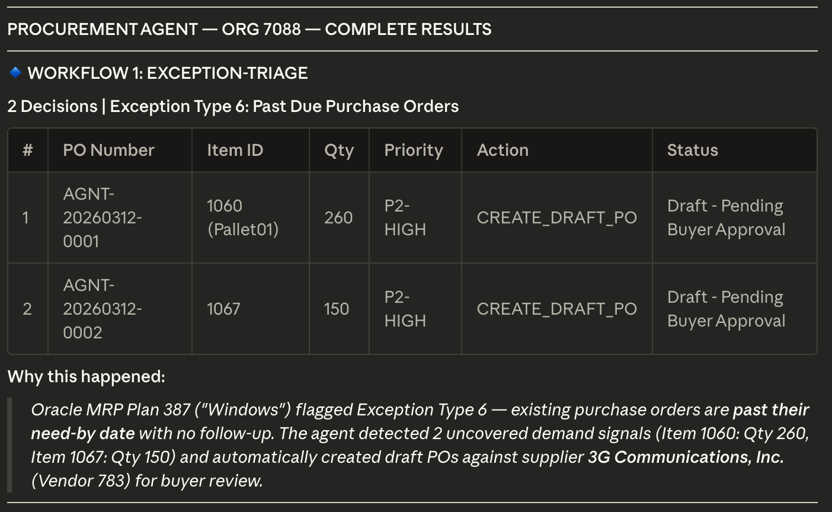
Workflow 1: Exception Triage
Sort hundreds of planning exceptions and push the most important ones to the top.
What it checks
• Past due purchase orders
• Late replenishment orders
• Items below safety stock
• Orders at risk and demand not satisfied
Typical action
Create a draft PO for supply-side issues or notify the buyer for customer-facing risk.
Why it matters
Removes backlog noise and makes sure the team works on the highest-impact supply issues first.
Notes:
Explain this workflow in simple business language: Sort hundreds of planning exceptions and push the most important ones to the top. Removes backlog noise and makes sure the team works on the highest-impact supply issues first.

Slide 9
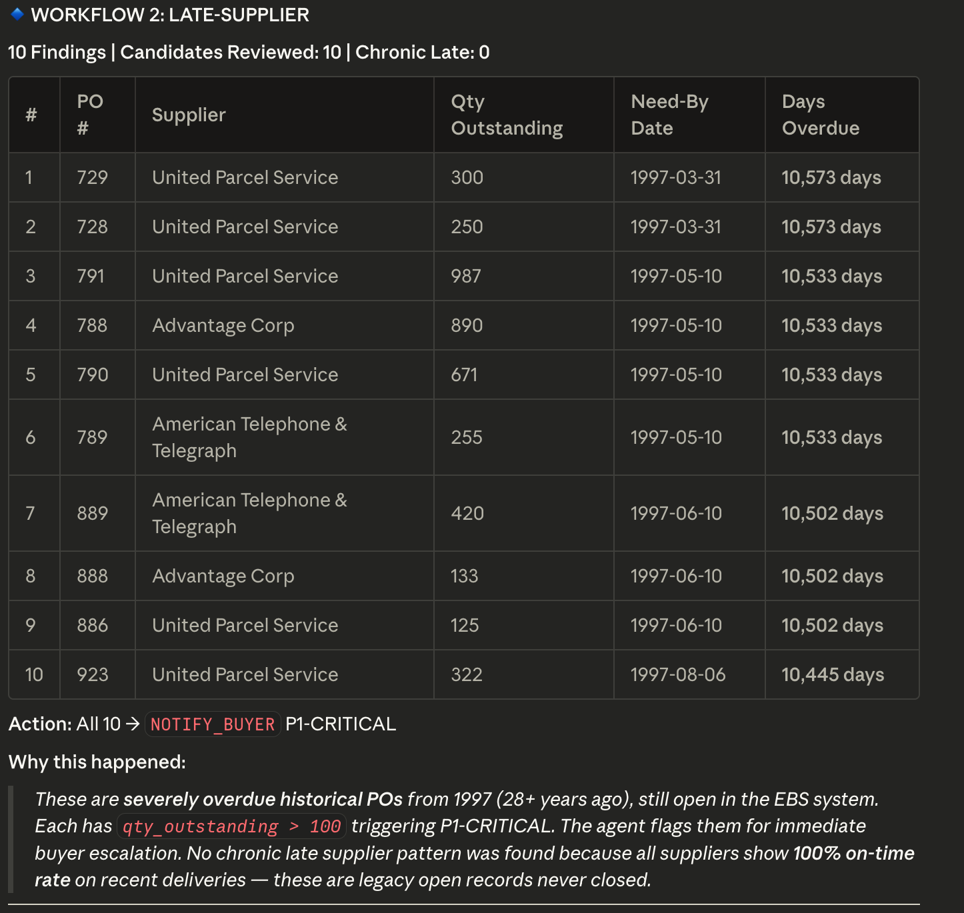
Workflow 2: Late Supplier Detection
Find overdue purchase orders and identify suppliers with repeat late delivery behavior.
What it checks
• Open POs that are overdue or nearly overdue
• Supplier on-time history
• Repeated lateness across multiple orders
• Availability of alternate suppliers
Typical action
Send a reminder for minor delay or escalate to the buyer with an alternate supplier recommendation for chronic lateness.
Why it matters
Helps procurement act before lateness becomes a supply interruption.
Notes:
Explain this workflow in simple business language: Find overdue purchase orders and identify suppliers with repeat late delivery behavior. Helps procurement act before lateness becomes a supply interruption.

Slide 10
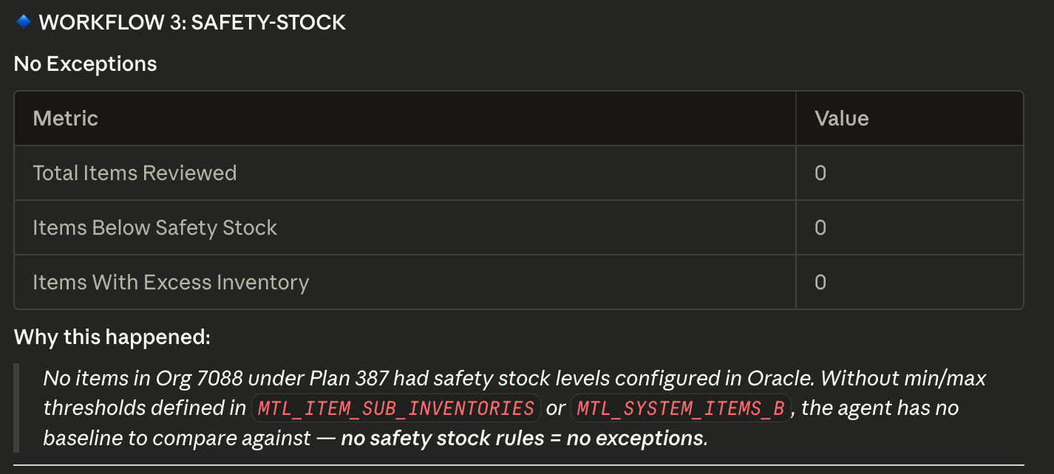
Workflow 3: Safety Stock Alerts
Compare available supply against minimum buffer stock levels.
What it checks
• Current supply vs safety stock target
• Shortage size
• Excess inventory above target
• Best supplier based on lead time and price
Typical action
Create a draft PO when stock is below target or flag excess inventory for review.
Why it matters
Protects service levels while also making excess inventory visible.
Notes:
Explain this workflow in simple business language: Compare available supply against minimum buffer stock levels. Protects service levels while also making excess inventory visible.

Slide 11
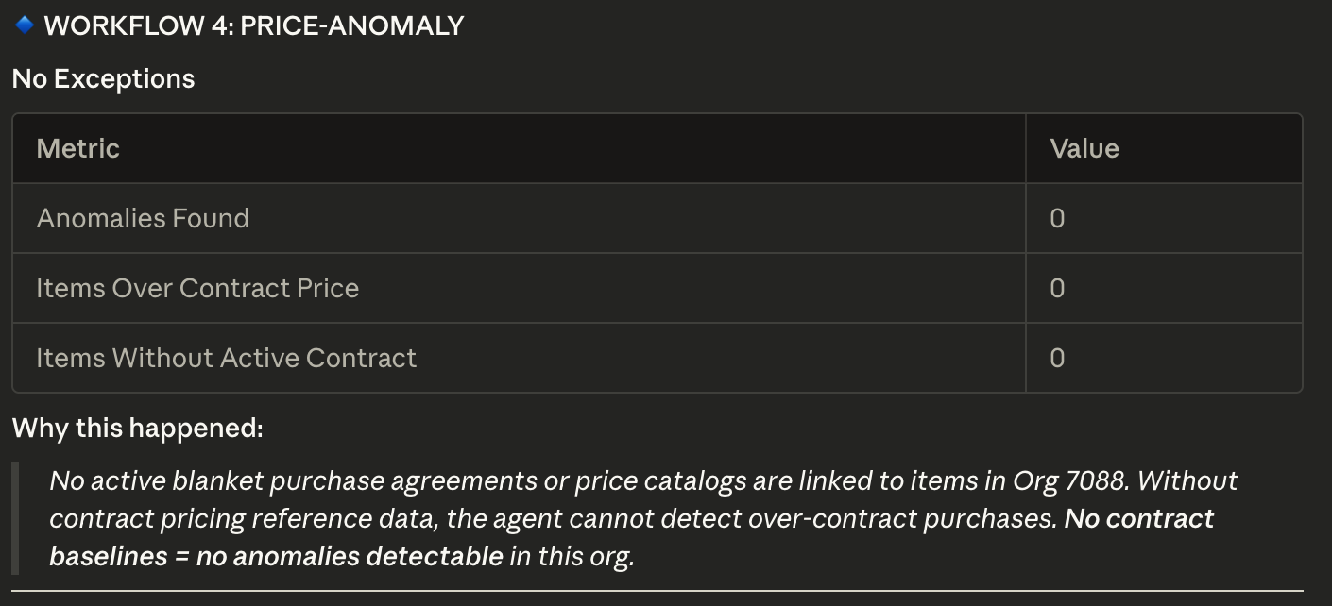
Workflow 4: Price Anomaly Detection
Spot items where current prices drift above contract or normal historical levels.
What it checks
• Current price vs contract price
• Current price vs 12-month average
• Missing blanket agreement context
• Potential maverick spend
Typical action
Flag the item for renegotiation, review, or compliance follow-up depending on the size of the deviation.
Why it matters
Protects margin and contract compliance by showing where pricing discipline is slipping.
Notes:
Explain this workflow in simple business language: Spot items where current prices drift above contract or normal historical levels. Protects margin and contract compliance by showing where pricing discipline is slipping.

Slide 12
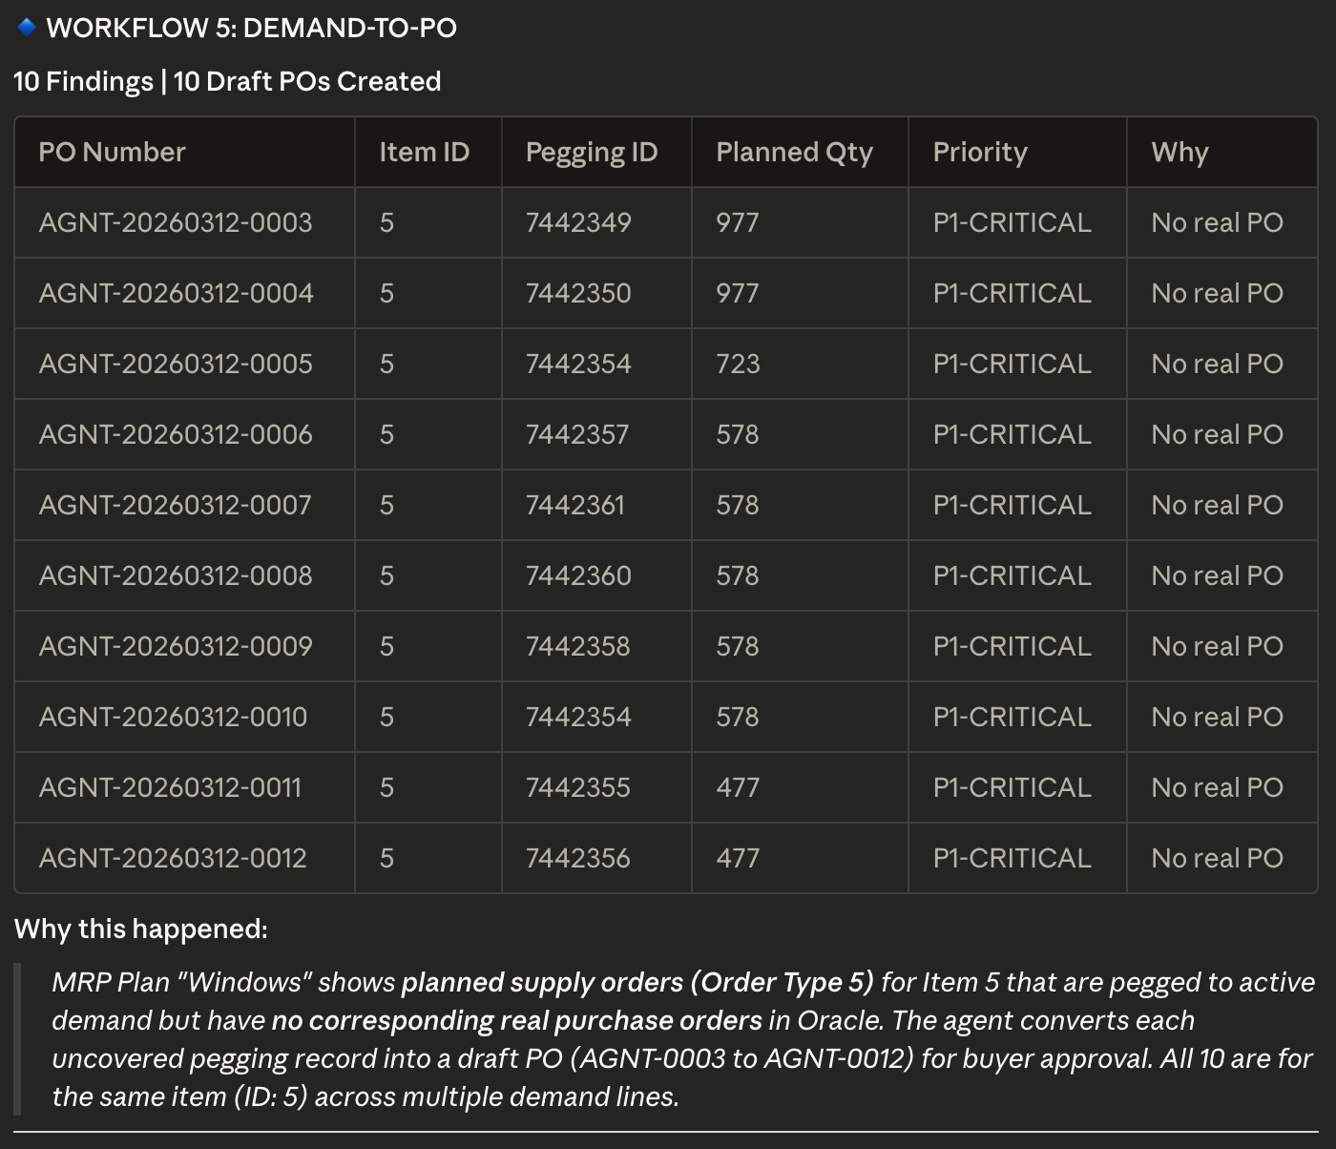
Workflow 5: Demand-to-PO Tracing
Find demand that is not yet covered by planned procurement supply.
What it checks
• Demand records in planning
• Pegging links between demand and supply
• Planned purchase order coverage
• Revenue at risk for uncovered demand
Typical action
Notify the buyer or create a draft PO recommendation when demand is exposed.
Why it matters
Makes customer service risk visible before missed commitments happen.
Notes:
Explain this workflow in simple business language: Find demand that is not yet covered by planned procurement supply. Makes customer service risk visible before missed commitments happen.

Slide 13
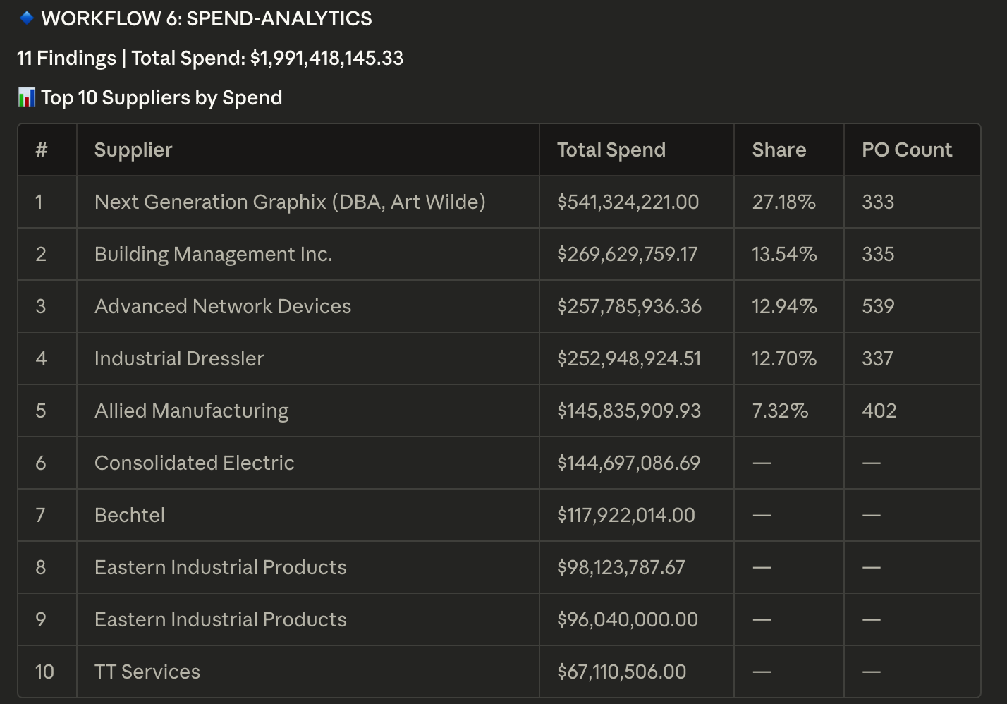
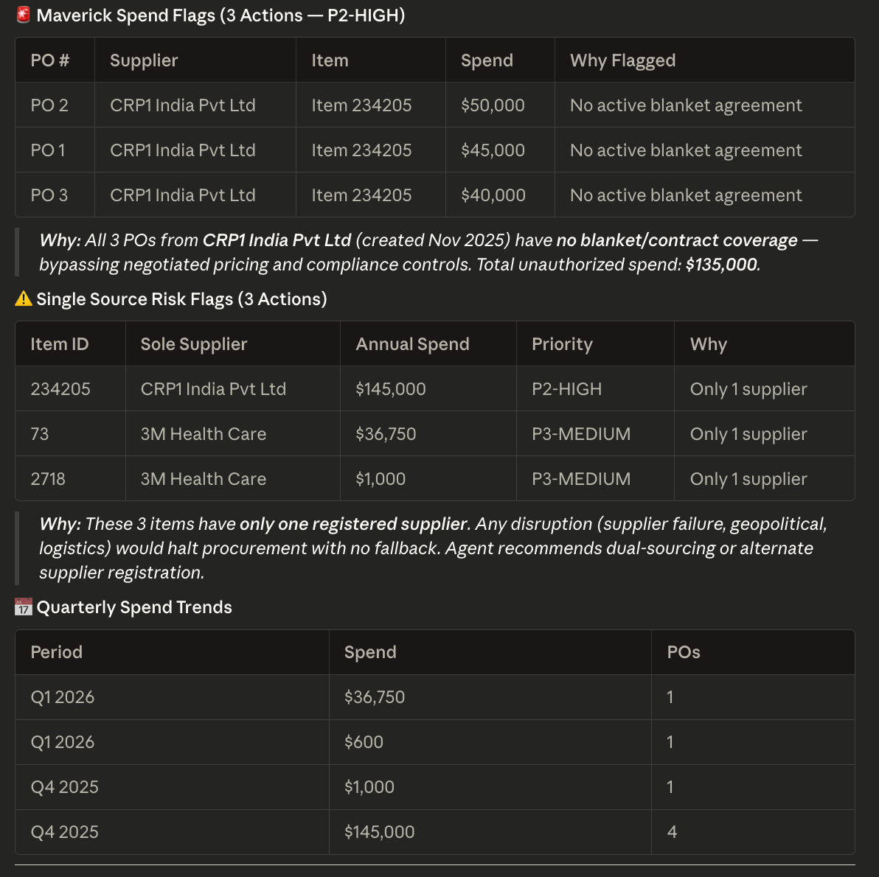
Workflow 6: Spend Analytics
Turn raw PO spend into supplier risk and savings insights.
What it checks
• Supplier concentration risk
• Maverick spend
• Single-source supply risk
• Consolidation opportunities and spend trend
Typical action
Flag supplier dependency, off-contract spend, and savings opportunities for sourcing or management review.
Why it matters
Helps the team move from transaction chasing to strategic procurement decisions.
Notes:
Explain this workflow in simple business language: Turn raw PO spend into supplier risk and savings insights. Helps the team move from transaction chasing to strategic procurement decisions.

Slide 14
Why Procurement Teams Like This Approach
Benefits, autonomy, and safe adoption
Speed
The agent processes large exception backlogs far faster than manual review.
Consistency
The same rules and priority logic are applied every run.
Actionability
The output is not just a report. It includes buyer recommendations and draft PO payloads when enabled.
Explainability
Every decision includes rationale, evidence, and a priority score.
Safety
Start with level 0 or 1. Even level 2 only creates draft PO payloads for human approval.
Business usability
Claude Desktop makes the whole flow accessible in plain English through MCP tools.
Closing line: The Procurement Agent AI turns Oracle EBS procurement data into an operational workbench instead of a reporting backlog.
Notes:
Close on the central message from the guide: this gives procurement a more proactive, traceable, and business-friendly operating model.

