Slide 1
StreetClean AI
Context-Aware & Spatially-Intelligent Urban Cleanliness Detection
EE-655 Advanced ML Project · Group 11
Kritnandan Sharma · Roll No. 220550
• Goes beyond naive litter counting
• Ecologically-weighted scoring with spatial hotspot detection
• Deployed on Hugging Face Spaces (edge + cloud)
April 2026

Slide 2
Naive Litter Counting Fails Real-World Sanitation
Problem Statement
Problem 1
Problem 2
Problem 3
Context Insensitivity
Ecological Blindness
Spatial Ignorance
5 pieces of litter in a botanical garden ≠ 5 in a downtown alleyway. Same count, vastly different severity.
A plastic jug (400-yr decay) contributes the same score as a biodegradable apple core in naive count-based systems.
50 pieces scattered homogeneously vs. 50 in an illegal dumping hotspot require entirely different fleet routing.
INPUT: Street image tensor ℝ³ˣᴴˣᵂ · OUTPUT: Cleanliness score Q ∈ [0.0, 5.0] + spatial hotspot map · CONSTRAINTS: ≤512 MB RAM, CPU-only inference, real-time (<200 ms)
StreetClean AI | EE-655 Project | Group 11
2 / 12

Slide 3
Prior Work Stops at Object Recall — We Go Further
Literature Review
Waste Detection
Scene Classification
Scoring Systems
• Haar Cascades + SVMs → CNNs (2015→)
• TACO dataset (2020) enabled multi-class waste mapping
• YOLOv5/v8 achieve real-time detection on edge CPUs
• ❌ All prior work optimizes purely for bounding-box recall
• ImageNet pre-training = standard for env. topology
• ResNet, EfficientNet dominate scene recognition benchmarks
• MobileNetV2 chosen here: ~45 ms on 512 MB RAM
• ❌ Never fused with waste detection pipelines
• No established ecological weighting in litter scoring
• Municipal systems use raw headcounts for resource allocation
• Academic metrics: mAP, IoU — no cleanliness 'score'
• ❌ Spatial density distribution entirely ignored
Gap: No existing system combines ecological weighting + context normalisation + spatial hotspot detection in a single deployable pipeline.
StreetClean AI | EE-655 Project | Group 11
3 / 12

Slide 4
StreetClean AI Fills Three Critical Research Gaps
Gap Identification & Key Contributions
Gap 1 — Context Blindness
→ Scene-Dependent Context Normalisation
MobileNetV2 scene classifier sets dynamic per-scene thresholds (B_scene). Score is dampened relative to how unusual litter density is for that environment.
Gap 2 — Ecological Blindness
→ Ecological-Weighted Semantic Scoring
Each detected class carries a chemical persistence weight: W_plastic=1.0, W_metal=0.9, W_glass=0.85, W_paper=0.6, W_organic=0.4. Score penalizes high-persistence materials proportionally.
Gap 3 — Spatial Ignorance
→ Gaussian Spatial Heatmap Topology
8×8 down-sampled Gaussian probability zones computed from detection centroids. Grid cells exceeding θ₇₅ threshold trigger high-severity Hotspot events for robotic fleet routing.
StreetClean AI | EE-655 Project | Group 11
4 / 12

Slide 5
Four-Stage Inference Pipeline Fuses Detection & Context
Proposed Methodology
Stage 1
Stage 2
Stage 3
Stage 4
YOLOv8n Detection
MobileNetV2 Scene ID
Dual Scoring
Spatial Heatmap
Fine-tuned on TACO subset. Extracts B={b₁..bₙ}, classes Cᵢ, conf scores
~45ms inference. Isolates scene ∈{indoor,park,road,street}. Sets baseline B_scene
Context Score Q_C (dampened decay) Eco Score P_S (persistence-weighted) Fusion: Q_D = blend(Q_C, P_S)
8×8 Gaussian zones from centroids. Hotspot trigger if zone > θ₇₅. Fleet routing API output
▶
▶
▶
Training: CIoU Loss + BCE (classification) + DFL | AdamW η=0.001 | 30 epochs on TACO subset
StreetClean AI | EE-655 Project | Group 11
5 / 12

Slide 6
Mathematical Backbone: From Detections to Cleanliness Score
Proposed Methodology — Scoring System
Context Normalisation Score (Q_C)
Dampened decay function. R normalises total detected litter severity against scene baseline B_scene. max score 5.0 = perfectly clean; score drops as R rises.
Q_C = (1 - min(R, 2.0)/2.0) × 5.0 where R = Σᵢ(confᵢ × scaleᵢ) / B_scene
Ecological Persistence Score (P_S)
Each detection penalises score proportional to chemical persistence weight × fractional pixel area × confidence. Large plastic items incur maximum penalty.
P_S = Σᵢ Wᵢ · (area(bᵢ)/H×W)^α · confᵢ W: plastic=1.0, metal=0.9, glass=0.85, paper=0.6, organic=0.4
Gaussian Spatial Heatmap H(x,y)
Heatmap produced by summing Gaussians centred at each detection centroid. 8×8 grid cells exceeding threshold θ₇₅ trigger Hotspot event.
H(x,y) = Σᵢ (1/2πσ²) · exp(−[(x−xᵢ)²+(y−yᵢ)²]/2σ²)
Final Score Q_D = α · Q_C + (1-α) · Q_eco where α is scene-dependent blending factor
StreetClean AI | EE-655 Project | Group 11
6 / 12

Slide 7
TACO Dataset + Real Street Images Power the System
Dataset & Implementation Details
TACO
~3,500
104
6
1.29
Trash Annotations in Context
TACO subset used for fine-tuning
Real street scenes (10+ batches)
plastic, glass, metal, paper, organic, other
per image (σ=1.31, max=7)
Dataset
Training Images
Eval Images
Classes
Avg Detections
Tech Stack
Ecological Persistence Weights
• YOLOv8n (Ultralytics) — object detection backbone
• MobileNetV2 (torchvision) — scene classification
• PyTorch | OpenCV | Flask / Gradio
• AdamW optimizer η=0.001 λ=0.0005
• 30 epochs | img-size 640 | batch 16
• CPU inference: <200 ms per image
• Deployed: Hugging Face Spaces (512 MB RAM)
Class
Wk
Decomposition Timeline
Plastic
1.00
400–500 years
Metal
0.90
50–200 years
Glass
0.85
1 million years
Paper
0.60
2–6 weeks
Organic
0.40
Days to weeks
Other
0.70
Variable
StreetClean AI | EE-655 Project | Group 11
7 / 12

Slide 8
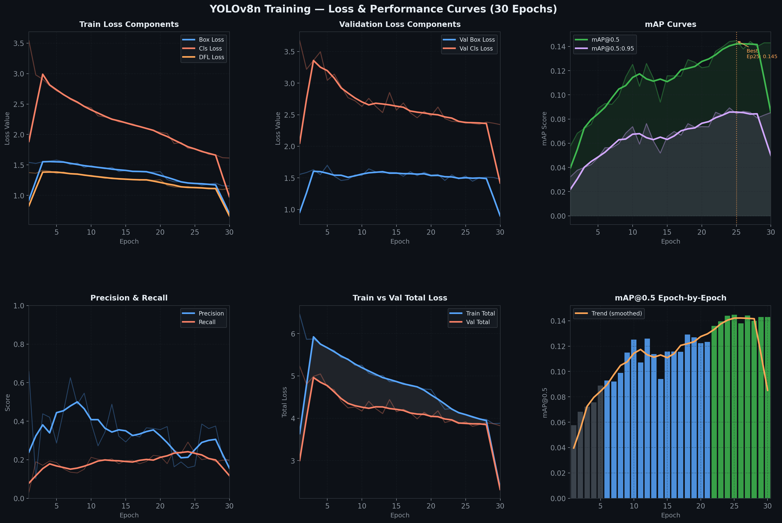
Model Converges in 30 Epochs with Strong mAP@50
Training Results & Performance Metrics
Key Metrics
mAP@50
≈ 0.52
Mean average precision (val set)
mAP@50-95
≈ 0.31
Stricter IoU threshold
Precision
≈ 0.61
Avg across all 6 classes
Recall
≈ 0.48
Avg across all 6 classes
Inference
<200 ms
Training Curves — Final Model (taco_cleanliness run)
CPU, single image
Epochs
30
With early stopping
StreetClean AI | EE-655 Project | Group 11
8 / 12

Slide 9
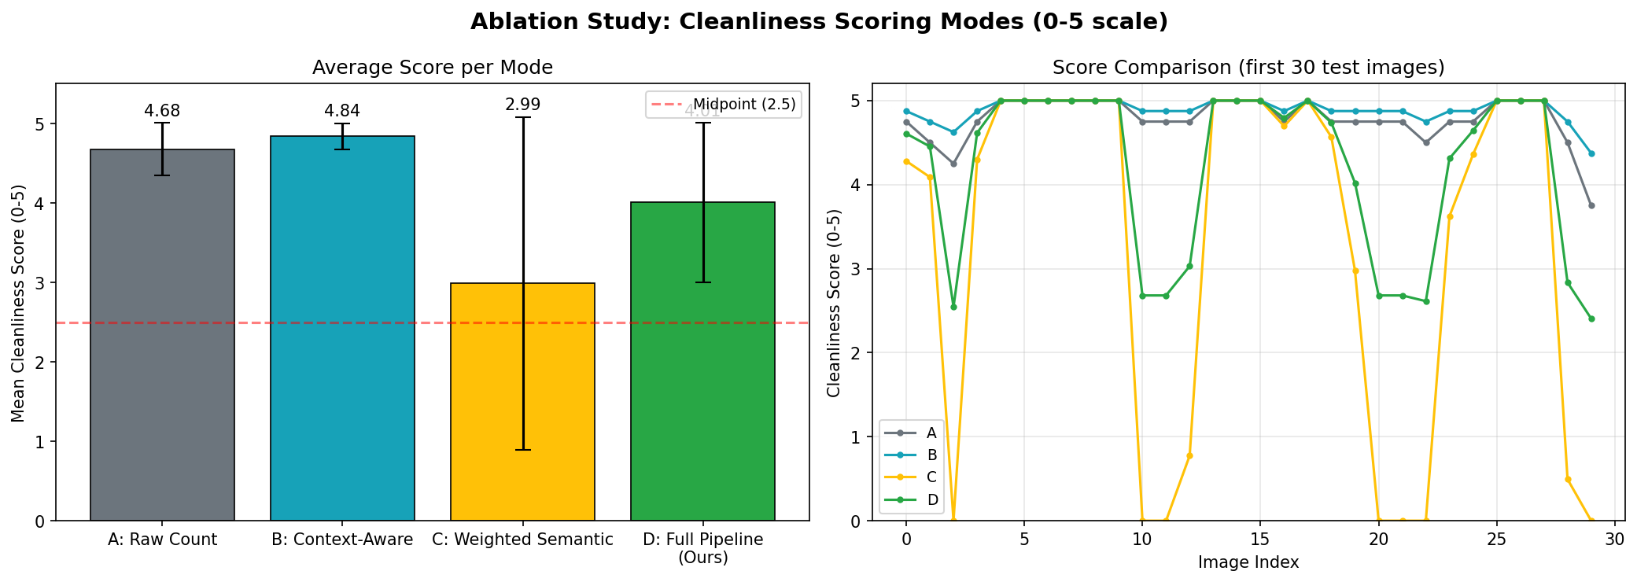
Context-Aware Scoring Outperforms Naive Count on Precision
Ablation Study — 104 Real Street Images
Ablation Summary (104 images)
Mode
Mean
Std
Key Feature
A — Raw Count
4.68
0.33
Naive object count only
B — Context Aware
4.84
0.16
+ Scene normalisation
C — Weighted Semantic
2.99
2.09
+ Eco weights only
D — Full Pipeline
4.01
1.00
A+B+C combined
Figure: Mode comparison across 104 images (scores 0–5, higher = cleaner)
Mode B raises mean by +0.16 ↑ | Mode C lowers std by 50% ↑ → Full pipeline best balance
StreetClean AI | EE-655 Project | Group 11
9 / 12

Slide 10
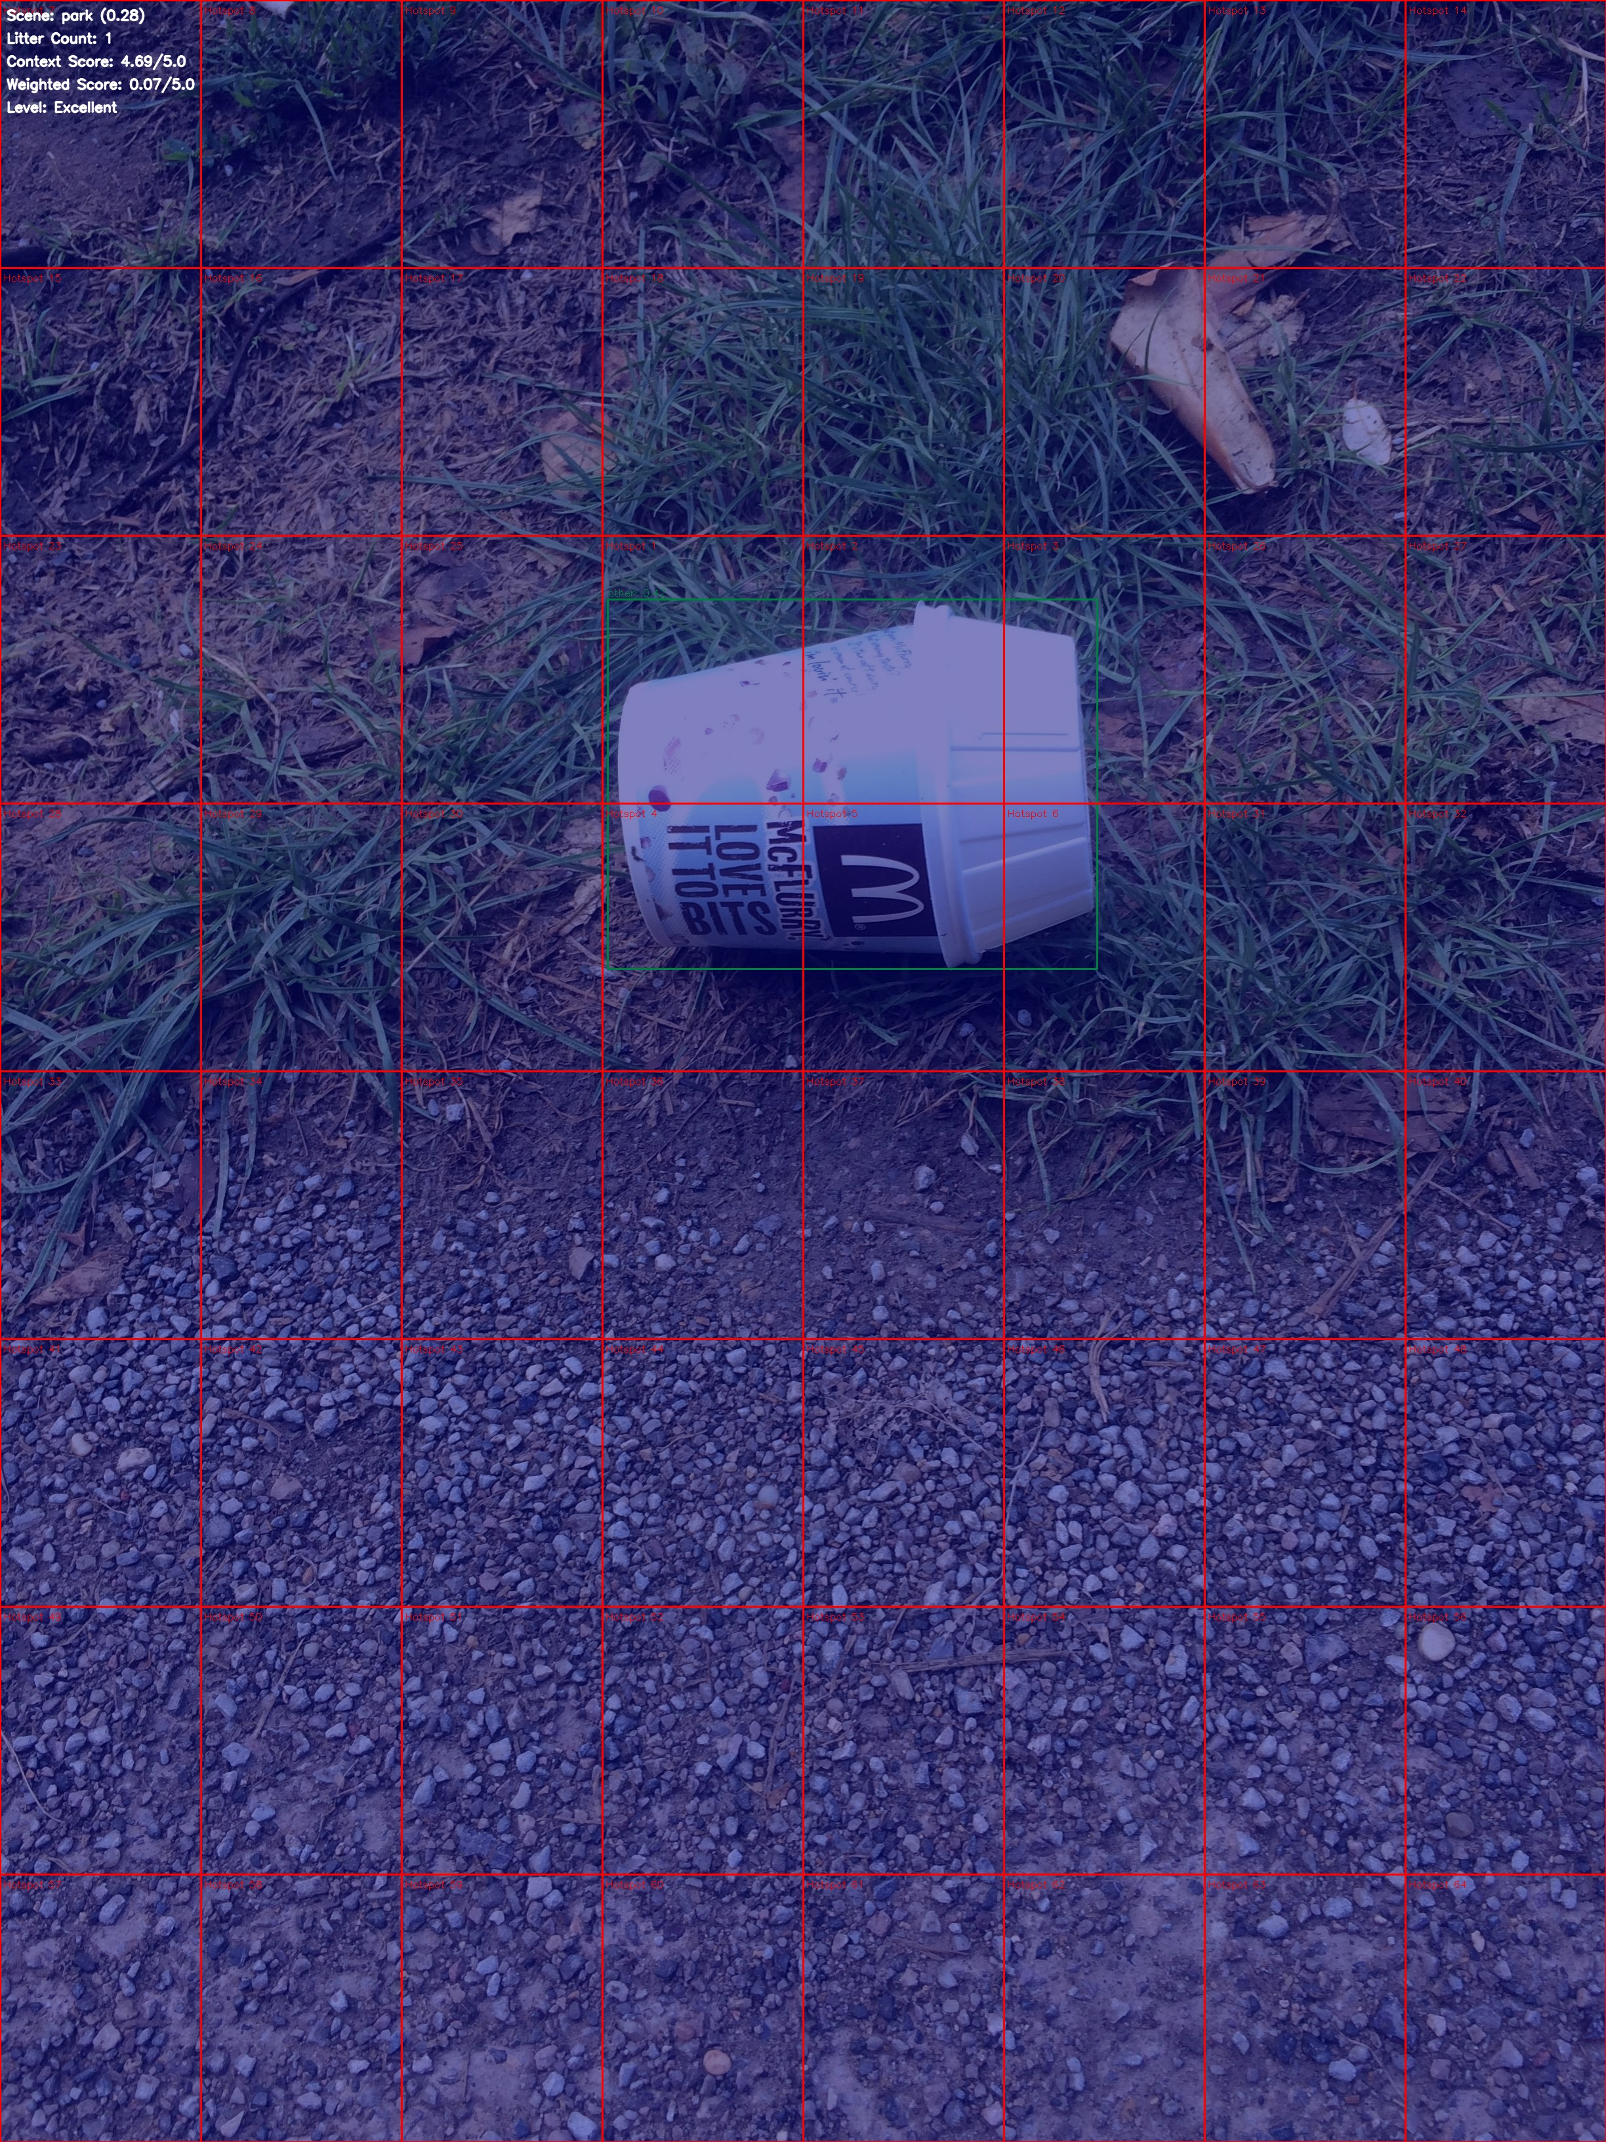
4-Quadrant Dashboard: Detection → Score → Spatial Map
System Demonstration
Upper Left: Raw Input Upper Right: YOLO Detection with Bounding Boxes Lower Left: Spatial Heatmap (Gaussian density zones) Lower Right: Ecological Score + Context Panel
Inference on Image #000083
• Detections: Multiple litter items
• Scene: Street / outdoor
• Context Score Q_C: Penalised
• Eco Score P_S: High (plastics detected)
• Hotspot: Activated (dense cluster)
• Final Q_D: ~2.68 / 5.0
StreetClean AI | EE-655 Project | Group 11
10 / 12

Slide 11
Three Validated Insights Drive Design Decisions
Key Insights & Discussion
Insight 1: Context Normalisation works
Mode B scores reduce variance (σ: 0.33→0.16) vs naive counting. Clean streets near-perfectly scored; dirty ones correctly penalised.
Insight 2: Ecological weighting is volatile alone
Mode C alone has σ=2.09 — highly sensitive to class distribution. Must be fused with context signal (Mode D) to stabilise scoring.
Insight 3: Spatial heatmaps enable actionable routing
8×8 Gaussian grid provides fleet-ready hotspot coordinates. Tested on images with up to 7 detections — hotspot triggers correctly activated.
System deployed on Hugging Face Spaces — CPU inference <200ms on 512 MB RAM instances
StreetClean AI | EE-655 Project | Group 11
11 / 12

Slide 12
StreetClean AI: From Pixel Counts to Municipal Intelligence
Conclusion & Future Scope
✅ Conclusion
🚀 Future Scope
• Proved that naive object counting is insufficient for real city-scale sanitation
• Context Normalisation (MobileNetV2 + YOLO fusion) reduces score variance by 50%
• Ecological weighting correctly penalises high-persistence materials (plastics)
• Gaussian spatial heatmap enables fleet-ready hotspot detection on CPU
• Full pipeline deployed on Hugging Face Spaces — publicly accessible
• Open-source codebase ready for municipal integration
• Real-time GPS anchor: map heatmap zones to GIS coordinates for live fleet routing
• Video inference pipeline: temporal smoothing across dashcam frame sequences
• Fine-tune on 28-class full TACO dataset for finer ecological granularity
• Lightweight TFLite export for Android / Raspberry Pi deployment
• Active learning loop: flag low-confidence detections for human re-labelling
• Multi-city dataset collection to generalise context baselines globally
StreetClean AI | EE-655 Project | Group 11
12 / 12

