Slide 1
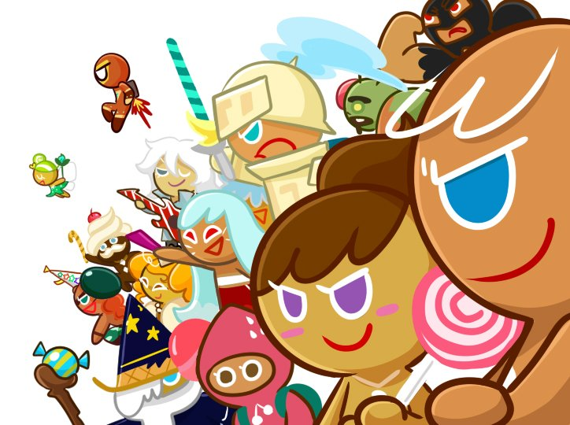
RETURN
COOKIE RUN
RETURN

Slide 2
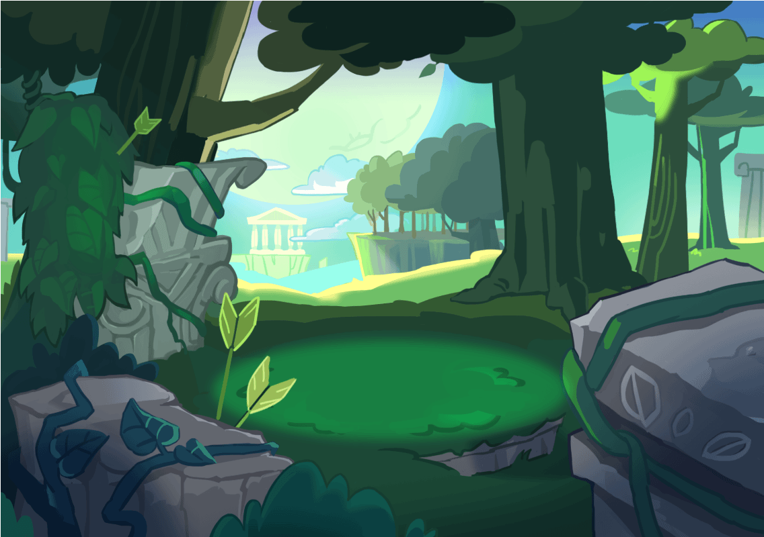

1
Pet
Cookie
PLAY

Slide 3

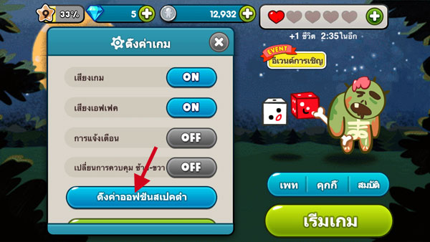
setting
Background Music
Sound Effect
ON
OFF
Coupon
Agreement

Slide 4
Enter your code here.
Complete
Coupons with limited validity periods can only be used before their expiration dates.
Each coupon code can only be entered once. Coupons are not reusable.
For inquiries about coupons, please see the Help page inside Cookie Runs settings.

Slide 5
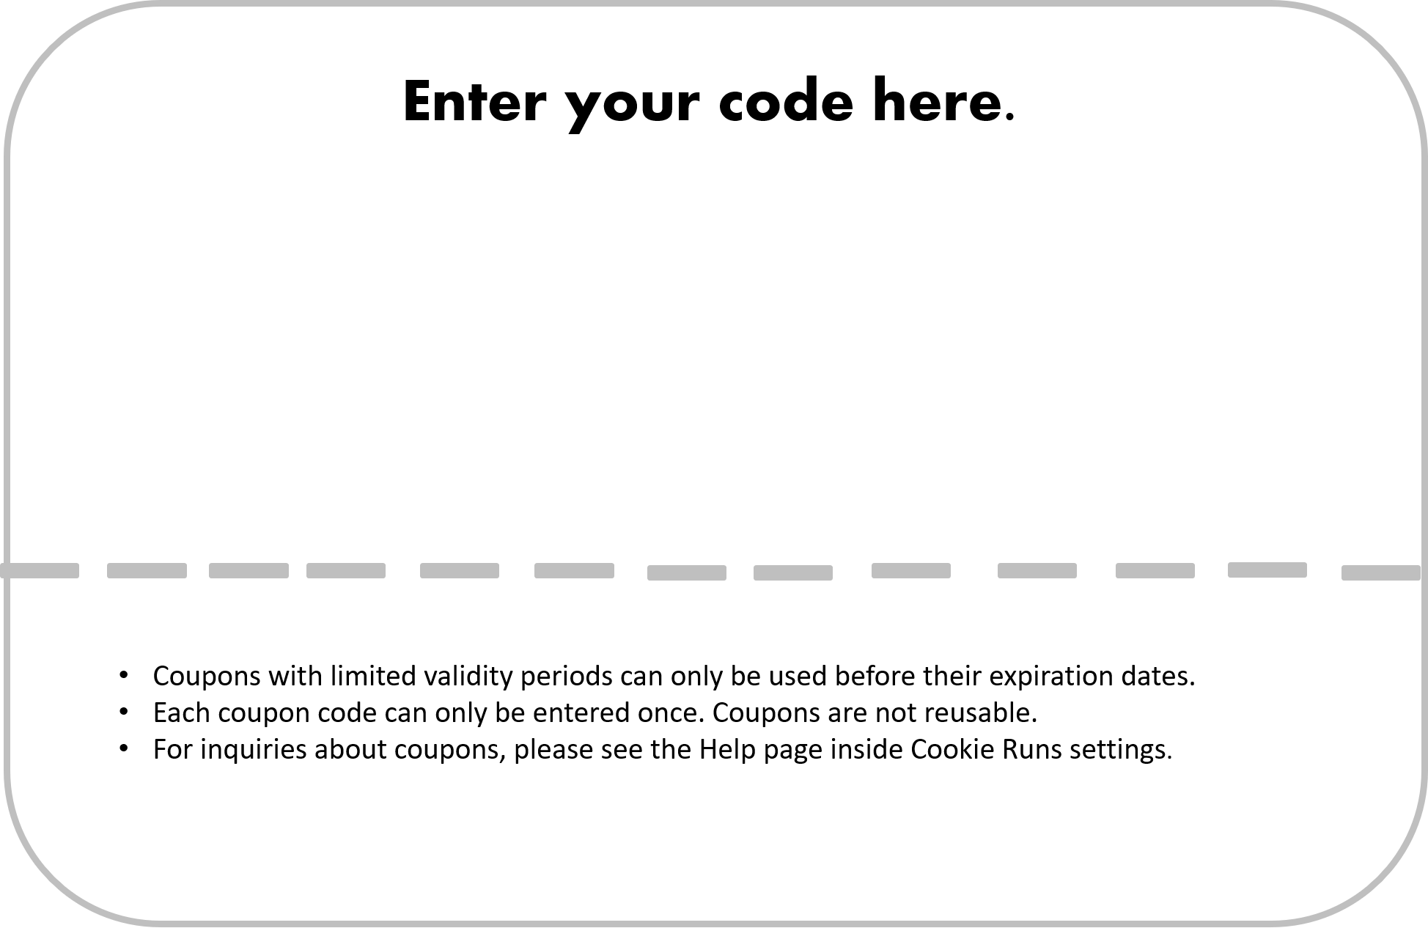
Cookie – Runner – Return.Coupon
Success.
You can enter each event once.
OK
OK
Invalid coupon.
OK

Slide 6
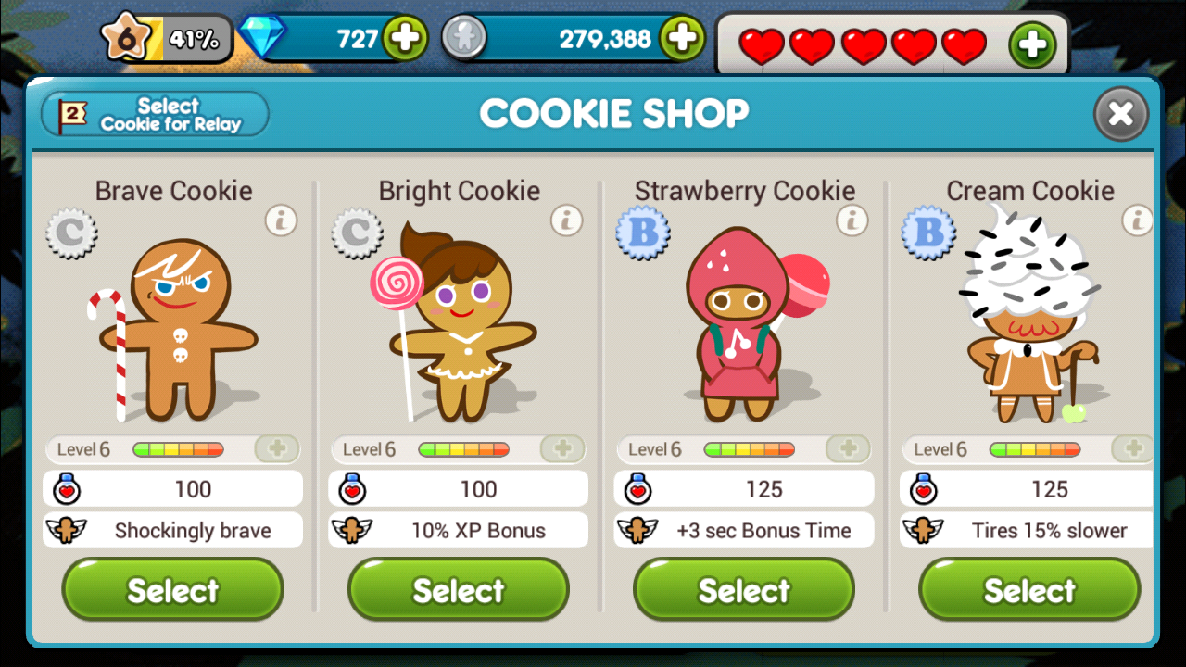
COOKIE SHOP
Select

